Slide 1
Mummification

Slide 2
Smt. Vimladevi Ayuvedic Medical College & Hospital , Chandrapur
Department Of Agadtantra

Slide 3
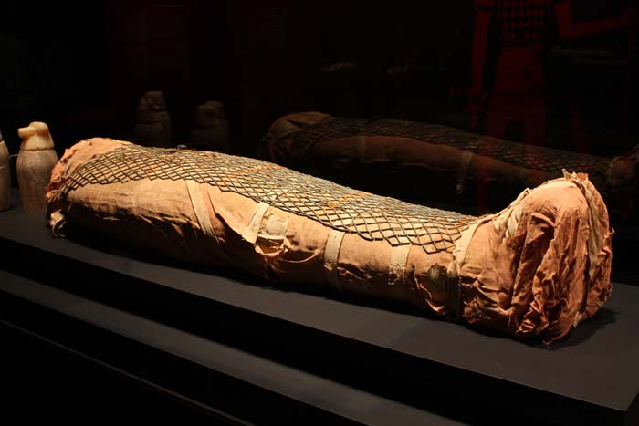
Definition
Mummification is defined as dessication or drying up of the dead body. It is also a modification of decomposition.
Mechanism
Mummification occurs because of evaporation of body fluids.

Slide 4
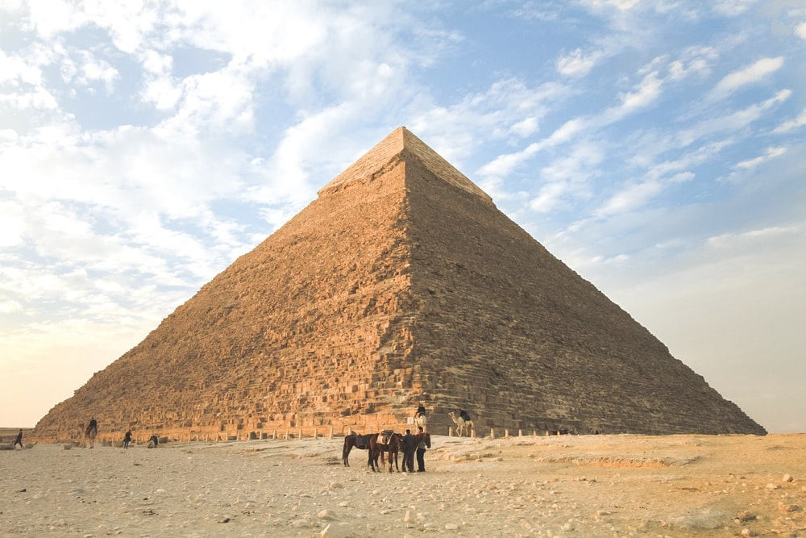
Essential requirements :-
1) Absence of moisture
2) Excess of air
3) Warmth
The ideal atmosphere for mummification to occur is present in deserts, especially in summer and also in bodies buried in shallow grave in sandy soil.

Slide 5
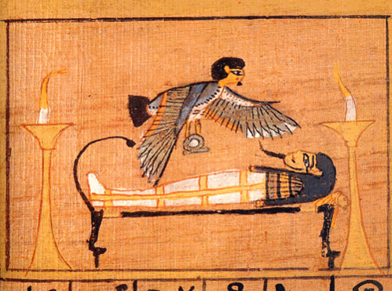
Why be Mummified?
Physical Body need to be preserved
2. Ensure a Safe Passage to the afterlife
3. Spirit would recognize you in the after life.

Slide 6
Step 1 & 2 of Mummification
1. Announcement of Death
Messenger Sent out to the streets to announce the dead.
2. Embalming the Body
Dead body brought to special tent for embalming

Slide 7
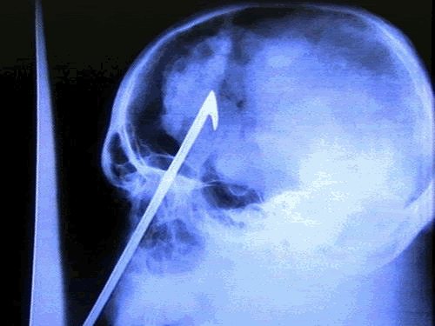
Step 2 - Removal of the Brain
Egyptians thought brain was a Waste of space.
Method 1: Remove brain through the nose with a hook
Method 2. Mix up brain with wire and let it drain out through nose

Slide 8
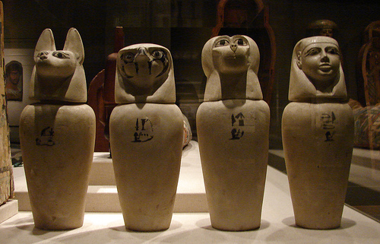
Step 3 – Removal of the Internal Organs
Liver, Lungs, Stomach & Intestines
Method: small slit cut in stomach and organs pulled out.
Organs then placed in Canopic Jars
Cleansing: Body washed with oil, lotion and preserving fluids
Body then stuffed with linen or straw to keep shape of a body
canopic-jars.50webs.com/canopic-jars2.jpeg

Slide 9
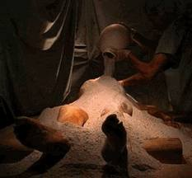
Step 4 – Drying out Process
Method: Body placed on slab and covered with Natron Salt
The slab was on a slant so water could run out.
40 Days

Slide 10
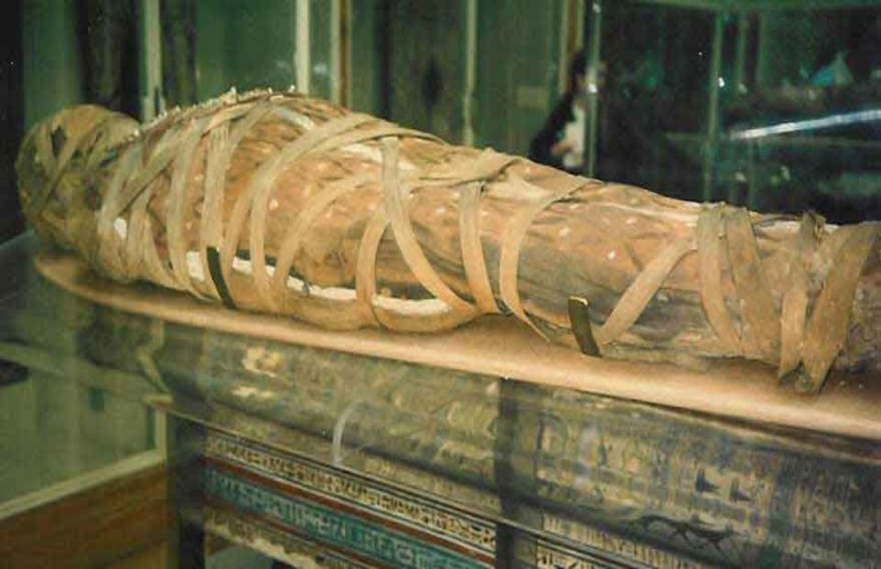
Step 5 – Wrapping the Body
Hundreds of Yards of Linen
Shroud added at end to keep wrappings together
Body covered with “Mummia” to glue everything together.

Slide 11
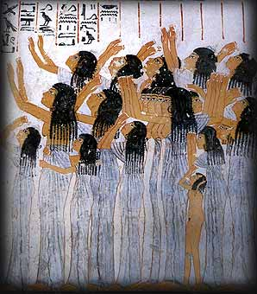
Step 6 – Final Procession
Family & friends would walk through town on their way to the burial.
People were paid to cry
to show the gods
the person was well loved
The more people crying,
the better.
ib205.tripod.com/death/burial-2.jpg

Slide 12
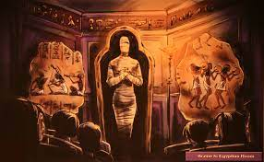
Characteristics
1. Body becomes thin, shrivelled, dried and dark brown or black.
2. Skin & muscles become thin, dark, leathery and adherent to bones.
3. All internal viscera blend with each other.
4. Body emits smell like rotten cheese.
Identification of dead body is possible.
b) Cause of death in case of death due to injuries can be established.

Slide 13
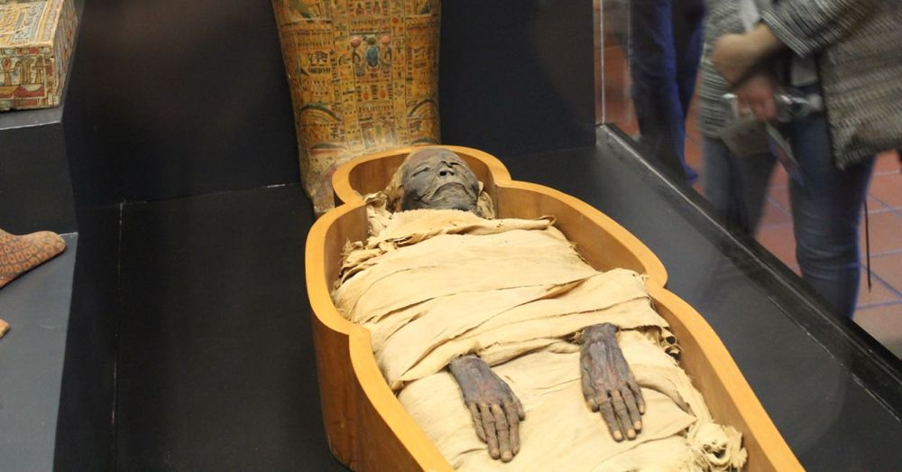
Time required
Time required for mummification, varies between 3 months 2 years.
If properly preserved, a mummified body can remain for years.

Slide 14
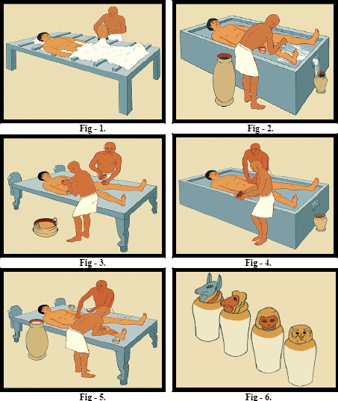
Medico legal importance of mummification
It is a sure sign of death.
2. Identity of the dead can be known.
3. Cause of death, in case of death due toinjuries can be known.
4. Time since death, can be known.
5. Surroundings of the dead body
established.

Slide 15
Thank You
Made By :- Yash Aknurwar
Roll no:- 02

