Slide 1
Smt. Vimladevi Ayurvedic Medical Collage & Hospital , Wandhari Chandrapur
Department Of Agadtantra & Vyavhar Ayurved
Presented by – Anjali Bhuyar
Roll no. - 09
Guided by :-
Dr. Akhilesh Deshmukh
Dr. Yogesh Dahegaonkar

Slide 2
Injuries
Topic - ABRASION

Slide 3
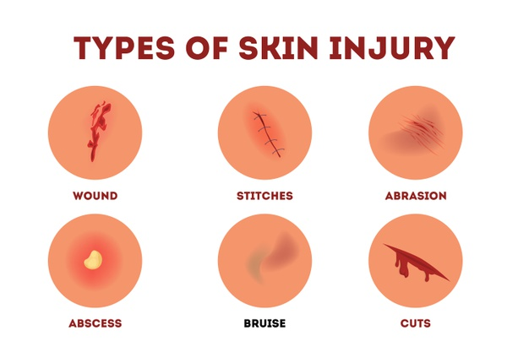
Injuries(व्रण)

Slide 4
Introduction
Injury :-
Legally as per sec.44 IPC , injury is defined as any harm caused
illegally to a person i.e., to his body , mind , reputation or property
Hurt :
As per sec, 319 IPC , hurt is defined as pain ,disease ,infirmity or deformity in the body part .

Slide 5
Classification OF Injury
Etiological Classification
Abrasion
Contusion
Stab
Fire arm
Laceration
Incised
Mechanical Injury

Slide 6
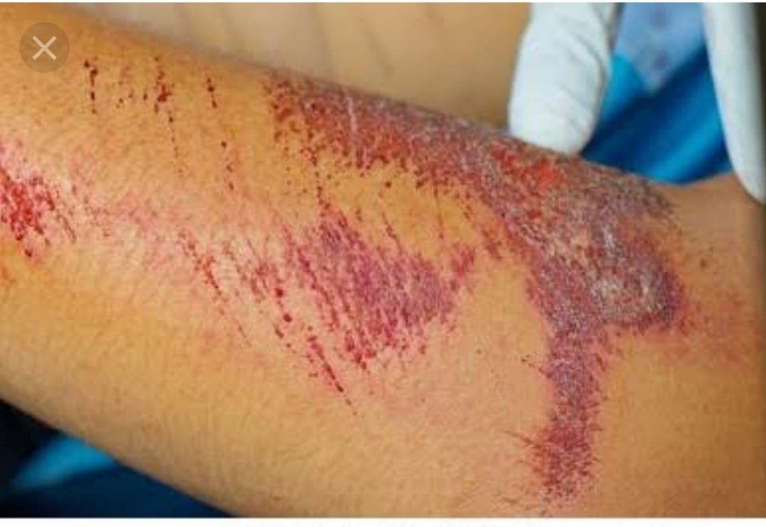
Abrasion
{ घृष्ट व्रण }
(Grazes or Scratches )
Definition -
It is a Superficial Injury on superficial layer of epithelium or on mucous membrane caused by Hard , Blunt , Rough Object

Slide 7
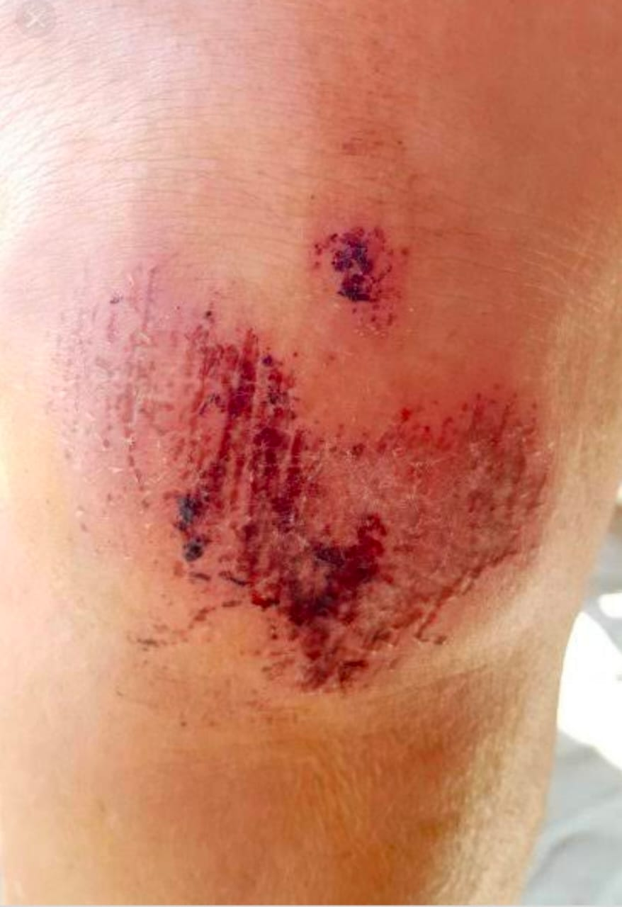
Characteristic Of Abrasion
Involves Mucous membrane
Cause Due to Friction of object
Size of Abrasion corresponds to Object size
Heal rapidly
Bleeds Slightly
After Healing , No Scarring

Slide 8
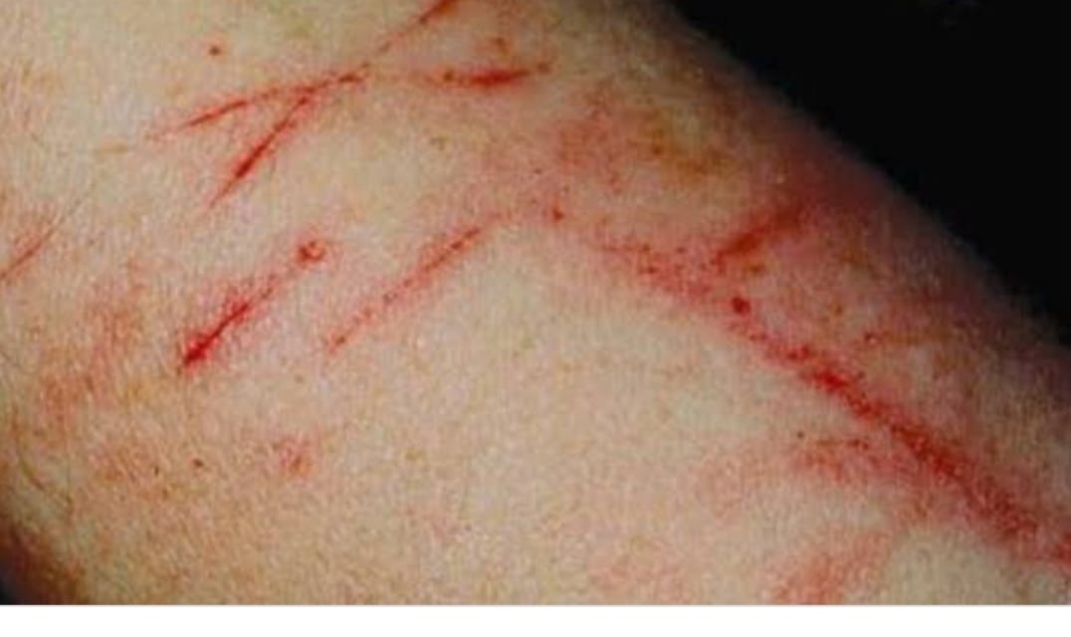
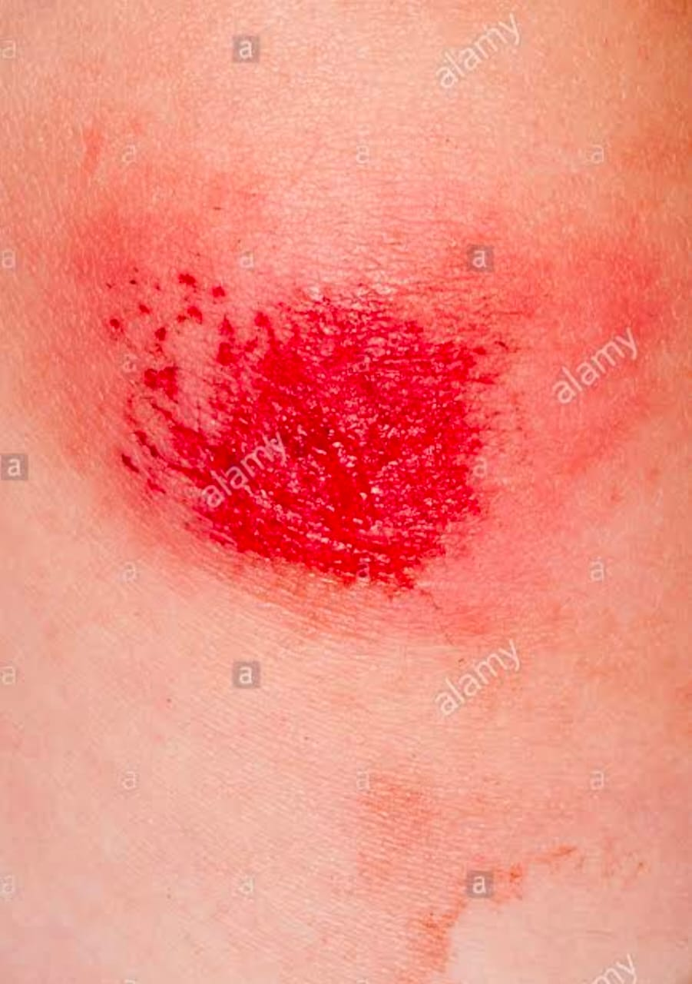
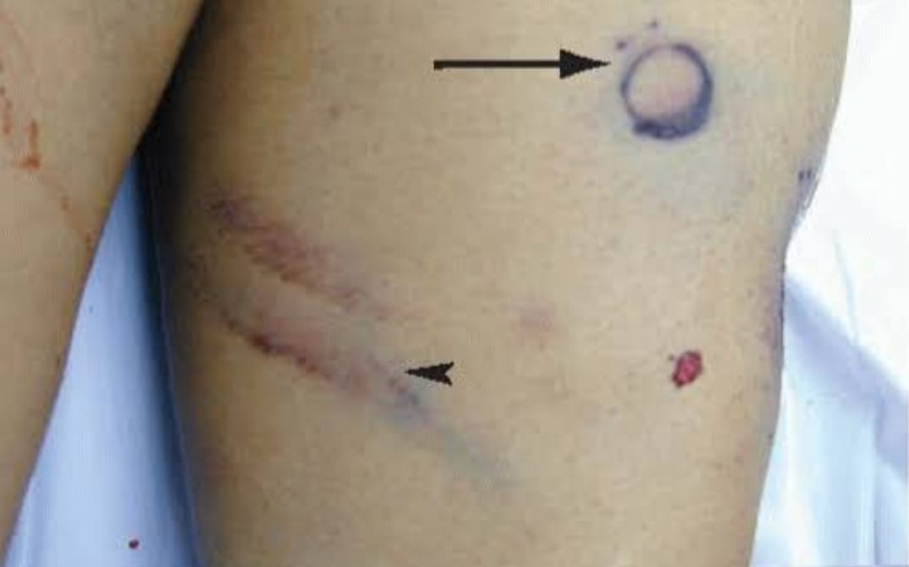
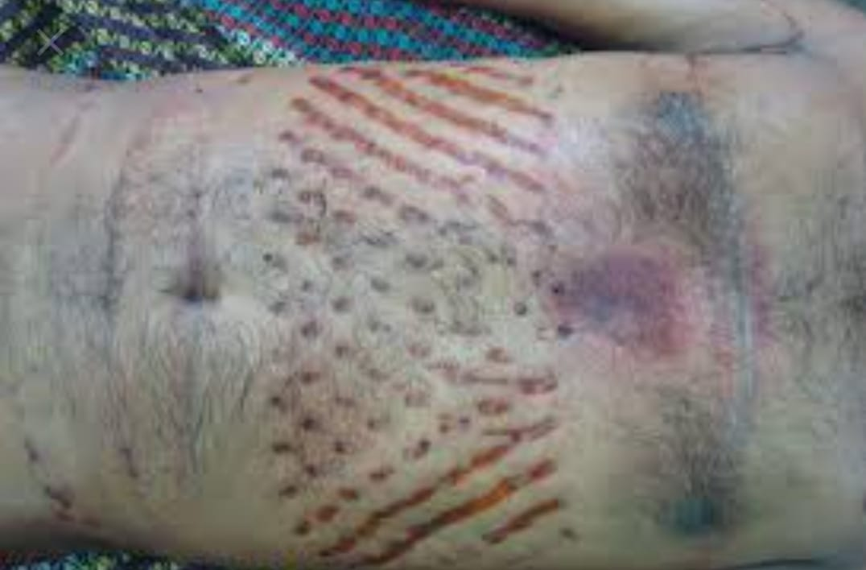
Types Of Abrasion
Scratches
Linear
Grazes
Sliding or Scrapping
Pressure
Crushing
Patterned
Imprint or Impact

Slide 9
Age Of Abrasion
Initially Bleeding
Clotting
Scab formation
Scab Dark
Scab Falloff
Normal skin
1-2 hr
12-24 hrs
3-4 days
4-7 days
10-14days

Slide 10
Differential Diagnosis
Excoriation of Skin
Bed Sores
PM Injuries
Medicolegal Aspect
Nature , Type and age of Injury
Direction Of injury
Purpose Of Injury
An Abrasion on Cornea can Lead to Blindness , a Grievous Injury

Slide 11
treatment of abrassion
Rinse and clean the abrassion
Apply thin layer of petroleum jelly or anitibiotic ointment
Protect and cover the abrassion
Change the dressing
Do not pick scabs
Check for size of infection

