Slide 1
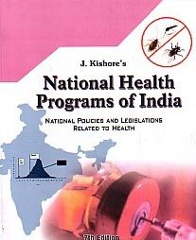
National Health Programs
Dr. JYOTI K. VARTHI
M.D. (Swasthavritta)
Assistant Prof. Swasthavritta

Slide 2

National Health Programmes
Prevention, control & eradication of communicable diseases
Prevention & control of non communicable diseases
Population control
Improvement of environmental sanitation
Raising the standard of nutrition
Improving the rural health

Slide 3
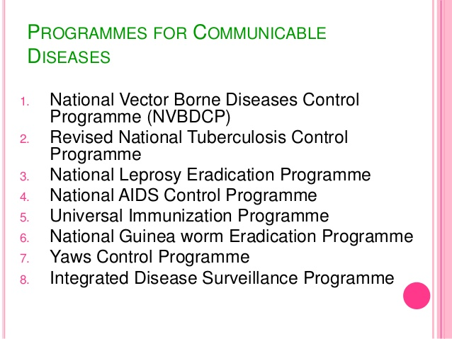

Slide 4
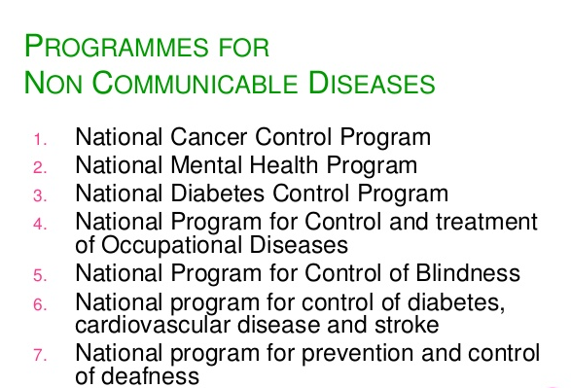

Slide 5
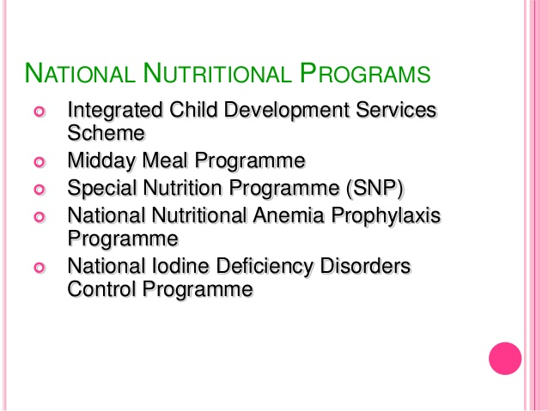

Slide 6
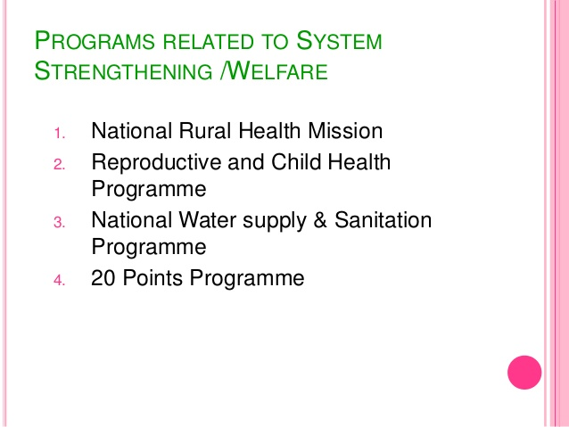

Slide 7
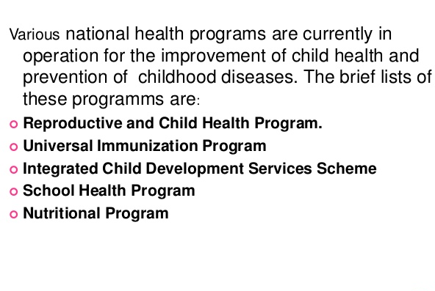

Slide 8


National AIDS Control Programme
Dr. jyoti k. varthi
M.D. Swasthavritta

Slide 9
Definition:
Acquired immune-deficiency syndrome
Slim disease
Breaks down body immune system

Slide 10
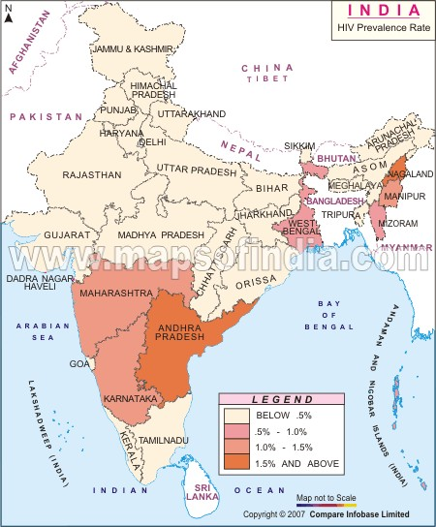
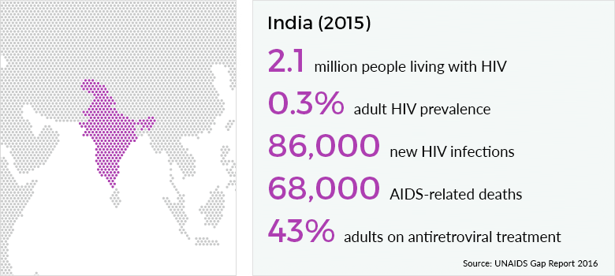
Problem statement

Slide 11
National adult (15-49 years) HIV prevalence which was estimated at 0.33% (0.29%-0.37%) in 2007, has declined to 0.27% (0.22%-0.33%) in 2011.

Slide 12
Milestones
1992 to
1998
NACP 1
2004
ART
Anti retroviral treatment initiated
2006
NACP 4 launched for 5 years
2014 -2017
2007-2012
National Council On AIDS Constituted
National Policy On Paediatric ART Formulated
NACP 3 launched for 5 years
NACP 2 1999 state AIDS control societies
First case of HIV detected in India
1987 NACP Launched
2002
1986
National AIDS prevention and control policy
National Blood Policy

Slide 13
Assistance
National AIDS Control Project.–
World bank
DFID
Department for International Development is a United Kingdom
G O I
GFATM
The Global Fund to Fight AIDS, Tuberculosis and Malaria the Bill & Melinda Gates Foundation, Clinton Health Access Initiative,
(USAID, CDC and PEPFAR)
UNAIDS,
UNFPA,
UNICEF,
UNDP,
WHO,

Slide 14
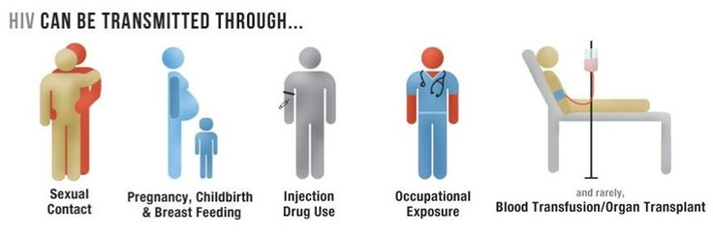
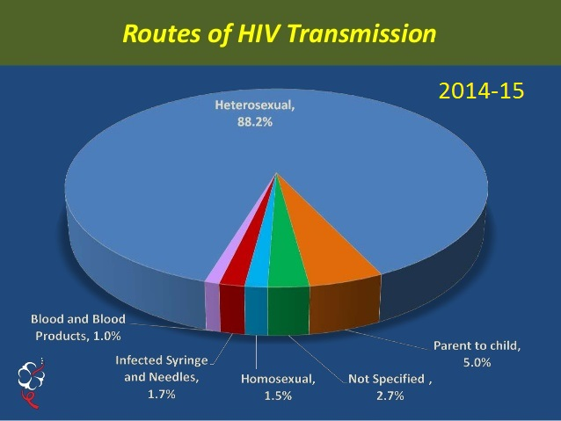

Slide 15
Targeted Interventions TI and High Risk Groups HRG
Vulnerable population TI (targeted interventions)and HRG (high risk gp)groups include partners of sex workers, partners of IDUs,(inj.drug user)
Bridge Populations HEG(eligible gp) high exposure group migrants ,long distance truckers moving between high and low prevalence areas Refugees, prisoners and engaging in unsafe practices
84% of female sex workers (FSW),
87% of men-who-have-sex-with-men (MSM)
84% of injecting drug users (IDU) have access to prevention interventions.

Slide 16
NACP I (1992-1998): Goals
Annual sentinel surveillance system by ANC clinic and STD clinics to generate awareness
Mass IEC.(imformation ,education,communication)
Providing safe blood. The national blood transfusion policy was prepared and guidelines issued
To set up zonal blood testing centres and component separation units.
To promote the use of condoms, improve their quality, and increase availability to TI and HRG
To set up treatment facilities and the pilot model care for PLHIV.

Slide 17
NACP II (1999-2006): Goals
focused on TI, to change the behaviour among HRG.
Over 1,000 targeted interventions were implemented.
Counselling and testing centres were set up to know status
Reach and Recall Study of PPTCT Campaign by NACO
Providing safe blood ; licensed blood banks increased to 1,230, including 82 blood component separation centres.
the levels of HIV transmission through blood was reduced to
< 2 % from 8 % in the late 1980s.
Family Health awareness Campaign

Slide 18
NACP III (2007-2012): Goals
To reverse the epidemic in India
STIS/RTIS, (reproductive tract inf.)
condom promotion, blood safety, care and treatment for ICTC (integrated councelling & testing centres)and PPTCT,(prevention of parent to child transmission)
Blood safety goal was to reduce the transfusion associated with HIV transmission to 0.5 percent.
A decline by 56% in new infections reported from
2.70 lack ( 2001) to 1.27 lack ( 2010)

Slide 19
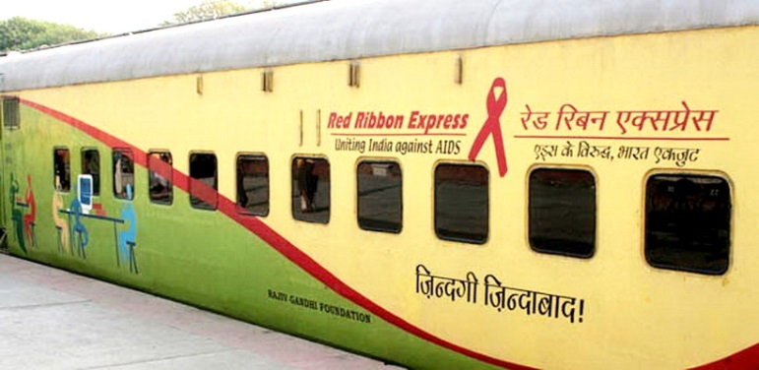
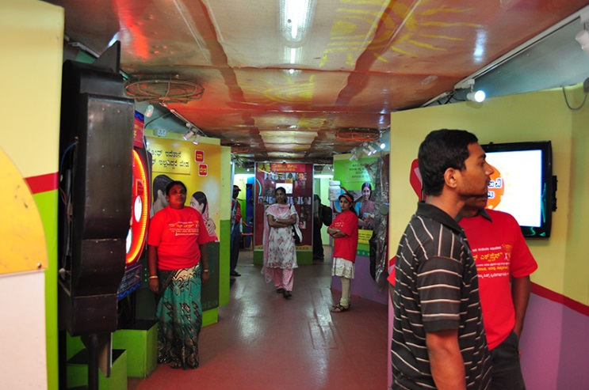
RED RIBBON EXPRESS
The seven coach train became the first time information ` and awareness about HIV/AIDS The idea of the Red Ribbon Express was developed by, the National AIDS Control Organisation and Nehru Yuva Kendra Sangathan in 2004.[4]
The Red Ribbon Express’ second phase was flagged on World AIDS Day, 2009. The train was designed and fabricated by Mr.P.P.Mokashi (VP) and Vineet Pandey (Project Manager) operated and maintained whole year during phase1(2007-08) and phase-2(2009-10).The third phase , launched on 12th January, 2012, covered 162 halt stations in 23 states and reached out to 1.14 crore people,
Over 90,000 persons were counseled for HIV and
over 70,000 persons were tested for HIV.

Slide 20

ADOLSCENT EDUCATION PROGRAME
In India 44% of the reported AIDS cases are in the age group of 15-29
The Department of Education and the National AIDS Control Organisation in partnership with UNICEF, UNESCO & UNFPA,
Implemented in all states across the country, the objective of the AEP is to ensure that all students in classes IX-XI have adequate.
Know about themselves, their adolescence and their sexuality
Basic facts on HIV and other sexually transmitted infections
protect themselves by developing and reinforcing life-skills
Knowledge to dispel myths and clarify misconceptions

Slide 21
NACP IV (launched in 2014):
Intensifying and consolidating prevention services with a primary focus on HRG and vulnerable populations, and secondary focus on the general population.
Increasing (IEC) services with a focus on behaviour change.
Expanding and promoting comprehensive Care, Support and Treatment services.
Building capacities at National, State, District, and Facility levels.
Strengthening Strategic Information Management Systems

Slide 22
Prevention Services
1. TI for High Risk Groups and Bridge Population (Female Sex Workers , Men who have Sex with Men , Transgenders/Hijras, Injecting Drug Users (IDU), Truckers & Migrants)
2. Needle-Syringe Exchange Programme (NSEP) and Opioid Substitution Therapy (OST- Methadon or Buprenorphine) for IDUs
3. Prevention Interventions for Migrant population at source, transit and destination
4. Link Worker Scheme (LWS) for HRGs and vulnerable population in rural areas
5. Prevention & Control of Sexually Transmitted Infections/Reproductive Tract Infections (STI/RTI)
6. Blood Safety

Slide 23
Prevention Services
7. HIV Counselling & Testing Services
8. Prevention of Parent To Child Transmission
9. Condom Promotion
10. Information, Education & Communication (IEC) & Behaviour Change Communication (BCC).
11. Social Mobilization, Youth Interventions and Adolescent Education Programme
12. Mainstreaming HIV/AIDS Response
13. Work Place Interventions

Slide 24
Care, Support & Treatment
Services
1. Laboratory services for CD4 Testing and other investigations
2. Free First line & second line Anti-Retroviral Treatment (ART) through ART centre and Link ART Centre (LACs),
Centre of Excellence (COE) & ART plus Centre.
3. Pediatric ART for children
4. Early Infant Diagnosis for HIV exposed infants and children
below 18 months
5. HIV-TB Coordination (Cross referral, detection and
treatment of co-infections)
6. Treatment of Opportunistic Infections
7. Drop-in Centre for PLHIV networks

Slide 25
NACO PPTCT 2001-02 Prevention of Parent-to-Child Transmission
Provided HIV testing services for all pregnant women enrolled in ANC.
a single dose of Nevirapine prophylaxis to HIV-positive pregnant women during labour and to newborns immediately after birth.
use of a single dose of Nevirapine instead of Multi-drug Anti Retro Viral (ARVS)
To efficiently bring down the rate of transmission of HIV from mother-to-child to less than 5 percent.

Slide 26
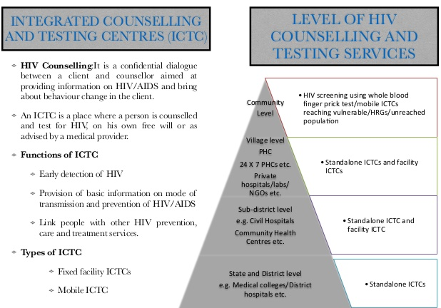

Slide 27
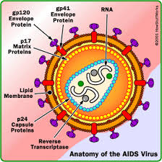
Causative Agent
Retrovirus(HIV)

Slide 28
CLINICAL MANIFESTATIONS:
Occurs in four stages as:
1. Initial infection with the virus &
development of Antibodies.
2. Asymptomatic carrier state:
3. AIDS related complex
4. AIDS

Slide 29
Initial infection with the virus & development of Antibodies.
Incubation period from few months to 10 years
Window period during this period antibodies are being produced but they are not detectable in any testing. This period is most of time great infectivity. (3-6 weeks) So to confirm again test to be done after 6 weeks post exposure

Slide 30
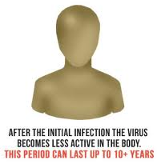
Asymptomatic carrier state:
The Antibodies are present but there is no over signs of disease except generalized lymphadenopathy.

Slide 31
AIDS related complex
Diarrhoea.
Fatigue,
Malaise,
Loss Of Body Weight More Than 10%,
Fever,
Night Sweat,
Oral Thrush, Enlarged Spleen
Patients with more than two of above symptoms and with decreased no of T-helper lymphocytes.

Slide 32
AIDS
End stage of HIV infection
Death is due to uncontrolled and untreatable secondary infection.
Following infections are seen:
Persistent generalized lymphadenopathy.
Tuberculosis Kaposi sarcoma
Hairy leucoplakia Oropharyngeal candidiasis.
Cytomegalovirus retinitis. Toxoplasma encephalitis.
Cryptococcal meningitis Herpes Zoaster
Pruritic dermatitis

Slide 33

Generalized lymphadenopathy

Slide 34
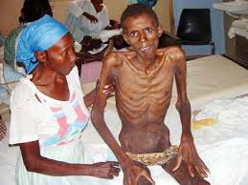
Tuberculosis

Slide 35
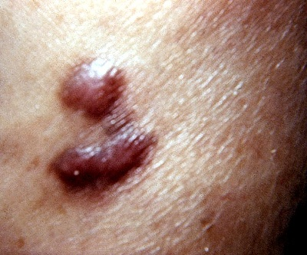
Kaposi sarcoma

Slide 36
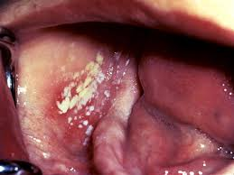
Hairy leucoplakia

Slide 37
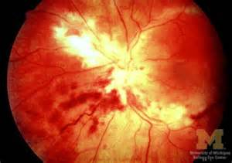
Cytomegalovirus Retinitis

Slide 38
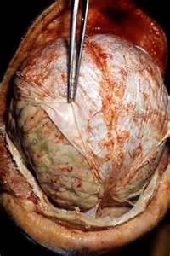
Cryptococcal Meningitis

Slide 39
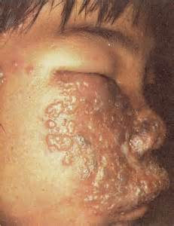
Herpes zoaster

Slide 40
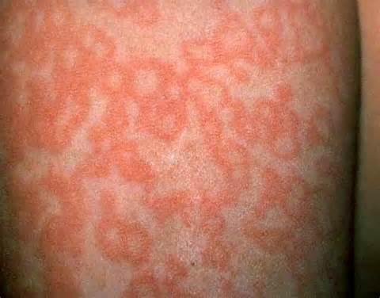
Pruritic dermatitis

Slide 41
Testing and counselling
Voluntary and right to decline testing.
All testing and counseling services must include the 5 ‘C’ recommended by WHO
Consent
Confidentiality
counseling
Correct test results
Care

Slide 42
Diagnosis of AIDS:

Slide 43
Clinical Methods
Major Signs:
Weight Loss More Than 10 %.
Chronic Diarrhea > 1month.
Prolonged Fever > 1 Month.
Minor Signs:
Persistent Cough For >1 Month
Generalized Purities Dermatitis H/O Herpes Zoster
Oropharyngeal Candidacies
Generalized Lymphadenopathy

Slide 44
Laboratory methods
ELISA: To Detect HIV - Antibodies
WESTERN BLOT: Confirmatory Test
CBC: Anaemia, Nutropenia,
Thrombo cytopenia
Absolute CD4 Lymphocyte count <950 /MicroLit.(N)
CD4 Lymphocyte Percentage
CD4:CD8 Ratio
HIV Viral Load Test
P24 Antigen

Slide 45
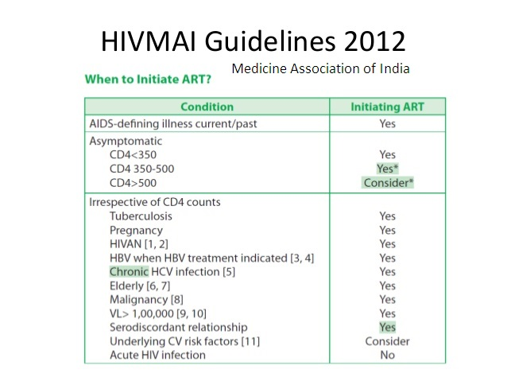
ART

Slide 46
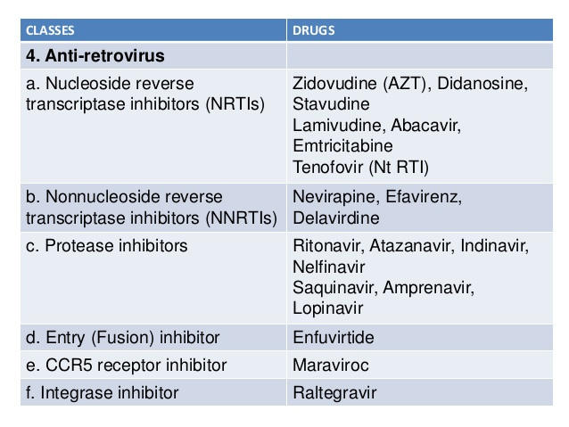

Slide 47
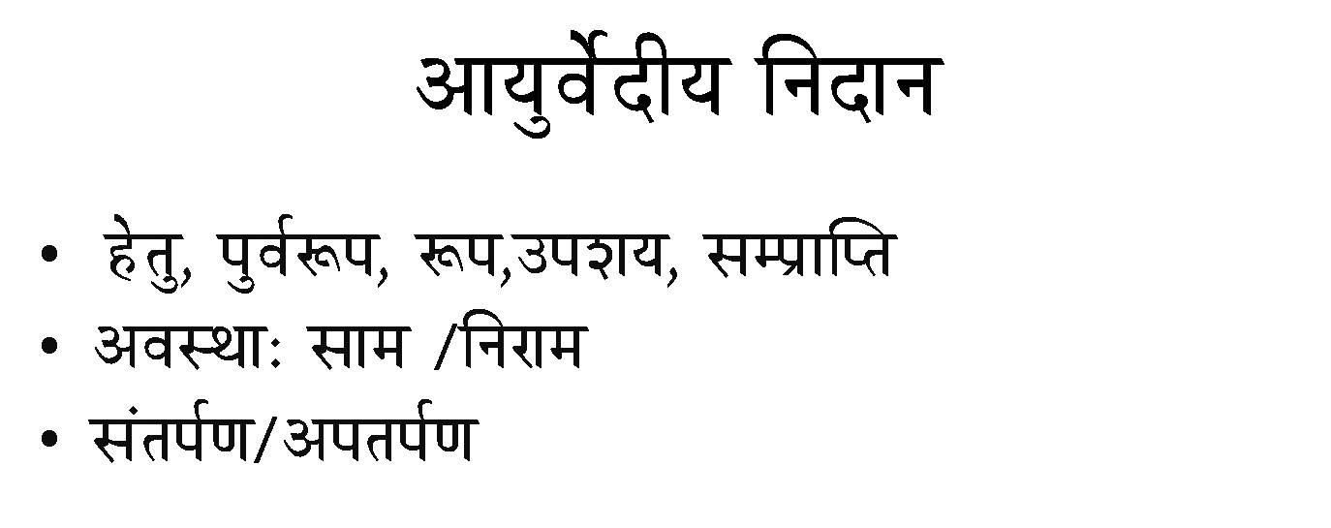

Slide 48
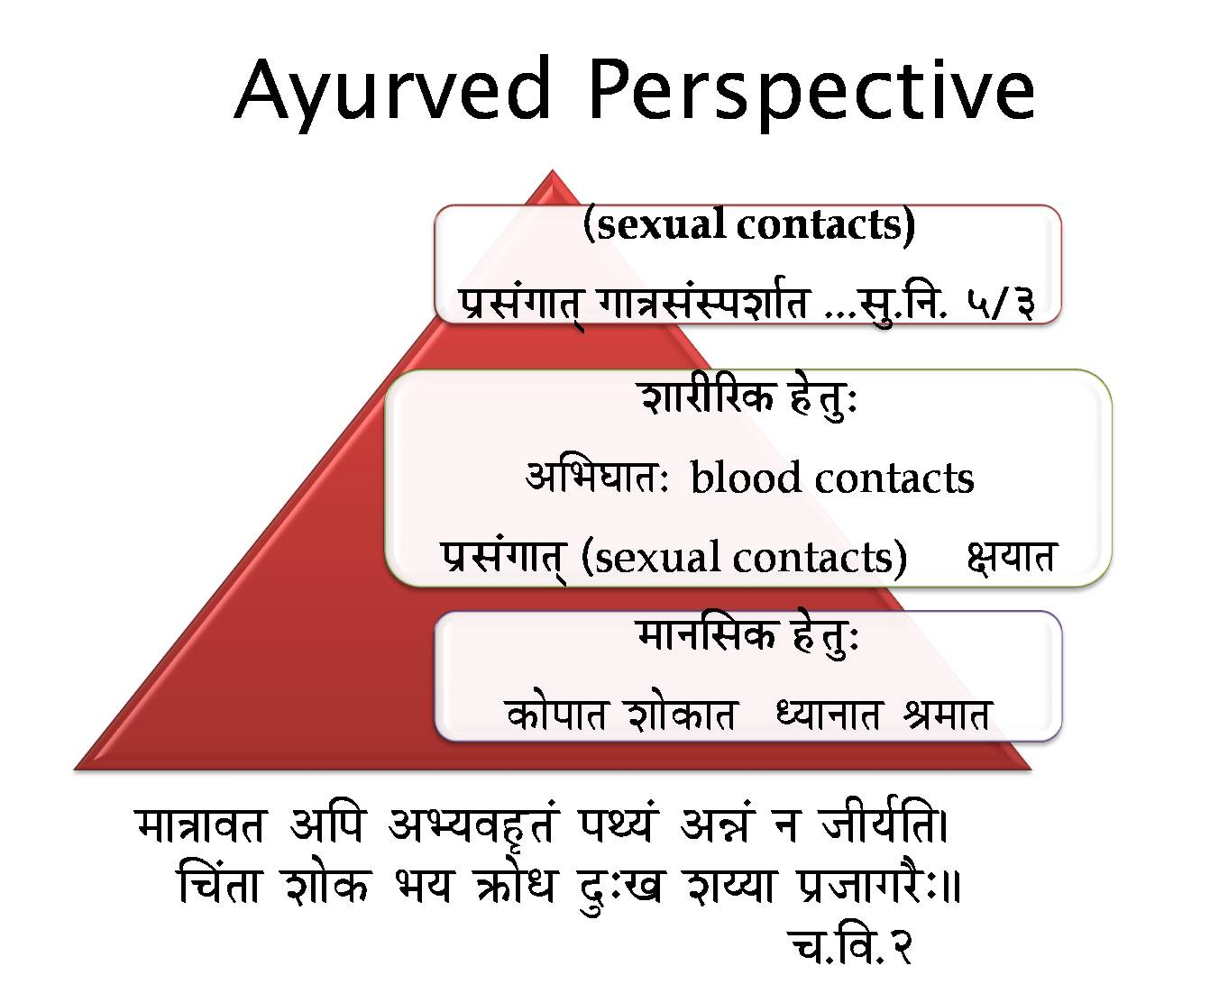
Ayurved Perspective
(sexual contacts)
mÉëxÉÇaÉÉiÉç aÉÉ§ÉxÉÇxmÉzÉÉïiÉ ...xÉÑ.ÌlÉ. 5/3
qÉÉlÉÍxÉMü WåûiÉÑ:
MüÉåmÉÉiÉ zÉÉåMüÉiÉ krÉÉlÉÉiÉ ´ÉqÉÉiÉ
zÉÉUÏËUMü WåûiÉÑ:
AÍpÉbÉÉiÉ: blood contacts
mÉëxÉÇaÉÉiÉç (sexual contacts) ¤ÉrÉÉiÉ
qÉÉ§ÉÉuÉiÉ AÌmÉ AprÉuÉWØûiÉÇ mÉjrÉÇ A³ÉÇ lÉ eÉÏrÉïÌiÉ|
ÍcÉÇiÉÉ zÉÉåMü pÉrÉ ¢üÉåkÉ SÒÈZÉ zÉrrÉÉ mÉëeÉÉaÉUæÈ||
cÉ.ÌuÉ.2

Slide 49

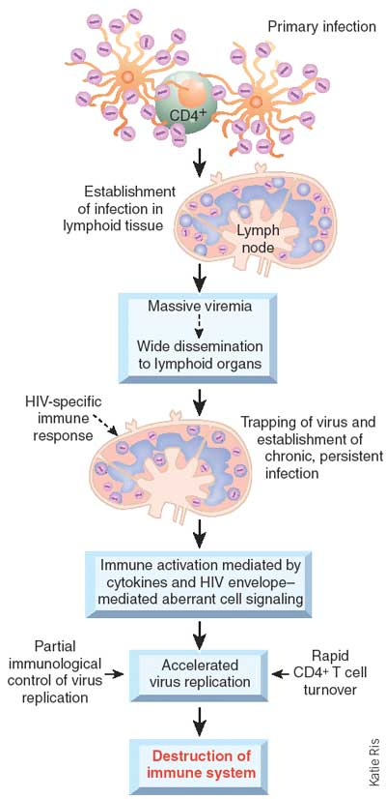
ओजःसङ्क्षीयते
तेजःसमीरितं
ह्येभ्योधातुग्रहणनिःसृतम्|
तस्माद्विस्रंसयतिदेहिनः||
Su.Su 15/28

Slide 50
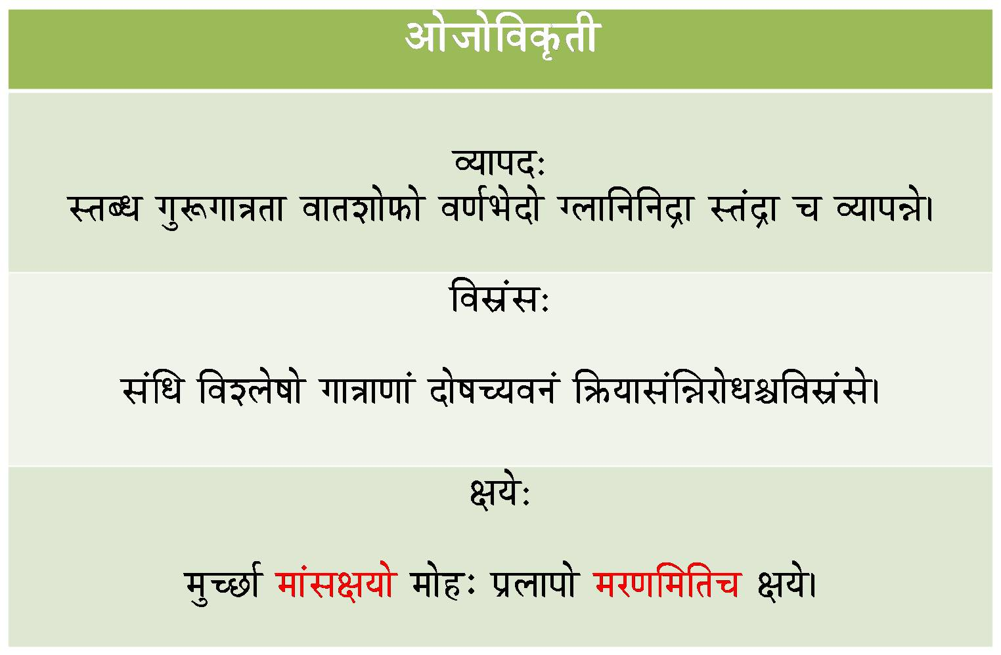
AÉåeÉÉåÌuÉM×üiÉÏ
urÉÉmÉS: xiÉokÉ aÉÑÃaÉÉ§ÉiÉÉ uÉÉiÉzÉÉåTüÉå uÉhÉïpÉåSÉå asÉÉÌlÉÌlÉSìÉ xiÉÇSìÉ cÉ urÉÉmÉ³Éå|
ÌuÉxÉëÇxÉ: xÉÇÍkÉ ÌuÉzsÉåwÉÉå aÉÉ§ÉÉhÉÉÇ SÉåwÉcrÉuÉlÉÇ Ì¢ürÉÉxÉÇÍ³ÉUÉåkÉ¶ÉÌuÉxÉëÇxÉå|
¤ÉrÉå: qÉÑcNûÉï qÉÉÇxÉ¤ÉrÉÉå qÉÉåWûÈ mÉësÉÉmÉÉå qÉUhÉÍqÉÌiÉcÉ ¤ÉrÉå|

Slide 51
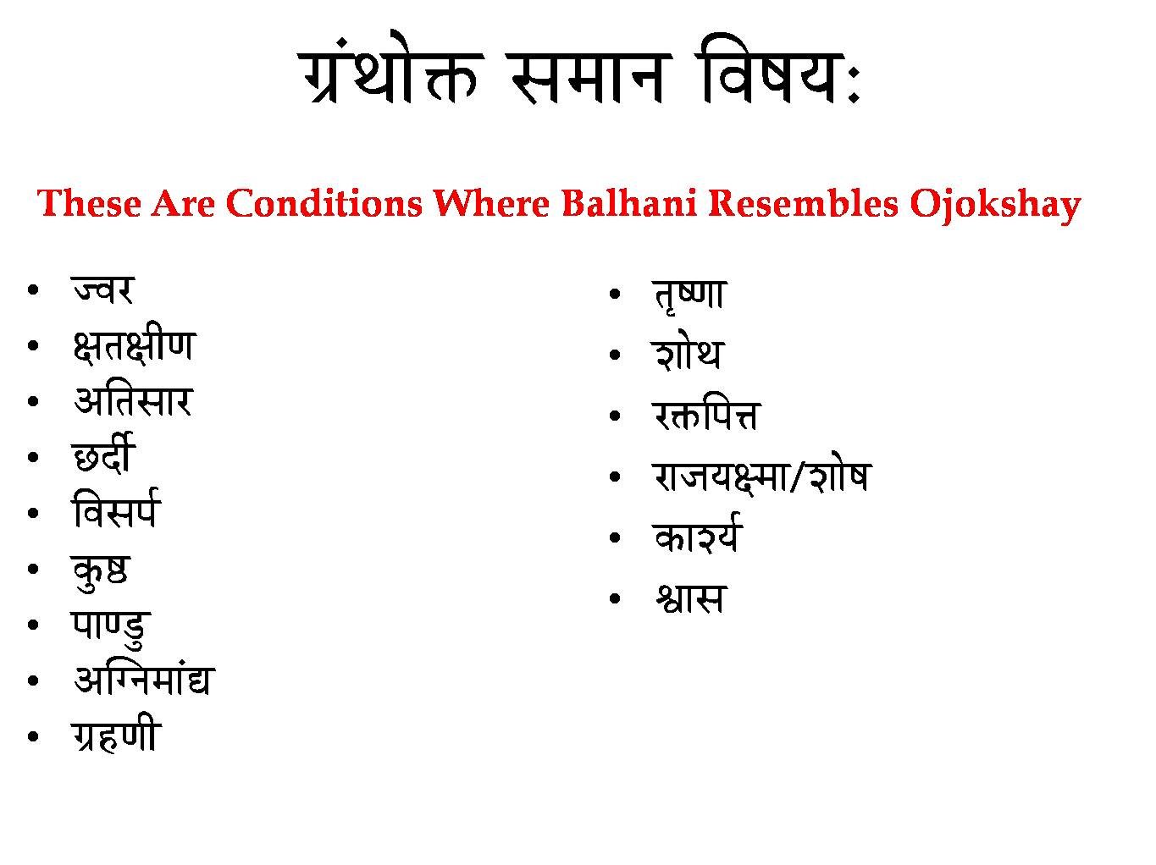
aÉëÇjÉÉå£ü xÉqÉÉlÉ ÌuÉwÉrÉ:
These Are Conditions Where Balhani Resembles Ojokshay
euÉU
¤ÉiÉ¤ÉÏhÉ
AÌiÉxÉÉU
NûSÏï
ÌuÉxÉmÉï
MÑü¸
mÉÉhQÒû
AÎalÉqÉÉÇ±
aÉëWûhÉÏ
iÉ×whÉÉ
zÉÉåjÉ
U£üÌmÉ¨É
UÉeÉrÉ¤qÉÉ/zÉÉåwÉ
MüÉzrÉï
µÉÉxÉ

Slide 52
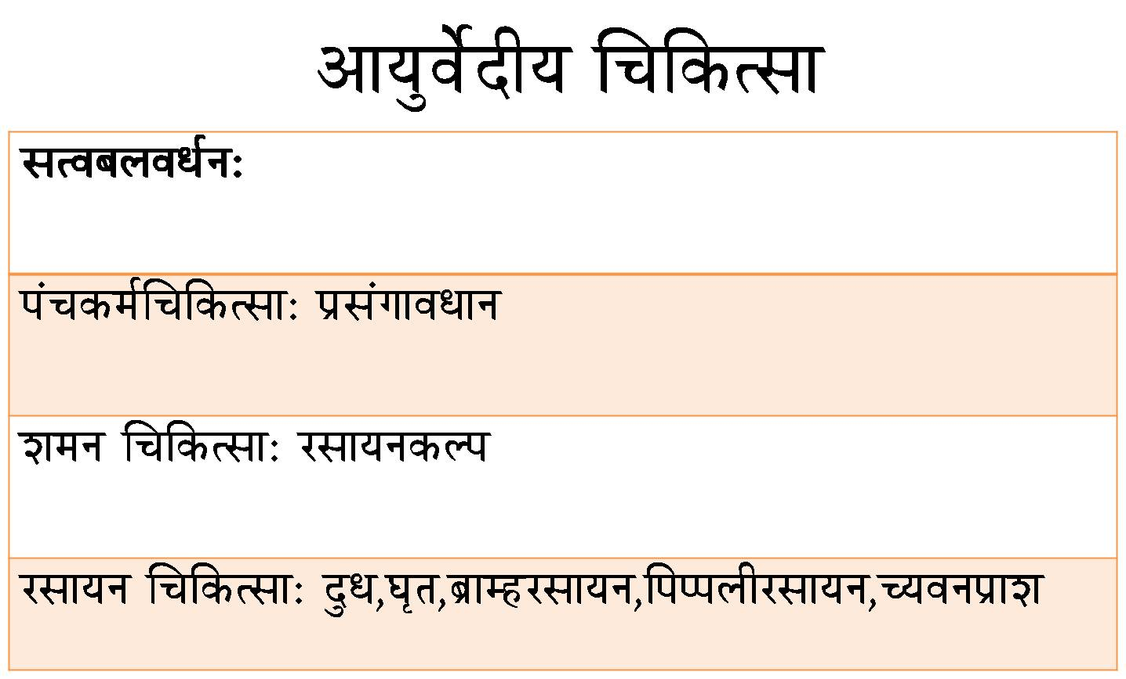
AÉrÉÑuÉåïSÏrÉ ÍcÉÌMüixÉÉ
xÉiuÉoÉsÉuÉkÉïlÉ:
mÉÇcÉMüqÉïÍcÉÌMüixÉÉ: mÉëxÉÇaÉÉuÉkÉÉlÉ
zÉqÉlÉ ÍcÉÌMüixÉÉ: UxÉÉrÉlÉMüsmÉ
UxÉÉrÉlÉ ÍcÉÌMüixÉÉ: SÒkÉ,bÉ×iÉ,oÉëÉqWûUxÉÉrÉlÉ,ÌmÉmmÉsÉÏUxÉÉrÉlÉ,crÉuÉlÉmÉëÉzÉ
;kSfxd mipkj
panucykyk{kkfn rSy Lusgu@vH;ax
fiaMLosn
c``ag.kcfLr f’kjks/kkjk f’kj%fipq
{khjikd % ’krkojh v’oxa/kk pksifpuh
xqMwph?ku lRRo
ve`rdy’k

Slide 53

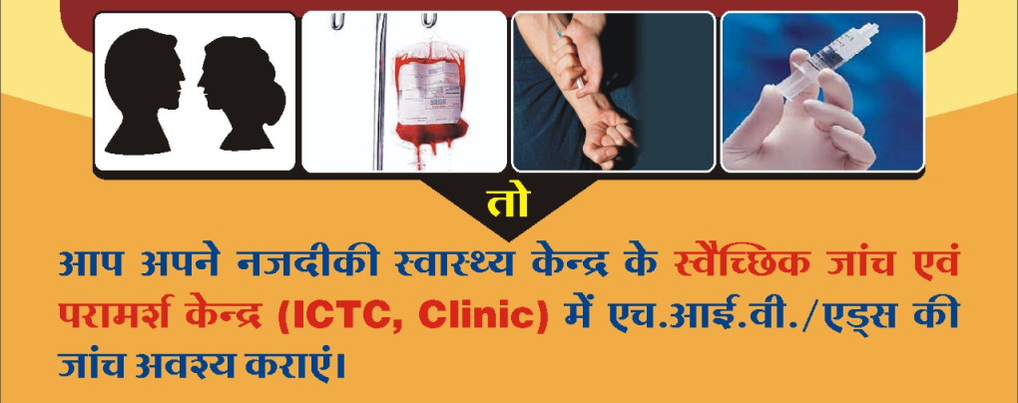
“If you are planning for a year, sow rice;
If you are planning for a decade, plant trees;
If you are planning for a lifetime, educate people.
Ms. Julie McLaughlin, Manager, Health, Nutrition and Population, South Asia Region, World Bank
THANKS

