Slide 1
Anesthesia
Definition
Types
Indications
Technique, Equipment
Drugs and Pharmacology
Adverse effects

Slide 2
Definition
Greek "without sensation“. It is a state of controlled, temporary loss of sensation and/or consciousness that is induced for medical purposes.
It may include some or all of :
Analgesia (relief from or prevention of pain),
Paralysis (muscle relaxation),
Amnesia (loss of memory), and
Unconsciousness

Slide 3
Types
General Anesthesia: Suppresses central nervous system activity and results in unconsciousness and total lack of sensation, using either injected or inhaled drugs
Regional or Local Anesthesia: Blocks transmission of nerve impulses from a specific part of the body.
Regional anaesthesia can be central neuraxial block or peripheral nerve blocks.
Depending on the situation, this may be used either on its own (in which case the patient remains fully conscious), or in combination with general anesthesia or sedation.

Slide 4
Technique
The first stage in anesthesia is the pre-operative risk assessment consisting of the medical history, physical examination and lab tests. Diagnosing a person's pre-operative physical status allows the clinician to minimize anesthetic risks.
The American Society of Anesthesiologists has developed a six-tier scale that stratifies the patient's pre-operative physical state. It is called the ASA physical status.
The ideal anesthetic drug would provide hypnosis, amnesia, analgesia, and muscle relaxation without undesirable changes in blood pressure, pulse or breathing.

Slide 5
ASA physical status classification system
ASA class | Physical status
ASA 1 | Healthy person
ASA 2 | Mild systemic disease
ASA 3 | Severe systemic disease
ASA 4 | Severe systemic disease that is a constant threat to life
ASA 5 | A moribund person who is not expected to survive without the operation
ASA 6 | A declared brain-dead person whose organs are being removed for donor purposes
E | Suffix added for patients undergoing emergency procedure

Slide 6
PREMEDICATION
1. To allay anxiety: Adults: (Night before and morning of surgery) Tab Diazepam 0.1-0.2 mg/kg Tab Lorazepam 2-4 mg orally Children: To enable easy separation from parents. Midazolam 0.5 mg/kg (maximum 10 mg) mixed with 5 ml of paracetamol syrup is given orally 15-20 minutes prior to the procedure.
2. To relieve pain: Morphine (0.1 mg/kg), pethidine (0.5 mg/kg) or tramadol (0.5-1 mg/kg) given IM are often used.
3. To dry secretions: An anticholinergic such as glycopyrrolate (0.2 mg) is added if a fibreoptic intubation is planned so that oral secretions do not hinder vision. It may be given intravenously just prior to surgery in ENT surgeries and oral surgeries.

Slide 7
4. To help anaesthesia induction: Premedication with a narcotic provides analgesia and helps induce anaesthesia more smoothly.
5. To blunt baroreceptor reflexes: A small dose of β blockers or clonidine may be given in certain patients to blunt baroreceptor reflexes during intubation.
6. To reduce gastric volume and acidity: Some patients are at risk of regurgitation of gastric contents and aspiration. They may be premedicated with a prokinetic such as metoclopramide ( 10 mg) and a H2 blocker such as ranitidine (150 mg orally). Pantoprazole 40 mg may be given instead of ranitidine.

Slide 8
Equipment
The core instrument in an inhalational anesthetic delivery system is an anesthetic machine (Boyles Apparatus). It has vaporizers, ventilators, an anesthetic breathing circuit, waste gas scavenging system and pressure gauges. The purpose of the anesthetic machine is to provide anesthetic gas at a constant pressure, oxygen for breathing and to remove carbon dioxide or other waste anesthetic gases.
Airway managing and breathing equipments, monitor, pulse oximeter, Spinal, Epidural needles and catheters for spinal and epidural anesthesia.

Slide 9
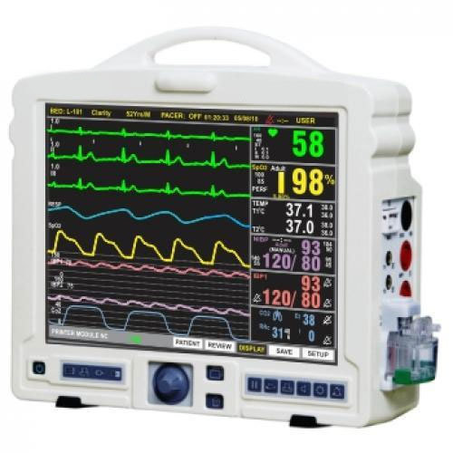
Monitoring
Patients under general anesthesia must undergo continuous physiological monitoring to ensure safety. These include electrocardiography (ECG), heart rate, blood pressure, inspired and expired gases, oxygen saturation of the blood (pulse oximetry), and temperature.
For more invasive surgery, monitoring may also
include temperature, urine output, blood pressure,
central venous pressure, pulmonary artery pressure
and pulmonary artery occlusion pressure, cardiac output,
cerebral activity, and neuromuscular function.

Slide 10
Assessment of airway

Slide 11
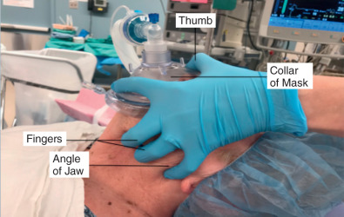
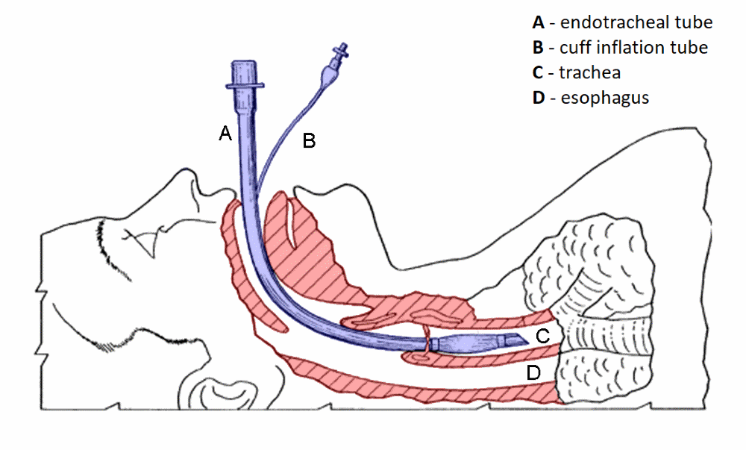
Depth of insertion
The distance of several points on the tube from the patient end is marked in cm along the tube.
The tube is fixed at 22 or 23 cm in adult men and at 20 or 21 cm in adult women.
In children, the following formula is used: Age/2 + 12 cm.
Endotracheal tube size (Their size is indicated as the internal diameter in mm)
Adult male: 8 or 8.5 mm/D
Adult female: 7 or 7.5 mm/D
Children < 6 years: Age/3 + 3.5 mm/D
Children > 6 years: Age/4 + 4.5 mm/D

Slide 12
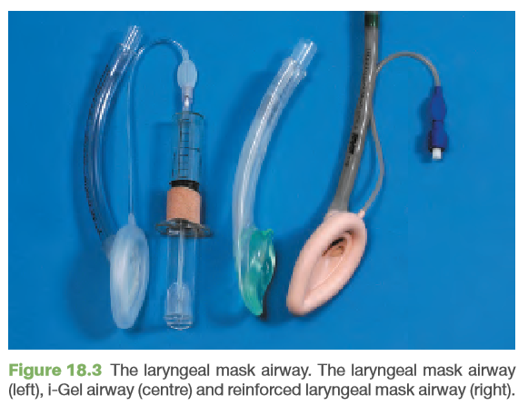
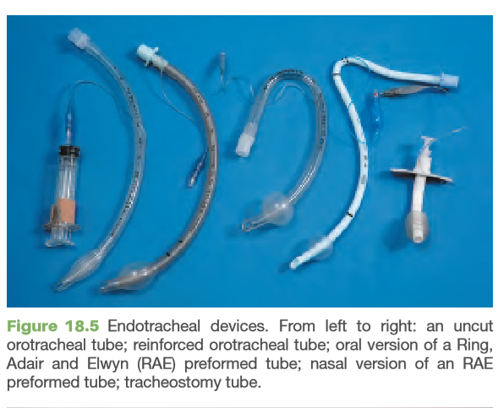
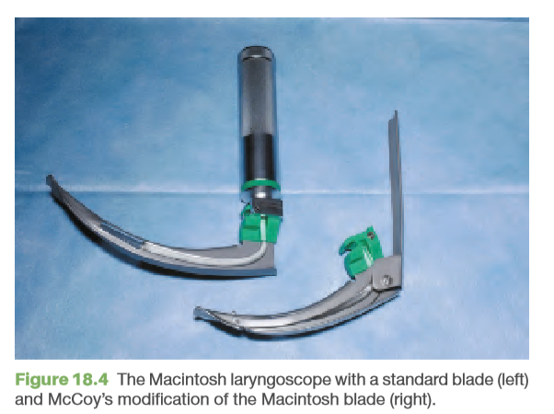

Slide 13
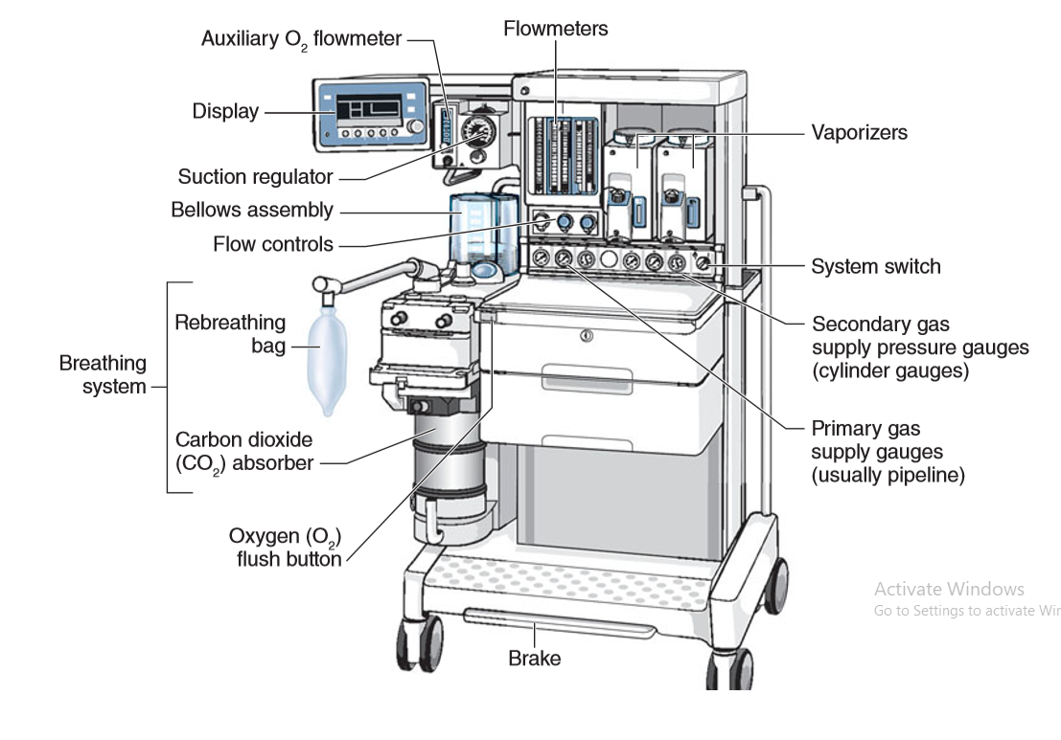
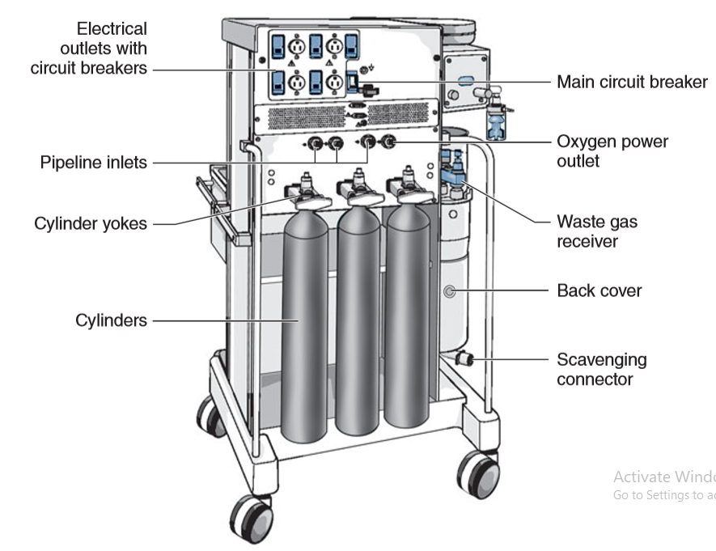
Boyles Apparatus

Slide 14
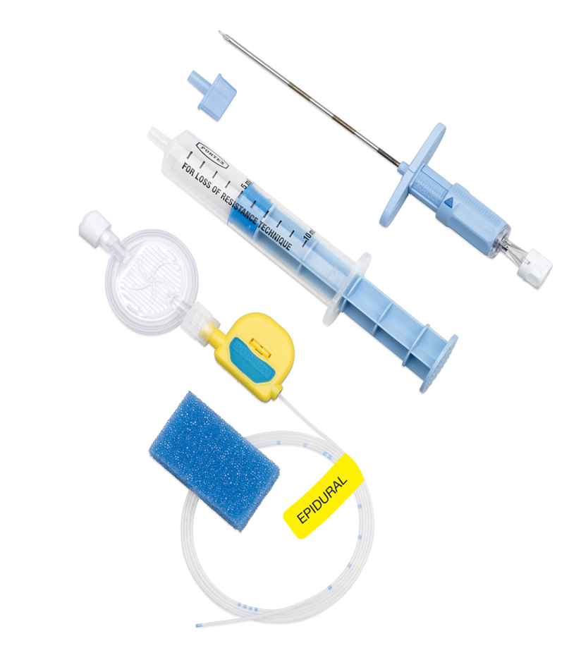

Slide 15
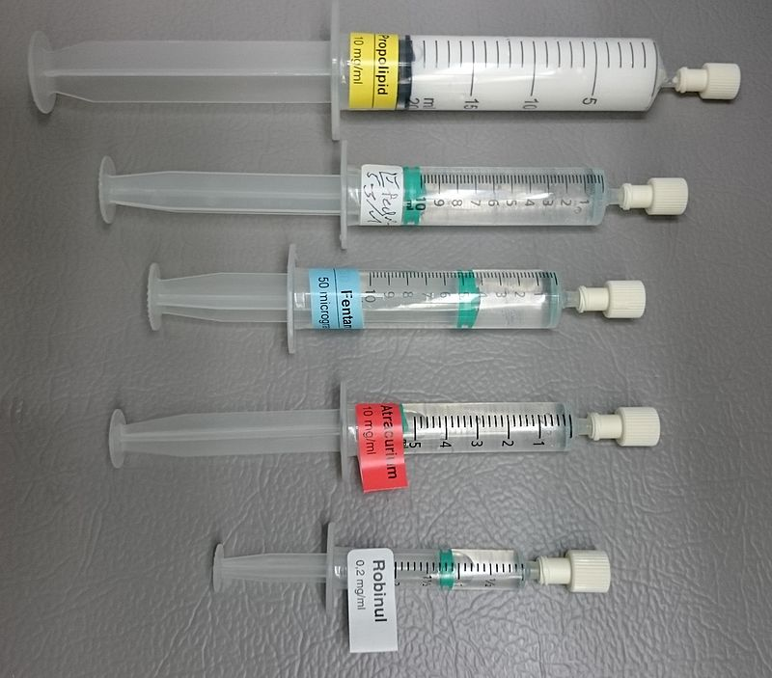
Syringes prepared with medications that are expected to be used during an operation under general anesthesia maintained by sevoflurane gas:
- Propofol, an hypnotic
- Ephedrine, in case of hypotension
- Fentanyl, for analgesia
- Atracurium, for neuromuscular blockade
- Glycopyrronium bromide (here under trade name "Robinul"), reducing secretions

Slide 16
Guedel's classification
Guedel's classification is a means of assessing of depth of general anesthesia introduced by Arthur Ernest Guedel (1883-1956) in 1937.
This classification was designed for use of a sole inhalational anesthetic agent, diethyl ether (commonly referred to as simply "ether"), in patients who were usually premedicated with morphine and atropine.
Stage I (stage of analgesia or disorientation): from beginning of induction of general anesthesia to loss of consciousness.
Stage II (stage of excitement or delirium): from loss of consciousness to onset of automatic breathing. Eyelash reflex disappear but other reflexes remain intact and coughing, vomiting and struggling may occur; respiration can be irregular with breath-holding.

Slide 17
Stage III (stage of surgical anesthesia): from onset of automatic respiration to respiratory paralysis. It is divided into four planes:
Plane I - from onset of automatic respiration to cessation of eyeball movements. Eyelid reflex is lost, swallowing reflex disappears, marked eyeball movement may occur but conjunctival reflex is lost at the bottom of the plane
Plane II - from cessation of eyeball movements to beginning of paralysis of intercostal muscles. Laryngeal reflex is lost although inflammation of the upper respiratory tract increases reflex irritability, corneal reflex disappears, secretion of tears increases (a useful sign of light anesthesia), respiration is automatic and regular, movement and deep breathing as a response to skin stimulation disappears.

Slide 18
Plane III - from beginning to completion of intercostal muscle paralysis. Diaphragmatic respiration persists but there is progressive intercostal paralysis, pupils dilated and light reflex is abolished. The laryngeal reflex lost in plane II can still be initiated by painful stimuli arising from the dilatation of anus or cervix. This was the desired plane for surgery when muscle relaxants were not used.
Plane IV - from complete intercostal paralysis to diaphragmatic paralysis (apnea).
Stage IV: from stoppage of respiration till death. Anesthetic overdose-caused medullary paralysis with respiratory arrest and vasomotor collapse. Pupils are widely dilated and muscles are relaxed.

Slide 19
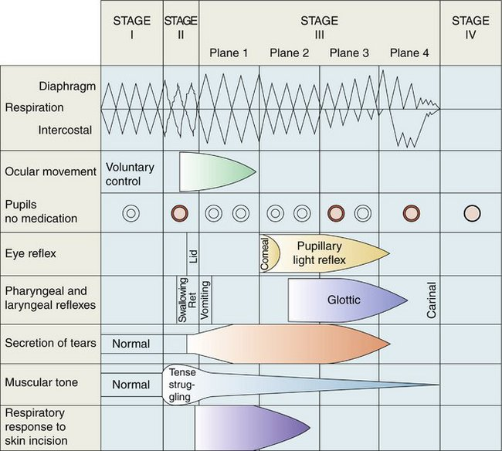

Slide 22
Nitrous Oxide
Nitrous oxide (N 2 O; laughing gas) is colorless and essentially odorless. Although non explosive and non lnflammable, nitrous oxide is as capable as oxygen of supporting combustion. Unlike the potent volatile agents, nitrous oxide is a gas at room temperature and ambient pressure. It can be kept as a liquid under pressure because its critical temperature lies above room temperature. Nitrous oxide is a relatively inexpensive anesthetic. However, concerns regarding its safety have led to continued interest in alternatives such as xenon (Less potent and expensive). Nitrous oxide, like xenon, is an NMDA receptor antagonist.

Slide 23
Nitrous Oxide
A. Cardiovascular: Nitrous oxide has a tendency to stimulate the sympathetic nervous system. Arterial blood pressure, cardiac output, and heart rate are essentially unchanged or slightly elevated in vivo because of its stimulation of catecholamines.
B. Respiratory: Nitrous oxide increases respiratory rate (tachypnea) and decreases tidal volume as a result of CNS stimulation and, perhaps, activation of pulmonary stretch receptors.
C. Cerebral: By increasing CBF and cerebral blood volume, nitrous oxide produces a mild elevation of intracranial pressure.
D. Neuromuscular: In contrast to other inhalation agents, nitrous oxide does not provide significant muscle relaxation. In fact, at high concentrations in hyperbaric chambers, nitrous oxide causes skeletal muscle rigidity.
E. Renal and Hepatic blood flow decreases.
F. Gastrointestinal: Use of nitrous oxide in adults increases the risk of postoperative nausea and vomiting, presumably as a result of activation of the chemoreceptor trigger zone and the vomiting center in the medulla.

Slide 24
Adverse effects: Almost all nitrous oxide is eliminated by exhalation. A small amount diff uses out through the skin.
Prolonged exposure can result in bone marrow depression (megaloblastic anemia) and even neurological deficiencies (peripheral neuropathies).
Because of possible teratogenic effects, nitrous oxide is oft en avoided in pregnant patients who are not yet in the third trimester.
Although nitrous oxide is insoluble in comparison with other inhalation agents, it is 35 times more soluble than nitrogen in blood. Thus, it tends to diffuse into air-containing cavities more rapidly than nitrogen is absorbed by the bloodstream.
Examples of conditions in which nitrous oxide might be hazardous include venous or arterial air embolism, pneumothorax, acute intestinal obstruction with bowel distention, intracranial air (pneumocephalus following dural closure or pneumoencephalography), pulmonary air cysts, intraocular air bubbles, and tympanic membrane grafting

Slide 25
Halothane
Halothane is a halogenated alkane, nonflammable and non explosive nature, Thymol preservative and amber-colored bottles retard spontaneous oxidative decomposition.
A. Cardiovascular: Dose-dependent reduction of arterial blood pressure is due to direct myocardial depression. Slowing of sinoatrial node conduction may result in a junctional rhythm or bradycardia.
B. Respiratory Halothane typically causes rapid, shallow breathing. Halothane is considered a potent bronchodilator, as it oft en reverses asthma-induced bronchospasm.
C. Cerebral: By dilating cerebral vessels, halothane lowers cerebral vascular resistance and increases CBF. Concomitant rises in intracranial pressure can be prevented by establishing hyperventilation prior to administration of halothane.

Slide 26
D. Neuromuscular: Halothane relaxes skeletal muscle and potentiates nondepolarizing neuromuscular-blocking agents (NMBA).
E. Renal: Halothane reduces renal blood flow, glomerular filtration rate, and urinary output.
F. Hepatic: Halothane causes hepatic blood flow to decrease in proportion to the depression of cardiac output. Hepatic artery vasospasm has been reported during halothane anesthesia. It may cause hepatic dysfunction to the patients with pre existing hepatic pathologies.
Halothane, like all inhalational anesthetics, should be used with care in patients with intracranial mass lesions because of the possibility of intracranial hypertension, hepatic pathologies, hypotension, LVF.

Slide 27
ISOFLURANE
Isoflurane is a nonflammable volatile anesthetic with a pungent ethereal odor.
Cardiovascular: It causes minimal left ventricular depression in vivo. Rapid increases in isoflurane concentration lead to transient increases in heart rate, arterial blood pressure, and plasma levels of norepinephrine.
Respiratory: Respiratory depression during isoflurane anesthesia resembles that of other volatile anesthetics, except that tachypnea is less pronounced. Despite a tendency to irritate upper airway reflexes, isoflurane is considered a good bronchodilator, but may not be as potent a bronchodilator as halothane.
Cerebral: It increases CBF and intracranial pressure.
Neuromuscular: It relaxes skeletal muscle.
Renal: It decreases renal blood flow, glomerular filtration rate, and urinary output.
Hepatic: Total hepatic blood flow (hepatic artery and portal vein flow) may be reduced during isoflurane anesthesia.

Slide 28
DESFLURANE
The structure of desflurane is very similar to that of isoflurane. Special desflurane vaporizer needed for induction. The low solubility of desflurane in blood and body tissues causes a very rapid induction and emergence of anesthesia. Wakeup times are approximately 50% less than those observed following isoflurane.
Cardiovascular: The cardiovascular effects of desflurane seem to be similar to those of isoflurane.
Respiratory: It causes a decrease in tidal volume and an increase in respiratory rate. Pungency and airway irritation during desflurane induction can be manifested by salivation, breath-holding, coughing, and laryngospasm.
Cerebral: Like the other volatile anesthetics, It directly vasodialates the cerebral vasculature, increasing CBF, cerebral blood volume, and intracranial pressure at normotension and normocapnia.
Neuromuscular, Renal and Hepatic effects are same as Isoflurane.
Contraindications: Malignant hyperthermia, Hypovolemia, Intracranial hypertension.

Slide 29
SEVOFLURANE
Like desflurane, sevoflurane is halogenated with fluorine. It’s solubility in blood is slightly greater than desflurane. Nonpungency and rapid increases in alveolar anesthetic concentration make it an excellent choice for smooth and rapid inhalation inductions in pediatric and adult patients.
A. Cardiovascular: It mildly depresses myocardial contractility.
B. Respiratory: It depresses respiration and reverses bronchospasm to an extent similar to that of Isoflurane.
C. Cerebral: It causes slight increases in CBF and intracranial pressure at normocarbia.
D. Neuromuscular: It produces adequate muscle relaxation for intubation of children.
E. Renal: It slightly decreases renal blood flow.
F. Hepatic: It decreases portal vein blood flow, but increases hepatic artery blood flow, thereby maintaining total hepatic blood flow and oxygen delivery.
Contraindications include severe hypovolemia, susceptibility to malignant hyperthermia, and intracranial hypertension.

Slide 30
Xenon
Xenon is a “noble” gas that has long been known to have anesthetic properties. It is an inert element that does not form chemical bonds. Xenon is scavenged from the atmosphere through a costly distillation process. It is an odorless, nonexplosive, naturally occurring gas.
Xenon’s anesthetic effects seem to be mediated by NMDA inhibition by competing with glycine at the glycine binding site. Xenon seems to have little effect on cardiovascular, hepatic, or renal systems and has been found to be protective against neuronal ischemia. Under Clinical trials.
Cost and limited availability have prevented its widespread use.

Slide 32
INTRAVENOUS ANAESTHETIC AGENTS
Intravenously administered anaesthetic agents are more popular for induction of anaesthesia because it is more rapid and smooth than that associated with inhalational agents. They can also be, used for maintenance of anaesthesia, sedation during regional anaesthesia, sedation in the ICU and treatment of status epilepticus.
INTRAVENOUS ANAESTHETICS
Rapidly-acting: Thiopentone, Propofol, Etomidate
Slower-acting: Ketamine, High dose opioids, Benzodiazepines

Slide 33
THIOPENTONE SODIUM
It is an ultra-short acting barbiturate, available as a yellowish powder. It is used as a 2.5% solution (25 mg/ml).
It is used in a dose of 4-5 mg/kg intravenously.
CNS: Generalised depression of the CNS is observed within 15 to 20 s of IV injection. Loss of eyelash reflex is used as an end-point. It is a potent anticonvulsant.
It is not an analgesic. To the contrary, 1t increases pain sensation (antanalgesic). Consciousness is regained within 5 to 10 minutes.
CVS: It produces myocardial depression, peripheral vasodilatation and hypotension especially when large doses are administered rapidly. Profound hypotension may occur, especially in a patient with hypovolaemia or cardiac disease. lt may induce tachycardia.

Slide 34
RS: It reduces respiratory drive. A short period of apnoea is common. It can precipitate asthma in susceptible individuals.
Skeletal muscle: There is poor muscle relaxation with thiopentone.
Eye: It reduces intraocular pressure. The corneal, eyelash and eyelid reflexes are abolished.
Side effects: Hypotension, tachycardia, Respiratory depression, Irritant to veins and can cause thrombophlebitis. If it extravasates, can cause tissue necrosis.
Intra-arterial injection: Usually inadvertent, can cause severe arterial spasm and pain.
Contraindications: Airway obstruction, Acute intermittent porphyria, Previous hypersensitivity reaction, Hypovolaemia, Asthma

Slide 35
PROPOFOL
It is comparable to thiopentone but is five times more expensive. It is highly lipid soluble and is formulated in a white, aqueous emulsion containing soy bean oil and egg phosphatide.
It is used in a dose of 2 to 2.5 mg/kg intravenously.
CNS: Propofol depresses the central nervous system within 20 to 40 s of injection. Loss of verbal contact is used as an endpoint. Recovery is rapid and there is a minimal "hang-over" effect even in the immediate post-anaesthetic period.
CVS: The arterial pressure decreases more than with thiopentone. This is due to peripheral vasodilatation. The degree of hypotension can be reduced by slowing the rate of administration. Heart rate increases slightly.

Slide 36
RS: After induction, apnoea occurs commonly and for a longer duration than with thiopentone. It causes ventilatory depression, particularly with opioids. It has no effect on bronchial muscle tone.
GIT, uterus and placenta: Propofol has no effect on Gl motility but causes mild transient decrease in hepatorenal function.
Uses: As an induction agent, As an infusion, can be used to provide total intravenous anaesthesia, To provide conscious sedation, As continuous infusion to sedate patients in the ICU, since its half-life is very short.
Adverse effects: Cardiovascular depression, Respiratory depression, Pain on injection, Allergic reactions.

Slide 37
ETOMIDATE
Etomidate is a rapidly acting intravenous anaesthetic agent with a short duration of action of 3-5 minutes.
It is a very cardiostable agent and is used to induce anaesthesia in cardiac patients and in haemodynamically unstable patients.
Continuous infusions are not advisable as it is known to depress synthesis of cortisol by the adrenal gland and impair response to ACTH.
It is used in a dose of 0.2-0.3 mg/kg IV.
Adverse effects 1. Suppression of synthesis of cortisol with infusions. 2. Excitatory phenomena: Involuntary movements, cough 3. Pain on injection and venous thrombosis 4. Nausea and vomiting

Slide 38
KETAMINE HYDROCHLORIDE
Ketamine produces dissociative anaesthesia, rather than generalised depression of the central nervous system.
It is used in a dose of 1-2 mg/kg IV or 4-5 mg/kg IM.
CNS: It induces anaesthesia within 30-60 s of intravenous injection and lasts for l0-20 mins. It is effective within 3--4 mins of intramuscular injection and lasts for 15-25 mins.
It produces anaesthesia by dissociating the cerebral cortex from the limbic system. It is a potent analgesic. It increases cerebral blood flow and intracranial pressure.
CVS: The heart rate, blood pressure and cardiac output increase.
RS: Respiration is usually well-maintained with ketamine although transient apnoea may occur occasionally. Ketamine is a good bronchodilator.

Slide 39
Skeletal muscle: There is increased muscle tone. Some spontaneous and involuntary movements may occur.
GIT: Increased salivation can occur and can be prevented by using anticholinergic agents.
Eye: lntraocular pressure increases.
Uterus and placenta: It readily crosses the placental barrier and hence should be given in lower doses in pregnant patients.
Adverse effects: Emergence delirium, Hypertension and tachycardia, Increased intracranial pressure, Vivid and unpleasant hallucinations are known with ketamine and can be prevented by prior injections of benzodiazepines.
Uses: Patients in severe hypotension, shock, Paediatric anaesthesia, Analgesia and sedation, Bronchial asthma, Difficult locations: Accident sites, war casualties.

Slide 41
LOCAL ANAESTHETICS
Local anaesthetics are drugs when injected around the nerves block impulse conduction distal to the site of injection and produce analgesia and anaesthesia in that area.
Classification:
Local anaesthetics consist of a hydrophilic tertiary amine group linked to a lipophilic aromatic group. They are classified into two main categories based on this linking group:
Aminoesters: Procaine, chloroprocaine, tetracaine
Aminoamides: Lignocaine, bupivacaine, ropivacaine.
Local anaesthetics produce sodium channel blockade. They block the fast sodium channels and the sodium influx, thus blocking all impulse transmission across the membrane.

Slide 42
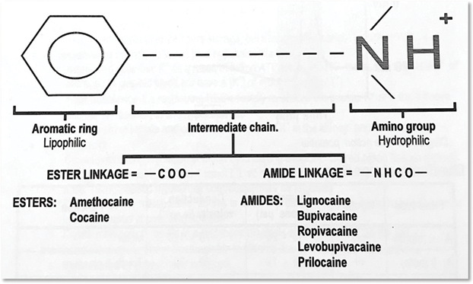
Classification
Amide type Ester type
Long acting Long acting
Bupivacaine Tetracaine (methocaine)
Levo-Bupivacaine Intermediate acting
Ropivacaine Cocaine
Dibucaine
Intermediate acting Short acting
Lidocaine Procaine
(lignocaine) Chloroprocaine
Mepivacaine Benzocaine
Prilocaine Proparacaine
Articaine

Slide 43
Factors influencing activity:
Lipid solubility: Higher the lipid solubility, higher is its ability to penetrate the lipoprotein membrane and hence greater is its potency.
pKa: The pKa of a drug is the pH at which the ionised and nonionisec portions of the drug are equal. The lower the pKa, lower is the, degree of ionisation for any given pH. The non ionised portion is lipophilic and crosses the cell membrane more easily hastening the onset of nerve blockade. For example, lignocaine has a pKa of 7.9 and acts faster than bupivacaine with a pKa: of 8.1.
pH: Acidosis decreases the proportion of the nonionised drug and reduces the amount of drug able to cross the membrane. That is why local anaesthetics do not work optimally when injected into an infected tissue (pH is acidic in these tissues).
Protein binding: The greater the degree of protein (membrane proteins) binding. longer is the duration of action.

Slide 44
Choice of local Anaesthetic agents:
Lignocaine:
Skin infiltration -0.5-1% ,
Minor nerve block- 1%,
Epidural- 1.5-2%,
Spinal anaesthesia-5% hyperbaric (heavy)
Two topical preparations: 2% lignocaine jelly and 4% lignocaine spray for the mucosal surfaces of the body. (l % means each ml contains IO mg of the drug, 2% to 20 mg/ml, and so on).
2) Bupivacaine:
Skin infiltration, epidural- 0.25%, 0.5%,
Spinal anaesthesia- 0.5% hyperbaric (heavy).
3) Ropivacaine: As: 0.2% for providing postoperative analgesia, labour analgesia and
As: 0.75% for spinal and epidural anaesthesia and nerve blocks.

Slide 45
Maximum recommended doses of local anaesthetics for infiltration and blocks:
Lignocaine- 5 mg/kg
Lignocaine with adrenaline- 7 mg/kg
Bupivacaine- 2.5 mg/kg
Ropivacaine- 5 mg/kg, not to exceed 200 mg for minor nerve blocks.
Lignocaine (preservative free) when used as an antiarrhythmic agent is given IV, in a dose of 1-2 mg/kg
Adrenaline containing preparations should not be used for nerve blocks of fingers, toes and penis as it can cause ischaemia. Bupivacaine and preservative-containing lignocaine are not for intravenous use.
The toxicity: of local anaesthetics is dose-dependent. These drugs always produce central nervous system (CNS) toxicity first. As the plasma level rises, cardiovascular toxicity and collapse occur.

Slide 46
The plasma levels of lignocaine required to produce cardiovascular collapse (CVS toxicity) is seven times that required to produce convulsions (CNS toxicity). Bupivacaine requires only three times the plasma level to produce cardiac toxicity as for CNS toxicity. Thus, bupivacaine has a greater potential for cardiotoxicity.
The likelihood of toxicity of local anaesthetics depends on several factors:
Amount of drug injected
Site of injection-vascularity
Addition of vasoconstrictors
Rapidity of injection
Nature of drug given
Presence of associated conditions such as low cardiac output or renal failure.

Slide 47
Systemic actions
C.N.S
Stimulation followed by depression.
Symptoms of overdose with clinically used LAs are-
Circumoral numbness, Abnormal sensation in the tongue, Dizziness, blurred vision, tinnitus followed by Drowsiness, dysphoria and lethargy. Still higher doses produce excitation, restlessness, agitation, muscle twitching , seizures and finally unconsciousness.
Heart
No significant effects at conventional doses.
High doses- LAs are cardiac depressants.
Decrease automaticity, excitability, contractility, conductivity and prolong ERP (Effective refractory period).
Quinidine like antiarrhythmic action.
Procainamide is a class IA antiarrhythmic.
QTc interval is prolonged and LAs can induce cardiac arrhythmias
Bupivacaine is relatively more cardiotoxic
Lidocaine used as an antiarrhythmic.

Slide 48
Blood vessels
BP due to sympathetic blockade
High cone locally- direct relaxation of arterial Smooth muscle.
Bupivacaine > Lidocaine > prilocaine
Toxic doses of LAs- cardiovascular collapse.
Cocaine has sympathomimetic property.
Sympathetic tone, causes local vasoconstriction , marked rise in BP and tachycardia
Pharmacokinetics
Ester/amide bond in LA governs its metabolism & ability to cause hypersensitivity reactions.
Ester LA are hydrolysed by plasma esterases & liver esterases.
Spinal fluids contain negligible esterases .
Amide LA are degraded by hepatic microsomes by N-dealkylation & hydrolysis.
Hypersensitivity more common with ester Las.
First pass metabolism is significant for both procaine & lidocaine, not used orally in arrhythmias

Slide 49
Adverse effects
CNS
Low Doses - Tongue numbness – Sleepiness - Mild headache - Visual & auditory disturbances
High doses
- Nystagmus & muscle twitching. – Convulsions - Cocaine- long lasting CNS stimulation & euphoria.
Allergic reactions
Ester LA are metabolized to PABA derivatives
Responsible for allergic reactions.
1. Rashes,
2. Angioedema ,
3. Dermatitis,
4. Contact sensitization ,
5. Asthma and
6. Rarely anaphylaxis occur.
Methylparaben added as preservative in certain LA solutions is responsible for allergic reaction
CVS
Bradycardia, Hypotension, Cardiac arrhythmias and Vascular collapse
Blood
Orthotoludine - metabolite of prilocaine, Oxidises Hb to metHb, 1'levels cause cyanosis , Rx- reducing agents like methylene blue or ascorbic acid LV to convert metHb to Hb.

Slide 61
