Slide 1
Smt. Vimladevi ayurvedic medical college and hospital. Wandhari, chandrapur
Subject:- Dravyaguna
Topic :- Brahmi
Guided by:- Dr. Sandip kamble
Dr. Vinod ganure

Slide 2
Introduction
Morphology
Attributes
Action and uses
Kalpa and dose
Chemical composition
Modern research
CONTENT

Slide 3
Introduction
Family:- Brahmi kula (scrophulariaceae)
Latin name:- Bacopa monnieri
Synonyms:- soumya,vaidhatree, manduki etc.
Regional name:- Brahmi
Habitat:- marshy places
Upyuktanga :- leaf.

Slide 4
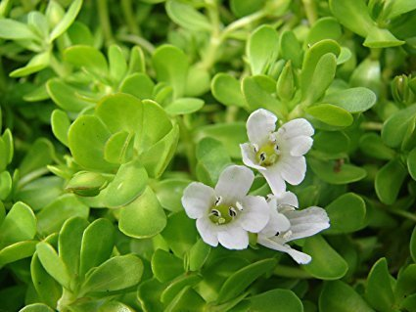
Morphology
A creeper that spreads on the ground
Leaf:- margins entire, sessile, with small black spots on it,fleshy ovate soft and smooth
Flower:- purple, whitish or pink. Five to seven leaves at each node

Slide 5
Attributes
Rasa:- Tikta, kashaya, madhura
Guna:- laghu,sara
Veerya:- sheeta
Vipaka:- madhura
Prabhava:- unmada and apasmaranashana

Slide 6
Action and uses
Doshaghnata:- vatashaman, pittashaman, kaphaghna.
Local:- leaf juice is massaged to joints in amavata
Internal :- stambhana due to kashaya and sheeta guna, used in atisara
Pranavaha:- usefull in children suffering from cough and coryza

Slide 7
Rasa- raktavaha:- acts as hridya and raktabharvardhak when given in small dose
Majjavaha:- Unmada and apasmara- it is useful to nourish the brain and nerve plexus to pacify mind. It removes mental weakness
Mootravaha:- Brahmi growing in anupadesha increases kleda and other secretions in the body and acts as diuretic
Rasayana:- increases rasadi dhatus due to its madhura rasavipaka and hence acts as rasayana

Slide 8
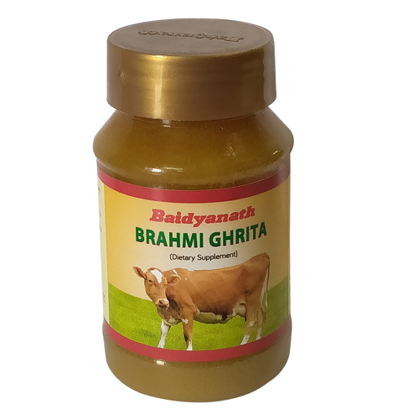
Kalpa and dose
Brahmiprasha
Sarasvatarishta
Brahmigrhta
Brahmi siddha taila
Dose:-
Swaras :- 5 to 10 ml
Choorna :- 0.23 gm to 1gm

Slide 9
Chemical composition
Modern reserch
Alkaloid brahmin
Butylinic acid
Sistesterol
Mannitol
Sigmesterol
Saponine etc.
Shows hypotensive action
Signs of anxiety and neurosis were reduced
Reduced levels of acetyl choline and catecholamines in whole brain tissue

Slide 10
Thank YOU

