Slide 1
VISCERA PRESERVATION
GUIDED BY –DR. AKHILESH DESHMUKH SIR

Slide 2
Viscera may be preserved for
a) In Living :
In case of poisoning – stomach wash, blood, urine, faeces and vomitus are sent for chemical analysis.
b) In Dead Body:
i) For chemical analysis.
ii) In cases of drowning for diatom examination.
iii) Culture and sensitivity in cases of suspected septicemia (especially of spleen).
iv) For suspected virus tissue preserved in 50% glycerine.
v) Viscera preserved in formaline, for histopathological examination, in case of doubtful cause of death.
vi) For enzyme studies Tissue collected in flask containing liquid nitrogen.
vii) For DNA finger printing - The sample is frozen and sent.
VISCERA PRESERVATION

Slide 3
Circumstances of Preservation
1) When the medical officer suspects the presence of poison by its smell or by some other evidence while conducting autopsy.
2) When the cause of death could not be found out after a full autopsy and there is no natural disease or injury
3) In decomposed bodies
4) In Spot death in burns
5) When an investigating officer requests so
VISCERA PRESERVATION

Slide 4
Routine viscera preservation
Since in majority of the cases, the poison is ingested and passes through stomach and intestines, is metabolised in liver and spleen and is excreted by kidneys in urine, the following is the viscera routinely preserved in cases of poisoning.
VISCERA PRESERVATION

Slide 5
Routine viscera preserved :
a) Stomach - whole of it.
b) Stomach contents - 100 - 200 ml.
c) Small intestine - about 1 metre.
d) Intestinal contents about 100 ml.
e) Liver with gall bladder about 1/3rd (about 500 gms) in adults and 1/2 in children.
f) Spleen half in adults and full in children.
g) Kidneys: half of each kidney in adults and both the kidneys in children.(Half of each kidney has to be preserved and it cannot be replaced by preserving one full kidney since a kidney may be absent or non functional.)
h) Blood about 100 ml.
i) Urine: 100-200 ml. ( not commonly preserved).
j) Gall bladder should be preserved since majority of the drugs can be detected in it.
VISCERA PRESERVATION

Slide 6
Additional viscera preserved
Depending upon the specific site of action these organs are preserved as additional viscera
a) Injectable poison and in snake bite : The skin and muscles from around the site of injection are preserved.
b) In cases of criminal abortion : uterus, cervix, bladder and rectum are collected.
c) In alcohol poisoning blood, CSF, lungs and brain.
d) In gaseous poisons : lungs and brain.
e) In cerebral poisons: eg. opium. Barbiturates-brain.
f) In strychnine poisoning: spinal cord and brain.
g) In cardiac poisons - heart.
h) In heavy metal poisoning: e.g. Arsenic lead, copper, mercury, antimony. bone, bone marrow, nails and hair.
VISCERA PRESERVATION

Slide 7
Collection of viscera
BLOOD:
In cases of poisoning - blood from peripheral vein or heart or abdominal cavity
In cases of alcohol poisoning- blood should not be taken from thoracic or abdominal cavities since due to seepage of alcohol from stomach, the value will be more.
For blood grouping-if no preservative is available then collect blood on filter paper and dry it.
VISCERA PRESERVATION

Slide 8
Collection of viscera
CSF: As much as possible, CSF is collected by:
Cisternal puncture or
Aspiration by a pipette from base of the brain.
URINE: preferably a catheter sample is taken.
BONE: 200-300gms, shaft of the femur 10-15cm.
BONE MARROW: from sternum or femur.
HAIR: about 10 gms plucked from head and pubic area (not cut)
NAILS: all the 20 complete nails pulled out.
SKIN AND MUSCLE: about 1 inch square of skin and muscle, upto about 2 inches depth.
All additional viscera are preserved in saturated salt solution in separate bottles.
VISCERA PRESERVATION

Slide 9
Packing of viscera
The viscera collected is packed in wide mouthed glass bottles
Bottle No 1: Stomach, intestine and their contents.
Bottle No 2: Part of liver, spleen and each kidney.
Bottle No 3: Blood
Any additional viscera collected is put in separate bottles.
VISCERA PRESERVATION

Slide 10
Preservative use for preservation
Ideally there should be no delay between the collection of specimens and their analysis in the laboratory
If the delay is short, refrigerated storage may be sufficient to preserve the samples . But the transportation of the viscera to the forensic science laboratory and their examination at the end would naturally take some time. To protect from putrefaction to set in and render chemical analysis difficult, certain preservatives should be used.
VISCERA PRESERVATION

Slide 11
Viscera :
a) In all cases of poisoning, excluding acid poisoning, but including carbolic acid poisoning = Saturated salt solution.
b) In all cases of acid poisoning, excluding carbolic acid
= Rectified spirit.
c) Additional viscera is preserved in saturated salt solution
Urine : (100-200ml) Saturated salt solution or rectified spirit or Sodium citrate or Sodium benzoate.
VISCERA PRESERVATION

Slide 12
Blood:
a) For grouping (2-3 ml) = 2 -3 ml of 0.5% sodium citrate containing 0.25% formalin.
b) In all cases of poisoning, including alcohol, but excluding carbon monoxide, fluoride and oxalic acid (10ml) = 30mg of Potassium oxalate (anticoagulant) and 10mg of Sodium fluoride (enzyme inhibitor).
c) In CO poisoning (10ml) = A layer of liquid paraffin.
d) In Fluoride and Oxalic acid poisoning (10ml) = 30mg Sodium citrate or 3 ml Heparin.
VISCERA PRESERVATION

Slide 13
Precautions
The important precautions in collection and despatch of viscera are:
1) All the viscera should be properly preserved.
2) There should be no chances of viscera being tampered during transport.
3) Never put viscera of two bodies in the same box.
VISCERA PRESERVATION

Slide 14
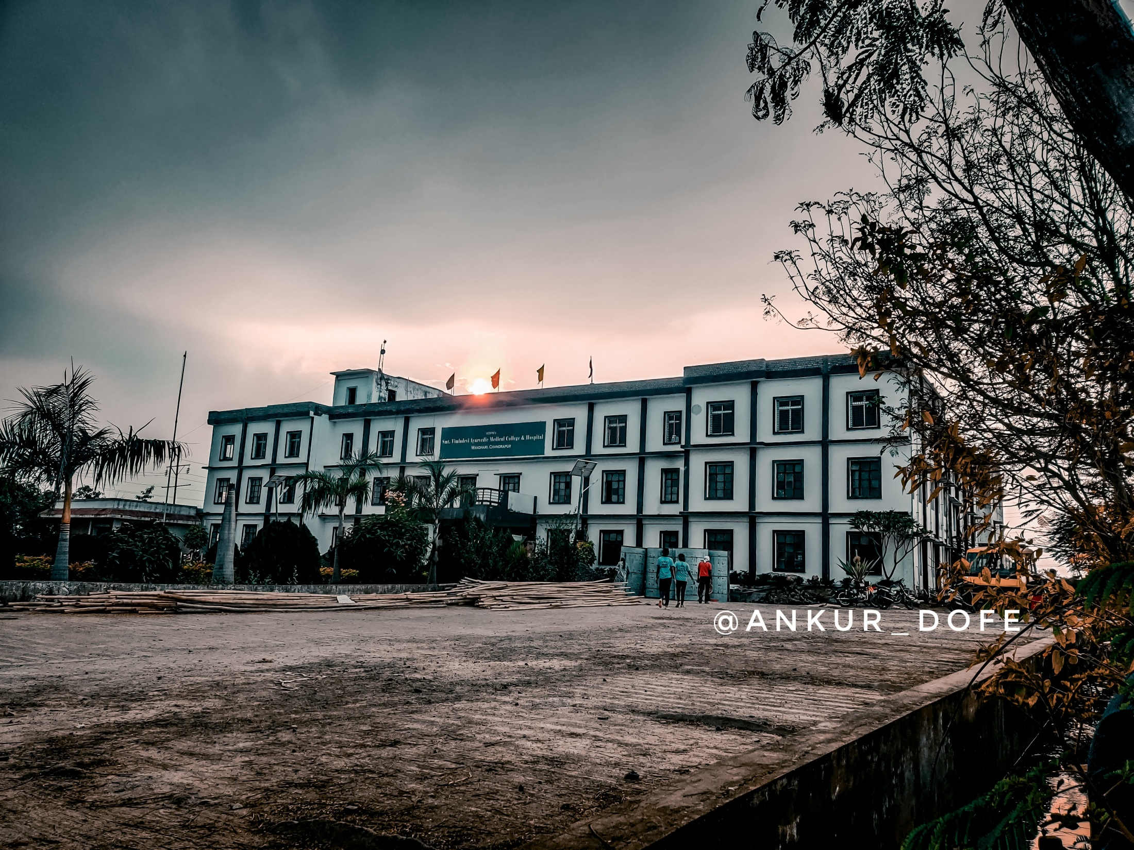
Aditya Diliprao Mehetre
BAMS 3RD YEAR
ROLL NO 38
Thank you!
VISCERA PRESERVATION

