Slide 1
THE cns EXAMINATION
Dr. Kiran Nandeshwar

Slide 2
GENERAL EXAMINATION IN CNS
ATTITUDE AND POSTURE OF THE PATIENT
SHAPE OF HEAD
BRACHYCEPHALY
DOLICHOCEPHLY
PLAGIOCEPHALY
FACIAL DYSMORPHIC FEATURES
ANTERIOR FRONTANELL
POSTERIOR FRONTANELL
CRANIOTABES
MACEWAN’S SIGN
TRANSILLUMINATION OF SKULL
VITAL PARAMETER

Slide 3
HIGHER FUNCTION
LEVEL OF CONSCIOUSNESS
Normal
Drowsy
Stupor
Delirium
Coma
INTELEGIENCE AND MEMORY
OERIENTATION OF TIME,PLACE AND PERSON
DELUSION AND HALLUCINATION
SPEECH
Aphasia and dysarthria

Slide 4
GLASGOW COMA SCALE
Eye opining (E) | Verbal response (V) | Motor response (M)
4. Spontaneous | 5. Oriented | 6. Follows command
3. To call | 4. Confuse | 5. Localises pain
2. To pain | 3. Inappropriate word | 4. Withdraws pain
1. None | 2.Non specific sound | 3. Flexion to pain
 | 1. None | 2. Extension to pain
 |  | 1. None
Total maximum score possible:- E + V + M = 15
Minimum score is 3, not zero

Slide 5
CRANIAL NERVES EXAMINATION

Slide 6
CRANIAL NERVE EXAM
I - OLFACTORY
DON’T USE A NOXIOUS STIMULUS
COFFEE, LEMON EXTRACT
II - OPTIC
VISUAL ACUITY
VISUAL FIELDS
FUNDOSCOPIC EXAM
COLOUR VISION

Slide 7
CRANIAL NERVE EXAM
III/IV/VI OCULMOTOR, TROCHLEAR, ABDUCENS
PUPILLARY RESPONSE
EYE MOVEMENTS
9 CARDINAL POSITIONS
OBSERVE LIDS FOR PTOSIS
V - TRIGEMINAL
MOTOR - JAW STRENGTH
SENS - ALL 3 DIVISIONS

Slide 8
CRANIAL NERVES
VII - FACIAL
OBSERVE FOR FACIAL ASYMMETRY
FOREHEAD WRINKLING, EYELID CLOSURE, WHISTLE/PUCKER
VIII - VESTIBULAR
ACUITY
RINNE, WEBER

Slide 9
CRANIAL NERVES
IX/X - GLOSSOPHARYNGEAL, VAGUS
GAG REFLEX
XI - SPINAL ACCESSORY
STERNOCLEIDOMASTOID M.
TRAPEZIUS MUSCLE
XII - HYPOGLOSSAL
TONGUE STRENGTH
TONGUE MOVEMENT

Slide 10
MOTOR SYSTEM EXAMINATION

Slide 11
MUSCLE POWER
GRADING
GRADED 0 - 5
0 - NO MOVEMENT
1 - FLICKER
2 - MOVEMENT WITH GRAVITY REMOVED
3 - MOVEMENT AGAINST GRAVITY
4 - MOVEMENT AGAINST RESISTANCE
5 - NORMAL STRENGTH

Slide 12
1) POSTURE OF THE LIMBS:-
The child may adopt a particular posture due to change in the muscle tone
2) NUTRITION OF MUSCLE :-
Assess whether the muscles are normal atrophied or hypertrophied
3) INVOLUNTARY MOMENTS:-
Tremors
chorea
Athetosis
Dystonia
Hemibaliismus
Myclonus
Tics

Slide 13
4) TONE OF MUSCLE:-
Test to assess tone of muscle
Tests | Normal | Hypotonia | Hypertonia
Palpation of muscle | Normal | Flabby | Rigid
Posture of limb | Normal | Limp | Stiff
Resistance to passive moments | Normal | Decreased | Increased
Range of passive moments | Normal | Increased | Decreased
In Infant tone is assess by following tests:-
Scarf sign, Heel to Ear manoeuvre, popliteal angle

Slide 14
Co-ordination
Gait of the patient
Finger nose test
Knee heel test
Rhomberg’s test-
positive in cerebeller lesion
Co-ordination can be tested only in children above 6-7 yrs when the muscle power is greater than 3

Slide 15
REFLEXES

Slide 16
Superficial reflexes
Test to asses
Superficial reflexes | Mothod of elicitation | Response
1. Planter reflex | Stroke the lateral border of the sole of the foot from heel to toes. | Normal response is planter flexion of all the toes
2. Abdominal reflex | Stoke the skin of abdomen from the lateral end towards the midline | Contraction of abdominal muscle of same side
3. Cremasteric reflex | Stroke the skin of medial side of thigh from above to downwords | Contraction of cremasteric muscle and elevation of testicle
4.Anal reflex | Stoke the skin in the perianal region | Contraction of the anal sphincter.

Slide 17
Deep tendon reflexes
Reflexes | Elicitation | Responce
Bicep | Tap the bicep tendon after partial flexion and pronation of the elbow | Flexion of the elbow and visible contraction of the biceps muscle
Tricep | Tap the tricep tendon just above the elbow after flexion | Extension of the elbow and visible contraction of the tricep muscle
Supinator | Tap the bracheoradialis tendon at the lower end of radius | Flexion and pronation of elbow and V.C. of the bracheoradialis muscle
Knee jerk | Tap the quadriceps tendon just below the knee | Extension of he knees visible contra. Of the quadriceps muscle
Ankle jerk | Tap the tendoachillis after partially flexing the knee | Planter flexion of the ankle and V.C.of the gastrocnemius muscle

Slide 18
Deep tendon reflex
Grading of reflex:-
Absent reflex | 0
Sluggish reflex | 1+
Normal | 2+
Brisk | 3+
Exaggerated with clonus | 4+

Slide 19
Deep tendon reflex
Causes of absent and brisk deep tendon reflex
Absent | Brisk
LMN Lesion | UMN Lesion
Severely spastic children | Tetanus or strychnine poisoning
Contraction of muscle | Hysteria
Stage of neuronal shock | In small children

Slide 20
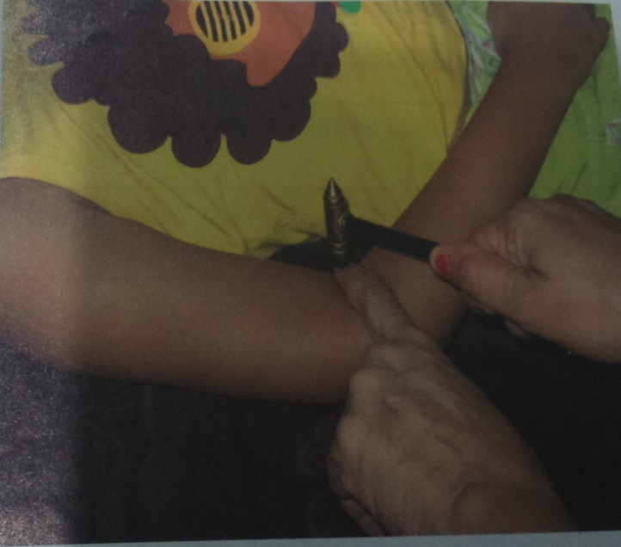
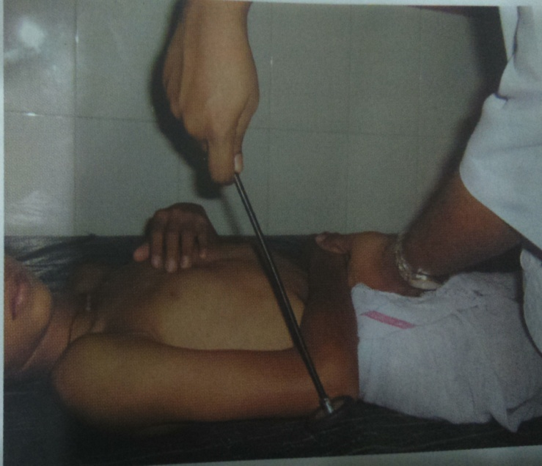
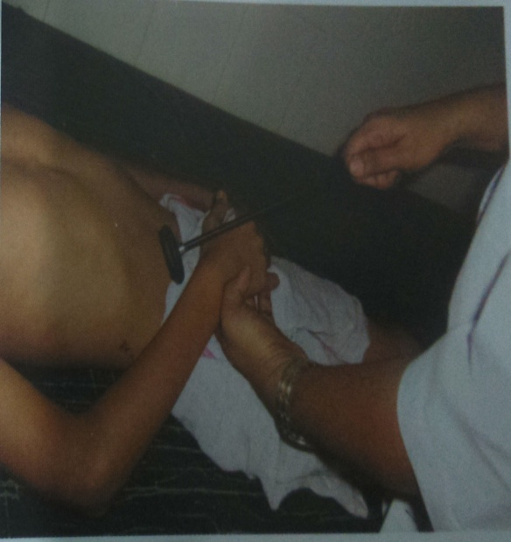

Slide 21
SENSORY system examination

Slide 22
Sensory examination
Superficial sensation
Touch
Pain
Temp
Deep sensation
Vibration
Position
Cortical sensation
tactile localisation
Tactile discrimination
steriognosis

Slide 23
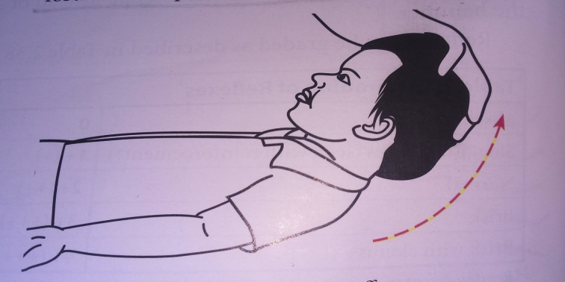
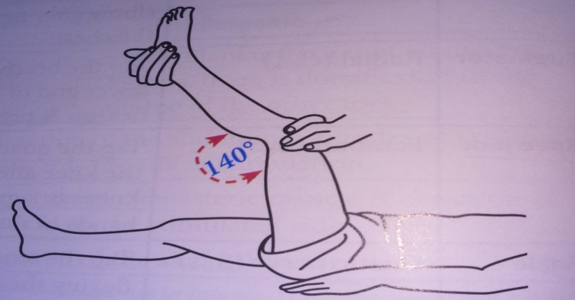
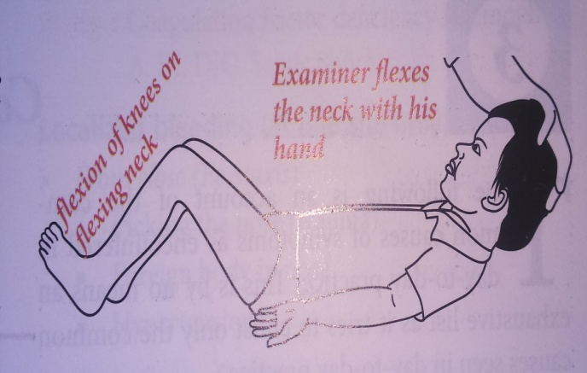
Signs of meningeal irritation
Neck stiffness
Kerning’s sign
Brudzinski’s sign

Slide 24
Thank you

