Slide 1
NETRA KRIYA KALPAM

Slide 5
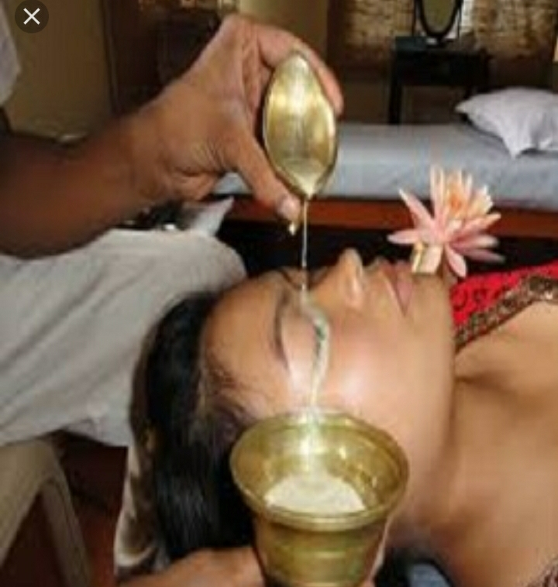
Parishek

Slide 10
Ashchotan

Slide 14
Pindika

Slide 17
Vidalak

Slide 28
Anjana salaka
Salaka should prepare with the metals are above.
e.g:- (1) for madhura rasa anjana - salaka should be prepare, with gold etc.
(2) for lekhana karma - salaka should be prepared with tamra
(3) ropana karma - salaka should be prepared with loha salaka
(4) prasadhana karma - salaka should be prepared with swarna salaka.
Anjana salaka should be 10 angula length. The two ends should be blunt
(should not sharp), like jasmine (flower), should be easy for handling, and
should not be rough, thin, hard, and breakable.

Slide 29
When anjana has to apply:-
(1) Body should be purified by siravyadha, virechana, nasya, vasthi etc.
(2) Aamavastha should be eliminated.
(3) The eye should be free from ama and should exhibit normal doshic
symptoms, then only after aschyotana anjana has to do.

Slide 30
Anjana vidhi
(1) Mangalacharana
(2) Devatha prarthana
(3) Then patient is asked to sit without fear & tension.
(4) Doctor with his left hand, has to open the eyes of the patient, and with his
right hand he has to handle anjana salaka and has to do anjana from
kaneenaka sandhi to apanga sandhi and from apanga sandhi to kaneenaka
sandhi.

Slide 31
(5) Anjana should not be more or less, hard or soft, teekshna or mridhu, quick
or delayed, if so causes injury to eyes.
(6) After anjana vidhi, by closing the eyes, eyeball should be rotated gently, eye
lids should be moved slowly - by this the medicine perfectly spreads in the
eyes.
(7) The dosha's dissolves and comes out in the state of lacrimation.
(8) The eyes should be cleaned when discharge stops.
(9) If required according to the condition prathyanjana has to give.

Slide 32
Anjana nisheda (Contraindication of anjana)
Anjana vidhi is not advisable for the following conditions or diseases like
srama, vegavarodha, udavartha, rodhana, madhyapana, krodha, bhaja jwara,
sirodosha, sirasthana, netra aakhatha, sun stroke, pipasa, vomitting, jakara,
nasya, rechana, dhoomapana.
If anjana has given in above states causes netra roga (hyperaemia), srava
(exudation), soola (pain), sotha (oedema), timira (dim vision), and difficulty in
opening and closing the eye lids.

Slide 33
Anjana yoga
(1) Choornanjana yoga :-
a) Souveera choornanjana
Heat the souveeranjana and dip in the triphala kashaya, for 6 times then 7th
time has to dip in stanya, then drug should be dried and powdered, this is
useful in most of the eye diseases.
b) Mareecha ½ part, pippali, samudra phena 1 part, saindava lavana ½ part,
sauveeranjana 1 part, togetherly powdered and used as anjana, in kaacha &
netra vikaaras.
c) Sireesha beeja, mareecha, pippali, and saindava lavana, choornanjana used
in savrana sukla.

Slide 34
(2) Souveeranjana yoga:-
a) Krishna sarpa vasa rasakriya anjana:-
Krishna sarpa vasa, sankha, nirmali phala is useful in andhatwa (blindness).
b) Gudoochi rasakriya anjana :-
Gudoochi swarasa 12g, madhu 1g, saindava lavana 1g mixed and grinded
together. It is used as anjana in arma, timira etc. netra vikara.
c) Babboola patra rasa kriyanjana - used in netra srava

Slide 35
(3) Gutika or varti anjana yoga :-
a) Karanja varti anjana :- Karanja beeja choorna bhavana in palasa pushpa
swarasa for many times, and used as the varthi anjana as in netra pushpa.
b) Samudra phenadi varti anjana:- Samudra phena, sankha, kukkudanda twak,
sigru beeja, the prapared varti anjana is used in sukra.
c) Nakthyantha nasini varti anjana
Rasanjana, haridra, daruharidra, jatipatra, nimba patra - grinded with gomaya
rasa and used as varti anjana.
Generally, lekhana anjana will be in powder form. Ropana and prasadana
anjana will be either in varti or rasakriya form.

Slide 37
VI. AKSHI TARPANA

Slide 39
Procedure of tarpana vidhi
Poorva karma :-
Kaya sodhana by vamana, virecana, vasti, raktamokshana etc. and
siro sodhana with nasya should do.
It can be given both in the morning and evenings.
Pradhana karma :-
In sadarana ritu (in normal season) either in the morning or in the
evening it should be done.

Slide 40
The place should be rajo dhooma rahitha (without dust or smoke),
prakaasavan (with bright light). Then the patient is asked to lie down (uthana
sayanam) with the paste of yava or masha, masha pali has to prepare and stick
around the eyes in 2” height, it prevents the medicine not to escape out from
eye cavity. The medicine (ghrita manda) has to melt by putting the vessel in
hot water (tapta ambu pravilapitam), the medicines has to pour in the cavity
formed by masha pali while the eyes are closed (nimeelatha netram), upto the
level of eyelashes and the patient is advised to open and close his eyelids
gradually upto specific time according to vitiation.

Slide 43
Paschat karma
1. After specific time of tarpana the medicine should be removed by doing
a perforation in mashapali at temporal side
2. The eyes should be cleaned with yava pishta
3. Ushnodaka (luke warm water) prakshalana
4. Siro virechana, and dhoomapana to save the eye from kaphaja disorders
5. Patient is advised not to see bright things

Slide 44
Samyak tarpita lakshana
1. Prakasa kshamatha (tolerance to light)
2. Swasthyam (health)
3. Vishada netram (lightness in the eyes)
4. Laghu lochana (sound sleep)
5. Swabhavika nidra (normal colour and complexion of the parts)
6. Swabhavika varna of netra anga (normal colour and complexion of the
parts)
7. Vyadhi nivaaranam (health gain)
8. Lagutva in nimeshonmeshanam ( easy in closing and opening of eyes)

Slide 45
Atitarpita lakshana
1. Gurutwa (heaviness in the eyes)
2. Avilatva (dirty collections in the eye)
3. Atisnigda (oiliness in the eyes)
4. Asru srava (epiphora)
5. Kandu (itching sensation)
6. Upadeha (sticky debris collection in the eye)
7. Kapha complication

Slide 46
Heena tarpita lakshana
1. Rookshata ( roughness)
2. Avilata (dirtiness)
3. Netrasrava (lacrimation and discharges)
4. Roga vridhi (aggravation of the disease)
5. Roopa darsana avarodha (indistinct vision)

Slide 49
Indications
By virtue of nourishment,
Visual disturbances - timira, avila darsana
Dry eye conditions - rooksha, parisushka, ativisushka
Allergic conditions - daruna, klishta vartma
Diseases of eye lids - hardened painful eyelids and damaged
eyelashes : daruna vartma and sirna
pakshma
Structural deformities - squint – jihwa (netra kutilata)
Difficulty in the movement of eyeball
and eyelids : Stabdata, krichronmeela

Slide 50
Diseases of suklamandala - Sirotpata, siraharsha, ajuna
Diseases of krishnamandala - Savrana sukla and avrana sukla
Diseases of sarva akshi - Abhishyanda, adhimanda, anyathovata,
Vataparyaya and sushkakshipaka
Diseases dominated by swelling- Sotha
Diseases due to injuries

Slide 51
Contraindications
➢ Climatic conditions : very hot, very cold, cloudy weather
➢ General weakness : during excessive stress, worries, tiredness, and
giddiness
➢ Associated with amalakshana (acute manifestation of eye diseases) like
raga, asru, soola, samramba, dooshika, and upadravas.
➢ Conditions forbidden for nasya karma : navapratisyaya, swasa and kasa
➢ Immediately after drinking : water, alcohol, poison, fatty substances or
eager to drink any one of them.
➢ Kapha dominant types of siroroga, karna roga and nasa roga

Slide 52
Ratio of the drugs
Flesh 2 pala, drava 2 pala, liquids 8 pala.
1. Snehana putapaka :- used in rooksha netra, vata vikara, the medicine has
to kept in the eyes for 200 matra kala. Two days can be given.
The medical combination is :-
Anupa mamsa, vasa majja, kakolyadi varga dravya are used. The
above medicines are grinded, bolus should be prepared and has to cover
with vata hara patra and so on. This should be heated (putapaka).
Swarasa be extracted and used like in tarpana vidhi.

Slide 53
2. Ropana putapaka :- dushti balya, vata, pitta, rakta vrana dosha hara, the
medicine is kept for 300 matra kala, upto 3 days it should be done.
Combination of medicine
Jangala mamsa, madhu, ghrita tikta dravyas, stanya, the putapaka has to
do for the perfect extraction of swarasa.

Slide 54
3. Lekhana putapaka :- it used in the vitiation of kapha dosha (atisnigdha
patients). The duration is 100 matra kala and the period is only one day.
Medicine combination
Jangala mamsa, yakrut, lekhana drugs like kantha loha bhasma, tamra
bhasma, sankha bhasma, pravala bhasma, saindhava lavana,
samudraphena, kaseesa, srothonjana, dadhi, masthu, madhu, sunti,
mareecha, pippali etc. drugs.
Medicine should be extracted by putpaka for the therapy.

Slide 55
Method
1. The specified ingredients are cleaned, cut into pieces and properly
grinded to make a smooth paste. This paste is made into a ball like
structure resembling a bilwa phala.
2. This ball is wrapped with leavesof erranda , vata, or utpala or any other
available leaves like gambhari, water lilies, banana etc.
3. It is tied properly with threads.

Slide 56
4. The outer covering is smeared with mud or clay. The thickness should be
nearly 2 inches.
5. It is thrown into fire to bake. The firewood of khadira, nirmeeli,
asmanthaka, eranda, patala, vrisha, badara or milk extruding plants are
preferred. Otherwise, burning cow dung can also be used.
For Snehana putapaka - the firewood of dhanva tree
For Lekhana putapaka - the firewood of dhanvana tree
For prasadana putapaka - cow dung fire

Slide 57
6. When this bolus becomes red hot and ingredients inside are properly
cooked, it is removed from fire. The outer mud covering is scrapped off.
The threads are cut open; the contents are squeezed by compressing.
7. This juice putapaka rasa is used for the procedure as in tarpana.
8. The medicines should be poured through kaneenaka sandhi, or in the
centre of dushti.

Slide 58
9. Lekhana putapaka is done only for one day. Snehana putapaka for two
consecutive days. Ropana putapaka for three consecutive days.
They are useful in the diseases of kapha, pitta and vata respectively.
10.Aftercare : Snehana, Swedana, and Dhoomapana
The exposure to illuminous bodies, mirror, sky and blowing wind are
avoided during this period.
Duration of the aftercare : Lekhana putapaka - 2 days
Snehana putapaka - 4 days
Ropana putapaka – 6 days

