Slide 1
PREVENTION OF OCCUPATIONAL DISEASES
Dr. Jyoti varthi
m.d. swasthavritta

Slide 2
definition
An occupational disease is any chronic ailment that occurs as a result of work or occupational activity. It is an aspect of occupational safety and health.
An occupational disease is typically identified when it is shown that it is more prevalent in a given body of workers than in the general population, or in other worker populations.

Slide 3
occupational health definition
As per World Health Organization (WHO) "occupational health deals with all aspects of health and safety in the workplace and has a strong focus on primary prevention of hazards”
Healthcare concerned with enabling an individual to undertake their occupation, in the way that causes least harm to their health.
Health has been defined as It contrasts, for example, with the promotion of health and safety at work, which is concerned with preventing harm from any incidental hazards, arising in the workplace.

Slide 4
Objectives of occupational health
(i) the maintenance and promotion of workers’ health and working capacity;
(ii) the improvement of working environment and work to become conducive to safety and health
(iii) development of work organizations and working cultures in a direction which supports health and safety at work and in doing so also promotes a positive social climate and smooth operation and may enhance productivity of the undertakings.
The concept of working culture is intended in this context to mean a reflection of the essential value systems adopted by the undertaking concerned. Such a culture is reflected in practice in the managerial systems, personnel policy, principles for participation, training policies and quality management of the undertaking."

Slide 5
field of occupational health
occupational health come from a wide range of disciplines and professions including medicine, psychology, epidemiology, physiotherapy and rehabilitation, occupational therapy, occupational medicine, human factors and ergonomics
These include how to avoid particular pre-existing conditions causing a problem in the occupation, correct posture for the work, frequency of rest breaks, preventative action that can be undertaken, and so forth.

Slide 6
Occupational health should aim at
"the promotion and maintenance of the highest degree of physical, mental and social well-being of workers in all occupations
the prevention amongst workers of departures from health caused by their working conditions;
the protection of workers in their employment from risks resulting from factors adverse to health
the placing and maintenance of the worker in an occupational environment adapted to his physiological and psychological capabilities
to summarize, the adaptation of work to man and of each man to his job.

Slide 7
occupational health and safety management system
the basis
policy,
Planning
Implementation
Operation
checking and corrective action
management review
continual improvement

Slide 8
In India
the Labour Ministry
formulates national policies on occupational safety and health in factories and docks with advice and assistance from Directorate General of Factory Advice Service and Labour Institutes (DGFASLI)
enforces its Policies through inspectorates of factories and inspectorates of dock safety.
DGFASLI is the technical arm of the Ministry of Labour & Employment, Government of India and advises the factories on various problems concerning safety, health, efficiency and well - being of the persons at work places.
The DGFASLI provides technical support in formulating rules, conducting occupational safety surveys and also for conducting occupational safety training programs

Slide 9
awareness
On April 28 The International Labour Organisation celebrates "World Day for Safety and Health"

Slide 10
types of Occupational hazards
chemical hazards,
biological hazards (biohazards)
psychosocial hazards
physical hazards.
In the United States, the National Institute for Occupational Safety and Health (NIOSH) and the Occupational Safety and Health Administration (OSHA) provide standards and guidelines to ensure worker safety against hazards in a variety of occupations

Slide 11
Chemical hazards
involve dangerous chemicals. Exposure to chemicals in the workplace can cause acute or long-term detrimental health effects.
classifications of hazardous chemicals
Neurotoxins
immune agents
dermatologic agents
Carcinogens
reproductive toxins
systemic toxins
Asthmagens
pneumoconiotic agents
and sensitizers.^{[3]}

Slide 12
Chemicals and hazards
carbon monoxide, carbon diox­ide, nitrogen dioxide, sulphur dioxide, hydrocarbons, sulphuric acid, tannic acid acetic acid, fumeric acid, ozone, limes and alkalies cause injury to the employee when they are absorbed through skin and inhaling or ingesting. Workers may suffer from respiratory diseases, skin diseases, allergy, heart disease, cancer and neurological disorders.
These diseases may be temporary or chronic in nature. Often a disease may be difficult to diagnose because either its symptoms may appear after a long dormant period or may not be apparent at all. These diseases often shorten employee s life expectancy.

Slide 13
Biological hazards
microorganisms and toxins
Those who work outdoors which include farmers, foresters, landscapers, groundskeepers, gardeners, painters, roofers, pavers, construction workers, laborers, mechanics, and any other workers who spend time outside encounter numerous biological hazards
bites and stings from insects, spiders, snakes and scorpions, contact dermatitis
blood-borne illnesses (such as HIV, hepatitis B, and hepatitis C)
Veterinary health workers, including veterinarians, are at risk for exposure to zoonotic disease
Other occupations at risk to biological hazard exposure include poultry workers, who are exposed to bacteria; and tattooists and piercers, who risk exposure to blood-borne pathogens

Slide 14
bacteria, fungi, vi­ruses, insects, dietary deficiencies, excessive drinking, allergies, brain fever, imbalances, tetanus, stresses and strains.

Slide 15
Environmental hazards
noise pollution, vibration and shocks, illumination, radiation, heat, ventilation, air and water pollution.
These hazards cause redness of eyes, genetic disorders, cancer, sterility, hearing loss, nerve injury etc., to workers.

Slide 16
Psychosocial hazards
Industrial/job stress caused by various stressors such as task and role demands, organisational leadership, lack of group cohesion, intergroup and interpersonal conflicts, life and career changes, etc., lead to emotional disturbances which, in turn, lead to fatigue and exhaustion.
All these affect health of employees. Apart from occupational hazards, there are some occupational diseases also that impair health of employees in industries.

Slide 17
occupational hazards that affect someone's social life or psychological health.
Psychosocial hazards in the workplace include occupational burnout and occupational stress, which can lead to burnout

Slide 18
Physical hazards
environmental hazards that can cause harm with or without contact.
ergonomic hazards
Radiation
heat and cold stress
vibration hazards
noise hazards

Slide 19
Pneumoconiosis
Pneumoconiosis is an occupational lung disease and a restrictive lung disease caused by the inhalation of dust, often in mines and from agriculture. ^{[2]}
In 2013 it resulted in 260,000 deaths up from 251,000 deaths in 1990. Of these deaths 46,000 were due to silicosis, 24,000 due to asbestosis and 25,000 due to coal workers pneumoconiosis.
Size of the particles
particles greater than 5 to 10 microns are unlikely to reach distal airways
particles smaller than 0.5 microns move into and out of alveoli, often without substantial deposition and injury.
Particles that are 1 to 5 microns in diameter are the most dangerous, because they get lodged at the bifurcation of the distal airways.

Slide 20
pneumoconiosis is charactorised by cough and shortness of breath.
The risk is generally higher when people have been exposed to mineral dusts in high concentrations and/or for long periods of time.
Inadequate or inconsistent use of personal protective equipment (PPE) such as respirators (specially fitted protective masks) is another risk factor since preventing dusts from being inhaled will also prevent pneumoconiosis.
a large part of the lungs gets fibrosed
oxygen may be prevented from easily reaching the blood during breathing resulting in hypoxemia (low blood oxygen levels).
Hypoxemia may only be present during activity or while sleeping.
Hypoxemia may be present all the time if pneumoconiosis is severe or progresses.
miners, sandblasters, stonemasons and foundry workers.

Slide 21
Types based on the type of dust inhaled
Coalworker's pneumoconiosis (also known as miner's lung, black lung or anthracosis) — coal, carbon
Asbestosis — asbestos
Silicosis (also known as "grinder's disease" or Potter's rot) — silica
Bauxite fibrosis — bauxite
Berylliosis — beryllium
Siderisis — iron
Byssinosis — cotton
Silicosiderosis — mixed dust containing silica and iron
Pneumoconiosis induced by ash from an erupting volcano

Slide 22
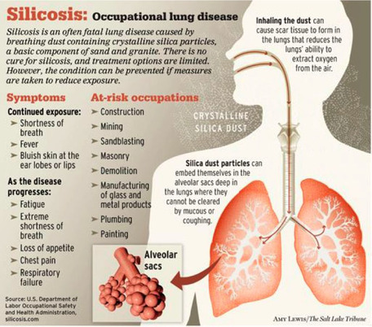

Slide 23
silicosis
Also known as miner's phthisis, grinder's asthma, potter's rot
Crystalline silica is a main component of dust from sand and rock.
Occupations exposed to silica include miners, sandblasters, stonemasons and foundry workers. Risk factors for developing silicosis include higher levels of silica exposure and longer time of exposure.
Lower levels of exposure over many years most commonly lead to "chronic simple silicosis" in which many small nodules of inflammation form in the lungs. This is the most common form of silicosis.
In a small percentage of cases, simple silicosis develops in to a more severe form of silicosis called "progressive massive fibrosis" (PMF) when many small nodules "grow" together into large masses.
In PMF, patients have more severe respiratory symptoms because the masses limit the function of normal lung. If exposure to silica is very intense over a shorter period of time, patients may

Slide 24
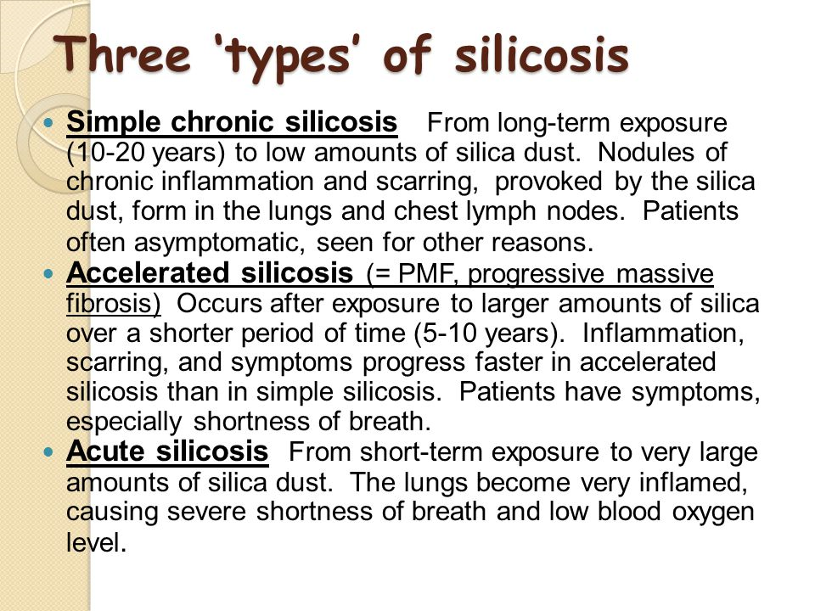

Slide 25
Dyspnoea (shortness of breath) exacerbated by exertion
Cough, often persistent and sometimes severe
Fatigue
Tachypnea (rapid breathing) which is often labored,
Loss of appetite and weight loss (Anorexia)
Chest pain
Fever
Gradual darkening of skin (blue skin), cyanosis
Gradual dark shallow rifts in nails eventually leading to cracks as protein fibers within nail beds are destroyed.
It may often be misdiagnosed as pulmonary edema (fluid in the lungs), pneumonia, or tuberculosis.
Cor pulmonale (right ventricle heart disease)
Respiratory insufficiency

Slide 26
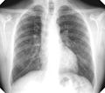


Slide 27
prevention
The best way to prevent silicosis is to identify work-place activities that produce respirable crystalline silica dust and then to eliminate or control the dust ("primary prevention").
Water spray is often used where dust emanates. Dust can also be controlled through dry air filtering.

Slide 28
anthracosis
Anthracosis (anthrac- meaning coal, carbon + -osis meaning condition)
defined in Bioline as, “the asymptomatic, milder type of pneumoconiosis as caused by the accumulation of carbon in the lungs due to repeated exposure to air pollution or inhalation of smoke or coal dust particles”
Coal dust is made of carbon-containing particles, and coal miners are at risk of inhaling this dust.
Coal miners may also be exposed to silica-containing dust because coal mining may involve some drilling into silica-containing rock.
Workers exposed to graphite dust can also develop pneumoconiosis similar to CWP.
Just like with silicosis, CWP is most commonly "simple" disease with nodules of inflammation forming in the lungs, but it can become PMF in a small percentage of patients.

Slide 29
BAF usually presents with pictures very similar to COPD with the exception of a history of cigarette smoking. Cough and dyspnea are the most frequent symptoms of BAF and anthracosis in most reports (Table 1). Association of TB does not change the chronic symptoms, but it may cause new onset weight loss or fever (25%) (58) which should be differentiated from pneumonia, which is reported to be superimposed on 30% of BAF subjects (8).
Physical examination of the lungs usually shows wheezing (7) and less frequently rales or decreased breath sounds (10). Some anthracosis subjects had normal physical examinations, but the frequency has not been mentioned in the literature.
Anthracosis may present with complications of enlarged mediastinal lymph nodes such as vocal cord paralysis (49) or broncholithiasis (59). Many of these cases were also reported in association with tuberculosis (49, 60).

Slide 30
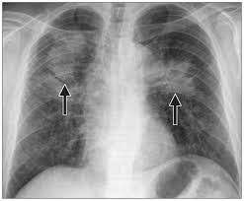
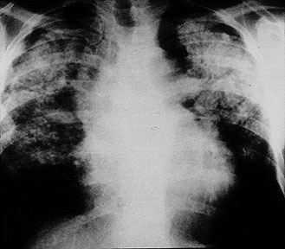
anthracosis

Slide 31
BAF usually presents with pictures very similar to COPD with the exception of a history of cigarette smoking. Cough and dyspnoea are the most frequent symptoms of BAF and anthracosis in most reports.
Association of TB does not change the chronic symptoms, but it may cause new onset weight loss or fever (25%)
which should be differentiated from pneumonia, which is reported to be superimposed on 30% of BAF subjects.
Physical examination of the lungs usually shows wheezing and less frequently rales or decreased breath sounds.
Some anthracosis subjects had normal physical examinations, but the frequency has not been mentioned in the literature.
Anthracosis may present with complications of enlarged mediastinal lymph nodes such as vocal cord paralysis or broncholithiasis. Many of these cases were also reported in association with tuberculosis.

Slide 32
berylliosis
Chronic beryllium disease (also called berylliosis) is another work-related lung disease that may be considered pneumoconiosis.
Beryllium is a very strong and lightweight metal that is used in the electronics, aerospace and nuclear power industries.
Chronic beryllium disease is caused by inhalation of airborne beryllium during its processing such as in melting or grinding it.
There are other less common mineral dusts that might also cause pneumoconiosis including cobalt, talc and aluminum oxide.

Slide 33
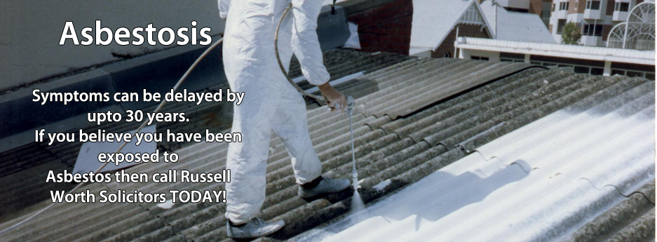
Asbestosis
Asbestosis is a chronic inflammatory and
scarring disease affecting the tissue of
the lungs.
People with the condition may experience
severe shortness of breath
at an increased risk for certain cancers,
including lung cancer rarely mesothelioma.
Asbestosis specifically refers to fibrosis
within the lung tissue from asbestos,
and not scarring around the outside of
the lungs.

Slide 34
Occupations leading to asbestosis
Ship building or repair, Dockworkers – we have had many Plymouth dockworkers successfully claim through Russell Worth for Asbestosis.
Boiler makers and insulators, Construction workers, Floor fitters, Brick layers, Floor layers, Sheet metal workers, Aerospace engineers, Lab techs, Electricians, Coal miners, Welders, Plumbers, Plasterers, Tile layers, Iron workers, Steam fitters, Car mechanics

Slide 35
symptoms
Coughing
Shortness of breath
Wheezing
Inability or reduced ability to exercise
Pain in the chest

Slide 36
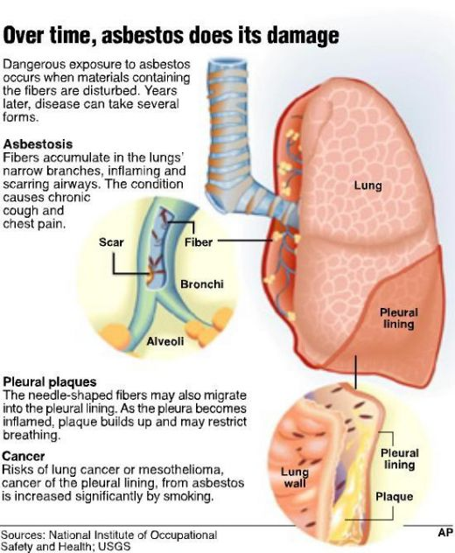

Slide 37
may hear inspiratory crackles
reduction in lung volumes, particularly the vital capacity (VC) and total lung capacity (TLC).
The TLC may be reduced through alveolar wall thickening
Large airway function, as reflected by FEV₁/FVC, is generally well preserved.
in severe cases, the drastic reduction in lung function due to the stiffening of the lungs and reduced TLC may induce right-sided heart failure (cor pulmonale).
In addition to a restrictive defect, asbestosis may produce reduction in diffusion capacity and a low amount of oxygen in the blood of the arteries.

Slide 38
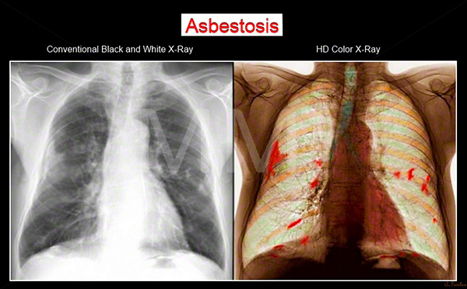

Slide 39
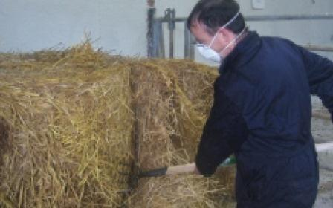
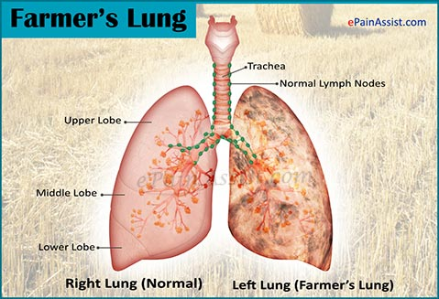
Farmer's lung
Farmer's lung is a hypersensitivity pneumonitis
induced by the inhalation of biologic dusts coming
from hay dust or mould spores or other
agricultural products

Slide 40
type III hypersensitivity inflammatory response and can progress to become a chronic condition which is considered potentially dangerous.
While inhaled allergens often provoke the creation of IgE antibodies that circulate in the bloodstream, these types of immune response are most often initiated by exposure to thermophilic actinomycetes (most commonly Saccharopolyspora rectivirgula), which generates IgG-type antibodies.
Following a subsequent exposure, IgG antibodies combine with the inhaled allergen to form immune complexes in the walls of the alveoli in the lungs.
This causes fluid, protein, and cells to accumulate in the alveolar wall which slows blood-gas interchange and compromises the function of the lung.

Slide 41
Symptoms
often spontaneously resolve within 12 hours to days if antigen exposure is eliminated or avoided.
Acute farmer's lung manifests as new onset of fever, chills, Tachycardia, non productive cough, chest tightness, dyspnoea, Rales, headache, and malaise.
If the inhalational exposure is large, patients may develop acute respiratory failure.
Subacute farmer's lung manifests as chronic non productive cough, dyspnoea, anorexia, and weight loss, Generalized fatigue. Subacute disease is insidious in onset and may occur over weeks to months.
chronic farmer's lung- Bibasilar rales, Clubbing - More often observed in patients with chronic farmer's lung with long-standing hypoxemia and parenchymal damage,Anorexia, More severe dyspnoea,Weight loss, Impaired exercise tolerance

Slide 42
bagassosis
Bagassosis is caused by a substance called bagasse which is produced when juice is taken out from sugarcane.
This substance is used for making paper. It is believed that a fungus is possibly involved in development of Bagassosis.
Shortness of breath, Cough, Coughing blood, Low grade fever
Hypersensitivity Pneumonitis caused due to inhalation of sugarcane fiber waste

Slide 43
Byssinosis, also called "brown lung disease" or "Monday fever", is an occupational lung disease caused by exposure to cotton dust in inadequately ventilated working environments.
Byssinosis commonly occurs in workers who are employed in yarn and fabric manufacture industries.
It is now thought that the cotton dust directly causes the disease and some believe that the causative agents are endotoxins that come from the cell walls of gram negative bacteria that grow on the cotton.
Although bacterial endotoxin is a likely cause, the absence of similar symptoms in workers in other industries exposed to endotoxins makes this uncertain.
Breathing difficulties, Chest tightness, Wheezing, Cough

Slide 44
Occupational cancer
caused by exposure to carcinogens in the workplace. Carcinogens are agents that cause the development or increase the incidence of cancer.
There are three different types of occupational carcinogens:
Biological carcinogens – some micro-organisms such as viruses have been known to cause cancer, either by damaging cells directly or by decreasing the body's ability to control abnormal cells, for example Hepatitis B, HIV viruses and so on.
Chemical carcinogens – a number of chemicals are known to be carcinogenic. These chemicals may occur naturally, such as asbestos, be manufactured like vinyl chloride, or be by-products of industrial processes, for example, polycyclic aromatic hydrocarbons.
Physical carcinogens – agents such as ionising and ultraviolet (UV) radiation have the potential to cause cancer. Examples of ionising radiation include X-rays and alpha, beta and gamma radiation. UV radiation can be divided into a number of bands such as UV-B, UV-C etc, some of which are known to cause skin cancer.

Slide 45
Occupational cancer can arise from exposure to many substances or from certain occupational circumstances such as:
• asbestos fibres (colorectum, larynx, lung, ovary, pharynx, stomach cancers, mesothelioma)
• wood dusts (nasopharynx, sinonasal cancers)
• UV radiation from sunlight (skin cancers)
• metalworking fluids and mineral oils (bladder, lung, sinonasal, skin cancers)
• silica dust (lung cancer)
• diesel engine exhaust (bladder, lung cancers)
• coal tars and pitches (non-melanoma skin cancer)
• arsenic (bladder, lung, skin cancers)
• dioxins (lung cancer)
• environmental tobacco smoke (passive smoke) (lung cancer)
• naturally occurring radon (lung cancer)
• tetrachloroethylene (cervix, non-hodgkin’s lymphoma, oesophagus cancers)
• work as a painter (bladder, lung)
• work as a welder (lung cancer, melanoma of the eye)
• shift (night) work (breast cancer).

Slide 46
Symptoms
It can take many years for symptoms of cancer to be noticeable and these usually differ depending on the type of cancer. It’s not possible to list all the symptoms that could be caused by every type of cancer, but some common symptoms include:
fever, general weakness, weight loss, loss of appetite, fatigue, anxiety, muscle, aches/unexplained pain, shortness of breath (lung related cancers), persistent cough or hoarseness, difficulty in swallowing, altered bowel habits, lump somewhere on the body, night sweats, reddish, scaly patchy skin, abnormal bleeding.

Slide 48
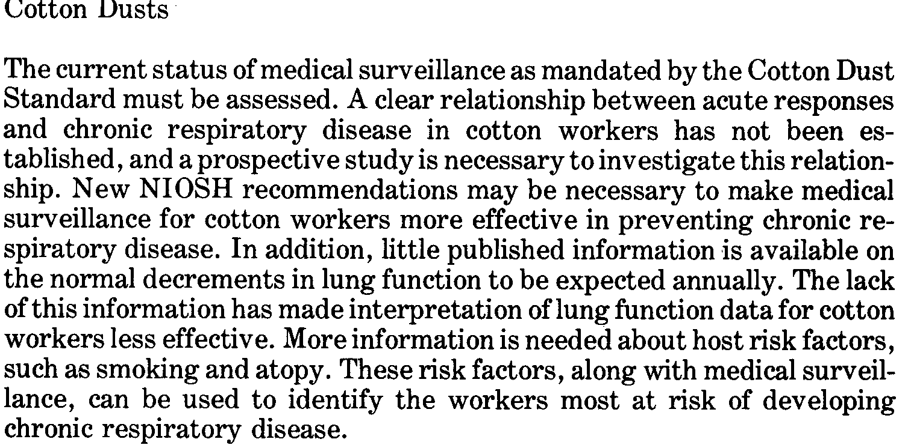

Slide 51
THANK YOU

