Slide 1
Knowledge of Hordeolum, Ptosis, Trachoma, Trichiasis, Entropion, Ectropion

Slide 2
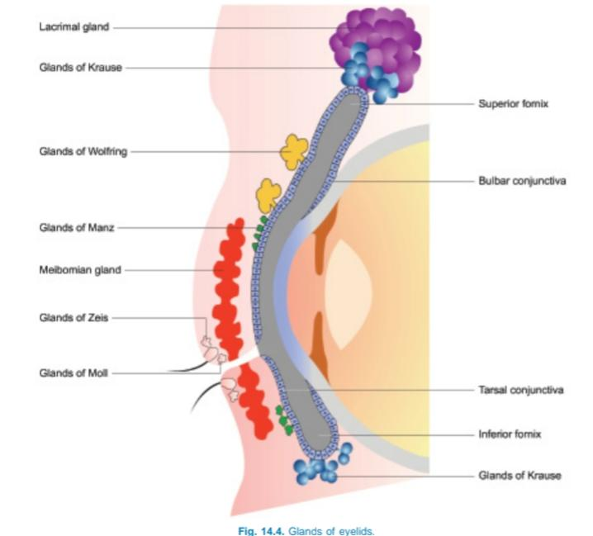
EXTERNAL HORDEOLUM (STYE) It is an acute suppurative inflammation of gland of the Zeis or Moll.

Slide 3
Etiology
1. Predisposing factors. It is more common in
children and young adults (though no age is bar)
and in patients with eye strain due to muscle
imbalance or refractive errors. Habitual rubbing
of the eyes or fingering of the lids and nose,
chronic blepharitis and diabetes mellitus are
usually associated with recurrent styes. Metabolic
factors, chronic debility, excessive intake of
carbohydrates and alcohol also act as predisposing
factors.
2. Causative organism commonly involved is
Staphylococcus aureus.

Slide 4
Symptoms
These include acute pain associated with swelling of
lid, mild watering and photophobia.
Signs
Stage of cellulitis is characterised by localised,
hard, red, tender swelling at the lid margin asso-
ciated with marked oedema
Stage of abscess formation is characterised by a
visible pus point on the lid margin in relation to
the affected cilia.
Usually there is one stye, but occasionally, these
may be multiple.

Slide 5
Treatment
Hot compresses 2-3 times a day are very useful in
cellulitis stage. When the pus point is formed it may
be evacuated by epilating the involved cilia. Surgical
incision is required rarely for a large abscess.
Antibiotic eyedrops (3-4 times a day) and eye
ointment (at bed time) should be applied to control
infection. Anti-inflammatory and analgesics relieve
pain and reduce oedema. Systemic antibiotics may
be used for early control of infection. In recurrent
styes, try to find out and treat the associated
predisposing condition.

Slide 6
CHALAZION
It is also called a tarsal or meibomian cyst. It is a
chronic non-infective granulomatous inflammation of
the meibomian gland.

Slide 7
Etiology
1. Predisposing factors are similar to hordeolum
externum.
2. Pathogenesis.Usually, first there occurs mild grade
infection of the meibomian gland by organisms of
very low virulence. As a result, there occurs
proliferation of the epithelium and infiltration of the
walls of the ducts, which are blocked.
Consequently, there occurs retention of secretions
(sebum) in the gland, causing its enlargement. The
pent-up secretions (fatty in nature) act like an
irritant and excite non-infective granulomatous
inflammation of the meibomian gland.

Slide 8
Clinical picture
Patients usually present with a painless swelling in
the lid and a feeling of mild heaviness. Examination
usually reveals small, firm to hard, non-tender swelling
present slightly away from the lid margin
It usually points on the conjunctival side, as a red,
purple or grey area, seen on everting the lid. Rarely,
the main bulk of the swelling project on the skin side.
Occasionally, it may present as a reddish-grey nodule
on the intermarginal strip (marginal chalazion).
Frequently, multiple chalazia may be seen involving
one or more eyelids.

Slide 9
Clinical course and complications
Complete spontaneous resolution may occur rarely.
Often it slowly increases in size and becomes very large. A large chalazion of the upper lid may press on the cornea and cause blurred vision
from induced astigmatism. A large chalazion of
the lower lid may rarely cause eversion of the
punctum or even ectropion and epiphora.
Occasionally, it may burst on the conjunctival
side, forming a fungating mass of granulation
tissue. Secondary infection leads to formation of
hordeolum internum.
Calcification may occur, though very rarely.
Malignant change into meibomian gland
carcinoma may be seen occasionally in elderly
people.

Slide 10
Treatment
1. Conservative treatment. In a small, soft and recent
chalazion, self-resolution may be helped by
conservative treatment in the form of hot
fomentation, topical antibiotic eyedrops and oral
anti-inflammatory drugs.
2. Intralesional injection of long-acting steroid
(triamcinolone) is reported to cause resolution in
about 50 percent cases, especially in small and
soft chalazia. So, such a trial is worthwhile before
the surgical intervention.

Slide 11
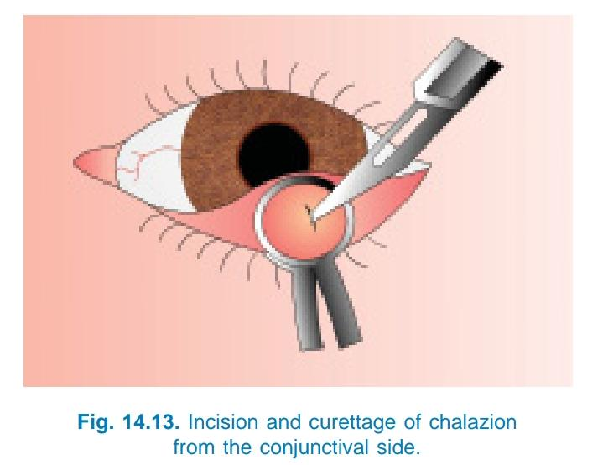
3. Incision and curettage is the conventional and effective treatment for chalazion.Surface anaesthesia is obtained by instillation of xylocaine drops in the eye and the lid in the region of the chalazion is infiltrated with 2 per-
cent xylocaine solution. An incision is made with
a sharp blade, which should be vertical on the
conjunctival side (to avoid injury to other
meibomian ducts) and horizontal on skin side (to
have an invisible scar). The contents are curetted
out with the help of a chalazion scoop. To avoid
recurrence, its cavity should be cauterised with
carbolic acid. An antibiotic ointment is instilled
and eye padded for about 12 hours. To decrease
postoperative discomfort and prevent infection,
antibiotic eyedrops, hot fomentation and oral
anti-inflammatory and analgesics may be given
for 3-4 days.
4. Diathermy. A marginal chalazion is better treated
by diathermy.

Slide 12
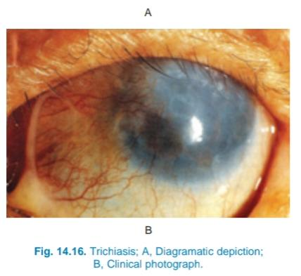
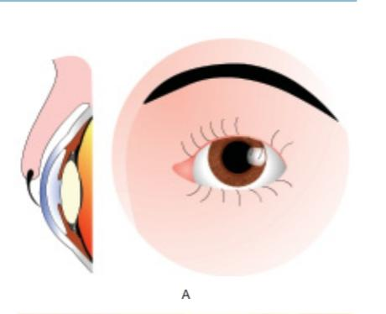
ANOMALIES IN THE POSITION OF THE LASHES AND LID MARGIN
TRICHIASIS It refers to inward misdirection of cilia (which rub
against the eyeball) with normal position of the lid
margin

Slide 13
The inward turning of lashes
along with the lid margin (seen in entropion) is called
pseudotrichiasis.

Slide 14
Etiology. Common causes of trichiasis are : cicatrising
trachoma, ulcerative blepharitis, healed membranous
conjunctivitis, hordeolum externum, mechanical
injuries, burns, and operative scar on the lid margin.
Symptoms. These include foreign body sensation
and photophobia. Patient may feel troublesome
irritation, pain and lacrimation.
Signs. Examination reveals one or more misdirected
cilia touching the cornea. Reflex blepharospasm and
photophobia occur when cornea is abraded.
Conjunctiva may be congested. Signs of causative
disease viz. trachoma, blepharitis etc. may be present

Slide 15
Complications
These include recurrent corneal
abrasions, superficial corneal opacities, corneal
vascularisation and non-healing corneal
ulcer.

Slide 16
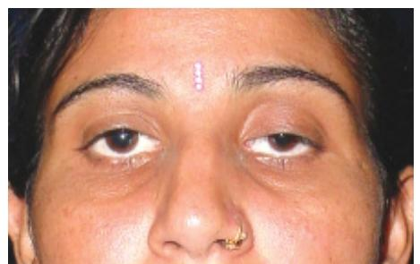
Ptosis
Abnormal drooping of the upper eyelid is called ptosis.
Normally, upper lid covers about upper one-sixth of
the cornea, i.e., about 2 mm. Therefore, in ptosis it
covers more than 2 mm.

Slide 17
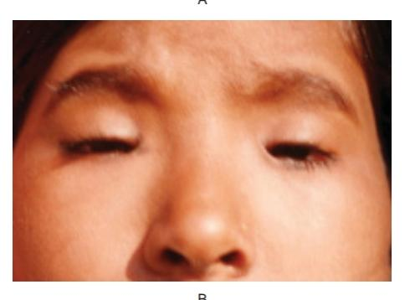
Types and etiology
I. Congenital ptosis
Simple congenital ptosis
Congenital ptosis associated with superior rectus muscle
blepharophimosis syndrome,
Congenital synkinetic ptosis (Marcus Gunn jaw-
winking ptosis)

Slide 18
II. Acquired ptosis
Depending upon causes neurogenic,myogenic, aponeurotic or mechanical.
Neurogenic ptosis. 3rd CN palsy ,Horner’s syndrome,Ophthalmogenic migraine and MS
Myogenic ptosis. LPS anomalies
Aponeurotic ptosis may be associated with post surgery ., senile ptosis

Slide 19
Mechanical ptosis. lid tumours, multiple chalazia and lid oedema

Slide 20
Clinical evaluation
History. age of onset, family history, history of trauma, eye surgery and variability in degree of the ptosis.
II. Examination
1. Exclude pseudoptosis
2. Observe the following points
3. Measurement of amount (degree) of ptosis.
4. Assessment of levator function.
5. Special investigations.
6. Photographic record

Slide 21
Treatment
I. Congenital ptosis. It almost always needs surgical
correction. In severe ptosis, surgery should be
performed at the earliest to prevent stimulus
deprivation amblyopia. However, in mild and moderate
ptosis, surgery should be delayed until the age of 3-
4 years, when accurate measurements are possible.
Congenital ptosis can be treated by any of the
following operations

Slide 22
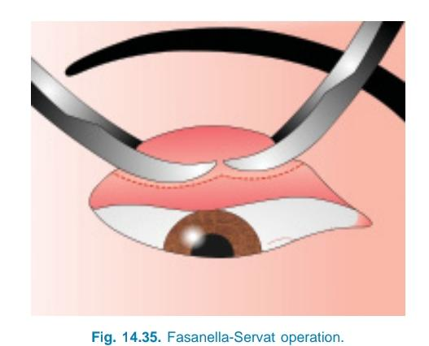
Fasanella-Servat operation. It is performed in
cases having mild ptosis (1.5-2mm) and good levator
function. In it, upper lid is everted and the upper tarsal
border along with its attached Muller’s muscle and
conjunctiva are resected

Slide 23
Levator resection. It is a very commonly performed
operation for moderate and severe grades of ptosis.
It is contraindicated in patients having severe ptosis
with poor levator function.
Amount of levator resection required: Most of the
surgeons find it out by adjusting the lid margin in
relation to cornea during operation on the table in
individual case. However, a rough estimate in different
grades of ptosis is as follows:
Moderate ptosis
Level of LPS Amount of LPS to be
Function resected
Good 16-17 mm (minimal)
Fair18-22 mm (moderate)
Poor 23-24 mm (maximum)
Severe ptosis
Fair levator 23-24 mm (maximum
function LPS resected)

Slide 24
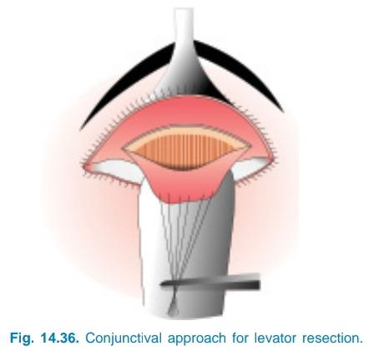
Techniques. Levator muscle may be resected by either
conjunctival or skin approach.
i. Conjunctival approach (Blaskowics’ operation):
This technique is comparatively easy but not
suitable for large amount of resection. In it LPS
muscle is exposed by an incision made through
the conjunctiva near the tarsal border, after the
upper lid is doubly everted over a Desmarre’s lid
retractor

Slide 25
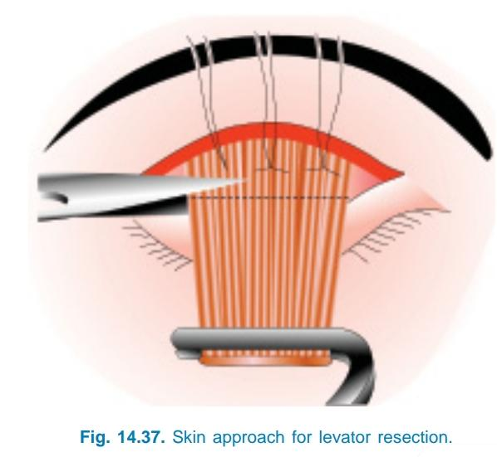
Skin approach (Everbusch’s operation): It is a
more frequently employed technique. It allows
comparatively better exposure of the LPS muscle
through a skin incision along the line of future lid
fold

Slide 26
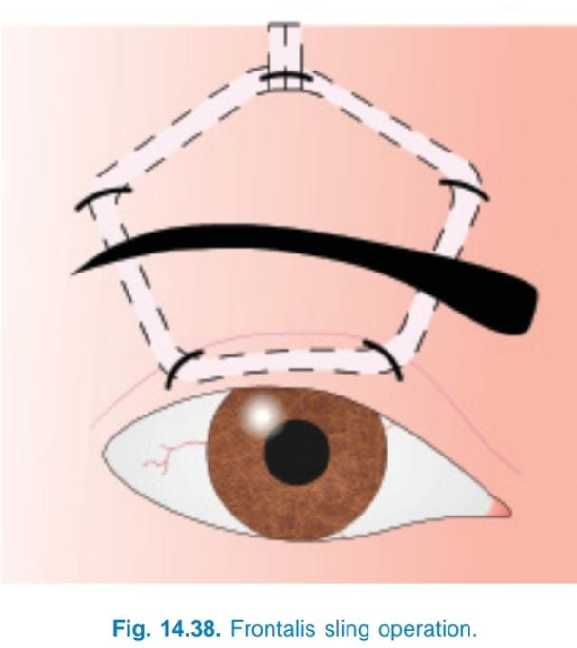
Frontalis sling operation (Brow suspension):
This is performed in patients having severe ptosis
with no levator function. In this operation, lid is
anchored to the frontalis muscle via a sling. Fascia lata or some non-absorbable material
(e.g., supramide suture) may be used as sling.

Slide 27
Acquired ptosis. Efforts should be made to find
out the underlying cause and if possible treat it. In
neurogenic ptosis conservative treatment should be
carried out and surgery deferred at least for 6 months.
Surgical procedures (when required) are essentially
the same as described for congenital ptosis. However,
the amount of levator resection required is always
less than the congenital ptosis of the same degree.
Further, in most cases the simple Fasanella-Servat
procedure is adequate.

