Slide 1
PRIMARY HEALTH CARE
DR. JYOTI VARTHI

Slide 6
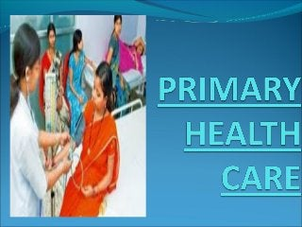

Slide 13
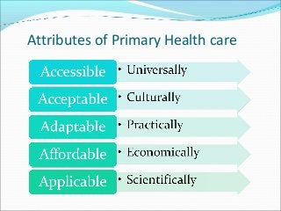

Slide 14
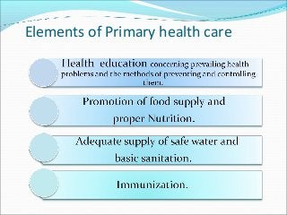

Slide 27
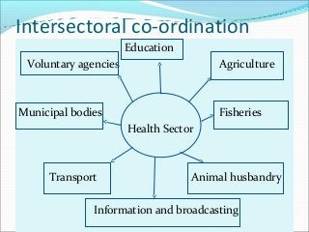

Slide 29
