Slide 1
Smt. Vimladevi Ayurvedic medical college, Chandrapur Presented By Sharir Kriya Dept. Asso. Prof. Dr. Prashant Chandekar

Slide 4
Prakruti remains unchanged from--
Birth – to --- Death

Slide 5
Prakruti

Slide 6
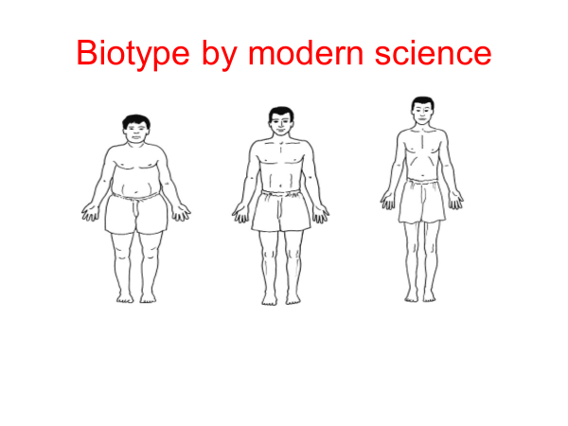

Slide 10
Fertilization - Shukra Shonit Samyoge

Slide 11
Fertilization – Shukra Shonit Samyoge

Slide 12
Fertilization

Slide 13
Prakruti – Ayurvedic Genomics

Slide 14
Prakruti – Ayurvedic Genomics

Slide 15
Mitosis & Meiosis

Slide 16
Prakruti –Genetic link

Slide 17
Role of DNA in Prakruti ?

Slide 33
Vata Lady Krusha deergha kruti

Slide 34
Ruksha or dry skin of vata

Slide 37
Vata teeth

Slide 38
Vata – Overcrowded Teeth

Slide 39
Vata wrist joint

Slide 40
Ruksha or dry hair of Vata

Slide 41
Ruksha or dry nails of vata

Slide 43
Vata –Anuk –Donkey – Voice & Colour

Slide 44
Vata –Anuk –Goat-Lean body

Slide 45
Vata Anuk – Rat – Colour,coward

Slide 46
Vata –Anuk-Rabbit-coward

Slide 47
Famous Vata People

Slide 50
Skin of Vata & Pitta

Slide 51
Pitta – Khalitya-Bald

Slide 52
Pitta –Shigra Palitya – (Premature Greying)

Slide 53
Pitta Skin with moles

Slide 54
Colour of Pupil is like Pitta

Slide 55
Pitta Nails

Slide 56
Pitta Teeth

Slide 59
Pitta anger,brave like Tiger

Slide 60
Pitta Anukatva -Monkey

Slide 63
Soft Skin of Kapha

Slide 64
Big eyes of Kapha

Slide 66
Kapha Wrist-Sandhi bandha

Slide 67
Kapha Teeth

Slide 68
Kapha Strength & Stamina
like Horse

Slide 70
Kapha body & Strength like Elephant

Slide 72
Kapha chest ,voice & bravery like Lion

Slide 73
Kapha Hair

Slide 74
Famous Kapha people

Slide 75
Liking of Prakruti

Slide 99
Vata Prakruti

Slide 100
Pitta Prakruti

Slide 101
Kapha Prakruti

Slide 102
Prakruti Features

Slide 103
Biotype by modern science

Slide 104
Phenotype & Genotype ?

Slide 105
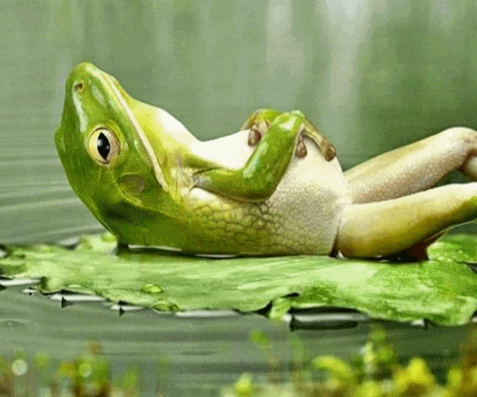
Thanking You

