Slide 1
Agadtantra Department
Death

Slide 2
Content
Definition
Diagnosis of death
Stages of death
Modes of death
Signs of death
Cooling of the dead body
Post mortem caloricity
Post mortem lividity
Changes in muscles after death
Decomposition
Mummification
Saponification

Slide 3
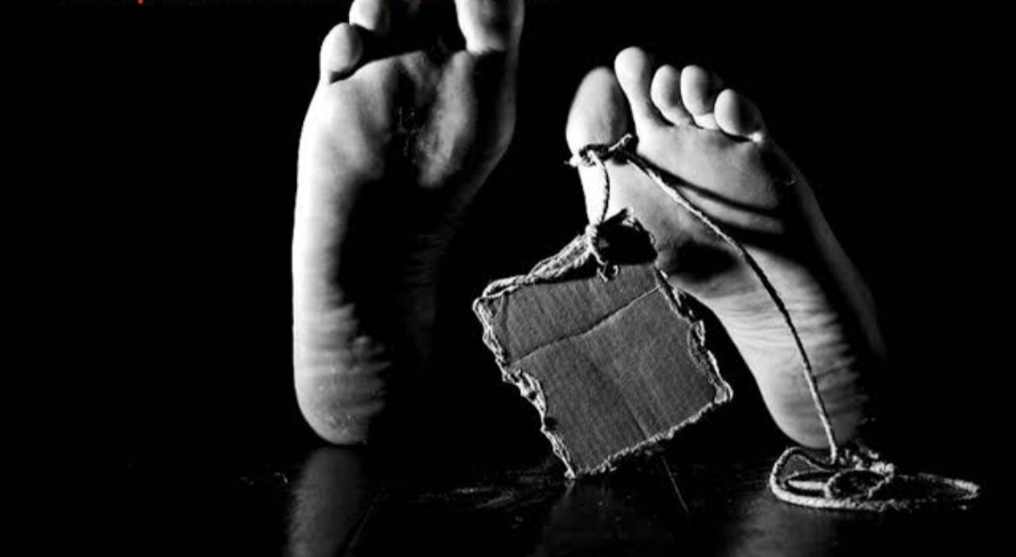
Definition
Death is cessation of life or ceasing to exist.
Death is defined as the irreversible cessation of life, insensibility to move and permanent and complete stoppage of functions of the vital organs of the body - known as tripod of life i. e., brain, heart & lungs

Slide 4
Diagnosis of death
1 ) Routinely
Death is clinically diagnosed by British code / harvard criterion –
Stoppage of respiration-
Absence of pulse-
Absence of heart beat-
Fixed dilated pupils

Slide 5
2)Brain stem death - can be diagnosed by
Person must be in deep coma for at least 6 hrs.
Absence of any typical postures due to decortication or decerebration-
No epileptic movements
Absence of spontaneous respiration
Fixed dilated pupils, not responding to light
Abolition of all brain - stem reflexes e. g., corneal, gag, vestibulo -cephalic, vestibulo -ocular & bronchial stimulation reflex

Slide 6
Stages of Death
Death
Somatic Death
Molecular Death
1. Somatic death
Is the death of tissue/ system/body.
Is a clinical death
Associated with immediate signs of death i.e. –
Permanent and complete cessation of function of organs like brain, heart, lungs

Slide 7
2. Molecular death
Occur after Somatic death.
Is death of all individual cells
Associated with early and late signs of death.
Early sign –
Changes in eye and skin.
Cooling of body
P.M lividity.
Late sign –
Decomposition or Mummification

Slide 8
MODES OF DEATH
As per Bichat there are 3 modes of Death –

Slide 9
1.COMA
Definition –
Coma is a defined as mode of death, where death results from failure of function of brain .
Causes of coma
1) Raised intracranial tension due to cerebral compression
2) Any gross injury to brain
3) Poisons
4) Metabolic disorders
5) Pathological disorder
P. M. appearance in coma
1) Causes of coma is found
2) Left chambers of heart are full

Slide 10
2.SYNCOPE
Definition
Syncope is defined as the mode of death, where death results from failure of function of heart
Causes of Syncope
1) Anaemia
2) Asthenia
3) Neurogenic shock
4) Exhaustion
P. M. Appearance in Syncope
In anaemia, heart is contracted and both sides of heart are empty
2) In asthenia, heart is dilated and both sides of heart are full

Slide 11
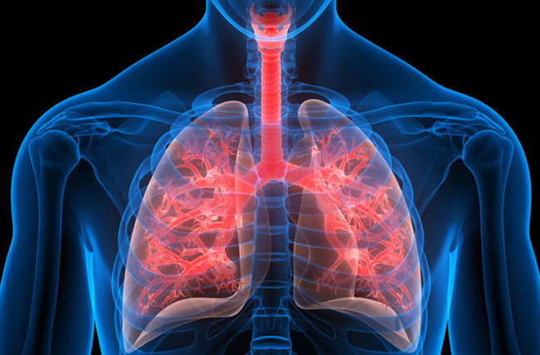
3. ASPHYXIA
Definition –
Asphyxia is defined as the mode of death, in which death is due to failure of function of lungs.
Causes of Asphyxia
1) Mechanical obstruction to Airways
2) Hypoxia
3) Pulmonary embolism
4) Collapse of lungs
5) Improper chest movements
6) Respiratory poisons
7) Pathological conditions
P. M. appearance in Asphyxia
1) External
2) Internal

Slide 12
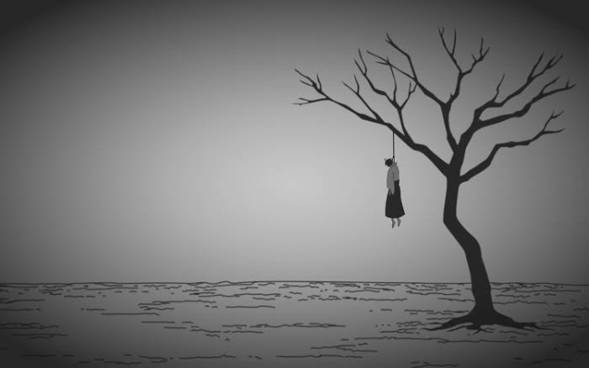
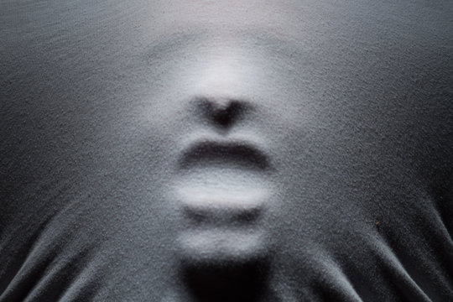
CLASSIFICATION OF VIOLENT ASPHYXIAL DEATHS
1] Hanging
2] Strangulation
3] Suffocation
4] Drowning /Submersion/Immersion

Slide 14
SIGNS OF DEATH
Classified as –
Immediate signs
Early signs
Late signs
IMMEDIATE SIGNS OF DEATH
A. Permanent and complete cessation of function of Brain and flat EEG
B. Permanent and complete cessation of function of Heart and flat ECG
C. Permanent and complete cessation of function of lungs

Slide 15
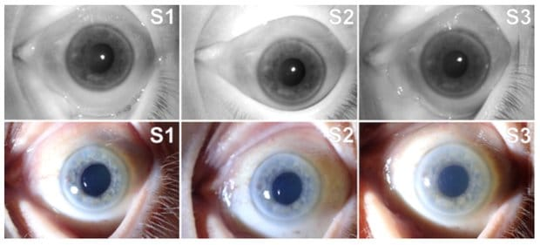
EARLY SIGNS OF THE DEATH
Changes appearing in death body after 3-24 hours of death .
Changes in eyes-
Losses its lustre
Cornea become dry, hard opaque .
Pupil gets dilated .
Fall in intraocular tension.

Slide 16
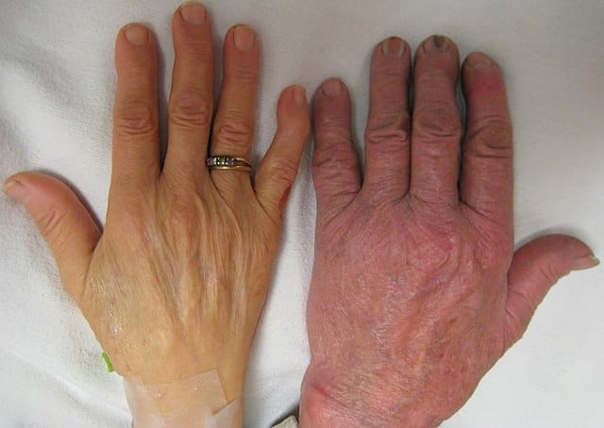
Changes in Skin
Becomes greyish white in colour.
Loss of translucency
Loss of elasticity
Lips become hard , dry, brown.

Slide 17
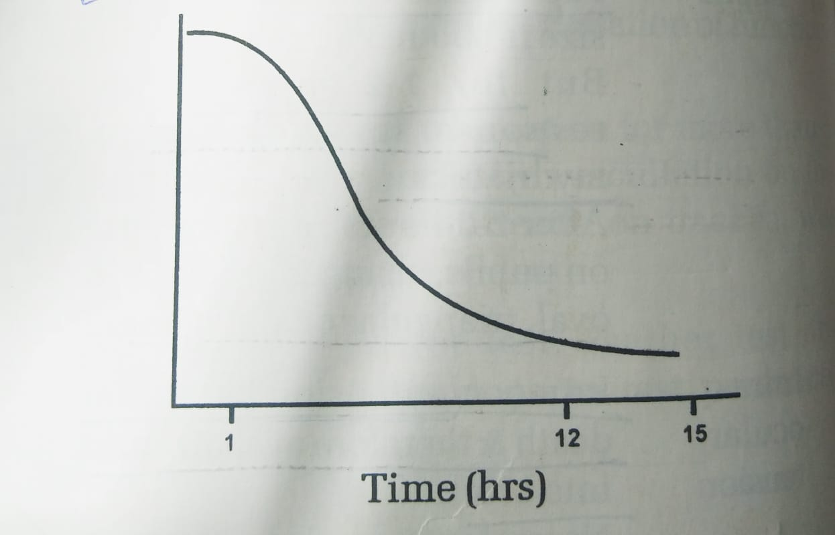
Cooling of dead body
Fall in body temperature by more than 10°c.
Factors influencing cooling of death body
Age
General conditions of body
Sex
Clothes
Atmospheric temperature
Type of death
Surroundings

Slide 18
Rate of fall of temperature
In first 2 – 6 hours – rate of cooling is 2 -2.5 degree F / hr
Next 6 hours- rate of cooling is 1.5 - 2.0 F/hr
later on - rate of cooling is 1 F/hr

Slide 19
POST MORTEM CALORICITY
Definition –
In some situations, for initial 2-3 hours, the dead body may gain heat, however Inter body cools as routine.
Reasons for P.M. Caloricity
Metabolic processes
Bacterial or viral activity
Death associated with extreme muscular activity
Heat regulating mechanism

Slide 20
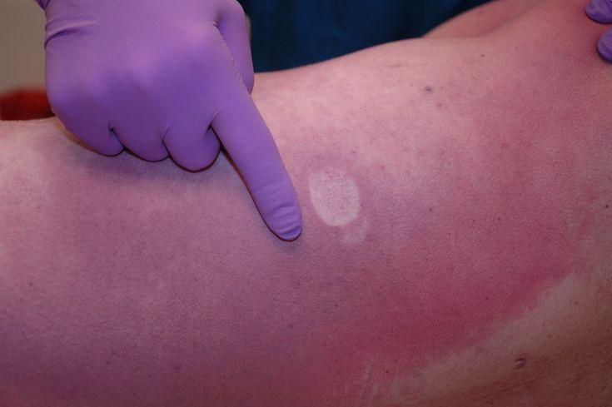
Post mortem lividity (LIVOR MORTIS / P.M . Staining )
Defination -
As dead body behaves like an inert substance , therefore there is gravitational flow of blood to the dependent parts of body , causing stagnation of blood in the toneless ,dilated capillaries, resulting in bluish purple staining of these parts.

Slide 21
Medico legal importance of P.M. lividity
Is a sign of death
Helps us know time since death
Helps us know position or posture of dead
If body is shifted in first 6 hrs, it can be known
Sometimes cause of death can be known due to peculiar distribution e.g. in hanging & drowning or due to colour changes.

Slide 22
Rigor Mortis ( Cadaveric rigidity / death stiffening )
Definition -
Rigor mortis is defined as contraction ,stiffening ,shortening and opacity of muscles after death .this change occurs after molecular death .
Factors influencing Rigor mortis
1) Age
2) Sex
3) Condition of muscles
4) Cause of death
5) Atmospheric temperature
Medico legal aspect of Rigor Mortis
1) Is a sign of death
2) Time since death can be known
3) It can be known, if dead body was shifted.

Slide 23
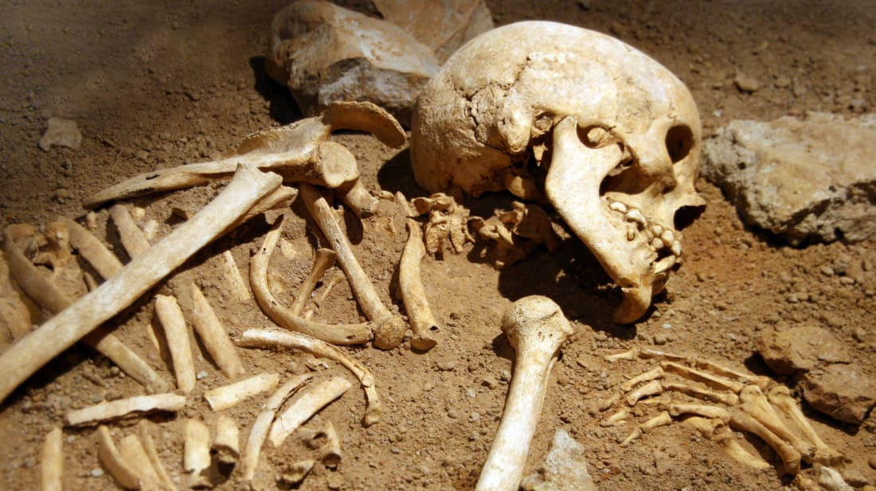
Decomposition (Putrefaction )
It occurs due to Autolysis.
Action of enzymes released by bacteria- causes softening and liquefaction of dead body.
The enzymes of the body breakdown the dead body by causing –proteolysis, glycolysis, lipolysis.

Slide 24
Necessary conditions for Decomposition
Warmth.
Moisture.
Air.
The earliest sign of decomposition is greenish discoloration of body, seen first in right iliac fossa.

Slide 25
Medicolegal aspects of Decomposition
It is the surest sign of death.
Time since death can be known.
Advanced decomposition-
Obliterates identity.
Obliterates cause of death

Slide 26
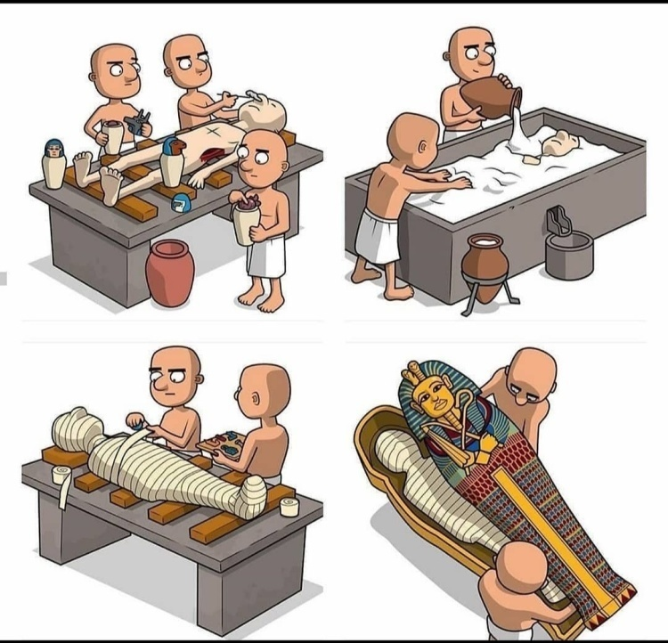
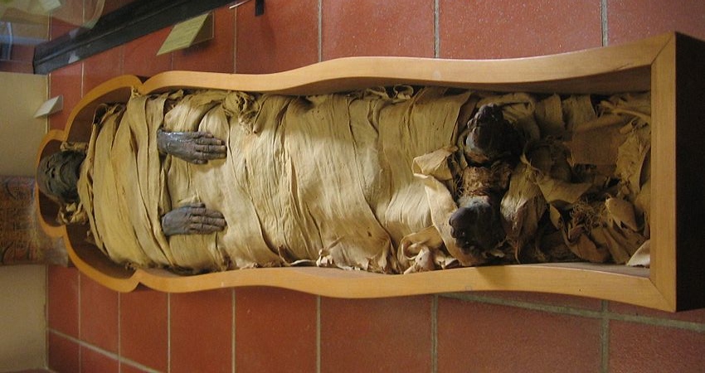
Mummification
It is desiccation or drying of the dead body .
It is also a modification of decomposition.
It occurs because of the evaporation of body fluids.

Slide 27
Essential requirement
Absence of moisture.
Excess of air.
Warmth.

Slide 28
Characteristics
Skin & muscles become thin, dark, leathery and adherent to bones.
Body becomes thin , shriveled, dried and dark brown or black.
All internal viscera blend with each other.
Body emits smell like rotten eggs.
Facial features and injuries are well preserved

Slide 29
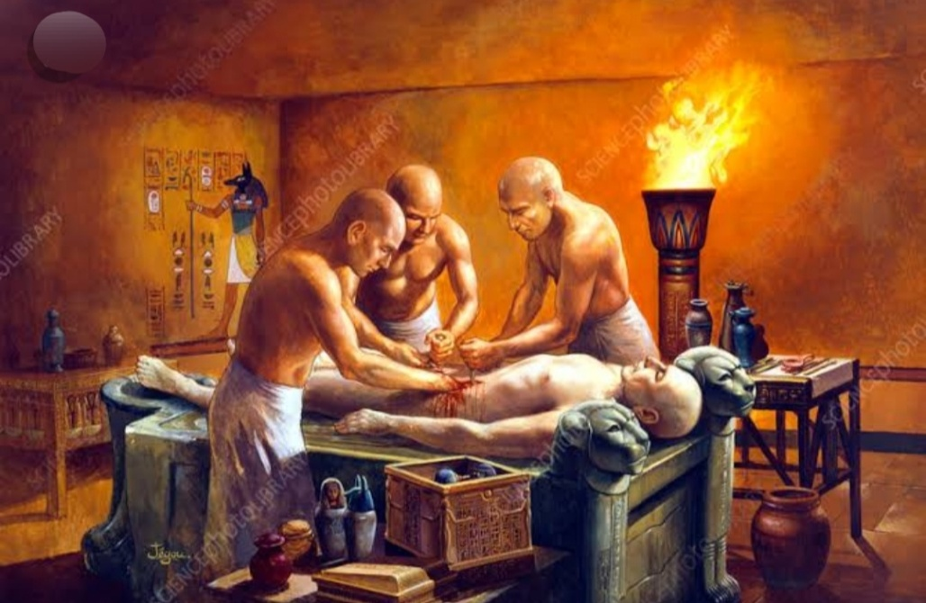
Embalming (artificial preservation of dead body )-
Artificial preservation of the dead body is required for
a) Preserving body for Anatomy dissection.
b) In case, dead body is to be transported over long distances.

Slide 30
It can be done by –
1) Intestinal contents are removed. then injection of 5 lil of 10-20 % formaline in a major blood vessel and also in thoracoabdominal cavities .
2) Injection of mixture of formaline , glycerine, saturated salt solution & eosin.
3) Injection of mixture of arsenic, lead sulphide & potassium carbonate.
4) Freezing & high concentration of lime or arsenic in grave also preserve the dead body

Slide 31
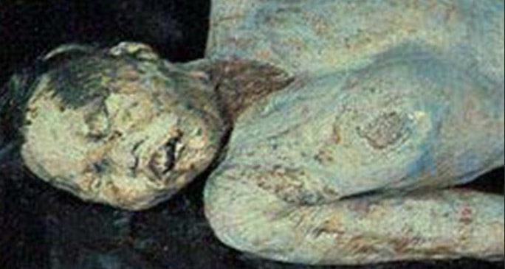
Saponification (Adipocere Formation )
It is the conversion of dead body into soft ,fatty, waxy substance.
This process is a modification of decomposition.
It is post- mortem hydrolysis and hydrogenation of body fats , so as to convert these fats into fatty acids.
These fatty acids later combine with calcium & ammonium ions to form insoluble soaps.

Slide 32
Essential condition for Saponification
Absence of air.
Excess of moisture.
Warmth.

Slide 33
Characteristics
Body is converted into soft, yellowish , waxy, fatty, & brittle substance.
It floats in water.
It can be cut easily.
It melts on heating.
It burns with faint yellow flame.
It dissolves in alcohol & ether.
Body emits sweetish disagreeable smell.
Facial features & injuries on body are well preserved.

Slide 34
Medicolegal importance
It is a sure sign of death.
Identity of the dead can be known.
Cause of death, in case of death can be known.
Time since death can be known.
Surroundings of the dead body can be established.

