Slide 1
dr kiran nandeshwar
EXAMINATION OF A NEWBORN BABY

Slide 2
HISTORY : - (Regarding to the examination of a newborn )
BASIC INFORMATION :-
-Age of mother
- < 18 yrs – Prone to deliver LBW
- > 35 yrs – Have babies with
congenital anomalies &
chromosomal disorders.
- Height –
- Educational ,occupational &
economical status .

Slide 3
2) PREVIOUS OBSTERICAL HISTORY : -
- The gravidity – No. of conceptions.
- The parity - No. of live births .
- H/O – Recurrent abortions & still birth .
3) MOTHER ILLNESS : -
Maternal systemic diseases : -
Heart diseases ,Bronchial asthma, Anemia ,
Tuberculosis ,CRF ….. etc
Endocrine disorders : -
DM ,Thyrotoxycosis , Myxoedema ..etc
SLE – Causes complete heart block .

Slide 4
.
MISCELENIOUS :
1 ) Nutrition
2) Blood group
3) Rh factor
4) Vactination
4 )ANTI NATAL HISTORY : -
H/O Drug ingestion during first trimester
H/O Maternal illness like torch infection
H/O PIH
H/O PV Bleeding
H/O Oligohydromnios
H/O Polyhydromnios
H/O MSL…….

Slide 5
5) PERINATAL HISTORY :-
PROM - > 24 hrs
Prolonged labour -1st stage > 18 hrs ,
2nd stage > 6 hrs .
Obstructed labour
More P/V examination - > 3

Slide 6
6)POST NATAL HISTORY
Neonatal history : -
- H/O Hypoxia
- H/O Birth asphyxia
-CRY
-APGAR SCORE
-Vitals at birth
- First urine time
- First stool time
H/O Jaundice, convulsions, feeding
difficulties, sepsis ….etc

Slide 7
H/O PRESENT ILLNESS : -
-Complaints in detail in chronological order.
- Duration .
-Common neonatal conditions
IN TERM BABY – RDS , HDN,
Septicemia, Congenital malformations.
IN PRETERM BABY : - HMD , PDA ,NEC,
IVH, Mtabolic disorders ,
Retinopathy of prematurity.

Slide 8
PHYSICAL EXAMINATIONS
Conducted in warm & comfortable room
Baby completely undressed & placed
on flat surface.
Good light source should be available.
Examiners hand should be sterilized
,clean & warm .

Slide 9
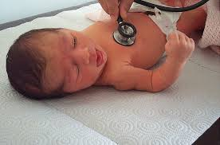

Slide 10
KEY TIMINGS FOR EXAMINATION OF
NEWBORN BABY : -
At birth .
Daily check lying in the ward .
Within 24 hrs.
Next day .
Daily examination of baby in NICU .
Examination at the time of discharge .
TIME : - After 1 hrs of feeding.

Slide 11
1) EXAMINATION AT BIRTH
AIM : -
-To insure and assess the lungs have
expanded and the air way is not
obstructed
- To make early diagnosis of life
threatening congenital
malformations
and birth injuries.

Slide 12
A) APGAR SCORING SYSTEM
AIM :-
-To assess the condition of baby at birth
- Most crucial are HR and RR.
CRITERIA | 0 | 1 | 2
Air way | Nil | Slow ,Gasping | Normal breathing
Heart rate | < 60/mint | 60 – 100 / mint | > 100/ mint
Color | Blue | Pale/peripheral cyanosis | Pink
Activity | Flaccid | In between | Flexed
Reflex response | Nil | Grimace | Crying

Slide 13
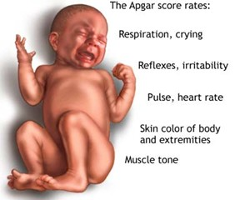

Slide 14
B) SCREENING OF CONGENITAL ANOMALIES
Birth weight & Gestational age : -
- Incidence of anomalies is twice in
preterm baby
- In small for date baby (especially in
hypoplastic ) incidence is 10 – 20 times
more.
Single umbilical artery & palmer crease : -
- Incidence – 15 -20 %
-Esophageal Atresia , Imperforate anus &
genito- urinary anomalies .

Slide 15
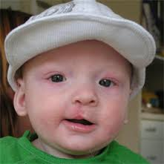
s

Slide 16
HYPOPLASIA OF THE DEPRESSOR
ANGULI ORIS MUSCLE: -
S/S : - Asymmetric facies during crying .
- during crying angle of mouth and
mandible are pulled down.
- flattening of nasolabial fold on normal
side.

Slide 17
ORIFICE COUNTING AND THEIR PATENCY
-Patency of esophagus
-anal opening.
CAUSES : -
Small for date baby .
Single umbelical artery.
Polihydromnios.
Maternal DM .
GASTRIC ASPIRATE EXCEEDS 20 ML .

Slide 18
RESPIRATORY DIFFICULTIES : -
- Chest x- ray should be done.
MID LINE LESION ON THE BACK AND
FRONT : -
- Cleft lip , cleft palate ,spina bifida ,
meningomyelocele ,hypospadias ,
epispadias ,exomphalos .
- Bil. Cleft lip may be associated with
ventricular septal defects.

Slide 19
SYSTEMIC EXAMINATIONS
Respiratory system : -
- shape of chest’
- RR / mint.
- air entry or any abnormal sound .
Cardio- vascular system : -
- Its position , murmur,
- dextrocardia – with respiratory
difficulty

Slide 20
FIRST DAY EXAMINATION
Enquire about feeding .
Vomiting after feed .
Assess for aspiration if vomiting occurs .
Look for jaundice .
First urine
First stool passed..
URINE OUTPUT – 1 – 3 ML /KG /HRS.

Slide 21
VITALS : -
HR - 140 – 160 / MINT
RR - 40 – 60 / MINT
Blood pressure - 60 / 40 mm of hg.
Temperature – 36.5 – 37 c
Bradycardia : - HR < 100 / min.
-Birth asphyxia , Hypothermia,
Hypothyroidism ,Hypertension &
Hyperkalemia . etc

Slide 22
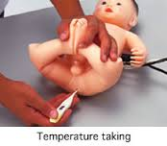
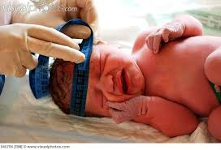

Slide 23
GENERAL BEHAVIOR :-
ASSESS - Activity,
- General alertness
- Colour of the skin.
MEASURMENTS : -
- Weight - > 2.5 kg
- Height - 48 – 50 cm
- Head circumference – 34 -35 cm
- Chest circumference – 2 -3 cm < HC

Slide 24
GESTATIONAL ASSESSMENT
BY 1 ) Physical examinations.
2) Neurological examinations.
CRITERIAS | TERM BABY | PRETERM BABY
Weight | >= 2.5 kg | < 2.5 kg
Sole creases | Deep sole creases over 2/3 rd of sole | Single deep crease at anterior sole or only superficial creases
Breast nodules | > 5 mm diameter | < 5 mm & nipple small or absent
Ear cartilages | Firm ,well developed | Cartilage deficient, recoiling poor
Genitals | Male – atleast one testes descended Female –L.M completely covers L.M | Male –undescended testes , scrotum is small ,few rugosities Female- L.M seperatd

Slide 25
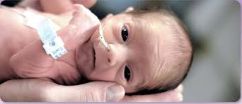

Slide 26
PRECISE ESTIMATION OF GESTATIONAL AGE
BALLARD CHART : -(Physical)
CRITERIA / SCORE | 0 | 1 | 2 | 3
Skin texture | Very thin & gelatinous | Smooth medium thick. | Thick ,peeling | -
b) Lanugo | Nil or scanty | Abundant | Thin | Scanty with baldness
c) Planter creases | Nil | Faint red marks over ant. ½ | Deep creses Over ant. 1/3 to ½ sole | Deep crease All over
d) Ear firmnes | Soft & foldable | Soft with recoil | Some cartilages along edge | Firm with throughout cartilages
e) Breast nodules | Nil | <5 mm (diameter) | 5 – 10 mm | > 10 mm
f) Genitalia M F | No testes d LM seprated | 1 T in IC LM partialy C | T D LM CC LMn | -

Slide 27
NEUROLOGICAL : -
CRITERIA /SCORE | 0 | 1 | 2 | 3
a) Posture | Arms & legs extended. | Mild flexion of hip & knees, Arms extended | Stronger flexion at legs & some at arms | Legs flexed & Abducted, arms completely flex
b) Arm recoil | Nil | sluggish | Full flexion | -
c) Popliteal angle (in degree) | 180 | 180 - 150 | 150 - 120 | 120 - 90
d) Head lag e) Glabellar tap | Complete lag Absent | Partial control Weak response | Maintain head in line. Brisk response | Brings ant. To body -

Slide 28
Relationship between total score & gestational age
TOTAL SCORE | GESTATION (WEEK)
9 | 28
10 | 29
11 | 30
12 | 31
13 | 32
15 | 33
16 | 34
18 | 35
19 | 36
20 | 37
23 | 38
25 | 39
26 | 40

Slide 29
MINOR DEVELOPMENTAL PECULIARITIES
SKIN : -
Toxic erythema neonatorum.
Milia on the nose & face
Capillary hemangiomata
Mongolian blue spots
Subcunjuctival haemorrhage
Tongue tie
Mastitis neonatorum
Pv bleeding
Mucoid vaginal dischrge … etc

Slide 30
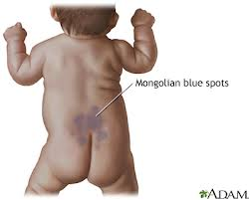
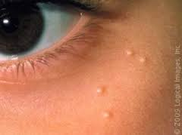

Slide 31
EXAMINATION OF HEAD
EXAMINE FOR : -
- Caput succedaneum
- Cephalohematoma
- Forcep marks
- Cranial sutures.
- Anterior fontanels – 2-3 cm
- Posterior fontanels - 1 cm
CRANIOTABES : - Causes
- Prematurity, Congenital rickets
,Osteogenesis imperfecta ,Congenital
syphilis …etc

Slide 32
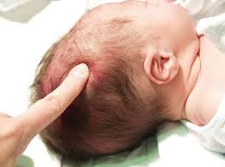

Slide 33
EXAMINATION OF FACE :-
- Milia ,acne
- Abnormal facies ,size ,shape ,
- Position of the ears
- Distance between two eyes
- Nasal bridge , its shape
- Hairy pina in DM
EXAMINATION OF EYES : -
-Subcunjuctival haemorrhage
- Watering of eyes .

Slide 34
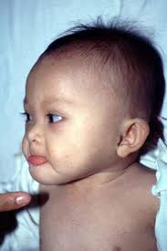
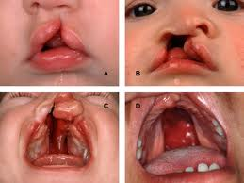

Slide 35
EXAMINATION OF SKIN : -
- Jundice, cynosis, petechiae ,
erythema neonatorum.
EXAMINATION OF SPINE : -
- Spina bifida , meningocele ,
- meningomyelocele.
EXAMINATION OF EXTREMITIES : -
- Examine for talipus equinovarus .
- look for oligodactyly ,polydactyly,
syndactyly
- bowed legs.

Slide 36
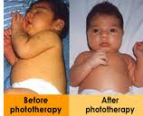
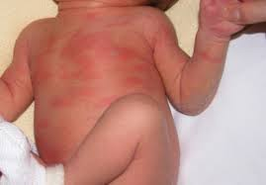

Slide 37
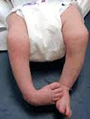
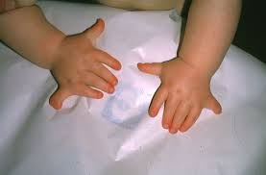

Slide 38
EXAMINATION OF ABDOMEN & GENITALIA
Umbilical cord dries and falls – 5 – 10 dys
delayed - in preterm , local infection &
immuno – deficiency disorder .
discharge : - watery or purulent .
Umbilical granuloma :-
pale irregular granular tissue .
Umbilical polyp : -
- pedunculated bright red with central
opening .
-watery or fecal discharge due to
communication with urachal cyst or
omphalomesentric duct.

Slide 39
Inguinal hernia : -
Hydrocele : -
hypospadias ,epispadias
Congenital adrenal hyperplasia
obstructive uropathy .

Slide 40
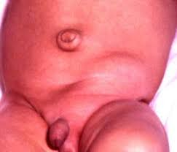

Slide 41
SPECIAL SENSES : -
VISION : -
Visual aquity – 6 / 45
Test by - blinking of eyes
32 weeks - head terns.
HEARING : -
Sound stimulus of bell.
Response - blinking of eyes ,
- sudden change in
activity, HR ,RR…

Slide 42
EXAMINATION OF MOTOR FUNCTIONS
Spontaneous movements : -
-watch & observe range and
symmetry of movements.
- jitteriness , blinking , staring ,
sucking or chewing .
Muscle tone : -
- Term baby – hypertonic
- Preterm baby - hypotonic
Tendon jerk : -
- variable & brisk .
- Ankle clonus – 8 jerks normal.

Slide 43
PRIMITIVE REFLEXES
1) Moro’s reflex : -
- Appears at – 30 weeks
- fully developed – 38 weeks
RESPONSE : -
- Depressed or absent – cerebral
depression
- Exaggerated – cerebral irritability .
- Asymmetric - brachial palsy ,fracture of
clavicle or humures .
- Kernicterus – sun setting sign .
2) Palmer & plantar grasp : -
- finger is placed at palmer surface
,grasps or flexion of digits .

Slide 44
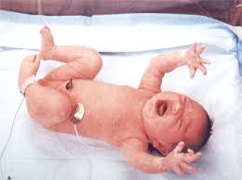

Slide 45
3) Glabellar tap : -
- 30 weeks
4) Rooting & sucking reflexes : -
- at 34 weeks.
5) Tonic neck reflex : -
- Asymetric response – disapears after
2 – 3 months.
- constant & persistant – signify future
development of cerebral palsy.

Slide 46
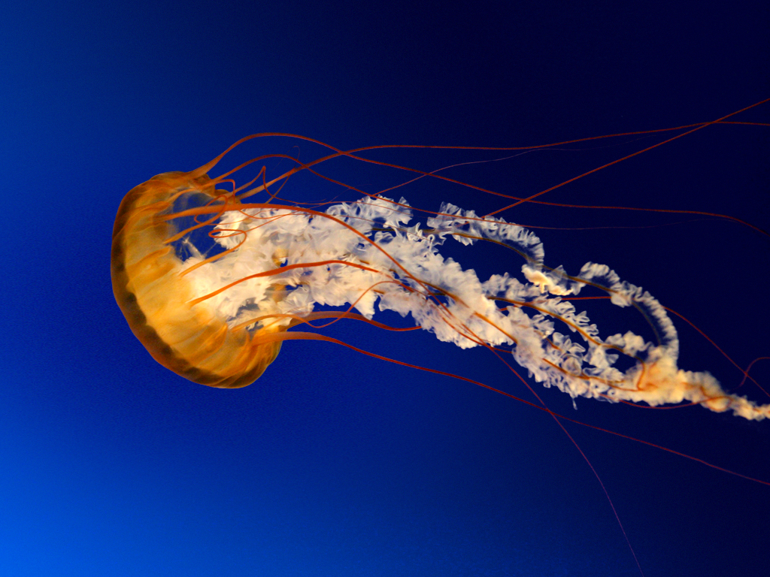
THANK YOU

