Slide 1
Dushi visha (cumulative poison)
Subject - Agadtantra

Slide 2
Dushi visha :
Introduction :
It is a cumulative poison which retains and accumulate within the tissue of human beings due to exposure seems prolonged period persistently.
It may be originated from inanimate, animate, or artificial sources of poison

Slide 3
Etiological derivation of dushi visha :
कालान्तरप्रकोपि विषं दूषीविषं ।
It is a kind of poison that manifests it's poisoning effects after a lapse of time.
It vitiates dhatus on being exited itself by place time and food and day sleep

Slide 4
Definition :
Immobile, mobile, or artificial poison which is old stored or attenuated by anti-poisonous remedies or dried in forest fire, wind and the sun or naturally deficient in properties attains the nature of dushi visha
It is not fatal due to mild potency and being covered with kapha
It stays in body for years to come

Slide 5
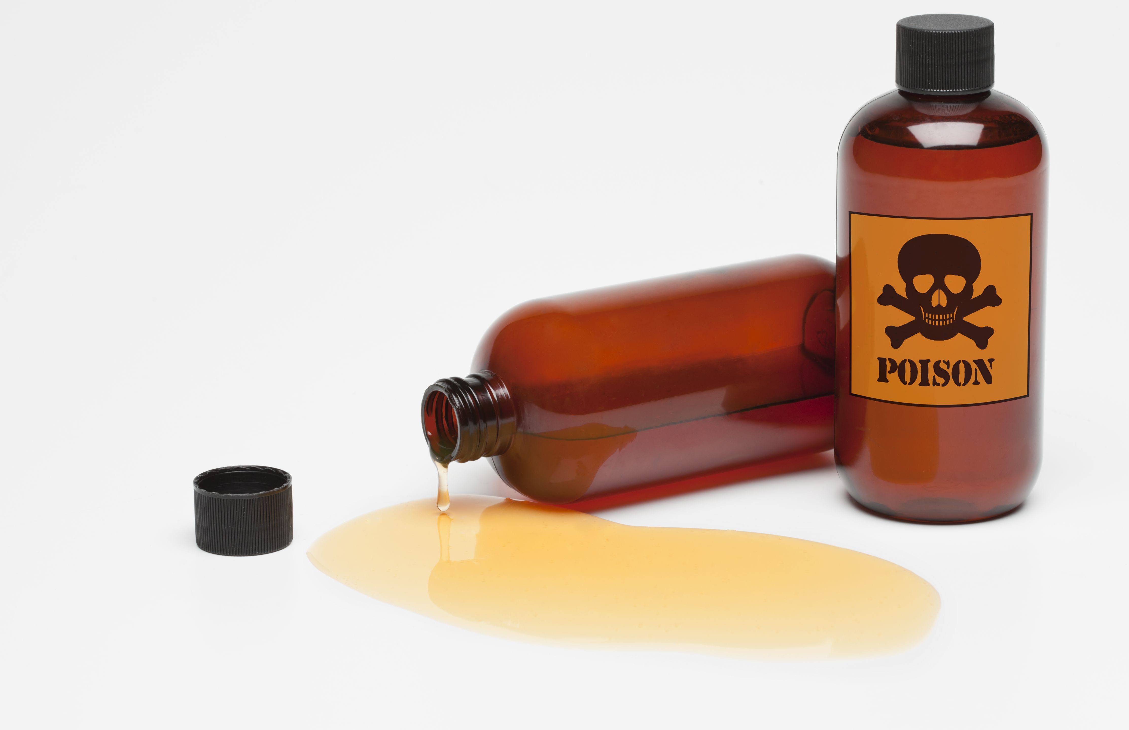
Etiology of dushi visha :
Inappropriate habitat, schedule, diet, lifestyle, physical labour, sexual indulgence, mental conflicts etc lessen the immunity and vigour of the person.

Slide 6
Purvarupa of dushi visha :
The premonitory symptoms are as follows :
Excessive sleep
Heaviness
Excessive yawning
Looseness
Horripilation
Malaise

Slide 7
Signs and symptoms :
Dushi visha vitiates blood and produces symptoms like
Eczema in head region
Psoriasis
Urticaria
Diarrhea
Halitosis
Loss of taste in mouth
Profuse thirst
Fainting
Vomiting
Muffled voice

Slide 8
Symptoms of dushi visha embedded in various organs :
If it is located in stomach the person suffers from disorders of kapha and vata
If it is located in intestines, he becomes a victim of the disorders caused by vata and pitta. In these case hairs fall off and the person resembles a bird with severed wings
If situated in rasa etc it produces respective disorders of dhatus as mentioned.

Slide 9
Prognosis of dushi Visha :
The case of poisoning of instantaneous origin and in the patient of strong will is curable, the same of one year's duration is palliable and it is incurable particularly in the patient who is emaciated and indulges in consumption of inapt articles.

Slide 10
Treatment of dushi visha :
After the Patient is subjected sudation, emesis and purgation one should give him to drink this antipoisonus recipe regularly -
- pippali, dhyamaka, mamsi, rodhra, paripelava, suvarchika, suksma ela, balaka and svarngairika ,mixed with honey

Slide 11
Complications of dushi vIsha:
Fever
Burning sensation
Hiccough
Tympanites
Loss of semen
Oedema
Diarrhea
Fainting
Cardiac ailment
Tremors

Slide 12
Treatment for complications of dushi vIsha :
Special formulation : tuttha bhasma, gandhali Ramayana and kalyanaka ghrItam are useful in the management of dushi visha.
Virecana (purgation)
Use of rasayana(rejuvation therapy)
Drugs useful in case of chronic aggravation of poison :
Suvarna bhasma
Suvarnamaksika bhasma
Rasadi churna
Tapyadi lauha

Slide 13
Thank you
Presented by - Samruddhi Khandekar

