Slide 1
DEPARMENTAL SEMINAR
DEPARMENT OF KAUMARBHRITYA
2014
GOVT.AYURVED COLLEGE ,NANDED.

Slide 2
DEPARMENTAL STAFF
VD. V.U.GAWAI
PROFESSOR &HOD
VD. P.L.PATIL
ASSO.PROFESSOR
VD. A.T.PAWAR
ASSO.PROFESSOR
VD. D.B.CHAVAN
ASSIST.PROFESSOR
VD. D.W.RAUT
ASSIST.PROFESSOR

Slide 3
PG STUDENTS
2013-2016
VD. S.U.CHAVAN
VD. S.R.BHAGWAT
VD. R.C.HARINKHEDE

Slide 4
NEONATAL JAUNDICE
DR S.U.CHAVAN.
(PG SCHOLAR)

Slide 10
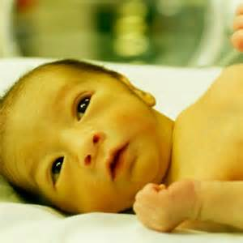
NEONATAL JAUNDICE
DEFINITION:-
Yellowish Discolouration Of Skin ,Sclera And Mucous Membranes Due To Increased Bilirubin Level In The Blood.

Slide 11
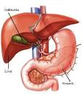
BILIRUBIN METABOLISM
Hb
Haem + Globin Production
Haem Oxygenase
Biliverdin + Co+fe
Blirubin Reductase
Bilirubin
Usb Binds To Albumin Transport
EHC Uptake
Conjugation
USB Excreaated In To The Bile
Excretion
BGD Stercobilirubin In Stool &
Urobilinogen In Urine.

Slide 12
CLASSIFICATION OF JAUNDICE
1 ) A) Unconjugated Hyperbilirubinemia
( Fat Soluble)
a) physiological jaundice.
b) non- physiological jaundice.
B) Conjugated Hyperbilirubinemia
( Water Soluble)
2) Hepatic,obstructive( Cholestasis) .

Slide 13
A) PHYSIOLOGICAL JAUNDICE
Characteristics:
- Occurs After 24 -36 Hrs after birth.
-can be prolonged by immaturity,birth
asphyxia,acidocis.
-80% term baby and 60% rerm baby get
jaundiced.
 | Sr.Bilirubin level. | Appearance (Days) | Disappearance (Days)
Term baby | 6-8 | 3 | 10
Preterm baby | 10-12 | 5 | 14

Slide 15
Etiology :-
-Policythemia.
-Reduced Life Span Of Rbc’s.
Mechanism:-
1) Increased Production Of Bilirubin.
2) Increased Enterohepatic Circulation.
3)Defectivwe Conjugation of Bilirubin.
due to transient deficiency of ligandin ..

Slide 16
PATHOLOGICAL JAUNDICE
CHARACTERISTICS:-
-occurs in 5% newborn.
-Occurs within first 24 Hrs of life.
-Sr.Bilirubin level increases > 5 mg /day
-Direct Bilirubin > 2 mg/dl.
-Stool clay colored & urine yellow.
-Common Causes :-
-Rh, Abo –incompatibility.

Slide 17
ETIOLOGY
Jaundice Within 24 Hrs of life:-
-Rh,Abo –Incompatability.
-Intrauterine TORCH Infections.
-Deficiency of G6PD Enzyme.
-Hereditory Spheriocytosis.
-Criggler Najjar Sndrome.
-Thalassaemia.
-Drugs-
-Vit –K in large amounts, Salicylates to
mother.

Slide 18
Between 24 - 72 Hrs of life:-
-It is called Physiological Jaundice ,which can be prolonged by following distress factors.
-Immaturity, Birth Asphyxia,Acidosis,
hypothermia,hypoglycemia, infections. etc
After 72 Hrs of life:-
-Septicaemia.
-Neonatal hepatitis.
-Extra hepatic biliary atresia.
-Breast milk jaundice.
-Galactoaemia.

Slide 19
CLINICAL ASSESSMENT
By Krammers Rule:-
-Cephalo-pedal progression of yellow
discoloration of skin.
Area Of Body | Sr.Bilirubin level ( mg/dl )
Face | 4 - 8
Upper trunk | 5 - 10
Lower trunk & Thigh | 10 - 12
Arms & L OWER Legs | 12 - 15
Palms & Soles | > 15

Slide 20
INDICATION FOR LAB INVESTIGATIONS
-H/O Jaundice, Ebt ,Kernicterus In Previuos Siblings.
-Mother With O –Blood Group Or Rh Negative.
-Jaundice Within First 24 Hrs Of Life.
-Perstisting > 2 Weeks.
-Yellow Colored Urine & Clay Colored Stool.

Slide 21
INVESTIGATIONS
Tolal Sr. Bilirubin Level.
Blood Group
Rh - Factor
Coombs Test
G6pd Enzyme Deficiency Screening
P.S For Rbc Morphology
Direct Bilirubin Level.
Cbc. Etc…

Slide 22
KERNICTERUS
Definition – Unconjugated Hyperbilirubinemia
Causing Damage To Brain Tissue.
Clinical Features:-
Lethargy ,Hypotonic,
Refusal To Feed ,Shrill Cry.
Setting Sun Sign
Fewer
Convulsion
Drowsynes Or Coma
Moro’s Response –Slugish

Slide 23
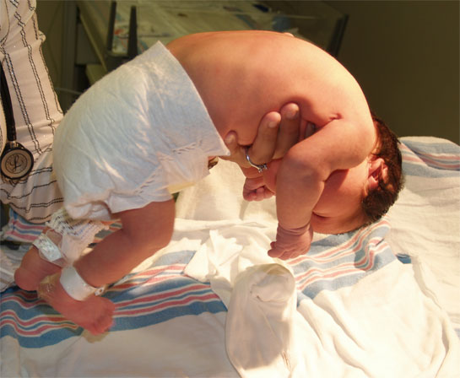

Slide 24
PATHOGENESIS
SR Bilirubin Level 20 Mg/ dl Or More May Caus Kernicterus.
-In Preterm It Can Be Devoloped At Low
Level.
Criterios For Kernicterus :-
-High Unconjugated Bilirubin Level In Bloob.
-Gestetional Maturity.
-Integrity Of Blood Brain Barier.

Slide 25
MANAGEMENT
PRINCIPLES OF MANAGEMENT:-
1) Identification Of Risk Factors For
Development Of Hyperbilirubinemia
2) Adequet Feeding
3) Aspiration Of Cephalohaematoma
4) Drug Therapy
5) Non Drug Therapy.

Slide 26
DRUG THERAPY
PHENOBARBITONE :-
ACTION:-
Induse Maturation Of Enzymes Like And Glucoronyl Transferase,thus Improving
Uptake,Conjugation & Excretion Of Bilirubin.
DOSE:-
MOTHER – 60 -100 Mg 1-2 Weeks Prior To EDD.
NEONATE : - Within 24 Hrs Of Birth .
10 Mg /Kg Im Single Dose
5 Mg/Kg Im Bd 3 Days.

Slide 27
PHOTOTHERAPY
Safe and effective method.
INDICATION:-
AAP - Sr Bilirubin >15 Mg/Dl.
Baby Without Hemolysis,sepsis.
MECHANISM OF ACTION:-
1) Photo –oxydation
2) Photo –isomerization – lumirubin.

Slide 28
PROCEDURE :-
Distance – 45 Cm
Bady Nacked.
Eyes & Genitals Covered.
DURATION:-
TSB Below 15 Mg /Dl.
SIDE EFFECTS:-
1) Dehydration.
2) Hyperthermia.
3) Loose Motion (Green Colored)
4) Bronze Baby Syndrome.
5) Irritability. Etc

Slide 29
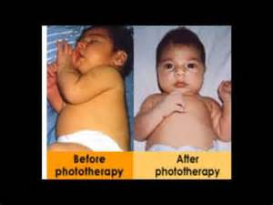

Slide 30
EXCHANGE BLOOD TRASFUSION
Most Effective And Reliable Method To Reduce Bilirubin Level
Early indication for exchange blood
transfusion.:-
-Cord HB <10 GM/DL.
-Cord Bilirubin 5 Mg /Dl.
- Unconjugated Sr. Bilirubin > 10
Mg/Dl In First 24 Hrs.
Pcv Or Ffp Is Used For EBT.

Slide 31
INDICATION FOR EBT
BIRTH WEIGHT (GM) | TOTAL SR.BILIRUBIN .
 | NORMAL INFANTS | HIGH RISK INFANTS
UP TO 1000 | 10 – 12 | 8 – 10
1001 – 1250 | 12 -14 | 10 – 12
1251 – 1500 | 14 – 16 | 12 – 14
1501 – 2000 | 16 – 18 | 14 – 16
2001 -2500 | 18 – 20 | 16 – 18
> 2500 | 20 – 22 | 18 – 20
NORMAL INFANTS | HIGH RISK INFANTS.
 | 10 – 12
 | 12 - 14
 | 14 – 16
 | 16 – 18
 | 18 – 20
 | 20 – 22

Slide 32
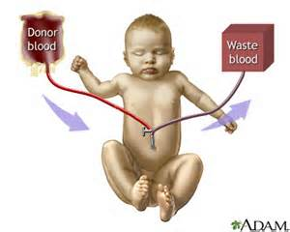
EXCHANGE BLOOD TRANSFUSION

Slide 33
MANAGEMENT OF HYPERBILIRUBINEMIA IN HEATHY BABY
AGE ( HRS.) | TOTAL SR.BILIRUBIN .( MG/DL)
 | CONSIDER PHOTOTHERAPY | EBT
< 24 | - | -
25 – 48 | > 12 | > 20
49 – 72 | > 15 | > 25
> 72 | > 17 | > 25

Slide 34
THANK YOU

