Slide 1
Sterilization
It is the process by which an article, surface or medium is made free of all microorganisms either in vegetative or spore form.
Disinfection: It refers to the destruction of all pathogens or organisms which can cause infection but not necessarily spores. All organisms may not be killed but the number is reduced to a level that no longer harmful to health.
Antiseptics: These are chemical disinfectants that are safe to apply on living tissues and used to prevent infection by arresting the growth of the microorganism.
Asepsis: This refers to the technique which helps to prevent the occurrence of infection into an uninfected tissue.

Slide 2
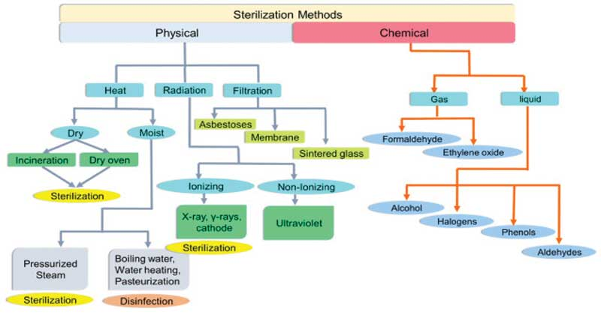

Slide 3
Sunlight :Sunlight has an active germicidal effect due to the presence of ultraviolet rays. It is a natural procedure of sterilization which reduces the number of microorganisms in water tanks, lakes, etc.
Heat: Heat is a mostly used method of sterilization. Moreover, it is a highly effective and most reliable process. There are two major methods of using heat in sterilization which are dry heat and moist heat. The principle behind both of these methods is similar. Dry heat induces the denaturation of protein, oxidative damage and toxic effect due to the high level of electrolytes. Moreover, the dry heat can also damage the DNA of the microorganism. As a result, the microorganism got killed. Moist Heat kills the microorganisms by denaturation and coagulation of proteins. There are several factors that can influence the heat killing procedure. Such as
Temperature and Duration: The duration and temperature are inversely connected to each other. Therefore, in the case of the long duration of heat provided for sterilization, the temperature will be reduced while in case of high temperature the duration will be reduced.
Characteristic of the Microorganism: Microorganisms can be present in both vegetative and spore form. Spore forms are generally heat resistant. Therefore, the sterilization process will vary on the basis of the characteristic of the microorganism.
Type of Material: Organic substances often provide protection to the vegetative and spore form of microorganisms which reduces the lethal property of heat. Apart from that, the materials containing the substances are also needed to be heat stable for proper sterilization.

Slide 4
Dry Heat: Procedures
Red Heat: Inoculation loops, wires, forceps tips, needles are needed to be sterilized to inhibit microbial contamination. These instruments are held in the flame of a Bunsen burner until they become red hot.
Flaming: Glass slides, scalpels, and mouths of culture tubes or conical flasks are passed through Bunsen flame without allowing them to become red hot.
Incineration: This procedure is used to reduce the infective material into ashes by burning. The incinerator is used for the process. Soiled dressings, animal carcasses, bedding, and pathological materials are dealt with this method.
Hot Air Oven: It is a widely used method of sterilization by dry heat. The heat inside the oven is maintained by electricity and a fan fitted inside it provides the adequate distribution of hot air inside the chamber. A thermostat is also connected which maintains the temperature inside the chamber. 160⁰C for two hours is required for sterilization. There are also some alternative temperatures and holding time which include 170⁰C for 1 hour and 180⁰C for 30 minutes.
Uses: Sterilization of Glasswares like glass syringes, Petri dishes, flasks, pipettes, and test tubes. Surgical instruments like scalpels, scissors, forceps, etc. Chemicals such as liquid, paraffin, fats, sulphonamides powders etc.
Sterilization control: The spores of Bacillus subtilis subsp. Niger (NCTC 10075 or ATCC 9372) are kept inside the oven. These spores should be destroyed if the sterilization is proper. Thermocouples may also be used.
Browne’s tube with a green spot is available. After proper sterilization, a green color is produced (after two years at 160⁰C).

Slide 5
Moist Heat Sterilization: Procedure, Temperature below 100⁰C
Pasteurization
There are two different types of pasteurization methods that are used for sterilization of milk, Holder method (63ºC for 30 minutes) and flash method (72⁰C for 20 seconds followed by cooling quickly to 13⁰C). This method is effective against all non-sporing pathogens such as mycobacteria, Salmonella, etc. except Coxiella burnetii which survives the holder method due to heat resistant characteristics.
Inspissation
Media like Lowenstein- Jensen’s and Loeffler’s serum are required to sterile at 80-85⁰C for 30 minutes daily on three consecutive days. This process is known as inspissation and the instrument used is called inspissator.
Vaccine bath
It is used for sterilization of bacterial vaccines at 60⁰C for one hour. Serum or other body fluids can be sterilized by heating in a water bath at 56⁰C for several successive days.
Low-temperature steam formaldehyde sterilization (LTSF)
This method is applicable for materials that cannot withstand 100⁰C temperature. In this method, steam at subatmospheric pressure at 75⁰C with formaldehyde vapor is used. Bacillus stearothermophilus plays an important role as a biological control to test the efficacy of the test.

Slide 6
At a temperature of 100⁰C
Boiling
It is an effective method that can kill vegetative cells. Boiling for 10-30 minutes can kill most of the vegetative cells; however, many spores can withstand this temperature. Boiling can be employed when adequate methods are not available to sterilize glass syringes, rubber stopper, etc.
Tyndallisation
In this case, steam at 100⁰C for successive 3 days is used. It is also known as intermittent sterilization. In this case, the first exposure kills the vegetative forms, and in the intervals between the heating and remaining spores germinates into vegetative forms which are killed on subsequent heating. This process is applied for sterilization of egg, serum or sugar-containing media which can be damaged due to exposure in high temperature for a longer period.
Steam sterilizer
Koch’s and Arnold’s steam sterilization is usually used for media which can easily decompose due to the high temperature in the autoclave. Those media are kept on a perforated tray and steam at 100⁰C and at atmospheric pressure passes through the media for 90 minutes. It is an effective method to kill vegetative cells.

Slide 7
Temperature above 100⁰C (under pressure)
Autoclave
Steam above 100⁰C or saturated steam has a better killing capacity than dry heat. Bacterial proteins coagulate rapidly at moist heat. Saturate steam has the ability to penetrate any porous material. When steam comes into contact with the cooler surface it condenses into water and releases its latent heat to the surface. The large reduction in volume sucks in more steam to the same site and the process continues until the temperature of the substance raised to that of steam. The condensed water produced moist conditions for killing the microbes present.
The autoclave is a modified pressure cooker which contains a vertical or horizontal cylinder. The cylinder is made up of stainless still. A lid on the cylinder is placed and fastened by screw clams to make it airtight. The lid contains a steam discharge unit, a pressure gauge, and a safety valve. Moreover, a thermostat is present to monitor the temperature. Heat is produced by electricity. At the time of sterilization, the cylinder is filled with an adequate amount of water and it is kept for some time for preheating. After that, the materials which are needed to be sterilized are inserted into the cylinder and the lid is then closed tightly. The temperature will increase eventually along with the pressure. When the temperature reaches 121.1⁰C and the pressure at 15 psi the sterilization is performed for 15 minutes.
Uses: Sterilization of Culture media, rubber material, dressing gloves. Materials that are unable to withstand dry heat in a hot air oven.
Sterilization control: Thermocouple, Bacterial spores of Bacillus stearothermophilus used at test organisms.
Browne’s tubes contain red solution which turns into green when exposed to the specific temperature for 15 minutes in an autoclave.

Slide 8
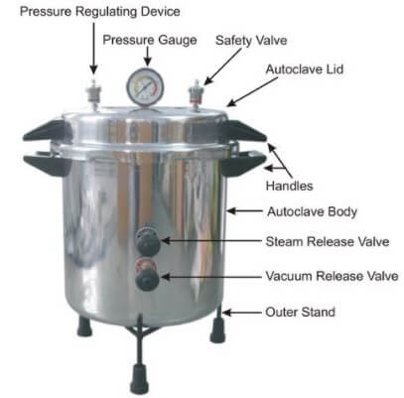
Autoclave

Slide 9
Ozone
Ozone sterilizer uses oxygen, water, and electricity to produce ozone within the sterilizer and provide sterilization without producing toxic chemicals. It runs at 25-35⁰C temperature. Inside this device, the oxygen is converted into atomic oxygen due to the intense electrical field. The atomic oxygen is then combined with the oxygen molecule to produce ozone. The ozone provides a sterility assurance of 10⁻⁶ in approximately 4 hours.
Filtration
This process is useful for sterilizing those materials which are unable to withstand heat. There are several types of filters such as
Candle filter: Used for purification of water. These filters consist of hollow candles and water passes through the candles for purification. Asbestos disc filters: These are made up of magnesium silicate. Sintered glass filters: These are prepared by fusing finely powdered glass powders. Membrane filters: These are made up of cellulose esters and are used for water analysis, sterility testing and for the preparation of the solutions. Membrane filters are available in pore size 0.015 to 12 micron. The .22 micron filter is most commonly used as it is smaller than bacteria. Air filters: These filters are used in laminar airflow chambers to give bacteria-free air supply. These are also known as High-efficiency particulate air (HEPA) filters. These filters can separate particles of 0. Micron or larger. Syringe filters: Syringes fitted with the membrane of different diameters are available.
A limitation of using the filtration process is that the pores are not small enough for viruses.

Slide 10
Radiation
Ionizing radiation
Ionizing radiations such as gamma rays, X rays, and cosmic rays are used for sterilization process. Due to the high penetrating power, these radiations are lethal for cells. The bacterial cells are killed by damage in the DNA. Gamma radiations from a cobalt 60 source are commercially used for sterilization of disposable items. This procedure is also known as cold sterilization.
Non-ionizing radiation
Infrared radiation and UV radiation comes under this of radiation. Infrared radiation is used for mass sterilization of syringes and catheters. UV radiation with a wavelength of 240nm to 280nm has bactericidal capacity. The UV radiation causes protein denaturation and interferes with DNA replication of bacteria. UV radiations are used for sterilization of close areas, surfaces, operation theaters, laminar airflow, etc.

Slide 11
Chemical Method
Several chemical agents are used as antiseptic and disinfectants. The properties of a chemical antiseptic or disinfectant are following
The chemical disinfectants need to have a broad spectrum of activity against all microorganisms such as bacteria, viruses, protozoa and fungi.
The chemical agents should act in the presence of organic matter.
High penetration power is an important property of the chemical agents
The chemical agent needs to be chemically stable under both acidic and basic environments.
The chemical substances should not have any corrosion activity in metals.
The disinfectants are needed to be non-toxic if absorbed into circulation.
Finally, the chemical agents are needed to be easily available and less expensive.
Alcohols: Ethyl alcohol and isopropyl alcohol are frequently used as chemical agents for disinfection. Both of the chemicals facilitate the protein denaturation of bacterial proteins. 70% ethyl alcohol is the standard concentration which is used for disinfection. These are used as skin antiseptics. Apart from this methyl alcohol has activity against fungal spores and used to disinfection of inoculation cabinets.

Slide 12
Aldehydes
Formaldehyde
It is known for its bactericidal, sporicidal and virucidal activities. It can be used in both aqueous and gaseous form. A 10% formalin solution is a standard chemical disinfectant. It is used for Prevention of tissues for histological examinations. Sterilization of bacterial vaccines Preparation of toxoids from toxins.
Glutaraldehyde
It has its activity against bacteria (Mycobacterium tuberculosis), fungi and viruses (including HIV, hepatitis B, etc). It can also kill spores and is known for its less toxic nature. It is used as a 2% buffered solution. Glutaraldehyde is used for Sterilization of cystoscopes, endoscopes, and bronchoscopes Sterilization of plastic endotracheal tubes, face masks, metal instruments, etc.
Orthophathalaldehyde
Orthophathalaldehyde (OPA) is a high-level disinfectant and is known for its stability during storage. It has bactericidal effects against mycobacteria. 0.5% OPA is slowly sporicidal and OPA vapors irritate the respiratory tract and eyes, therefore, it must be handled with appropriate safety.

Slide 13
Phenols
Lister (father of antiseptic surgery) used phenol for the first time in the sterilization of surgical instruments. Phenols work as a disinfectant and kill microorganisms by cell membrane damage. It is toxic for the skin. Different derivatives of phenol are used as antiseptics which are following
Cresols
An example of cresol is Lysol which is mostly used for sterilization of infected glasswares, floors, etc.
Chlorhexidine
Savlon is an example of a chlorhexidine solution which is widely used in wounds, preoperative disinfection of the skin. It is bactericidal at high dilution. Moreover, it also has fungicidal activity.
Chloroxylenol
Dettol is commercially available as a chloroxylenol solution. It is less toxic and less irritant.
Hexachlorophene
It is bacteriostatic at very high dilution.

Slide 14
Halogens
Chlorine and iodine are commonly used disinfectants. Chlorine is used in water supplies, swimming pools, food, and dairy industries. Chlorine compounds in the form of bleaching powder, sodium hypochlorite, and chloramines. The disinfection action of all the chlorine compounds is due to the release of free chlorine which becomes a strong oxidative agent.
Iodine in alcoholic and aqueous solution is used as a skin disinfectant. It is active against M tuberculosis and slightly active against spores. Compounds with iodine with surface-active agents known as iodophors are claimed to be more active than aqueous or alcohol solution.
Oxidizing agents
Hydrogen peroxide
It is effective against most organisms in the concentration of 3-6 %. However, it kills spores at higher concentrations (10-25%). The mode of action is by the liberation of free hydroxyl radical on the decomposition of hydrogen peroxide. These free radicals are active ingredients in the disinfection process.
Peracetic acid: It is an oxidizing agent and is a more potent germicidal agent than hydrogen peroxide.

Slide 15
Salts
Slats of heavy metals have a toxic effect on bacteria. The salts of copper, silver, and mercury are used as a disinfectant. They are protein coagulant ant act by combining with sulphydryl groups of bacterial proteins and other essential intracellular compounds. Merthiolate (sodium ethyl mercurithiosalicylate) is used in a dilution of 1:10000 for the preservation of sera.
Dyes
Two groups of dyes, aniline and acridine dyes have been used as a skin and wound antiseptics. Both the dyes have bacteriostatic activity. Aniline dyes include crystal violet, brilliant green, and malachite green. Acridine dyes include acriflavine, cuflavin, proflavin, and aminacrine.
Vapor phase Disinfectants
Ethylene Oxide (ETO): It is a colorless liquid with a boiling point of 10.7⁰C. It is effective against all types of microorganisms including viruses and spores. It acts by alkylating the amnio carboxyl, hydroxyl and sulphydryl groups in protein molecules. In addition, it reacts with DNA and RNA. It is specially used for sterilizing plastic and rubber articles, respirators, heart-lung machines, dental equipment, etc.
Betapropilolactone (BPO):This is a condensation product of ketane and formaldehyde. It has rapid action and used in0.2%. It is more efficient in fumigation than formaldehyde. BPO is used for the inactivation of vaccines.

