Slide 1
Acute respiratory distress syndrome (ARDS)
DR. SANDESH .P. GOJE
ASSISTANT PROFESSOR
(KAYACHIKITSA)
SVAMCH, CHANDRAPUR

Slide 2
Acute respiratory distress syndrome (ARDS)
It is characterized by damage of alveolar epithelium and pulmonary capillary endothelium.
Alveolar spaces become flooded with oedematous fluid of high protein content.
ARDS is characterized by cynosis,tachaepnoea,tachaycardia.

Slide 3
Definitions:-
Acute in onset
Partial pressure of arterial oxygen to fractional inspired oxygen concentration ratio < 200mmHg
Bilateral pulmonary infiltrates on chest radiograph.
Pulmonary artery wedge pressure < 18mmHg or no clinical evidence of left atrial hypertension.

Slide 4
Causes of ARDS
Viral, bacterial, fungal, pneumocystis jiroveci, Mycoplasma
Vomiitus, water aspiration (drowning)
Ammonia, chlorine, nitrogen dioxide, ozone, oxygen, smoke
Heroin, methadone, morphine, dextropropoxyphene
Barbiturates, thiazides, nitrofurantoin.
Shock, septicemia, uremia, eclampsia.
DIC, blood product transfusion, thrombocytopenic purpura, massive blood transfusion .
Fat, air, amniotic fluid
Acute pancreatitis, raised ICP, cardiopulmonary bypass, trauma, Good pasture's syndrome, SLE

Slide 5
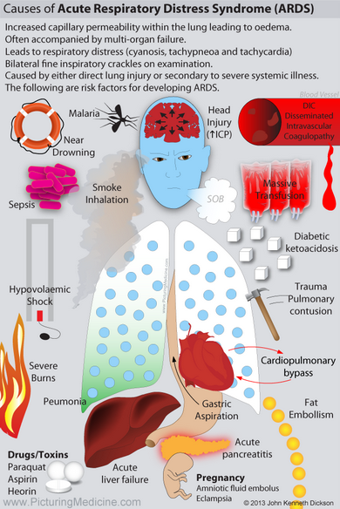

Slide 6
Pathophysiology of ARDS
Altered pulmonary capillary permeability.
Alveolar diffusion capacity.
The increased intrapulmonary shunt.

Slide 7
A. Exudative phase :-
(1-3 days) is characterized by diffuse alveolar damage with necrosis of majority of type I pnemocytes, diffuse micro vascular injury and influx of inflammatory cells and proteineous fluid into the interstitium.
Cytokines & Interleukins.
Pro-inflammatory mediators that initiate and amplify the inflammatory response.

Slide 8
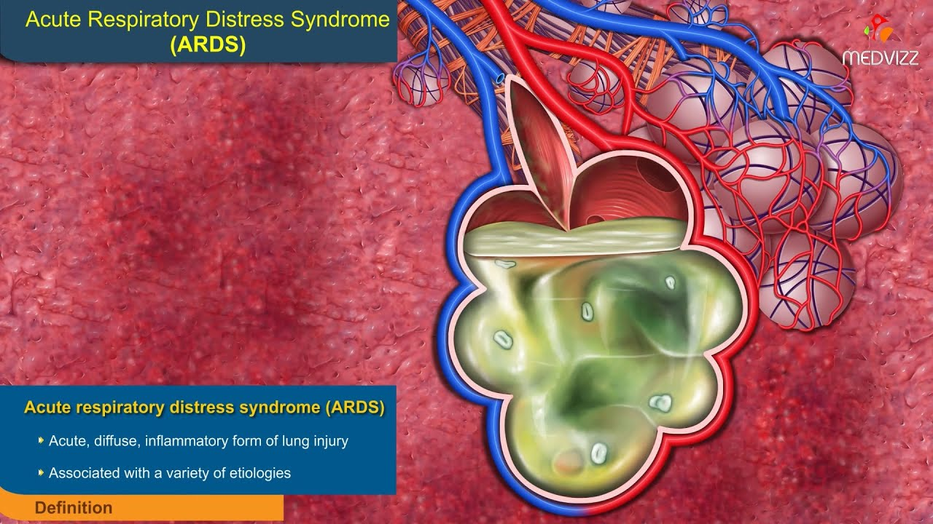

Slide 9
Proliferative phase
(3-7 days) is characterized by prominent interstitial inflammation and early fibrosis.
C. Fibrotic phase
Is characterized by proliferation of fibroblasts resulting in lung fibrosis.
Release of various cytokines (including IL-I, IL-6 and tumor necrosis factor TNF)
Multiorgan dysfunction syndrome (MODS)can occurs.
Impaired gas exchange with intrapulmonary shunt, which is manifested as profound hypoxemia.

Slide 10
Clinical features
Tachypnoea,
Dyspnoea
Fine inspiratory crepitations
Cyanotic
Tubular breath sounds
Hypotension
Blood-gas abnormalities leads to death

Slide 11
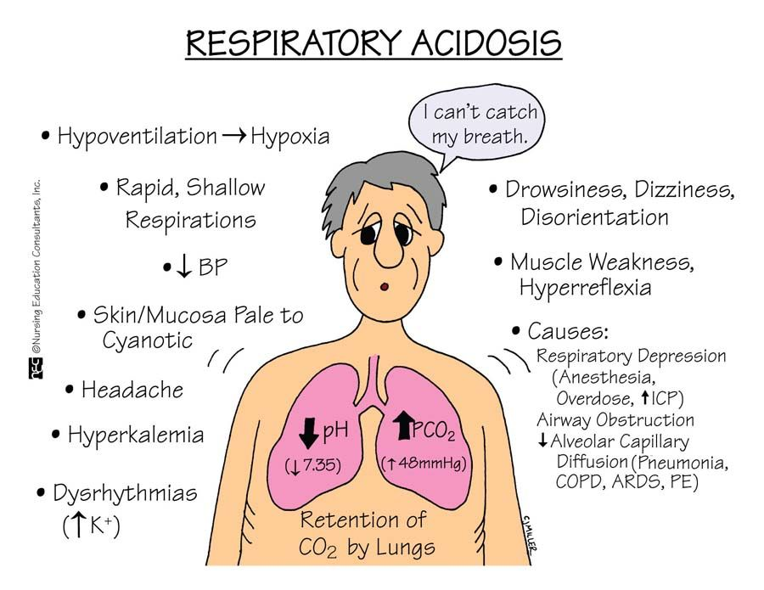

Slide 12
Investigations
CBC, KFT, LFT
Blood culture
Culture of tracheal aspirate
Culture of bronchoalveolar lavage.
CXR-PA view (ill-define patchy shadowing, whiteout appearance)
Arterial blood-gas analysis
CT scan

Slide 14
Complications
Sepsis, septicemia
Failure of other organs
Thrombocytopenia
Renal failure
Liver failure
Ileus, Hypotension
CNS deprecation
DIC

Slide 15
Management
Supportive care
Avoiding secondary lung injury aspiration, barotraumas, nosocomial infections oxygen toxicity.
Maintaining adequate oxygen delivery
Check & optimizing cardiovascular function and body fluid balance.
Nutritional support
Correction of hypoxiaemia
Prone position
Hypoxemias may be correctable with supplemental oxygen.
Nitric oxide and prostacyclin nebulization
Endotracheal intubation and mechanical ventilation if required

Slide 16
Corticosteroids use:-
Ing. Dexamethasone 4-8mg IV TDS
Ing. Hydrocortisone sodium succinate 200mg IV
Ing. Methyl prednisolone 60-80 mg IV bolous
Tab. Prednisolone 40-60mg BD PO
Tab. deflazacort 6-30mg BD PO
Antibiotics use:-
Ing. Aztreonam 1-2gm IV BD
Ing. Linezolid 600 mg PO/IV q12hr for 10-14 days
Ing. Vacomycin 500 mg q6hr or 1 gram q12hr
Ing. Meropenen 1 gm IV TDS OR
Ing. Imipenem 1 gm IV TDS OR
Ing. Pipracilline tazobactum 4.5 gm IV TDS OR
Ing. Ceftriaxone HCL 1-2 gm IV TDS
IV oflox 200-400 IV BD
IV levofloxacillin 500mg OD
Ing. Amakasin sulphate 500mg IV BD

Slide 17
Experimental therapies:-
(vasopressors and Inotrops)
Ing. Adrenaline 0.5-1ml IM and repeat
Ing. Atropine 1-2mg IV stat & SOS.
Ing. Dopamine / Ing. Dobutamine / Ing. Noradrenaline / Ing.Phenylephrine.
High frequency ventilation
Extracorporeal membrane oxygenation of blood
Diuresis therapy:-
Hydrochlorothiazide 12.5-25mg OD or
Chlorthaiazide 62.5-500 mg BD or
Chlorthalidone 12.5-25mg OD or
Fursoemide 10-40 mg BD or
Torasemide 05-10 mg BD

Slide 18
Correction of acidosis:-
Ing. Soda bicarb 10ml IV TDS
Bronchodilators:-
IV Aminophyllin 250mg IV in 20ml of dextrose. @ 20-25 drops /mins.
Ing. Deriphyline 2ml IV BD

Slide 19
Thank You…

