Slide 1
sterlization, asepsis and antisepsis as per
ancient and modern point of view

Slide 2
Sterilization
It is a process which kills or removes all micro-
organisms including bacterial spores from an article,
surface or medium.

Slide 3
disinfection
disinfection which destroys pathogenic micro-
organisms but does not kill or remove spores.

Slide 4
good antiseptic/ disinfectant should be:
(i) Chemically stable.
(ii) Cheap.
(iii) Nonstaining with agreeable colour and
odour.
(iv) Cidal and not merely static, destroying
spores as well.
(v) Active against all pathogens-bacteria,
fungi, viruses, protozoa.

Slide 5
(vi) Require brief time of exposure.
(vii) Able to spread through organic films and
enter folds and crevices.
(viii) Active even in the presence of blood, pus,
exudates and excreta.

Slide 6
Sterilization can be accomplished by physical
agents (viz. sunlight, heat, filtration and radiation)
and chemical agents (such as alcohols, aldehydes,
halogens, phenol, surface acting agents and gases)

Slide 7
Methods of sterilization
Heat sterilization
Chemical sterilization
Radiation Sterilization

Slide 8
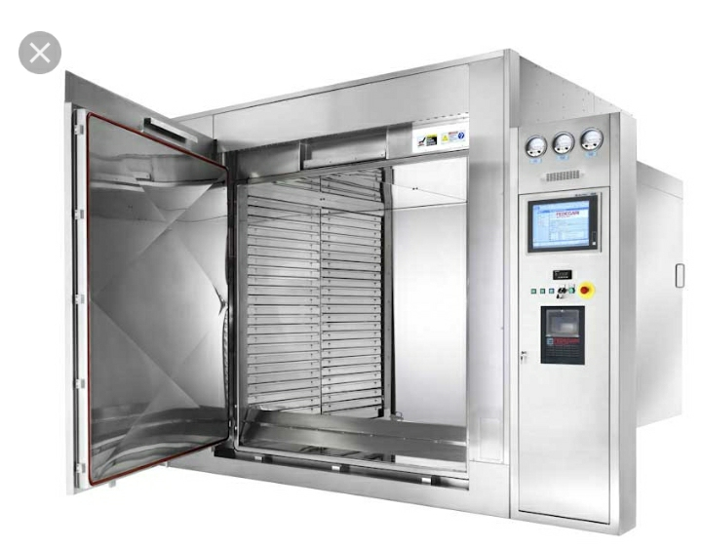
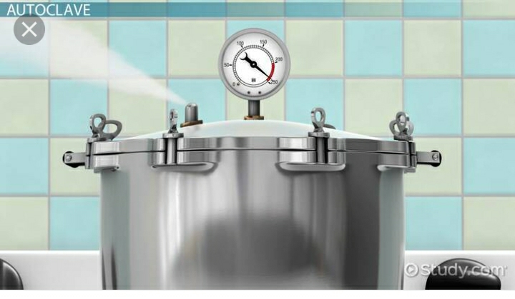
Heat sterilization
Dry heat sterilization
Moist heat sterilization

Slide 9
Dry Heat Sterilization
Flaming : The instrument is held in
a bunsen flame till it becomes red hot.
Incineration : it is used to destroy soiled
dressings, beddings and pathological materials
Hot air oven : kills bacteria,spores and viruses. The item
must be double wrapped and kept at 150° C for 1hours or 180 C for 20 min.

Slide 10
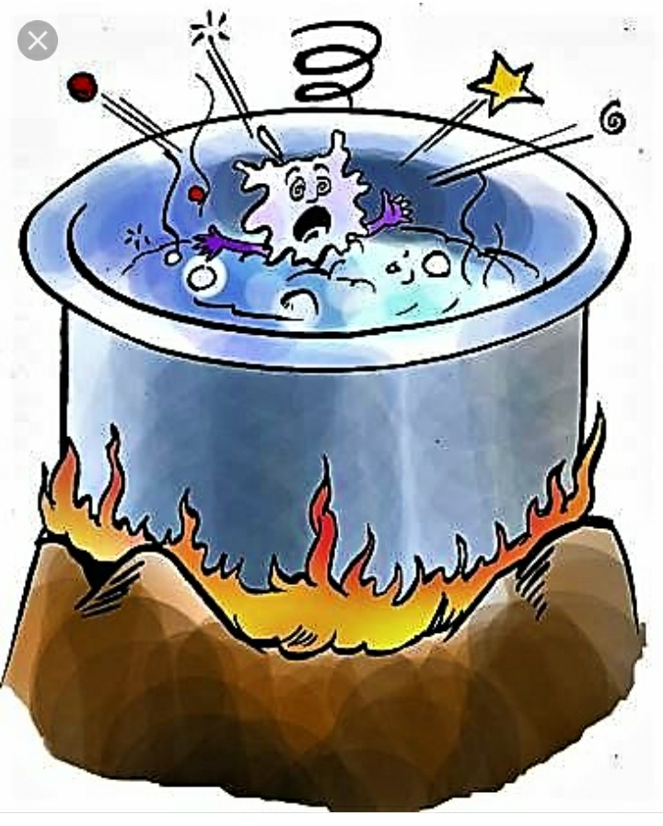
Moist heat sterilization methods
Boiling: It kills bacteria and viruses. Heavier
metallic ophthalmic instruments, e.g., Bard-Parker
handles, lid guards etc. can be sterilized by boiling
in water for 30 minutes. This method, however,
blunts the cutting instruments.

Slide 11
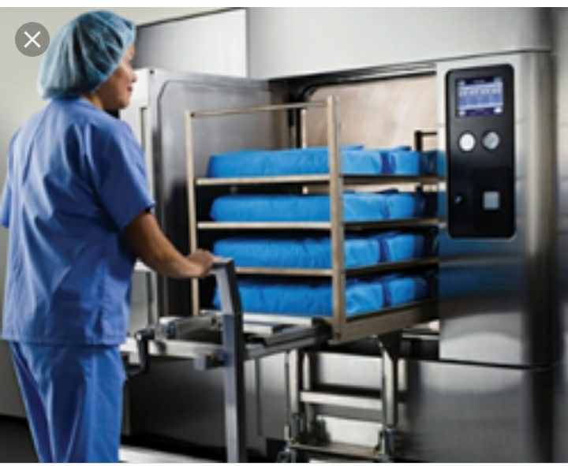
Steaming. It kills most bacteria and viruses, but
not spores. The instruments are placed on a shelf
above the level of water and steamed for about
30 minutes. Most of the metallic instruments e.g.,
scissors and knives can be sterilized by this
method.

Slide 12
Autoclaving (steam under pressure).It is the most
widely used method for sterilization. It is based
on the principle that at boiling point of water, the
vapour pressure equates the atmospheric
pressure. So, if the pressure is increased, boiling
point tends to rise, which increases the
penetrating power of the steam.
Autoclaving at 121° C under 15 1b/in2 pressure for
20 min. or at 116° C under 10 1b/in2 pressure for 40
min. kills bacteria, spores and viruses. This method
is suitable for sterilizing various instruments, linen,
glass wares, rubber goods, gowns, towels, gloves
dressings and eyedrops.

Slide 13
Chemical sterilization
Savlon. It comprises of cetavlon or cetrimide and
chlorhexidine. Cetavlon is a surface active agent
and chlorhexidine is a phenol. It is active against
most gram-positive organisms. It is used for
cleaning/preparation of skin. Scissors, catheters,
knives etc. may also be sterilized with it.
2. Spirit (95% alcohol). It kills bacteria and spores,
but not viruses. It is mostly used with savlon.

Slide 14
3. Methylated spirit. It is 70 percent isopropyl
alcohol. Schiotz tonometer can be sterilized by it.
4. Formaldehyde
i. Formalin. 10 percent solution of formalin has
a marked bactericidal, sporicidal and some
viricidal activity. It is suitable for cryoextractor
probes and heat sensitive instruments.
ii. Formaldehyde gas. It may be used for
fumigating wards, sick rooms and laboratories.
But this gas is irritant and toxic when inhaled.

Slide 15
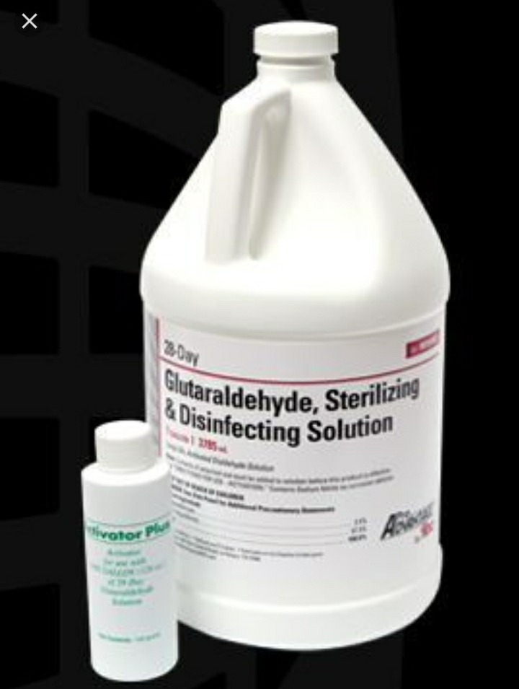
Glutaraldehyde (2%). It is available as ‘Cidex’
solution. It has a special activity against tubercle
bacilli, fungi and viruses. It is mostly used for
sterilising endoscopes because it has no damaging
effect on the lenses. It can be safely used for
catheters, face-masks, anaesthetic tubes and metal
instruments. However, it is not suitable for silicone
tubing. It is specially used to sterilize sharp
instruments, as it does not affect the sharpness.
In three hours, the instruments are free of
pathogens and spores. Instruments should be
thoroughly washed with sterile distilled water
before use.

Slide 16
6. Hydrogen peroxide. A 3 percent solution of
H2O2 is used for sterilisation of applanation
tonometers, prisms and ophthalmoscopy lenses.
It is specially active against AIDS and herpes
viruses.

Slide 17
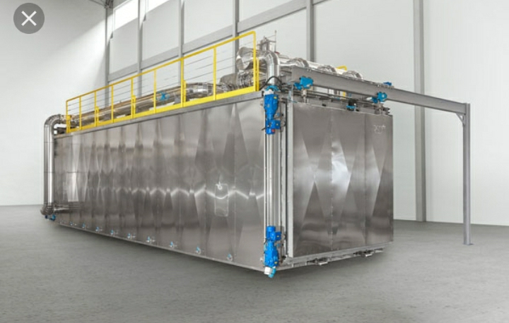
Ethylene oxide gas: It is a highly inflammable
gas and is usually mixed with an inert gas like
nitrogen or carbon dioxide. It denatures the protein
molecules. It is effective against almost all bacteria,
spores and viruses. Goniotomy lenses, indirect
ophthalmoscopy lenses, DCR tubings and
cryoprobes can be sterilized with it.
8. Acetone. Use of acetone is a quick and cheap
method of sterilising instruments. Instruments
should be kept in acetone for 5 minutes and then
thoroughly washed with sterile water before use.

Slide 18
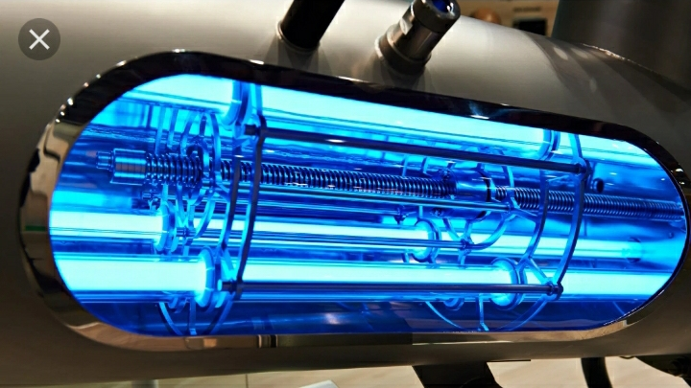
Radiation sterilization
1. Ionising radiations: These include X-rays,
gamma-rays, cosmic rays. They are highly lethal
to DNA and thus kill all types of micro-organisms.
They can penetrate solids and liquids without
raising the temperature appreciably (cold
sterilisation). They are used for sterilizing plastic
syringes, swabs, catheters, tubings etc.
2. Non-ionising radiations: They act as a form of
hot air sterilization since they are absorbed as
heat. They include the infrared rays which is
used for rapid mass sterilization of disposable
syringes.

Slide 19
Fumigation of operation theatre

