Slide 2
Ayurvedic Aspect of Neonatal Sepsis
oÉÉsÉMüÉlÉÉlÉuÉcÉxÉÉÇ ÌuÉÌuÉkÉÉ SåWû uÉåSlÉÉ |
mÉëÉSÒpÉÑïiÉÉ MüjÉÇ uÉæ±Éå eÉÉlÉÏrÉÉssÉ¤ÉhÉÉjÉïiÉ: ||
AÉqÉSÉåwÉ (ÌuÉwÉqÉrÉiÉÉ) - mÉÑuÉïÃmÉ
xiÉæÍqÉirÉ: AÃcÉÏÌlÉSìÉ aÉÉ§ÉmÉÉhQÕûiÉÉÅUÌiÉÈ |
UqÉhÉÉzÉlÉzÉrrÉÉSÏlÉ kÉÉ§ÉÏÇcÉ ²åÌ¹ ÌlÉirÉzÉÈ ||
AxlÉÉiÉÈ xlÉÉiÉÂmÉzcÉ xlÉÉiÉ¶ÉÉxlÉÉiÉ SzÉïlÉ |
AÉqÉzcÉæiÉÉÌlÉ ÂmÉÉÌlÉ ÌuÉ±É²æ±Éå pÉÌuÉwrÉiÉÈ||
- MüÉ.xÉÔ.25/23-33

Slide 3
Ayurvedic Aspect of Neonatal Sepsis
ÌmÉlÉxÉ (mÉëÌiÉzrÉÉrÉ) -
qÉÑWÒûqÉÑïZÉålÉÉåcNûuÉÍxÉÌiÉ ÌmÉiuÉÉ mÉÏiuÉÉ xiÉlÉ iÉÑ rÉÈ |
x§ÉuÉiÉÉå lÉÉÍxÉMåü cÉÉxrÉ sÉsÉÉOû cÉÉÍpÉiÉmrÉiÉå ||
x§ÉÉåiÉxrÉpÉÏ¤hÉ xmÉ×zÉÌiÉ mÉÏlÉxÉå MüÉxÉiÉå ||
- MüÉ.xÉÔ.25/37-38
ÍzÉUÉåUÉåaÉ -
pÉ×zÉï ÍzÉUÈ xmÉhSrÉÌiÉ ÌlÉÍqÉsÉrÉÌiÉ cÉ¤ÉÑwÉÉå |
AuÉMÑüeÉirÉUÌiÉqÉÉlÉxuÉmlÉzcÉ ÍzÉUÉåÂeÉÉå ||
- MüÉ.xÉÔ.25/6

Slide 4
Ayurvedic Aspect of Neonatal Sepsis
AVûxÉMü -
ÍzÉUÉå lÉ kÉÉUrÉÌiÉ rÉÉå ÍpÉ±iÉå eÉ×qpÉiÉå qÉÑWÒïû|
xiÉlÉ ÌmÉoÉÌiÉ lÉÉirÉjÉï aÉëÍjÉiÉ NûSïrÉijÉÌmÉ ||
ÌuÉwÉÉSkqÉÉlÉÉÂÍcÉÍjÉÌuÉ±ÉSsÉxÉMü ÍzÉzÉÉå |
- MüÉ.xÉÔ.25/26-28
AÇkÉmÉÑiÉlÉÉ -
AÇkÉmÉÑiÉlÉÉrÉÉcNûÌSïeuÉUÈ MüÉxÉÉåÅsmÉÌlÉSìiÉÉ |
uÉcÉïxÉÉå pÉåS uÉæuÉhrÉï SÉåaÉïlkrÉÉlrÉXûaÉzÉÉåwÉhÉqÉç ||
- A.xÉÇ.E. 3/78

Slide 5
Ayurvedic Aspect of Neonatal Sepsis
UåuÉiÉÏ -
euÉUÉÌiÉxÉÉUÉåuÉæxÉmÉïÈ mÉÏQûlÉåÎlSìrÉSÒwÉhÉqÉçû|
AÉhÉWû zÉÑsÉÂÍcÉÍpÉï lÉ µÉÉxÉMüÉxÉiÉ×Oû ||
ÌlÉSìÉlÉÉzÉÉåÅ ÌiÉÌlÉSìÉ cÉûqÉÑZÉmÉÉMüÉå uÉëhÉÉå°uÉ |
- MüÉ.xÉÇ.ÍcÉ. 20
kÉëÑmÉlÉ ÍcÉÌMüixÉÉ -
LiÉæoÉÉïsÉÉlÉ xÉqÉÉmÉhhÉÉlÉËU¹ÉaÉÉUqÉåuÉ cÉ |
uÉx§ÉzÉrrÉÉxÉlÉÉ± cÉ oÉÉsÉÉlÉÉ kÉÔmÉrÉåÎ°wÉMçü ||
- MüÉ. kÉÔmÉMüsmÉÉkrÉÉrÉ

Slide 6
SYSTEMIC BACTERIAL INFECTION OR BLOOD STREAM INFECTION (such as septicemia, meningitis, pneumonia)
What is Neonatal Sepsis ?

Slide 7
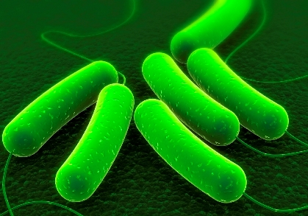
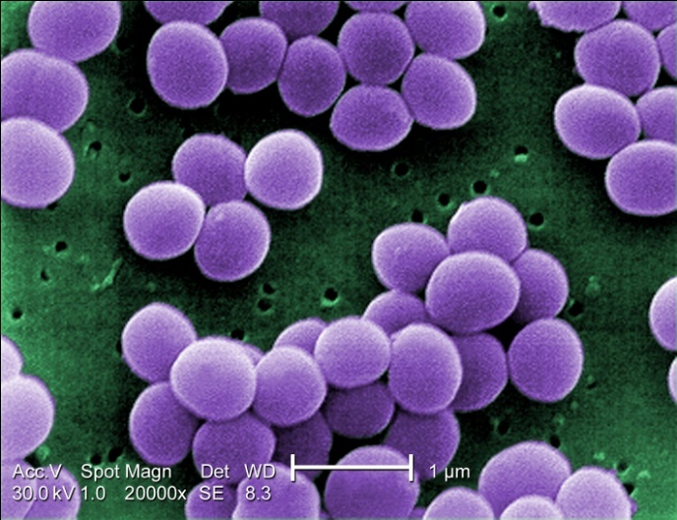
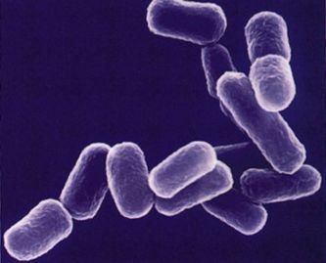
Etiology
E-coli Staphylococcus oureus
Klbsiella Species

Slide 8
Early onset Sepsis
Less than 72 hrs
Infection cause by organisms prevalent in the maternal genital tract/ in the delivery area

Slide 9
Early onset Sepsis
Predisposing Factor
LBW
PROM
Foul smelling liquor
Multiple per vaginal exam.
Maternal fever
Difficult prolonged labor
Aspiration of meuconium

Slide 10
Late onset sepsis
More than 72 hrs
Infection cause by organisms thriving in the external environment of the home or the hospital.
infection transmitted through the hands of care provider.

Slide 11
Late onset sepsis
Predisposing Factor
LBW
Lack of breast feeding
Poor cord care
Superficial infection
Aspiration of feeds
Disruption of skin integrity

Slide 12
When Suspects NNS?
Suddenly refuses to suck
Lethargic
Inactive
Poor Cry
Hypothermia / Changes in body temp.
Abdominal distention
Vomiting

Slide 13
When Suspects NNS?
Fast breathing, chest retraction & grunt indicate pneumonia.
Presence of excessive cry, fever, seizures, neck retraction are suggestive of meningitis.
Shock, Bleeding, sclerema, renal failure indicates overhelming sepsis.

Slide 14
Sepsis screen
PARAMETER | Abnormal Value
TLC | <5000/c.mm
Absolute Neutrophil count | <1800/c.mm
I/T ration (Immature to total neutrophill ratio) | >0.2
Micro ESR | >15mm in 1st hour
CRP | >1mg/dl

Slide 15
Supportive Care
1) Provide Warmth
2) Start Oxygen if cyanosed / grunting
3) Start IV line if hypoglycemia (D10% 2ml/Kg)
4) Ensuring optimal nutrition
5) Administer vit. K 1mg IM
6) Transfuse packed cell if low haematocrit count
MAnagement

Slide 16
Antibiotic Therapy
Early recognition, prompt administration of effective & appropriate antibiotic therapy with optimal supportive management are mandatory to improve their intact survival.
MAnagement

Slide 17
Initial antibiotic Therapy
CLINICAL Situation | SEPTICEMIA & PNEUMONIA | MENINGITIS
FIRST LINE-COMMUNITY AQUIRED RESISTANT | AMPICILLINE / PENICILINE & GENTAMICINE | CEFOTAXIM & GENTAMICINE
SECOND LINE-HOSPITAL AQOIRED | AMPICILLINE / COXACILLINE & AMPICILLINE | CEFOTAXIME & AMICACINE
THIRD LINE- HOSP. AQUIRED SEPSIS | CEFOTAXIME & AMIKACINE | CEFOTXIME & AMIKACINE

Slide 18
Duration of Antibiotic Therapy in neonatal sepsis
DIAGNOSIS | DURATION
Culture and sepsis screen negative | 5-7 days
Sepsis screen positive | 7-10 days
Blood culture positive | 10-14 days
Meningitis | 21 days
Arthritis, osteomyelitis, endocarditis | 4-6 weeks

Slide 19
EXCHANG BLOOD TRANSFUSION
1) Sick babies in the presence of sclerema.
2) Disseminated coagulation
3) hyperbilirubinemia.
INTRAVENOUS IMMUNOGLOBULINS
It has doubtful beneficial immune-enhancing effect.
ADJUNCT THERAPy

Slide 20
THE OUT COME DEPENDS UPON
1) Weight & maturity of infant. 2) Type of etiologic agent.
3) Its antibiotic sensitivity pattern 4) Adequacy of specific & supportive therapy.
Prognosis

