Slide 1
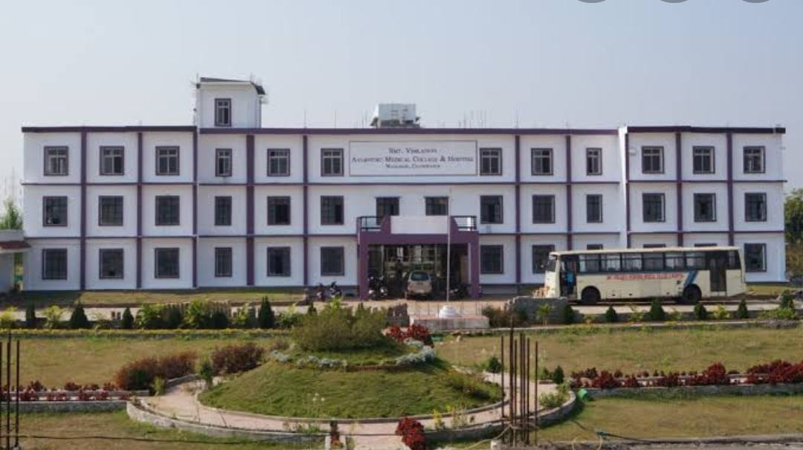
SMT. VIMLADEVI AYURVEDIC MEDICAL COLLEGE AND HOSPITAL .
WANDHARI , CHANDRAPUR .

Slide 2
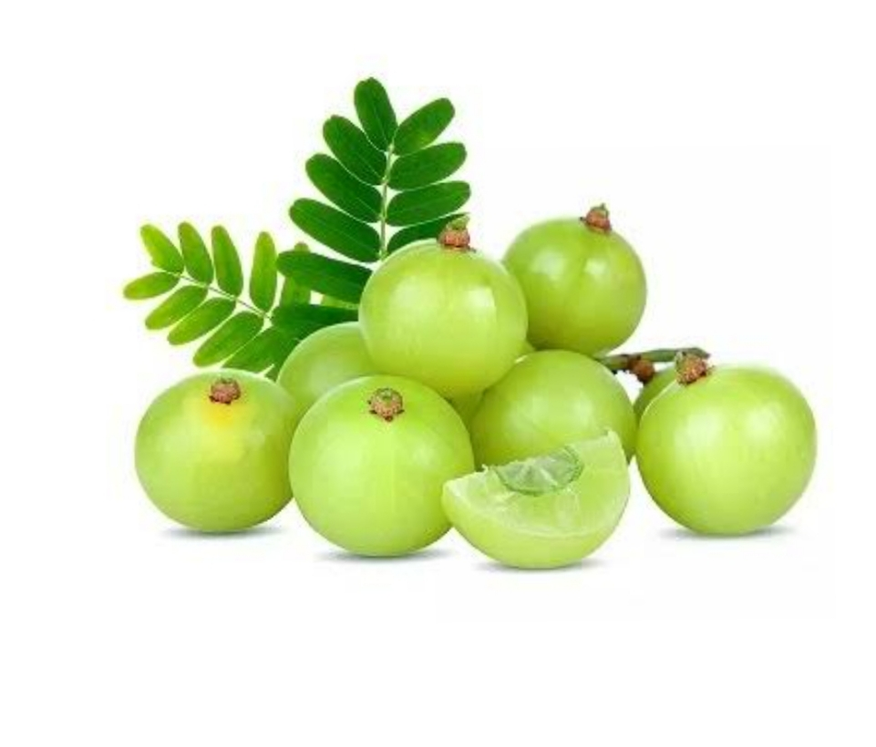
AMALAKI
Gana :
Vayasthapana .
Rasayana .
Family :
Eranda Kula . ( Ephorbiaceae )
Latin Name :
Emblica officinalis .

Slide 3
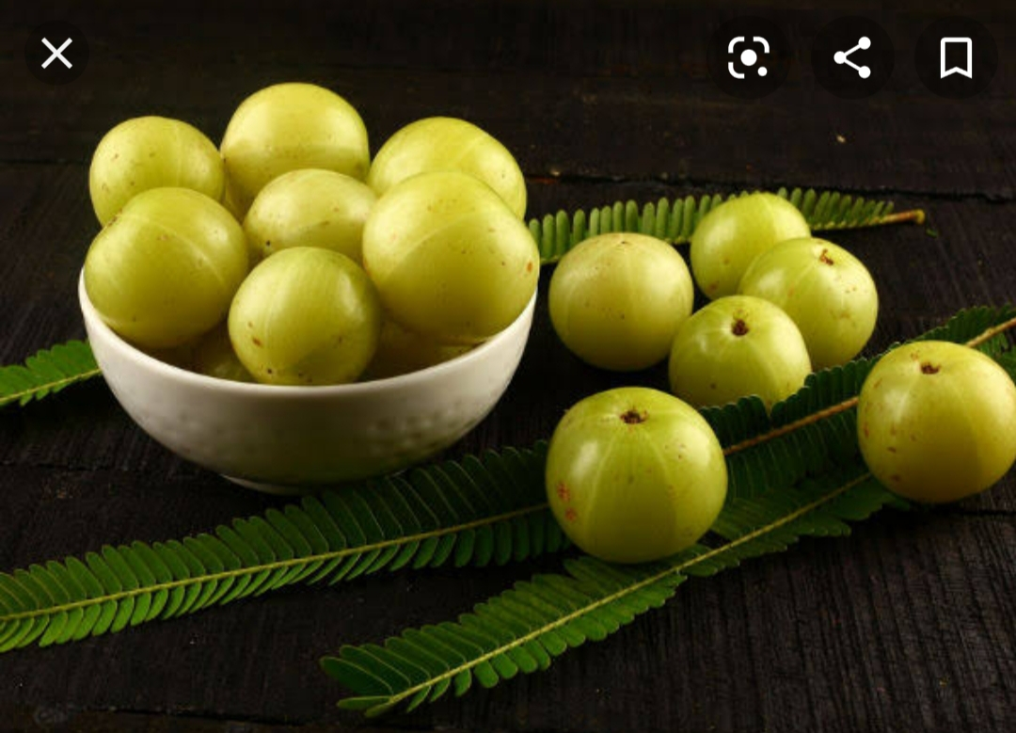
Synonyms :
Dhatree
Shriphala
Amrita
Shiva , etc .
Regional Names :
Marathi – Avala
Hindi – Amla

Slide 4
Morphology :
A medium sized tree about 8 to 10 metres tall .
Stembark is greenish black ,
thin leaf , oblong , resembling that of chincha , but smaller and thinner .
Flower – longer flower stalk .
Fruit – rounded , 1 to 2.5 cm , diameter , fleshy , greenish yellow when raw and reddish yellow when ripe . There are six vertical lines on the fruit .
Seeds – with six edges , hard .
Big berrys are even 50 to 60 gm in weight .

Slide 5
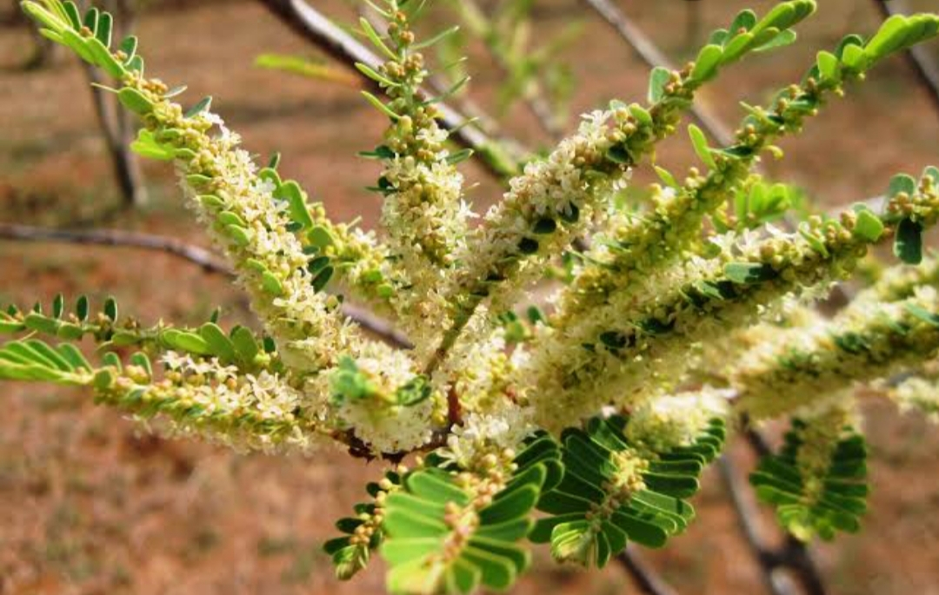
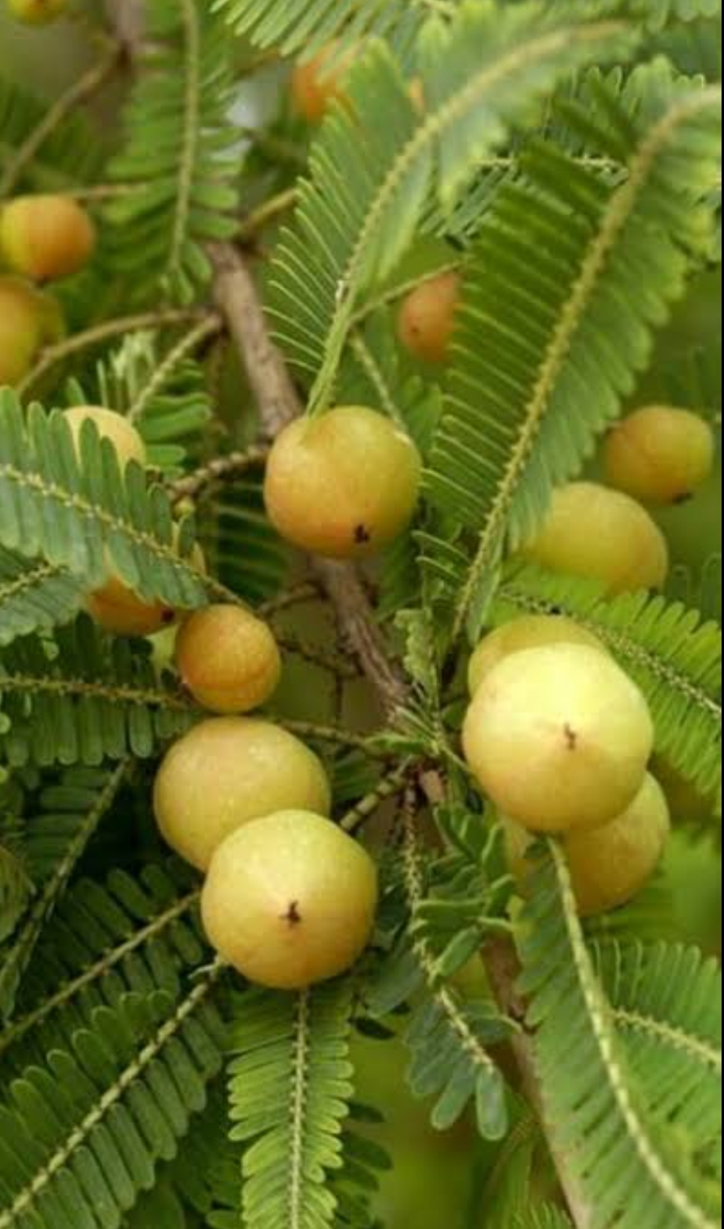
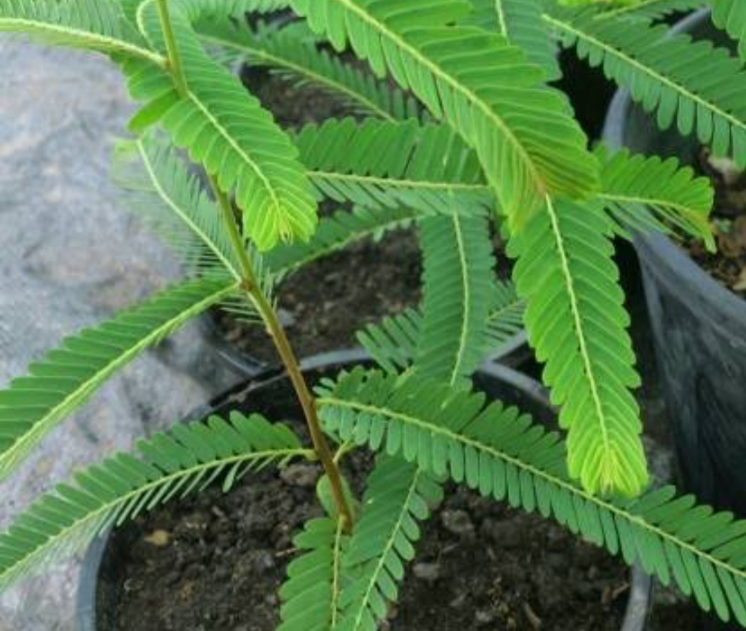
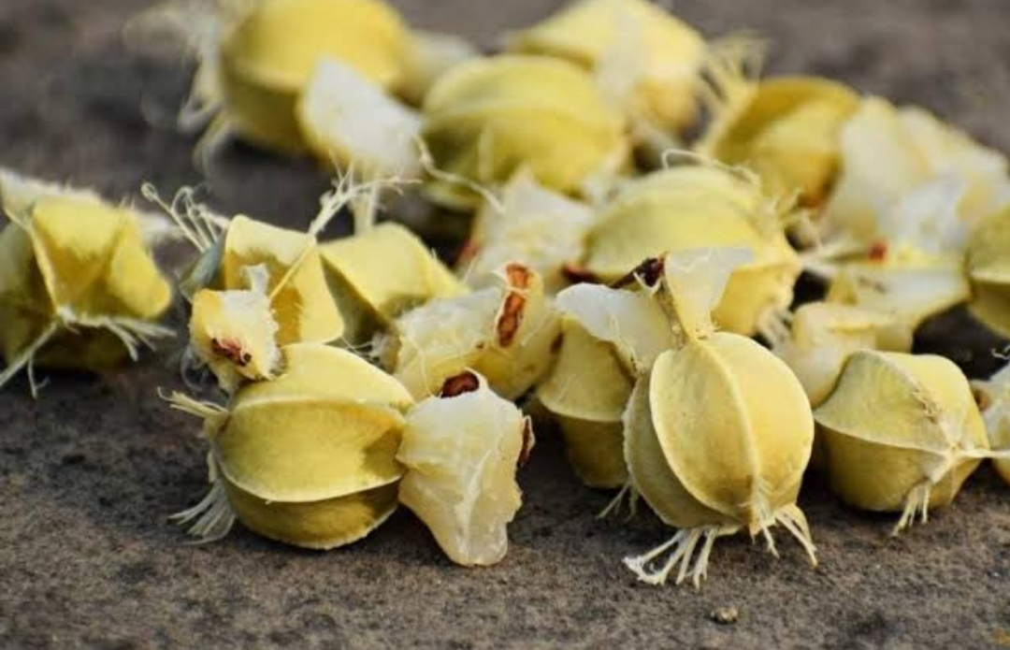

Slide 6
Habitat :
All over India upto 1500 meters of height .
Upayuktanga :
Fruit .
Attributes :
Rasa – Five except lavana . Amla is main
Vipaka – madhura
Veerya – sheeta
Gunas – Laghu , rooksha .

Slide 7
Action and Uses :
Doshaghnata –
Vataghna being amla .
Pittaghna being madhura and sheeta .
Kaphaghna being rooksha and kashaya .
Local –
A paste of its svarasa is applied in daha
Hair shuould be washed with its svarasa in khalitya and palitya .
Its siddha taila acts as keshya .

Slide 8
Internal :
Anna and Pureeshavaha –
Used in – aruchi
agnimandya
and diseases of yakrit
It eliminates shirashoola as well .

Slide 9
Rasa – Raktavaha :
Jvara – it is useful in pittanubandhi jvara being sheeta.
It pacifies all the three doshas residing with rasa and increases strength of dhatus .
Medovaha :
Prameha – it digests kleda and excretes it through basti .
Majavaha :
It is medhya and balya to vatavahinis and increases strength of jyanendriyas .

Slide 10
Shukravaha :
It is shukravardhana due to its madhura rasa vipaka and its prabhava.
Rasayana :
It purifies dhatus and alleviates doshas in them.
It removes obstruction in channels hence respective elements from ahararasa are transported satisfactorily to dhatus through rasa .
Thus amalaki acts as rasayana and vayasthapana.

Slide 11
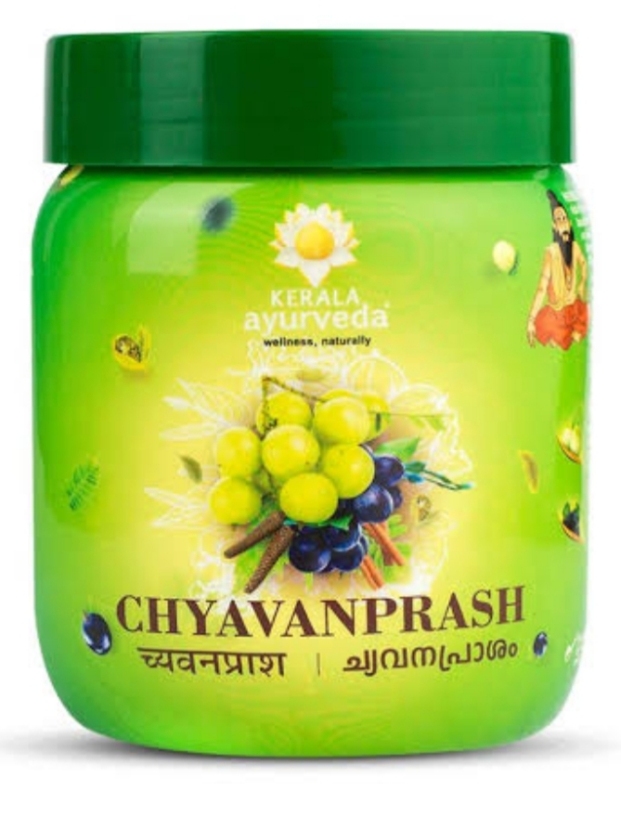
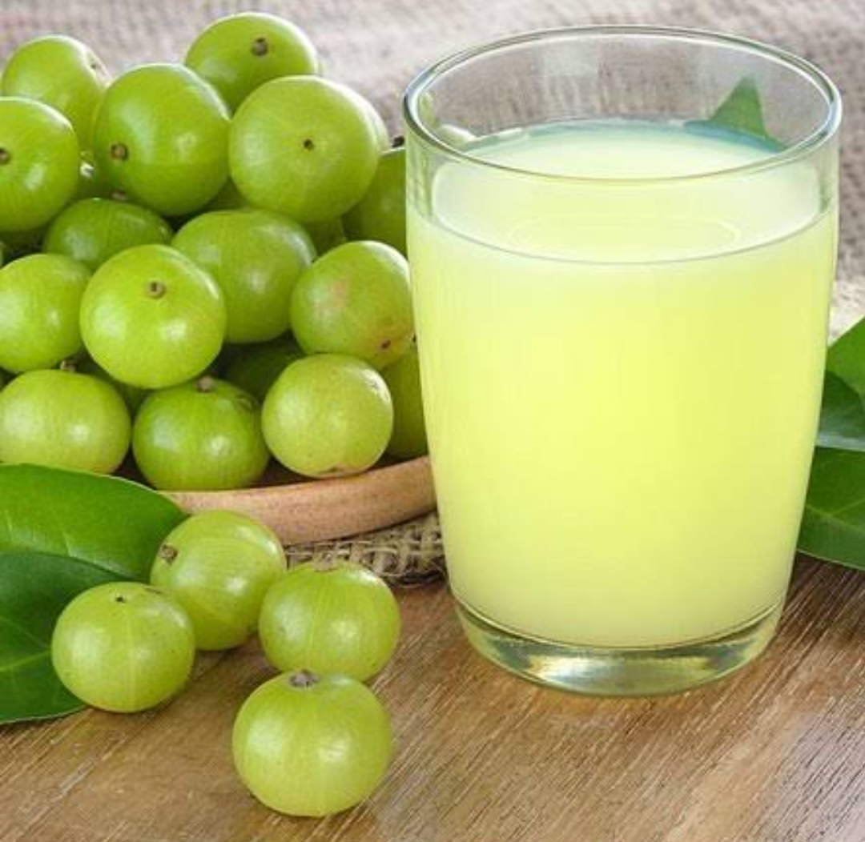
Dose :
Svarasa – 10 to 20 ml.
Choorna – 1 to 2 gm .
Kalpa :
Chyavanprashavaleha
Dhatreyavaleha
Amalakyadi choorna , etc .

Slide 12
Amayika prayoga :
Fresh amalaki juice is indicated alongwith jeeraka powder and sugarcandy in amlapitta.
Amalaki juice and ghee should be given together for shukravriddhi .
Chemical composition :
Gallic acid
Tannic acid
Sugar , albumin ,calcium
Plenty of vitamin C , which is heat resistant .

