Slide 1
COMA
DR SANDESH .P. GOJE
ASSISTANT PROF ( KAYACHIKITSA )
SVAMC&H , CHANDRAPUR.

Slide 2
COMA
Coma has been defined as absence of any psychologically
understandable response to external stimuli or inner need.
Coma is a state where consciousness is altered severely
and there may be depressed brain function.
Coma is a state of alter consciousness from which a person
cannot aroused easily.
Presentation of coma
I Altered physiological function
II Raised intracranial tension
III Herniations syndromes

Slide 3
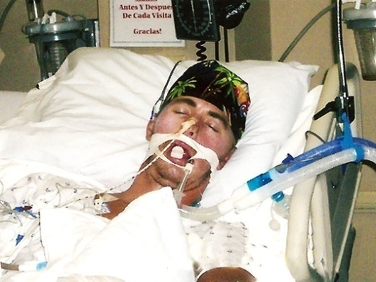
Comatose patient

Slide 4
Altered physiological function
State of consciousness:- Awareness and responsiveness of
Individual minds to himself, the environment and impressions made by
his senses.
Confusion :- Mild lowering of level of consciousness, impaired
capacity to think clearly as well as respond slowly to the verbal stimuli
by remembrance of the questions.
Fugue state:- Disturbance in consciousness for several days during
those period patients performs various acts. But while when he/she
become consciousness, fails to remember the action carried out during
that period.
Syncope;- Impaired circulation, partial or transient, suspension of
consciousness, shallow respiration impaired circulation, pallor,
perspiration and cold skin.

Slide 5
Lethargy:- Drowsiness , prolonged sleep. He appears to
incomplete possession of his senses but goes back to sleep as soon as the stimulation is removed.
Stupor:- Disturbed consciousness from which the patients can be aroused.
Altered mental status:- It is a continuum and includes
any state where the level of consciousness is altered.
Delirium:- Confusion disorders perception and loss of
attention, disorientation in time, hyperkinesias.
Coma:- Complete loss of consciousness, patient not
responding to painful stimuli, all reflexes e.g. corneal,
light, cough, swallowing, are lost.

Slide 6
Pupils:- Pupilary reaction helps to differentiate
structural from metabolic causes of coma.
Absence of light reflexes- suggest structural lesion,
asphyxia, hypothermia and under influence of drugs like
barbiturates, atropine etc.
Fixed and dilated pupils:- mydriatic drops, trauma
Hippus (rhythmic constriction and dilatation of pupils):-
due to mid-brain damage
Irregular pupils:- e.g. trauma or mydriatic etc.

Slide 7
C Respiratory pattern:-
Cheyne-stokes respiration:- e.g. hypertensive
encephalopathy, metabolic diseases, transtentorial
herniation, status asthamaticus etc.
Hyperventilation:- e.g. hypoxia, acidosis, salicylate.
poisoning, meningitis, encephalitis, brain access etc.
Hypoventilation:- e.g. ARDS, sedative-narcotic over
dosage, brain stem compression
Ataxic breathing:-e.g. medulla compression, lesion in
brain, herniation.

Slide 8
D Eye movement:-
Dolls eye movements:- E.g. hypoglycemia, hepatic
encephalopathy, metabolic coma.
Ocular bobbing:- e.g. primary pontine hemorrhage.
Sundown deviation:- e.g. mid-brain compression.
Conjugate gaze:- e.g.pontine lesion.
Corneal reflex:- e.g. absent in brainstem lesion, or death.
E Motor response:-
Decorticate posture (flexion of all extremities)
Decerebrate posture (extension of all extremities)
Triple flexion (extension of upper extremities and flexion
lower extremities)

Slide 9
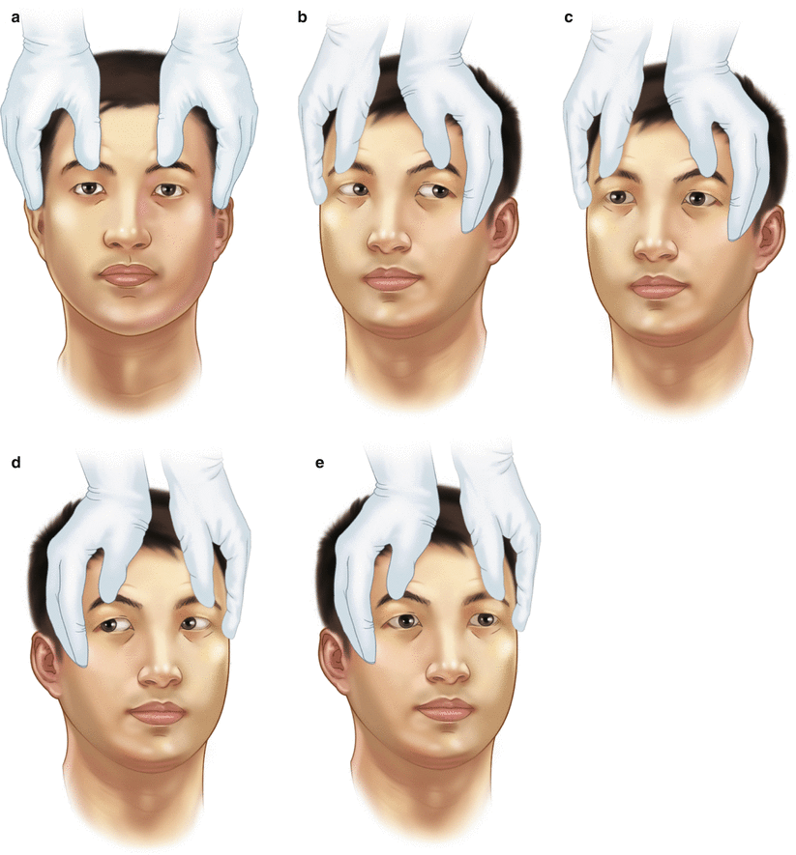
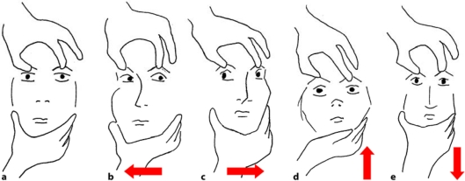
Doll’s eye sign

Slide 10
Divergent eye sign

Slide 11
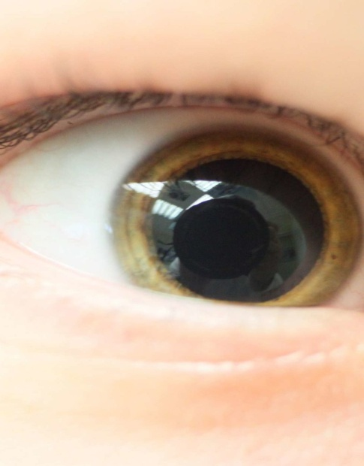
Dilated pupils

Slide 12
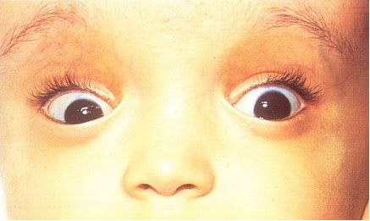
Sunset sign

Slide 13
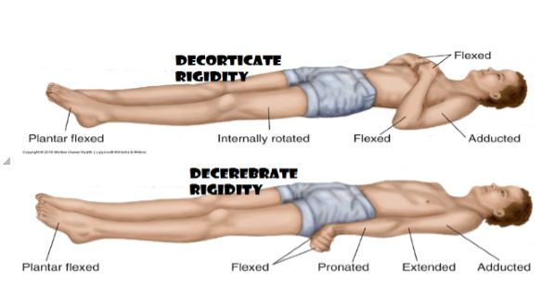

Slide 14
Glass glow coma scale
Eye opening response
Spontaneous 4
To loud noise /voice 3
In response to pain 2
No response 1
Motor response
Obeys commands 6
Localizes pain 5
Flexion/withdrawal to pain 4
Flexion posturing 3
Extension posturing 2
No verbal response 1
Verbal response
Oriented 5
Confused/disoriented 4
Inappropriate words 3
Incomprehensible words 2
No response 1

Slide 15
Severity of coma
Grade 0 : fully conscious
Grade 1: drowsy, but responds to verbal commands
Grade 2 : unconscious, but responds to minimal pain stimulus
Grade 3 : unconscious, but responds to strong pain stimulus
Grade 4 : unconscious with no response to pain

Slide 16
II Raised intracranial pressure:-
Normal ICT- 2-15mm of Hg. Raised in SOL, headache
vomiting, papilloedema, bradycardia, hypertension,
chynes-stokes respiration yawning and hiccuping.
III Herniation syndromes:-
Uncal herniation:- Intracranial Lesion in temporal lobe or lateral cranial vault. Compression of midbrain,
oculomotor nerve and posterior cerebral artery.
Transtentorial herniation:- Lesion in frontal pariatal,
temporal lobe, midbrain is displaced.

Slide 17
Causes of Coma
A Late causes (by which coma develops late):-
Cerebral anemia (cardiac failure, hypotension, hypoxia, etc..)
Severe systemic infections ,septicemia, typhoid, cholera,
pneumonia, malaria, Weil’s disease).
Toxic (arsenic, lead, milk alkali syndrome, drugs).
Infections (meningitis, encephalitis,
cerebral abscess, GPI, trypaosomiasis)
Cerebral tumors
Metabolic causes (diabetes, uremia, hypoglycemia,
uremia, hepatic encephalopathy, electrolyte disturbances.
Addison’s disease, hypothyroidism, hypothermia).

Slide 18
B. Early causes (by which coma develops early)
Miscellaneous (heat stroke, caisson’s disease, extreme
cold).
Supratentorial
1 Extra cerebral-
Head injury (concussion, confusion, epidural or subdural hematoma)
subarachnoid hemorrhage
meningitis
2 Intra cerebral-
Cerebro-vascular accident (thrombosis, embolism, hemorrhage, venous thrombo-phlebitis)
Encephalitis
SOL (neoplasm, abscess)
pituitary apoplexy

Slide 19
Subtentorial
Pontine, midbrain or cerebellar hemorrhage.
Basilar artery occlusion
Cardiac (stokes-adams syndrome, hypertensive encephalopathy)
Post – epileptic
Metabolic(as above)
Toxic (barbiturates, alcohol, opium, heroin, kerosene etc.)

Slide 20
Investigation
CT brain plain & contrast
MRI brain plain & contrast
CSF microscopic
KFT,LFT parameters (Sr.urea, Sr. creatinine, Na+, K+)
CBC, LFT, ABG, ESR, Sr. Ca.
CXR-PA View.

Slide 21
Treatment
Physical examination of comatose patients
Level and severity of coma.
Any focal deficits ( hemiparasis, weakness, convulsions)
Check for pupils size and response to light stimuli
Motor response
Check for respiration pattern
Check for breathing (sluggish, slow, rapid etc.)
Check for oculocephalic and oculovestibular reflexes
Complete systemic examination
Check for acidotic breathing e.g. DM keto acidosis, uremic encephalopathy
Check for cyanosis

Slide 22
……..Treatment
Maintain ABCD
TPR BP check, SPO2
Bed side RBS by glucometer
Insert central line
Diagnose underline causes as early as possible
Adopt appropriate specific treatment most earlier.
E.g. if patient is diabetic then starts hypertonic glucose without waiting for reports. Clean oral cavity by glycerin borack 3 times/day.
Do suction in repeated interval
Urine cauterization (condom, Foley's)
Daily catheter care by betadine and savlon
Bladder exercises given after few days to regain a loss of stone

Slide 23
Bowel care:-
For constitution, using saline enema alternate day,Use of diaper
Peri anal and genital region care in daily basis by using antiseptic dusting powders
Eyes and skin care:-
Use antibiotic and lubricant eye drop daily 3-4 times
To avoid bed sore, patient bed sheet, cushion is properly maintain, clean and hygiene.
Water bed or air bed should be use
Turn the positions of patients every 2-3 hours
Dressing of sore by using H2O2, salvon, betadine and antiseptic cream
Passive physio therapy should be done daily to avoid stiffness
Ing. Nikethamide (coramin –respiratory stimulants)
Vasopressors use.
IV fluids (isotonic and hypertonic saline)
Ryle’s tube feeding (daily 1500-2000 calories
Milk, juices, vegetable soups, rice kanji, water, sugar, coconut water etc.
Treating the primary cause of coma.

Slide 24
…Thanks

