Slide 1
MICRONUTRIENTS – HEALTH & DISEASES
Dr. Kiran Nandeshwar
MD Kaumarbhritya

Slide 2
WATER SOLUBLE VITAMINS
Thiamine (vit B1)
Riboflavin (vit. B2)
Niacin (vit. B3)
Pyridoxin (vit. B6)
Cobalamine (vit. B12)
Folic acid (ptroylglutamic acid)
Biotin
Pantothenic acid
Vitamin C

Slide 3
Thiamine
DAILY REQUIREMENT: 0.4 mg/1000kcal of carbohydrate intake
SOURCE: unrefined and fortified cereal grains, enriched backery products, organ meats.
Sensitivity to heat, sulfites, pasteurization & sterilization.
DEFICIENCY: who consume diets based on polished rice

Slide 4
BERIBERI
TYPES:
Wet
Dry
Infantile

Slide 5
INFANTILE BERIBERI
First 6 month of life
Breast milk deficient in B1
Rapid onset
Cyanosis, tachycardia, labored breathing.
Heart failure and death.

Slide 6
Dry beriberi : nerve involvement
Wet beriberi : cardiac involvement

Slide 7
Severe deficiency:
Wernicks encephalopathy
Korsakoff syndrome

Slide 8
Diagnosis
CLINICALLY:
Lack of coordination
Weak reflexes
Droopy eyelids
Difficulty in walking
Rapid heart rate
Dyspnea
Lower limb swelling

Slide 9
Lab investigations
24 hr urinary thiamine excretion
Normal: 40-100 µg/day
Deficiency <15µg/day
Erythrocyte transketolase activity

Slide 10
treatment
Mild beriberi: 5mg/day IV BD
Severe form: 10 mg/day IV BD

Slide 11
RIBOFLAVIN
REQUIREMENT:
0.4mg/1000kal – infants
0.8-1.2mg/1000kcal - children

Slide 12
Deficiency
Due to inadequate intake or malabsorption
Term used: ARBOFLAVINOSIS
Photophobia
Corneal vascularisation
Cataract

Slide 13
Glossitis
Angular stomatitis
Seborrheic dermatitis
Magenta tongue
Sore throat
Normocytic normochromic anaemia

Slide 14
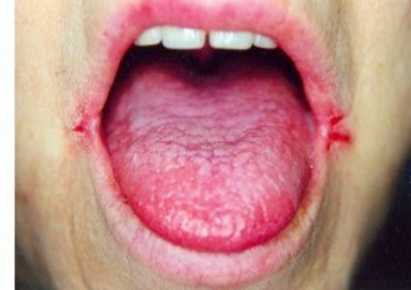
Magenta tongue

Slide 15
Diagnosis
Characteristic lesions of beriberi
Always associated with other vitamin B deficiencies

Slide 16
Lab investigations
24 hr urinary excretion of riboflavin
Less than 10% of intake in 24hr - deficiency

Slide 17
Treatment
Children - 1mg TDS
Infants – 0.5mg BD

Slide 18
NIACIN
Two forms: nicotinic acid & nicotinamide
Source : milk, cereals, leafy vegetables, fish, tea , coffee
Resistant to heating

Slide 19
Deficiency
Due to maize dependency
Deficiency of nicotinic acid or its precursor tryptophan
Leads to the disease PELLAGRA

Slide 20
PELLAGRA
Dermatitis
Diarrhea
Dementia

Slide 21
Dermatitis
Pigmented rash aggravated by sunlight
Progresses to vesiculation, ulceration and secondary infection
Erythema- roughening and keratosis with scaling

Slide 22
Dementia
Apathy
Headache
Loss of memory

Slide 23
Diarrhea
GIT symptoms precedes skin manifestation
Glossitis, atrophy of papillae of tongue with gastritis
Acute inflammation of small intestine and colon
Failure to thrive
IBS

Slide 24
Diagnosis : investigation
24 hr urinary excretion of N¹methylnicotinamide
Normal – 4-6mg/day
Deficiency <3mg/day
Pellagra- 0.5-0.8mg/day

Slide 25
Treatment
Daily dose of treatment is about 10 times of recommended dietary intake
Nicotinamide given orally
PREVENTION
Adequate protein diet containing tryptophan & niacin rich food

Slide 26
PYRIDOXINE
FUNCTIONS
Food assimilation
Protein and essential fatty acid metabolism
Production of antibodies against bacterial disease
Decreases formation of homocysteine
Absorption of vit B12
Production of neurotransmittors

Slide 27
Source
Yeast
Sunflower seeds
Wheat germ
Soyabeans
walnuts

Slide 28
Deficiency
Anemia
Neuropathy
Seizures
Skin problem
Mouth sores

Slide 29
Patient INH treatment
Pyridoxine 10-50mg /kg/day
Prevent peripheral neuropathy and other neurological effects

Slide 30
COBALAMINE
Most commanly available form- cyanocobalaime
Active form- methylcobalamine & 5-deoxyadenosylcobalamine

Slide 31
Function
Normal functioning of brain and CNS
Formation of RBC
Helps in formation of tetrahydrofolate from methyl folate
Hence deficiency of vit B12 – blocks above reaction- traps folate in inactive methyl form- folate deficiency

Slide 32
Source
Only produced by microorganisms
Liver, kidney, heart, muscle meat
Clams and oyesters

Slide 33
absorption
Intrinsic factors- secreted by parietal cells
Destruction or absence of these glycoprotein
Pernicious anemia- inability to absorb ingested vit B12

Slide 34
requirement
Infants- 0.3 µg/day
Children- 0.5- 1.5 µg/day
Adult – 2 µg/day

Slide 35
deficiency
Impaired absorption
Disease of liver or intestine
Strict vegetarian diet
Methylmalonic aciduria
Megaloblastic anemia
Neutrophil hypersegmentation
thrombocytopenia

Slide 36
Diffuse and progressive demyelination
Begins in peripheral nerve and progresses to involve the posterior and lateral column of spinal cord and CNS

Slide 37
DIAGNOSIS
Anemia –Macrocytic, nucleated RBC
Serum cobalamine level < 1.1 mmol/L indicates negative vitamin B12 balance
Methylmalonic acid increased
Hemocystine increased
Red cells, folate level decreased
Serum LDH level elevated

Slide 38
treatment
Parenteral administration of vitamin B12
250-1000mcg IM on alternate day for 1-2 wks
Then wkly until blood count is normal
Maintenance dose: 1000mcg/2-4 month

Slide 39
FOLIC ACID
FUNCTION:
Normal growth and maintenance of cell
Acts as a co-enzyme for normal DNA & RNA synthesis
Folate is vital for multiplication of cells within the fetus
Folic acid with vit B12 converts hemocystiene to methionine- reduces blood level of hemocystiene- lowers risk of heart disease
Maintains integrity of CNS

Slide 40
source
Leafy vegetables- spinach, turpin greens, lettuce, dried beans and peas
Fortified cereal products
Sunflower seeds

Slide 41
requirement
25mg in infancy
200mg in adolescent

Slide 42
deficiency
Limits cell division & protein synthesis
Affects normal growth and repair of tissue
Erythropoesis is hindered- megaloblastic anemia
Impaired brain & CNS function- memory problems
Maternal deficiency during pregnancy- neural tube defect in fetus

Slide 43
treatment
0.5- 1mg/day folic acid orally for 3-4 wks
Periconceptional folate supplement:
1 month before and 3 month after conception– reduces the risk of NTD

Slide 44
biotin
FUNCTION
Co-enzyme for various carboxylation reaction
Aminoacid catabolism
Gluconeogenesis
Fatty acid metabolism

Slide 45
source
Egg yolk
Milk
Meat
Yeast extract
Generally produced by gut flora

Slide 46
requirement
0.15 mg biotin in multivitamin supplement for infant and children

Slide 47
deficiency
Individual consuming large no. Of raw eggs for several month
Long term parental nutrition without biotin
Genetic defect affecting activity of biotinidase

Slide 48
deficiency
Dry scaly dermatitis
Seborrheic dermatitis
Fine & brittle hair
Aloepecia
Fungal infection
hypercholesterolemia

Slide 49
treatment
Oral: 2-5mg daily for 2-3 wks in mild case
Parenteral biotin 200µg daily for 2-5 days in severe cases

Slide 50
Pantothenic acid
Essential for reaction of fatty acid, steroids and cholesterol synthesis
REQUIREMENT
Infant – 2-3 mg
Children- 3-5 mg
DEFICIENCY
Burning feet
Insomnia
GIT symptoms

Slide 51
Vitamin C
SOURCE:
Fruits ( berries, citrus)
Vegetable (cauliflower, broccoli, cabbage)
Lost in cooking
Stable in canned & frozen food

Slide 52
requirement
Infants- 30-40 mg
Children- 40-70 mg

Slide 53
function
Affects immune response
Detoxification
Collagen syntheis
Wound healing

Slide 54
Deficiency: scurvy
INFANCY: unfortified & heated milk
Disease of 6-24 month age group
Anorexia
Diarrhea
Pallor
Irritability
Increased susceptibility to infection

Slide 55
Clinical features
Pseudoparalysis
Spongy bleeding gums
Frog leg position
Resents handling due to pain
Petechial hemorrhage in skin & mucus
Delayed wound healing

Slide 56
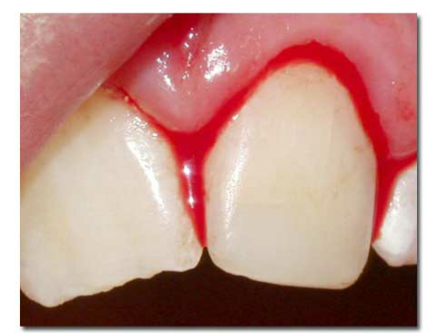
Spongy bleeding gums

Slide 57
Radiological findings
Long bones- ground glass appearance
White line of frankel

Slide 58
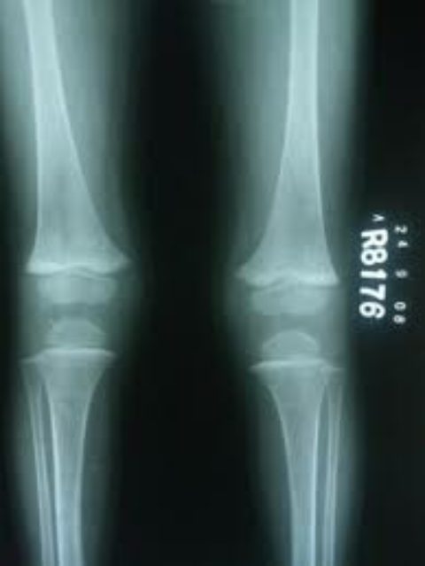
Scurvy x-ray

Slide 59
treatment
Oral vitamin C
250mg 6hrly for 3 days
Taper the dose for 2-3 month
Daily intake of 100ml orange juice or tomato pulp

Slide 60

Thank-you.....

