Slide 1
Status asthmaticus
DR. SANDESH .P. GOJE
ASSISTANT PROFESSOR
(KAYACHIKITSA)
SVAMCH, CHANDRAPUR

Slide 2
Introduction & definition
Chronic inflammatory diseases of airway which is characterized by increased responsiveness of tracheobronchial tree to various stimuli.
Presenting with paroxysms of dyspnoea, cough and wheezing, narrowing of airway, muscle spasm, mucosal oedema and viscid bronchial secretion.

Slide 3
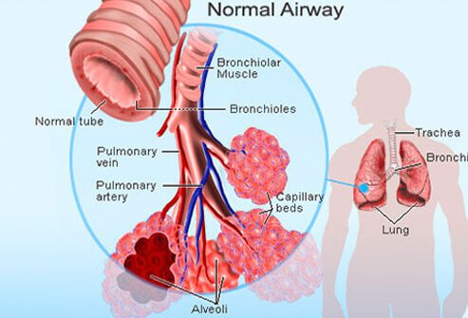

Slide 4
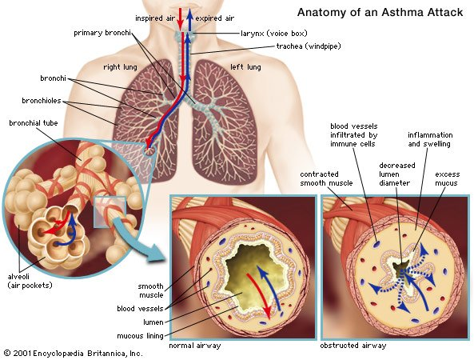

Slide 5
Triggering factor:-
Exercise
Hyperventilation
Cold air, Fog
Tobacco smoke
Dust and acid fumes
Respiratory infections
Emotional stress
Drug- Aspirin, beta-blockers ,NSAIDs
Hereditary cause induced by gastrointestinal reflux.
Occupational exposure

Slide 6
Clinical features:-
Severe airway obstruction
Severe dyspnoea , cyanosis, exhaustion few mins. To several hours.
Unproductive Dry cough
Can not complete sentence in one breath
Sweating, Irritability
Central cyanosis
Tachycardia, arrhythmia, confusion
Pulsus paradoxes
Altered consciousness and coma

Slide 7
Signs
Silent chest
Increased respiratory rate > 25breath/min.
SPO2 < 90%
Pulse rate > 110/min.
PaO2 < 60mm of Hg, PaCO2> 45mm of Hg
High pitched polyphonic expiratory and inspiratory rhonchi
Basal crepitation
Hyper resonant percussion
Breath sound are vesicular with prolonged respiration
Peak expiratory flow <33%
Vesicular breath sounds
Respiratory Accessory muscles in action

Slide 8
Differential diagnosis:-
COPD
Tropical eosinophilia
Obstruction in upper respiratory tract, trachea or primary
Allergic lung diseases other than asthma
Constructive bronchiolitis
Cryptogenic organizing pneumonia

Slide 9
Presentation (Status Ashtamaticus)

Slide 10
Investigation
CBC, ESR, LFT, KFT, RBS
Chest x-ray, SPO2
PFT (pulmonary function test)
Spirometry
Bronchoscopy
ABG
Skin hyper sensitivity test
Sputum and blood examination
Serum IgE level

Slide 11
Treatment
Avoidance of allergens.
Oxygen inhalation –MC mask 6liters/min.
Bronchodilators-
Salbutamol 5mg By nebulizer Every
Terbutaline 10mg 20min. for 3 doses
Ipratropium bromide 0.5mg + salbutamol 5mg/ terbutaline 10mg
Sodium chromo glycate
Nedocromil sodium 4mg QID
Beclomethasone dipropionate 200microgram
Budesonide 200 microgram
Fluticasone 125 microgram

Slide 12
Metered dose inhaler
Salbutamol 5mg
Terbutaline 10mg
Ing. Supplementation β2-agonist:-
Ing.salbutamol 250 microgram IV/SC
Ing. terbutaline 250-500 microgram IV/SC
Ing. Epinephrine 0.2-0.5mg subcutaneous every 20min.
IV Aminophylline 5mg/kg IV over 20min/250mg in 500ml of dectrose .
Ing./Tab. Deriphyline 300mg BD
Ing. Magnesium sulphate SOS
Tab. doxophylline 400mg BD TO

Slide 13
D. Corticosteroids
Ing. Dexamethasone 4-8mg IV TDS
Ing. Hydrocortisone sodium succinate 200mg IV
Ing. Methyl prednisolone 60-80 mg IV bolous
Tab. Prednisolone 40-60mg BD PO
Tab. deflazacort 6-30mg BD PO
E. Endotrachical intubation and mechanical ventilation
F. 70-80% of helium with oxygen
G. Leukotrienes inhibitors:-
H. Ing. Magnesium sulphate
Montelukast 10mgHS or
Zalfirlukast 20mg BD or
Zileuton 600mg TDS

Slide 14
Thank you…….

