Slide 1
NATIONAL PROGRAMMEs RELATED TO CHILD HEALTH Dr. Kiran Nandeshwar MD Kaumarbhritya

Slide 4
Programmes for Non Communicable Diseases
National Cancer Control Program
National Mental Health Program
National Diabetes Control Program
National Program for Control and treatment of Occupational Diseases
National Program for Control of Blindness
National program for control of diabetes, cardiovascular disease and stroke
National program for prevention and control of deafness

Slide 5
Programmes for Communicable Diseases
National Vector Borne Diseases Control Programme (NVBDCP)
Revised National Tuberculosis Control Programme
National Leprosy Eradication Programme
National AIDS Control Programme
Universal Immunization Programme
National Guinea worm Eradication Programme
Yaws Control Programme
Integrated Disease Surveillance Programme

Slide 8
Medications :
Only few cases required medications
Route of medications :

Slide 14
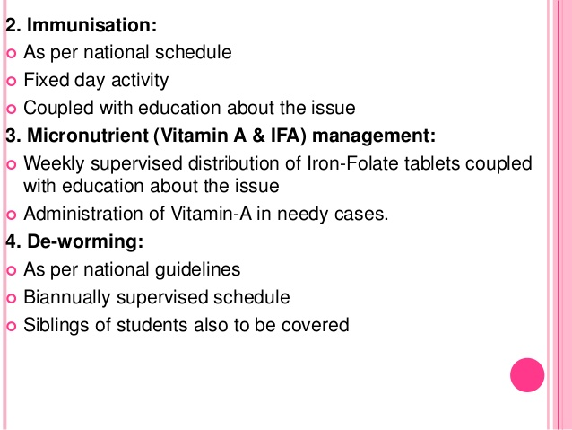

Slide 25
STRATEGY :
1. Infancy :
Encourage colostrum feeding
Exclusive breastfeeding for six month and
thereafter complementery feeding .
2.Childhood:
Education about intake of Vit-A rich
food.
Early detection and prompt treatment
of infections.
3. Sick children :
All childrens with Xerophthalmia to be treated
at health facilities.
All childrens suffering from Measles to be given
dose of Vit-A.
All cases of severe malnutrition to be given an
additional dose of Vit-A.

Slide 26
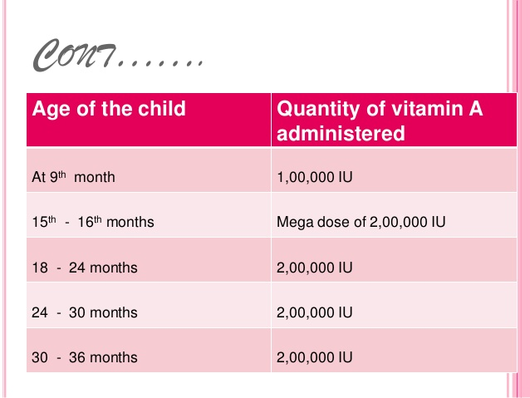

Slide 34
INTEGRATED CHILD DEVELOPMENT SERVICES (ICDS)
Launched in 1975.
ICDS is India’s social welfare scheme to
tackle malnutrition and health problems in children below 6 years of age and their mothers .
Objectives:
1. to raise the health and nutritional status of poor Indian children below 6 years of age
2. To create a base for proper mental, physical and social development of children.
3. To reduce the instances of mortality ,malnutrition
and school dropouts among Indian children.

Slide 35
Scope of services :
1. Immunization
2. Supplementary nutrition.
3. Health check-up.
4. Refferal services.
5. Preschool education.

Slide 36
IMPIEMENTATION :
1. For nutrition – Provides 300 kcal everyday to every child below 6 yrs of the age.
For adolescents girls – 500kcal with 25 gm of protein per day to every girl.
2. Delivery of services under ICDS is managed in an integrated manner through Anganwadi centers and its workers.

Slide 37
National Programme on Mid Day Meal Scheme
01.07.1982 - PTMGR Nutritious Meal Programme
was launched in Primary Schools
for classes I - V and to Pre-School
Children of 2-5 years in Rural areas.
15.09.1982 – Further extended to Urban areas.
15.09.1984 - Extended to the Children of VI – X std.

Slide 38
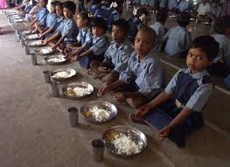

Slide 39
Objectives of Mid Day Meal
Primary Objective
Eradicating extreme poverty and hunger among children
particularly economically disadvantaged so as to improve
their nutritional & health status.
Other Objectives
Achieving universal primary education.
motivation for further education.
retention & reducing dropouts.
Reducing child mortality, morbidity & malnutrition.
Combating all diseases including those resulting due to
deficiencies.
Reduce gender gap in education.

Slide 40
ACCREDITED SOCIAL HEALTH ACTIVIST (ASHA)
ASHA’S are community health workers instituted by GOI as a part of NRHM.
Mission’s began in 2005 and full implementation achieved by 2012.
From 2012 there is an ASHA a village.

Slide 41
Contd…
ROLE AND RESPONSIBILITIES:
1.Motivating womens to give birth in hospitals.
2. Bringing childrens to immunization clinics.
3. To encourage “FAMILLY PLANNING”
4. Treating basic illness and injury with
first aid.
5. Keeping demographic records.
6. Improving village sanitation.

Slide 42
Remuneration:
“ASHA receive outcome based remuneration
And financial compensation.”
If ASHA facilates –
1. Institutional delivary -600 Rs per delivery.
2. Child complete immunization-150 Rs
per child.
3. For each family planning -150 Rs.

Slide 43
