Slide 1
Congestive heart failure (CCF)
DR SANDESH .P. GOJE
ASSISTANT PROF ( KAYACHIKITSA )
SVAMC&H , CHANDRAPUR.

Slide 2
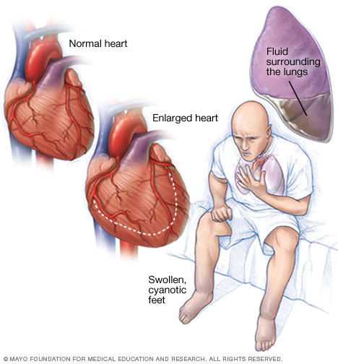

Slide 3
Congestive heart failure
Introduction & Definition
CCF is defined as a state in which the ventricles at normal filling pressure (i.e. adequate intravascular volume) cannot maintain an adequate cardiac output to meet the metabolic needs of peripheral tissues.
Heart fails to maintain and output which is sufficient for need of our body.

Slide 4
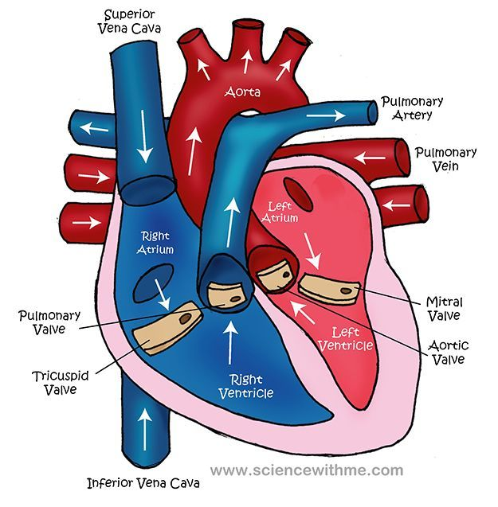

Slide 6
Normal Cardiac Output

Slide 9
Causes of Heart Failure
Pressure overload of ventricle
Systemic hypertension
Pulmonary hypertension
Aortic stenosis / regurgitation
Pulmonary stenosis / regurgitation
Atrial septal defect
Inflow obstruction of ventricle
Mitral stenosis/ regurgitation Low output failure
Tricuspid stenosis/ regurgitation
Endomyocardial fibrosis
Impaired ventricular function
Diffuse myocardial diseases
Myocarditis
Cardiomyopathy
Segmental myocardial disease
Myocardial infraction

Slide 10
Volume overload of ventricle
Conditions associated with increased metabolic
Demand
(Thyrotoxicosis, Anemia and, High output failure
hypoproteinemia Beriberi, AV Fistula,
Cirrhosis of liver, Cor pulmonale, Paget’s
disease of bone)
Precipitating and aggravating causes of CCF
Infections (infective endocarditic)
Anemia, pregnancy, thyrotoxicosis
Myocarditis, myocardial infraction
Systemic hypertension
Pulmonary embolism
Drugs (beta-blockers, disopyramide, corticosteroids, NSAID’s
Excess salt intake
Physical and emotional stress
Poor compliance with therapy

Slide 11
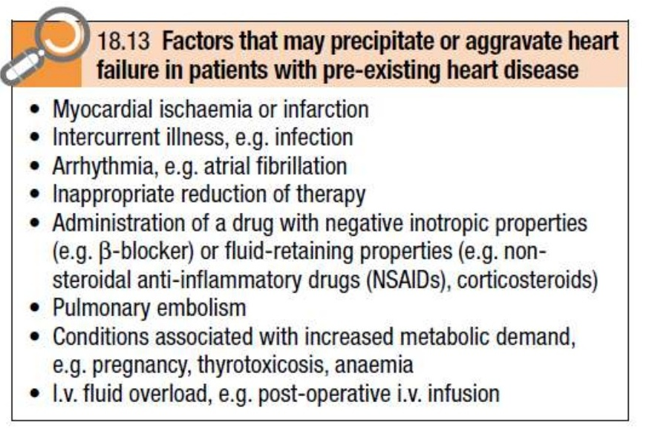
Precipitating factors

Slide 12
PATHOPHYSILOGY
The theory of CCF depends on three points
1. Preload
The pressure that fills the left ventricle during diastole i.e. left ventricular end-diastolic pressure in addition with stroke volume. Main determents of preload are left ventricular compliance and venous return.
2. Afterload
Pressure against which the left ventricle contracts and measured as the mean aortic pressure. Main determinants are total peripheral resistance and left ventricle size.
3. Myocardial contractility
Depends on the adrenergic nervous activity and the level of circulating catecholamine.

Slide 13
Pathogenesis
HF means decreased Cardiac output (CO)
Mixed function of Preload + Afterload + Myocardial contractibility
Preload + Afterload + Myocardial contractibility
In initial stages HF with reduced Cardiac output
Some compensatory mechanism do work out
e.g. Renin – Angiotensin – Aldesterone – System
+ Autonomous nervous system

Slide 14
A. Increased myocardial contractility
Ventricle dilates
Increased preload
Increased LV contraction
Increased volume blood ejected
Myocardial cell contractility increased beyond its limits
Results contractility diminishes
Increased LV- filling pressure which transmitted to Pul. veins
Alveolar transudation of fluid
Pul. Congestion
Pul. oedema
O₂ demands of heart increases

Slide 15
B. Myocardial hypertrophy
Vol. and pressure overload in ventricles
Enhanced contractility
Hence increase in cardiac output
Increased O₂ demand
Reduced compliance of ventricle
Results in increased preload
Transmitted to pulmonary vasculature Pul. Congestion

Slide 17
C. Sympathetic stimulation
Peripheral vasoconstriction
Renin- Angiotensin – Aldesterone - system
Na⁺ and H₂O retention with peripheral vasoconstriction
Enhance contractility
Increased after load
Also CO and
O₂ of heart

Slide 18
D. Myocardial remodeling
Due to above Progressive nature of myocardial dysfunction
Remodeling of heart develops
In which Change in structure and function of heart
Hypertrophy and apoptosis of myocytes
Gradual loss of ischemic as well as normal heart tissue
Contractility over a period of time

Slide 19
Types of heart failure
Types of heart failure
Acute heart failure
Develop suddenly.
Reduction in cardiac output results in systemic hypotension without peripheral oedema (MI, rupture of cardiac valve)
Chronic heart failure
Develops gradually
Oedema (dialated cardia myopathy multivalvular diseases)
Systolic heart failure
An abnormality of ventricular contraction.
EF is below 40%
Diastolic heart failure
Impaired ventricular relaxation
Increase ventricular stiffness results diastolic dysfunction.
E.g. LVH, HT, aortic stenosis

Slide 20
Left sided heart failure
Related with left artrium, left ventricular, mirtal valve, aortic valve
Excess fluid accumulates upstream failing left ventricle.
Reduction in left ventricular output, increasing left atrial pressure results increase in pulmonary venous pressure.
Pulmonary conjunction, pulmonary oedema e.g. MI
left atrial pressure results pulmonary hypertension but no pulmonary oedema e.g. aortic stenosis.
Right sided heart failure
Excess fluid accumulates upstream failing right ventricle.
Reduction in right ventricular output results systemic venus conjunction.
E.g. cor pulmonary valvular stenosis, multiple pulmonary emboli.
Biventricular heart failure
Failure of both left and right ventricles
E.g. dilated cardiomyopathy, IHD

Slide 21
High output heart failure
Heart fails to maintain sufficient circulation dispite and increased cardiac output
There is primarily no defect in heart, but due to extra cardiac condition there3 is increase work load on heart which causes cardiac failure with increased cardiac output.
E.g. hyperthyroidism, anaemia, pregnancy, arteriovenous fistulae, beriberi and paget’s disease
Low output heart failure
Associate with low cardiac output
Heart fails to generate adequate output or can do so with high filling pressures.
Basically there is defect in heart results decreased in contractibility of the heart results diminished cardiac output

Slide 23
Clinical features of CCF (LVF)
Severe Dyspnoea
Orthopenoea, sinus tachycardia,
Pulsus alternans (@ LVF – alternate large and small pulses without any change in rhythm)
Presence of Third and fourth heart sound
Low grade fever, anorexia, nausea, abd. Pain, fullness
Oedema (pitting type) over dependent part, Anasaraca.
Paroxysmal nocturnal dyspnoea (PND)
Cough with pinkish forly sputum, extreme suffocation
Cyanosis, perspiration, air hunger
Mental confusion, insomnia, weakness, fatigae, headache, anxiety.
Cardiac asthma,
Cheyne-stokes respiration
Nocturia

Slide 24
Clinical features of CCF (RVF)
Cough dyspnea, hemoptysis
Anorexia, nausea, vomiting, abdominal fullness
Rt. Hypochondriac pain
Edema of feet (Pitting Type)
Weakness and fatigue
Raised JVP
Hepato – spleenomegaly, pulmonary oedemia, coarse crepitations & rhonchi.
Hypoglycaemia, jaundice, hepatic conjunction, hyper bilirubilneamia
pain in right hypocondrium
Cyanosis pansystolic murmur
Plural effusion, ascites, pericardial effusion
Nocturia and oliguria
Weight loss and malnutriction

Slide 25
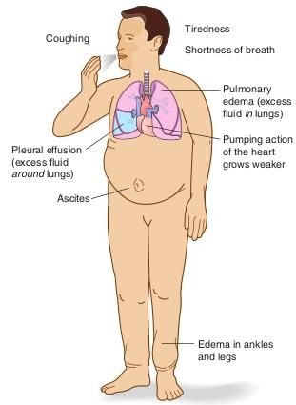
CCF Presentation

Slide 27
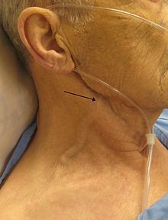
Raise JVP (jugular venous pressure)

Slide 28
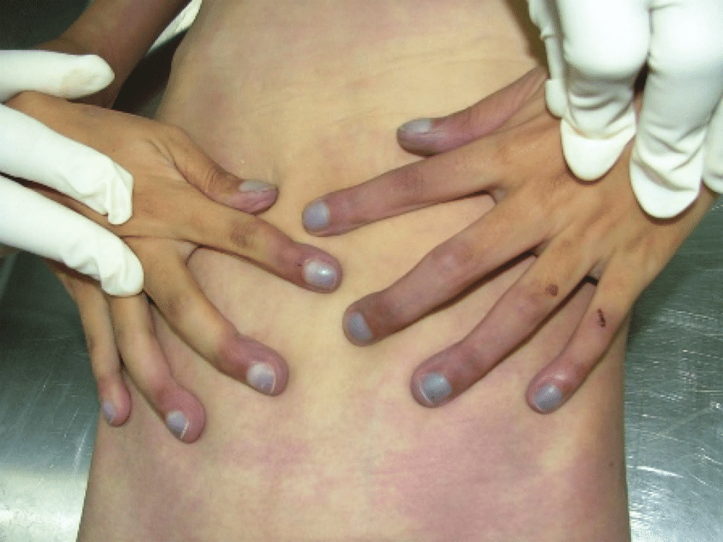
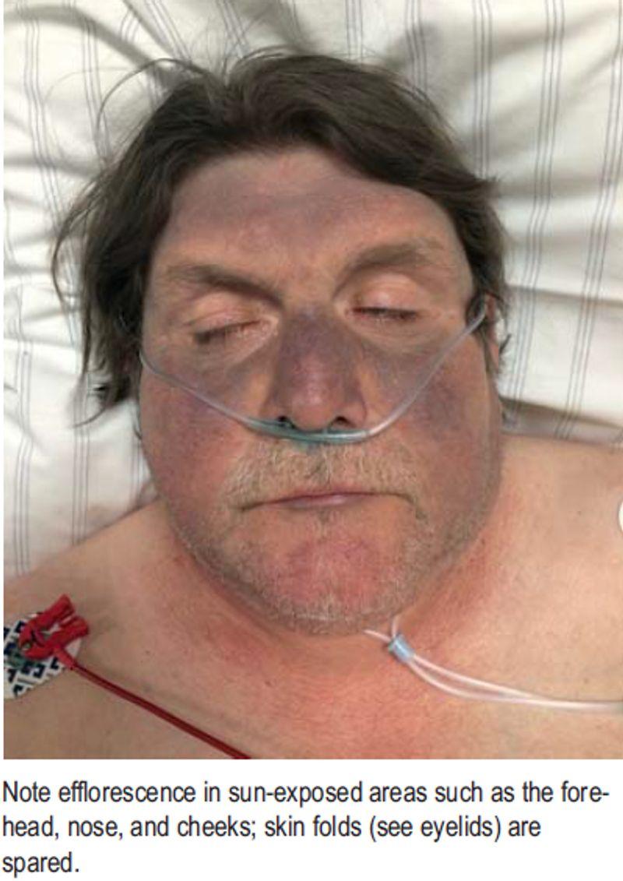
Cyanosis (central & peripheral)

Slide 29
Investigation
CXR PA-view (Cardiomegaly, kerley A and B lines, bat’s wing bronchovascular makings)
ECG
4D echocardiography (ejection fraction, valvure functions, chamber size & shapes)
TMT avoided
Holter monitoring for arrhythmias
Brain natriuretic peptide (BNP)
CBC, LFT, KFT, ESR, RBS, urine ASO titer
C-reactive protein, ANA
T3, T4, TSH, complete thyroid profile

Slide 30
CXR-PA view

Slide 32
Other Investigations

Slide 33
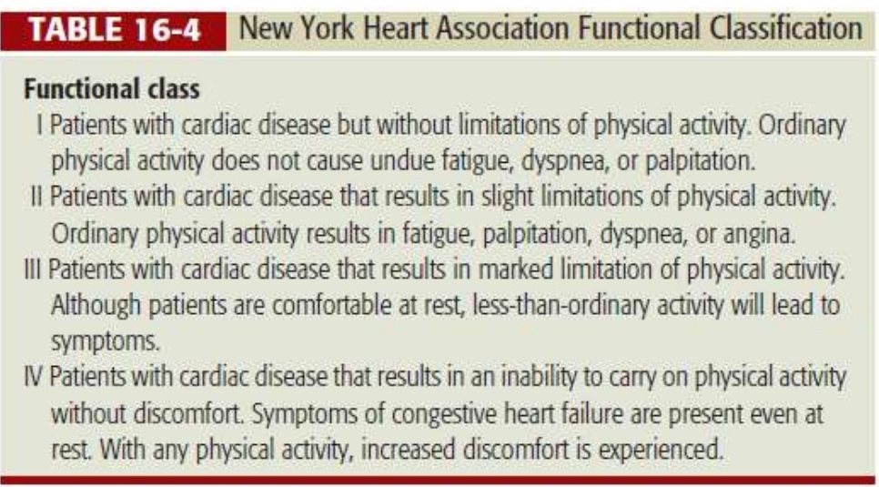
Classification of CCF Pts.

Slide 34
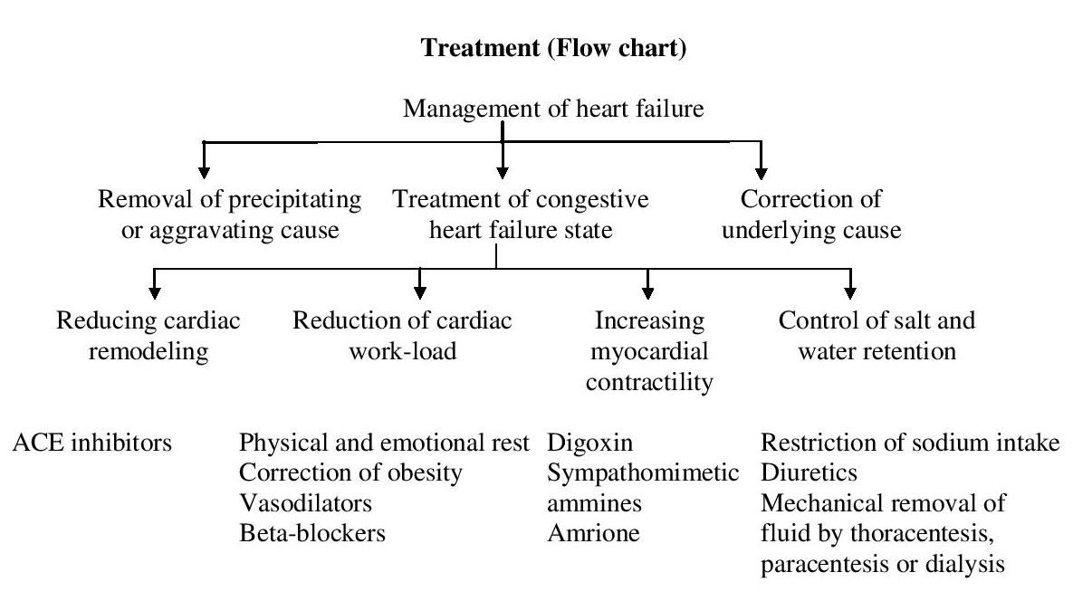
Treatment (Flow chart)

Slide 37
Treatment
Complete physical (Bed rest) and emotional rest
Obesity control by restriction of caloric intake.
Regular exercise
Antilipidemic drugs use. E.g. orlistat
Patient admitted in cardiac care unit CCU.
O2 inhalation 6liters/min.
Prop up position.
Connect NIBP monitor, urine catheterization, central line, ECG, connect IV line.
Bronchodialators use
Diuretics use. Especially Potassium spearing diuretics e.g. spironolactone
Hydrochlorothiazide 12.5-25mg OD or
Chlorthaiazide 62.5-500 mg BD or
Chlorthalidone 12.5-25mg OD or
Fursoemide 10-40 mg BD or
Torasemide 05-10 mg BD or
spironolactone 50-200 mg

Slide 38
Digoxin use.
Dose:- 0.25-0.5 mg orally or IV followed by 0.25 mg 6 hourly to total dose of 1-1.5 mg
ACE inhibitors use
Lisinopril 2.5-40 mg OD or
Enalpril 2.5-20 mg OD or
Caotopril 12.5-50 mg TDS or
Ramipril 2.5-20 mg OD
ARB’s (Angiotensin II receptor antagonists)
Losartan potassium 25-50mg BD or
Telmisartan 20-80 mg OD or
Olmesatan 20-40 mg OD
Beta-blockers use with cautiously
Carvedilol 3.125 mg/day
Bisoprolol 1.25mg/day
Metoprolol 25mg/day
Nebivolol 1.25 mg/day
Use of aldosterone receptor blockers
Vasodilators use
NTG Drip 10-200 microgram/min. IV
Hydralazine 10-50 mg QID or
Minoxidil 1.25-40 mg BID
Sodium nirtoprusside 10-300 microgram/min. IV

Slide 39
Use of sympathomimetic amines
Dopamine – 3-10 micro gm. /kg/min
Dobutamine – 1-10 micro gm. /kg/min
Noradrenaline – 2-8 micro gm. /min
Adrenaline – 1-8 micro gm. /min
Phenylephrine – 20-200 micro gm. /min
Restriction of sodium intake strictly.
Procedures should be carried out e.g. thoracentesis, paracentesis and dialysis.
Anticoagulation therapy (for thromboembolism, left ventricular thrombus, embolic stroke)
Streptokinase 5lakhs -15 lakhs unites IV
Urokinase 15 lakhs unit IV
Low dose heparine 5000 unit SC BD
Implantation of cardioverter defibrillator and biventricular pacing
Surgical intervention e.g. left ventricular aneurysmectomy, left ventricular assist devices, cardiac transplantation.

Slide 40
…….Thanks

