Slide 1
Hypertensive emergencies
DR. SANDESH .P. GOJE
ASSISTANT PROFESSOR
(KAYACHIKITSA)
SVAMCH, CHANDRAPUR

Slide 2
Stages of Hypertension
Classification | Systolic BP (mmHg) | Diastolic BP(mmHg)
Normal | <120 | <80
Pre hypertension | 120-139 | 80-89
Stage 1 hypertension | 140-159 | 90-99
Stage 2 hypertension | > 160 | > 100

Slide 3
Identification of Hypertension
Severe hypertension >180/110mmHg with onset at age<20 years or > 50years
Family history of hypertension
Headache, palpitation, pallor, perspiration-4points of pheochromocytoma
Polyuria, nocturia, protienuria, haematuria.
Obesity
H/o polycystic kidney disease
Kidney enlargement
Cushing syndrome
Multiple neurofibromatosis

Slide 4
Types of Hypertension
Primary or essential hypertension
In 85% of cases
Not any specific underlying cause
Family history
Secondary hypertension
In 15% of cases
Presence of specific disease or abnormality
White coat hypertension
Sudden increase in blood pressure in normal individuals when his/her BP is recorded in a hospital or by a Doctor.
Paradoxical hypertension
If Pts. Is on antihypertensive agents paradoxically show increase in BP due to -
DM with HT – develop paradoxical rise in BP if they develop hypoglycemia due to sympathetic simulation.
Pts. With bilateral renal artery stenosis who are given ACE inhibitors
Only beta-blockers are given to the patients with phaeochromocytoma.

Slide 5
Causes
Atherosclerosis
Thyrotoxicosis
Coarctation of aorta
Aortic regurgitation
Pregnancy induced
Smoking and tobacco use
Obesity, dyslipidemia
Renal causes:- Acute AGN, CKD, chronic pyelonephritis, collagen vascular diseases, polycystic kidney disease, renal artery stenosis.
Endocrine causes :- Acromegaly, Cushing's syndrome, conn’s syndrome, Thyrotosicosis, hyperparathyroidism, congenital adrenal hyperplasia, phaeochromocytoma.
Drugs induced:- NSAID’s, OC pills, cyclosporine, phenylpropanolamines, corticosteroids, sibutramine, bromocriptine,
Chronic Alcoholism
Others causes:- porphyria, lead poisoning, raise ICT

Slide 6
Clinical features of Hypertension
H/o alcoholism, smoking, obesity, hyperlipidemia, DM, CAD.
Majority are asymptomatic
Transient headache, palpitations
Polyuria
LVH
Left atrial hypertrophy
Diastolic murmur
Fundal changes
Radio-femoral delay
Back pain, recurrent UTI (Pyelonephritis)
Palpable kidneys ( polycystic kidney disease)
Abdominal bruit (Renal artery stenosis)
Cushingoid facies and habitus

Slide 7
Hypertensive emergencies
Definition: -
The condition which constituents the group of clinical
syndromes in which severe (DBP>120mmHg) and rarely moderate hypertension is associated with established/ ongoing target organ damage.
Factor responsible for hypertensive emergencies
HT drug withdrawal
Catecholamine excess in pheochromocytoma
Chronic alcoholism
AKD & CKD
Drugs induced (corticosteroids)
CAD etc..

Slide 8
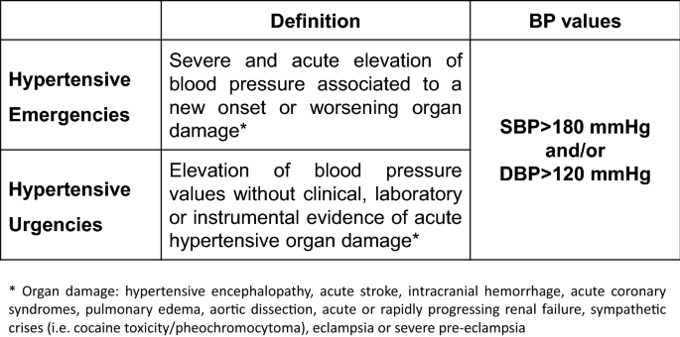

Slide 9
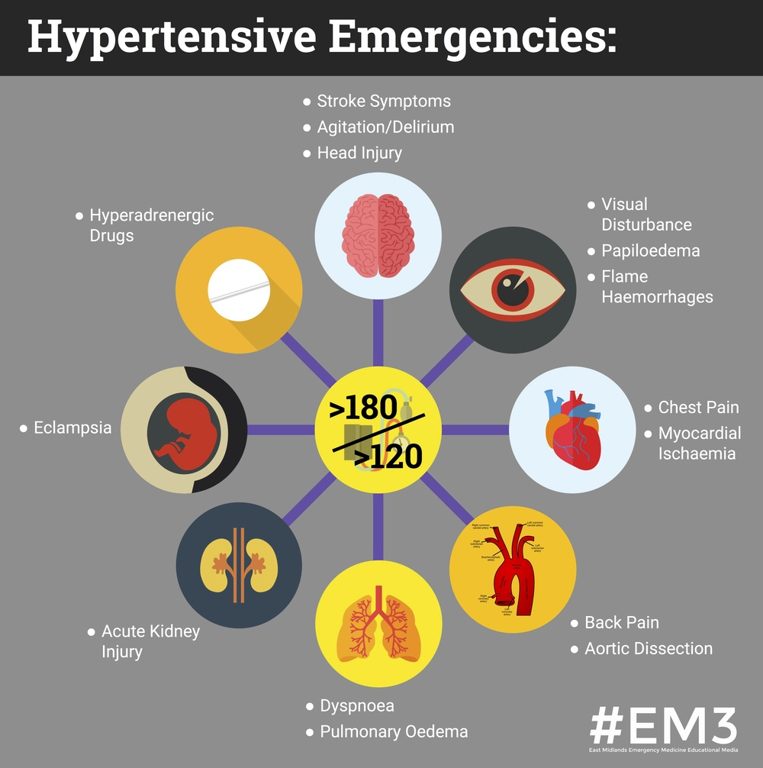

Slide 10
HT emergencies in CNS
CVA
Cerebral thrombosis
Cerebral hemorrhage
TIA
SAH (subarachnoid hemorrhage)
Hypertensive encephalopathy
HT emergencies in EYE
Hypertensive retinopathy
Thickening of wall of retinal arterioles, diffuse of segmental of narrowing of blood columns, varying width of the light reflex, from vessel walls, arterio-venous nipping retinal hemorrhage, hard exudates, papiloedema, and blindness.
HT emergencies in CVS
LVF
CAD
Aortic aneurysm
Aortic dissection
HT emergencies in renal system
Protein urea
Progressive renal failure

Slide 11
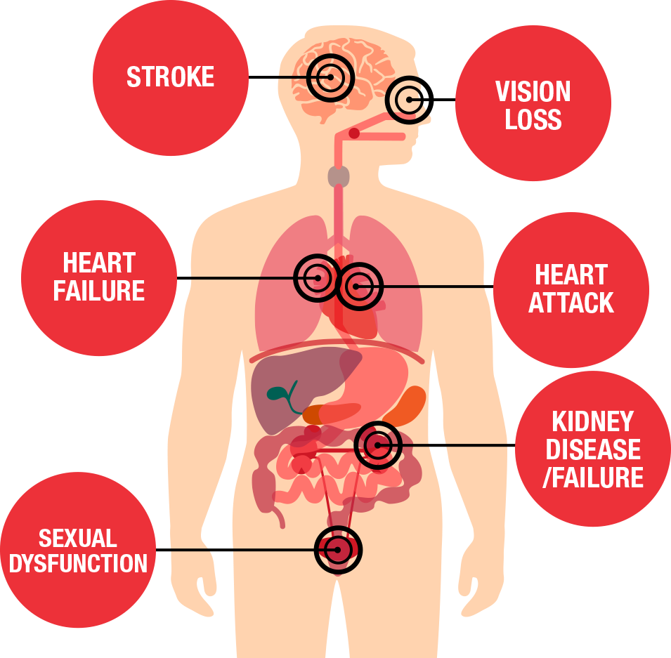

Slide 12
Miscellaneous disturbances :-
Post-operative bleeding form suture sites
Eclampsia
Severe epistaxis
Grade III-IV fundal changes.

Slide 13
Investigation
Urine analysis (For protein, blood and glucose)
KFT (for urea, creat., Na, K)
FBS, PMBS, RBS
LFT
Lipids profile
Sr.Ca
Sr. uric acid
ECG, CXR PA – view

Slide 14
Treatment
General measures
Antihypertensive
Treatment of underline cause in secondary HT.
Preventive Measures.

Slide 15
A. General measures:-
Lifestyle modifications
Reassurance
Control of obesity
Low sodium diet
Special diet (Diet rich in fruit, vegetables, potassium and low-fat dairy products, low-saturated fat, Omega3, fatty acid)
Avoidance of smoking and alcoholism
regular aerobic relaxation therapy, Yoga & meditation

Slide 16
B. Antihypertensive
1. Diuretics
Hydrochlorothiazide 12.5-25mg OD or
Chlorthaiazide 62.5-500 mg BD or
Chlorthalidone 12.5-25mg OD or
Fursoemide 10-40 mg BD or
Torasemide 05-10 mg BD
2. Beta-blockers
Propranolol 10-40 mg QID or
Metoprolol 25-50 mg BD or
Atenolol 25-50 mg BD

Slide 17
3. Combined alpha and beta-blockers
Carvedilol 6.25-25 mg BD or
Libetalol 100-900 mg BD
4.ACE Inhibitors
Lisinopril 2.5-40 mg OD or
Enalapril 2.5-20 mg OD or
Captopril 12.5-50 mg TDS or
Ramipril 2.5-20 mg OD

Slide 18
5. ARB’s (Angiotensin II receptor antagonists)
Losartan potassium 25-50mg BD or
Telmisartan 20-80 mg OD or
Olmesatan 20-40 mg OD
6.Calcium channel blockers
Nifedipine(SR) 30-90mg OD or
Amlodipine 2.5-10mg OD or
Diltiazem 30-120 mg TDS

Slide 19
7.Alpha-blockers
Prazosin 1-10 mg BD or
Terazosin 1-20 mg OD
8. Vasodilators
Hydralazine 10-50 mg QID or
Minoxidil 1.25-40 mg BID

Slide 20
Anticonvulsants:-
Ing. Diazepam 10mg IV and SOS
Ing. Phenytoin sodium 100mg IV TDS
Ing. Phenobarbitone 100-200mg IM
To reduce ICT:-
IV Mannitol 350ml OD
Ing. Furosemide 40mg IV BD

Slide 21
Thank you……

