Slide 1
eÉÉiÉqÉÉ§É mÉËUcÉrÉÉï uÉ
CARE OF NEWBORN
Presented by
Dr. Kiran Nandeshwar
Dept. of Kaumarbhritya

Slide 2
Navjat Shishu Paricharya
Charak Sharir 8 | Sushruta Sharir 10 | Vagbhat Uttarsthan 1
Pranapratyagaman | Ulva apnayan | Ulva parimarjan
Snana | Mukha vishodhan | Pranapratyagaman
Mukha vishodhan | Pichu dharan | Nala chedan
Pichu dharan | Jata karma | Snana
Garbhodhak Vaman | Snana | Pichu dharan
Nala chedan |  | Suvarna prashan
Jata karma |  | Jata karma
Raksha karma

Slide 3
mÉëÉhÉmÉëirÉÉaÉqÉlÉ
cÉ.zÉÉ. 8/42
AzqÉlÉÉåÈ xÉÇ†¡û–ûlÉÇ MühÉïrÉÉåqÉÑïsÉå,
zÉÏiÉÉåSMåülÉÉåwhÉÉåSMåülÉ uÉÉ qÉÑZÉmÉËUwÉåMüÈ iÉjÉÉ xÉ YsÉåzÉÌuÉWûiÉÉlÉç mÉëÉhÉÉlÉç mÉÑlÉsÉïpÉåiÉ |
M×üwhÉMümÉÉÍsÉMüÉzÉÔmÉåïhÉ cÉælÉqÉÍpÉÌlÉwmÉÑhÉÏrÉÑrÉï±cÉå¹È xrÉÉSè rÉÉuÉiÉç mÉëÉhÉÉlÉÇ mÉëirÉÉaÉqÉlÉqÉç |
xÉÑ. zÉÉ. 10/12
AjÉ eÉÉiÉxrÉÉåsoÉqÉmÉlÉÏrÉ |

Slide 4
xlÉÉlÉ
cÉ.zÉÉ. 8/42
iÉiÉÈ mÉëirÉÉaÉiÉmÉëÉhÉÇ mÉëM×üÌiÉpÉÔiÉqÉÍpÉxÉqÉÏ¤rÉ xlÉÉlÉÉåSMüaÉëWûhÉÉprÉÉqÉÑmÉmÉÉSrÉåiÉç
xÉÑ. zÉÉ. 10/13
¤ÉÏUÏuÉ×¤ÉMüwÉÉrÉåhÉ xÉuÉïaÉlkÉÉåSMåülÉ uÉÉ ÂmrÉWåûqÉmÉëiÉmiÉålÉ uÉÉ uÉÉËUhÉÉ xlÉÉmÉrÉåSålÉÇ MüÌmÉijÉmÉ§ÉMüwÉÉrÉåhÉ uÉÉ MüÉåwhÉålÉ rÉjÉÉMüÉsÉ rÉjÉÉSÉåwÉÇ rÉjÉÉÌuÉpÉuÉÇ cÉ |

Slide 5
qÉÑZÉÌuÉzÉÉåkÉlÉ uÉ aÉpÉÉåïSMü uÉqÉlÉ
cÉ.zÉÉ. 8/43
AjÉÉxrÉ iÉÉsuÉÉå¸MühPûÎeÉÀûÉmÉëqÉÉeÉïlÉqÉÉUpÉåiÉÉ…¡ÓûsrÉÉ xÉÑmÉËUÍsÉÎZÉiÉlÉZÉrÉÉ xÉÑmÉë¤ÉÉÍsÉiÉÉåmÉkÉÉlÉMüÉmÉÉïxÉÌmÉcÉÑqÉirÉÉ | mÉëjÉqÉÇ mÉëpÉÉÎeÉïiÉÉxrÉxrÉ cÉÉxrÉ ÍzÉUxiÉÉsÉÑ MüÉmÉÉïxÉÌmÉcÉÑlÉÉ xlÉåWûaÉpÉåïhÉ mÉëÌiÉxÉÉgNûÉSrÉåiÉç | iÉiÉÉåÅxrÉÉlÉliÉUÇ xÉælkÉuÉÉåmÉÌWiÉålÉ xÉÌmÉïwÉÉ MüÉrÉïÇmÉëcN-SïlÉåqÉè |
xÉÑ. zÉÉ. 10/13
AjÉ eÉÉiÉxrÉÉåsoÉÇ qÉÑZÉÇ cÉ xÉælkÉuÉxÉÌmÉïwÉÉ ÌuÉvÉÉåkrÉ, qÉÔÎblÉï ÌmÉcÉÑÇ S±ÉiÉè |

Slide 6
lÉÉsÉNåSlÉ
cÉ.vÉÉ.8/44
lÉÉsÉNåSlÉ 8 AÇaÉÑsÉÏ AÇiÉUÉuÉU
vÉxÉë - AkÉïkÉÉU (xuÉhÉï, UeÉiÉ, sÉÉåW kÉÉiÉÑ lÉå oÉlÉuÉsÉåsÉå)
AprÉÇaÉ - sÉÉåkÉëqÉkÉÑMü-ÌmÉërÉ…ûÑ-xÉÑUSÉÂ-WÌUSìÉ MüsMüÌxÉ® iÉæsÉ
AuÉcÉÑhÉïlÉ - uÉUÏsÉ AÉæwÉÌkÉSìurÉ ÌxÉ® cÉÑhÉï
xÉÑ.vÉÉ. 10/12
lÉÉsÉNåSlÉ 8 AÇaÉÑsÉ AÇiÉUÉuÉU
uÉÉ.E. 1/5
lÉÉsÉNåSlÉ 4 AÇaÉÑsÉ AÇiÉUÉuÉU
mÉÌUwÉåMü - MÑü¸ iÉæsÉÉlÉå

Slide 7
eÉÉiÉMüqÉï
cÉ.vÉÉ. 8
oÉÉsÉMüÉiÉ eÉlqÉÉlÉÇiÉU eÉå uÉæÌSMü MüqÉï rÉ¥É rÉÉåaÉÉÌS MüqÉï MåüsÉå eÉÉiÉÉiÉ, iÉxÉåcÉ oÉÉsÉMüÉxÉ xuÉxjÉ uÉ ÎeÉÌuÉiÉ PåûuÉhrÉÉxÉ eÉÏ MüqÉåï MåüsÉÏ eÉÉiÉÉiÉ irÉÉxÉ eÉÉiÉMüqÉï AxÉå qWûhÉiÉÉiÉ.
iÉiÉÉåliÉUÇ eÉÉiÉMüqÉï MÑüqÉÉUxrÉ MüÉrÉïqÉç iÉ±jÉÉ-qÉkÉÔxÉÌmÉïwÉÏ qÉl§ÉÉåmÉqÉÌl§ÉiÉå rÉjÉÉqlÉÉrÉÇ mÉëjÉqÉÇ mÉëÉÍzÉiÉÑ S±ÉiÉç |

Slide 8
U¤ÉÉMüqÉï
cÉ.vÉÉ. 8/47
AjÉÉxrÉ U¤ÉÉÇ ÌuÉSkrÉÉiÉè-AÉSÉlÉÏZÉÌSUMüMïülkÉÑmÉÏsÉÑmÉÃwÉMüvÉÉZÉÉÌpÉUxrÉÉ aÉ×WÇ xÉqÉliÉiÉ: mÉÌUuÉÉUrÉåiÉè | xÉuÉïiÉ¶É xÉÔÌiÉMüÉaÉÉUxrÉ xÉwÉïmÉÉiÉxÉÏiÉhQÑsÉMühÉMüÌhÉMüÉ: mÉëÌMüUårÉÑ: | iÉjÉÉ iÉhQÑsÉoÉÌsÉWÉåqÉ: xÉiÉiÉqÉÑpÉrÉMüÉsÉÇ Ì¢ürÉåiÉÉlÉÉqÉMüqÉïhÉ:| ²ÉUå cÉ qÉÑxÉsÉÇ SåWsÉÏqÉlÉÑ ÌiÉU¶ÉÏlÉÇ lrÉxÉåiÉè | uÉcÉÉMÑü¸¤ÉÉæqÉMüÌW…¡ûÑxÉwÉïmÉÉiÉxÉÏsÉvÉÑlÉ-MühÉMüÌhÉMüÉlÉÉÇ U¤ÉÉåblÉxÉqÉÉZrÉÉiÉÉlÉÉÇ cÉÉæwÉkÉÏlÉÉÇ mÉÉåÌsÉMüÉÇ oÉSçkuÉÉ xÉÔÌiÉMüÉaÉÉUxrÉÉå¨ÉUSåWsrÉÉqÉuÉxÉ×eÉåiÉè |

Slide 9
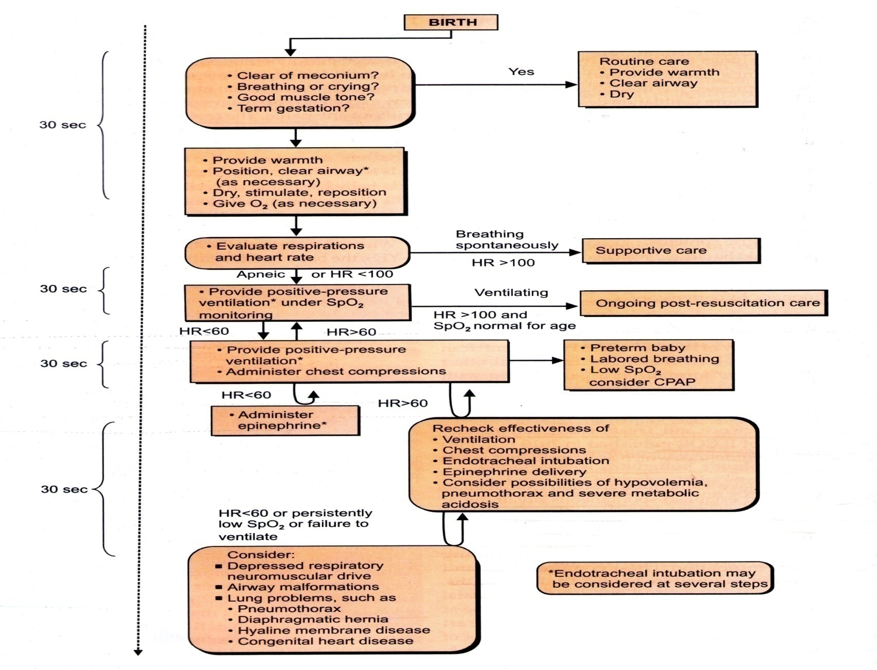
Resuscitation

Slide 10
Essential Care for Newborns
Essential care for all newborns
  Cleanliness
  Thermal protection
  Early and exclusive breast-feeding
  Eye Care
  Immunization
Essential care for sick newborns
  Care of low birth weight babies
  Management of newborn illnesses
  Neonatal Resuscitation*

Slide 11
Routine Supportive Care for All Newborns after delivery
Keep baby dry and warm
Keep baby with mother – room in
Initiate breast-feeding within 1 hour
Give Vitamin K
Keep umbilical cord clean and dry
Apply eye ointment to prevent infection
Give oral polio, BCG, and hepatitis B injections

Slide 12
Cleanliness
The six “cleans” of the WHO
1. Clean hands of the attendant
2. Clean surface
3. Clean blade
4. Clean cord tie
5. Clean towels to dry the baby and then wrap the baby
6. Clean cloth to wrap the mother

Slide 13
Cleanliness
Hygiene during delivery:
  Clean hands, perineum, delivery surface
  Sterilized equipment
Clean cutting of umbilical cord
  Clean hands with soap and water.
  Sterile razor blade for cutting cord
  Sterile ties or gauze to tie cord off
Umbilical cord care
  Umbilical stump is main source of entry for infections
  Cord should be kept clean and dry, no dressings should be applied if stump is able to be kept clean without them
  Infant’s clothes and blanket should be kept clean
  If cord becomes dirty, it should be washed and then dried with clean cotton or gauze

Slide 14
Cleanliness
Prevention of hospital infections:
  Rooming-in with mother:
  No over-crowding
  Clean water
  Importance of hospital staff hand-washing!!!

Slide 15
Thermal Protection
Normal temperature of a newborn is between 36.5 and 37.5 degrees Celsius

Slide 16
Thermal Protection
Hypothermia can be a sign of infection!!!
Hypothermia is temperature less than 36.5 degrees C
  Large surface area
  Poor insulation
  Small body mass to produce heat
Signs of hypothermia
  cool hands and feet
  less active or lethargic
  Hypotonic
  poor suck
  weak cry
  shallow breathing
  redness of face and skin

Slide 17
Thermal Protection
Preventing hypothermia:
  deliver infant in warm room
  dry thoroughly after birth, including drying the head,
  wrap in warm dry cloth
  give to mother as soon as possible for skin to skin contact
  no washing in the 1st 6 hours after birth
Treatment:
  skin to skin contact
  loosely wrapped warm blanket

Slide 18
Thermal Protection
Hyperthermia is a temperature > 37.5 degrees C
Signs:
  Irritable
  Rapid respirations
  Rapid heart rate
  Hot and dry skin
  Lethargic
  Convulsions
Hyperthermia is often accompanied by dehydration and re-hydration should be considered if infant is showing any signs

Slide 19
Thermal Protection
Prevention:
  Hyperthermia in an infant is environmental
  Do not expose infant to high temperatures, sunlight, heaters, etc!!
Treatment:
  Active cooling

Slide 20
Early and Exclusive Breast-feeding
Early and exclusive breastfeeding is one of the least expensive and most cost-effective interventions for saving children’s lives!!!!
Breast-feeding and HIV:
  Exclusive breastfeeding recommended for all mothers in HIV-endemic areas, including HIV-positive mothers.

Slide 21
Early and Exclusive Breastfeeding
Exclusive breastfeeding for six months
Benefits:
  including improved cognitive development
  reduced risk of infections
  better overall chances of survival
Hazards of Formula feeding -
Formula feeding raises risk of illness by depriving infection-fighting components of human milk
Bottle feeding carries risks of possible contamination of water and formula

Slide 22
Eye Care: application of topical antibiotic
Tetracycline eye ointment
Prevents infection of tissues surrounding the eyes caused by bacteria from the birth canal
  The most significant of these bacteria are gonorrhea and chlamydia
  Also helps prevent infection with other bacteria
  Untreated, gonorrhea and chlamydia can cause permanent visual impairment and also spread to other parts of the body such as the lungs causing pneumonia

Slide 23
Immunization
Each year, over four million African children die before their fifth birthday, many from vaccine-preventable diseases
But, notably, there are a number of vaccines given to babies just after birth LIKE,
• BCG vaccination to reduce the risk of tuberculosis
• Hepatitis B vaccination to prevent hepatitis B infection
• OPV to prevent polio infection

Slide 24
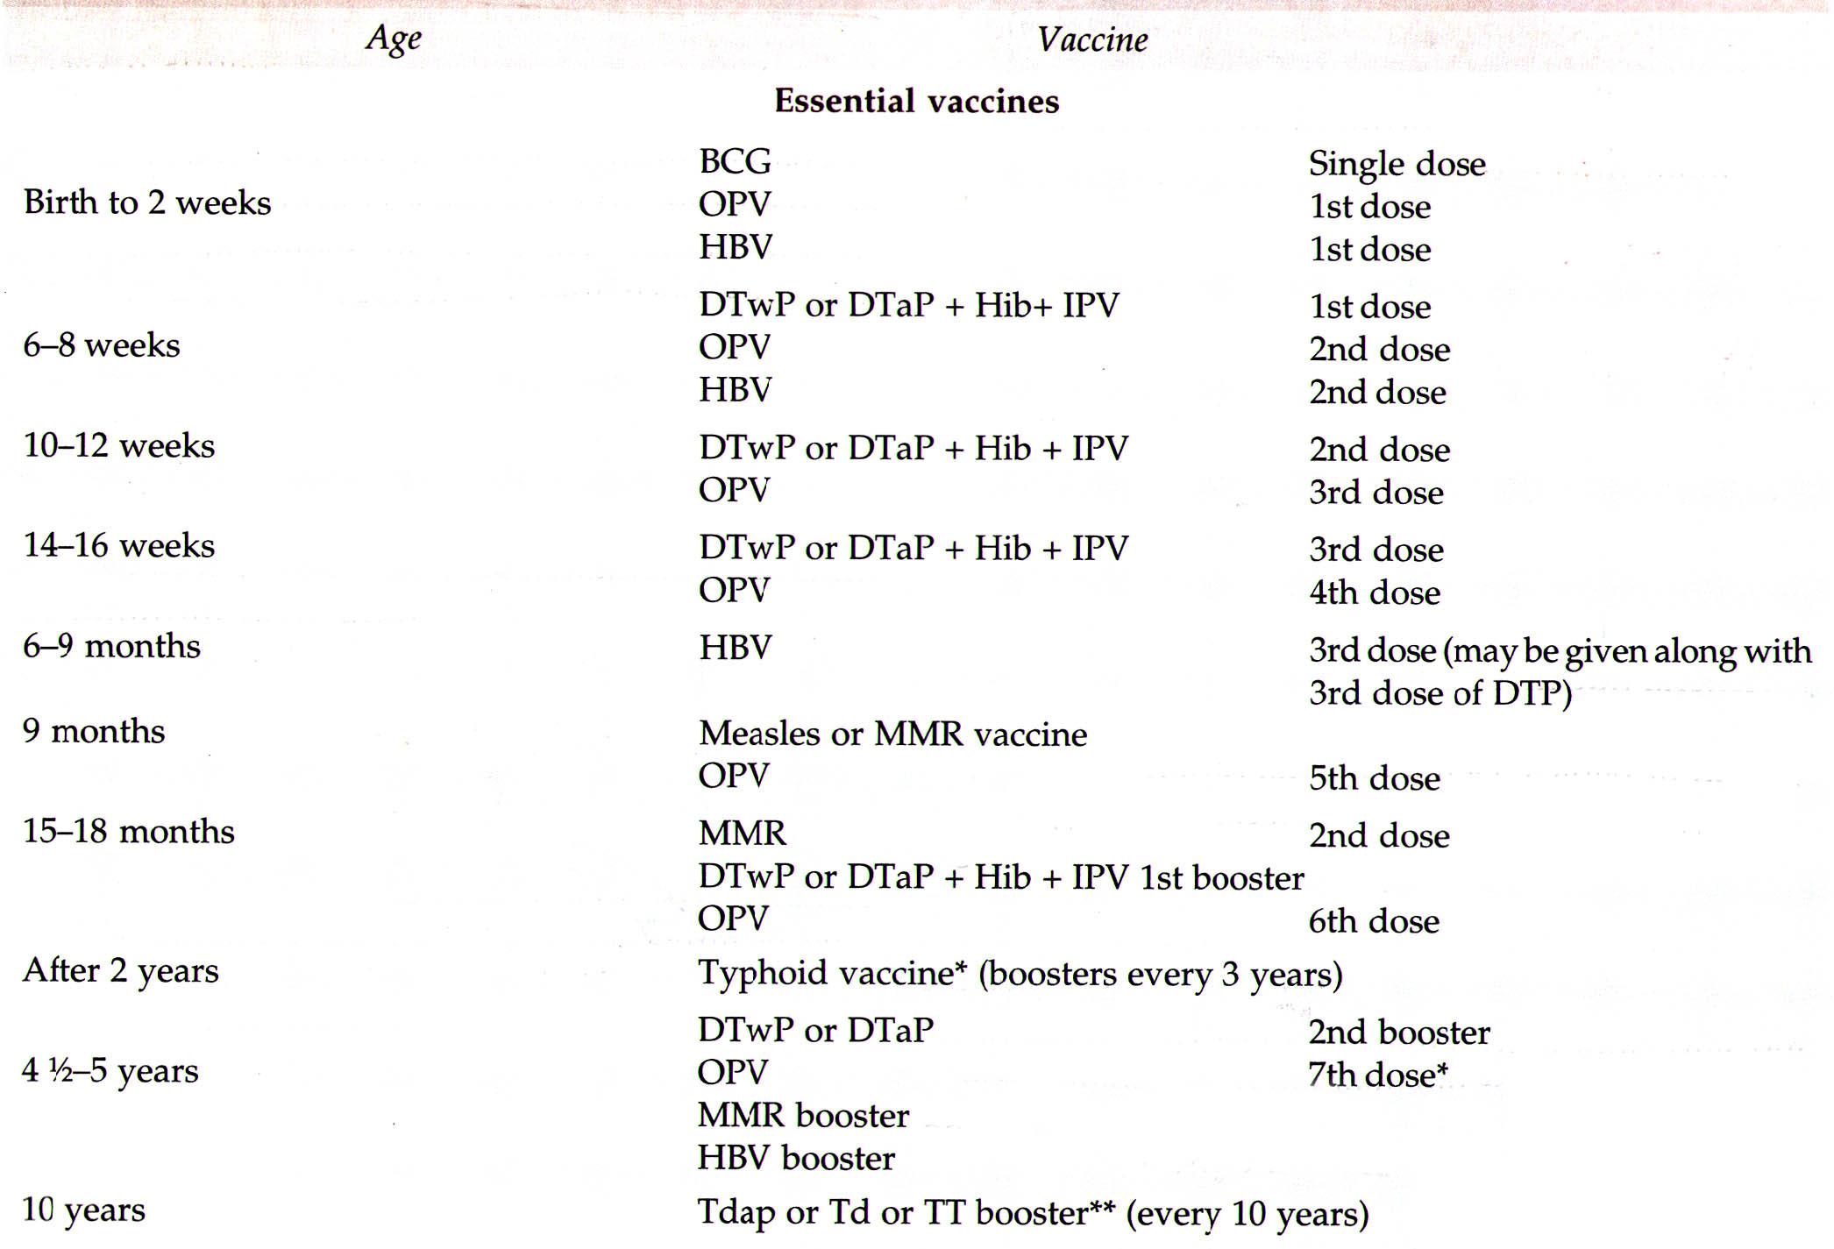
IAP
According to IAP

Slide 25
Management of Sick Infant

Slide 26
Essential care of Sick Infant
Recognizing danger signs
Treating serious bacterial infection
Treating convulsions
Treating low birth weight baby

Slide 27
General principles of management of all sick infants
  Keep infant dry and warm
    Wrap infant
    Kangaroo infant with mother if possible
  Follow temperature closely
  Encourage frequent breast-feeding if infant is alert
    If baby is lethargic or having frequent convulsions, avoid oral feeding

Slide 28
General principles of management of sick infants:
  If giving IV fluids, follow the TOTAL amount of fluids given to infant
    This includes oral and IV fluid
    WHO recommends:
      60cc/kg/day on Day 1
      90cc/kg/day on Day 2
      120cc/kg/day on Day 3
      150cc/kg/day thereafter
    Note: Infant may need more fluids if kept under radiant warmer
    Note: Following infant’s weight is good measure of over or under-hydration

Slide 29
Recognizing Danger Signs
Danger signs in a newborn:
  Convulsions
  Drowsy or unconscious
  Not feeding well
  Fast breathing (more than 60 breaths per minute)
  Slow breathing (less than 20 breaths per minute or not breathing)
  Grunting or severe chest in-drawing
  Fever (above 38°C)
  Bleeding from any site.
  Jaundice appearance within 24 hrs of age.
  Failure to pass meconium within 48 hrs. and urine within 24 hrs.

Slide 30
Recognizing Danger Signs
Danger signs in a newborn:
  Hypothermia (below 35.5°C),
  Very small baby (less than 1500 grams or born more than two months early)
  Severe abdominal distension
  Bulging fontanelle
  Signs of local infection (ex: swollen joints, skin pustules or redness)
  Central cyanosis

Slide 31
Emergency Treatment of Danger Signs
  Give oxygen by nasal prongs or catheter to any ill-appearing infant
    Especially if having respiratory symptoms
  Provide bag and mask ventilation if breathing is too slow or labored
    With oxygen if available, or room air

Slide 32
Emergency Treatment of Danger Signs
  Give penicillin/ampicillin and gentamicin as soon as possible to any infant presenting with signs of illness
  If convulsing, give Phenobarbital (IV15-20 mg/kg)
  If patient is drowsy, unconscious, or convulsing:
    Check blood sugar if possible, give IV glucose if blood sugar is low
    If unable to check blood sugar, give IV glucose
    If unable to give IV glucose, give either expressed breast-milk or glucose through a nasogastric tube

Slide 33
Low Birth Weight Baby
Low birth weight is baby weighing less than 2500 grams.
Simple care of these small babies, close monitoring and early treatment of problems could save many newborn lives.
Maintain temperature of 36.5-37.5 ºC
Start feeding within 1 hr.
If needed give proper IV fluids

Slide 34
Low Birth Weight Baby
Birthweight less than 1.75 kg
  If possible, give IV fluids
  Give 2-4ml of expressed breastmilk every 2 hours by nasogastric tube IF:
    baby looks well
    no abdominal distension
    bowel sounds present
    baby has passed meconium,
  If baby is tolerating these feeds, increase volume slowly

Slide 35
Low Birth Weight Baby
Birthweight less than 1.75 kg
  Monitor for signs of infection and begin antibiotic therapy if any sign prsent
  If infant has apnea, treat:
    caffeine citrate 20mg/kg PO or IV x 1, then daily 5mg/kg
    OR aminophylline 10mg/kg x 1, then 2.5 - 4 mg/kg q 12 hours

Slide 36
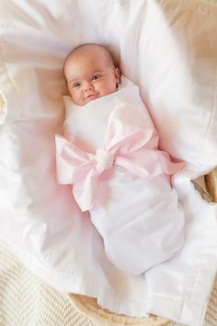

Thank you

