Slide 1
PRETERM BABY

Slide 2
Ayurveda point of view
vdky izlqr ckyd & vizxYHk ckyd
vFk nks”kcysuk vfi xHkkZsokfi izlq;rs A
okr laizsfjrs xHkZs viq.kZs fnolS;kZfi AA
izlq;rs okI;Fk rnxHkZs cky iznq’;rs AA
& gk- la- 1@24&27
xzLRkL; tkrgkfj.; f’k’kks #ikfu es J`.kq A
tkxfrZ jksfnrh Hk`”k fiM;rs p eqgqeqZgq AA
‘olrs dklrs NkSfr ‘khrhHkofr p {k.kkr A
u iq”;fr ;Fkkdkya Lru u izfruUnfr AA
e`nqukih p jksxs.k fiMkekiuksfr nk#.kke A
& dk- d- jsorhdYi v/;k;

Slide 3
fpfdRlk %&
vr m/oZ oj.kcU/keqidzfe”;ke% A
cU/kks fg xfHkZ.;k {k;fr izkx”Ve eklkr AA
vr m/OkZ izfr”ks/kLr’pkU;= A
& dk- d- jsorhdYi v/;k; A

Slide 4
WHAT IS PRETERM ?
liveborn infants delivered before 37 wks from the 1st day of the last menstrual period are termed premature by worid health organization

Slide 5
CAUSES OF PRE TERM BIRTH
FETAL-
fetai distress
Muitiple gestation
erythroblastosis
nonimmune hydrops
PIACENTAL-

Slide 6
placental dysfunction
Piacenta pravia
abrupio piacenta
UTERINE –
Bicarnuate uterus
incompetent cervix
MATERNAL-
Preenclampsia
Cronic medical illness

Slide 7
infection
drug abuse
OTHER-
Premature rupture of membrane
poiyhydramnios
Iatrogenic
trauma

Slide 8
ASSESMENT OF GESTATIONAL AGE AT BIRTH
commonly used ballard scoring system is accurate to +_2 wks, it consist physiological and neuromuscular criteria

Slide 9
NEONATAL PROBLEM ASSOCIATED WITH PREMATURE INFANT-
RESPIRATORY-
Respiratory distress syndrome
Bronchopulmonary dysplasia
Congenital pneumonia
Apnea
CARDIOVASCULAR
Patent ductus arteriosus
hypotention
Bradycardia

Slide 10
HEMATOLOGIC
Anemia
GASTROINTESTINAL
Necrotizing enterocolitis
hyperbiluribunemia
METABOLIC ENDOCRINE
Hypocalcemia
Hypoglycemia
Hypothermia
late metabolic acidosis

Slide 11
CNS
Intraventricular hemorhage
Seizures
Retinodathy prematurity
Deafness
hypotonia
RENAL
Hyponatremia
renal tubular acidosis renal glycosurea
Oedema
OTHER-infection(perinatal ,nasocomial etc.)

Slide 12
Nursery Care
At Birth, the measure needed to clear the airway initiate breathing, care for the umbilical cord & eyes, & administer vitamin k are the same for imatuare infants as for those of normal weight & maturity.
Special care is required to maintain a patent airway. Additional consideration are the need for
Thermal control & monitoring of the heart rate & respiration.
Oxygen therapy.
Special attention to the details of fluid requirement and nuitrtion.

Slide 13
MONITORING
Vital signs :H.R.,R.R. etc
Activity and behaviour.
Color
Tissue perfusion
Fluid and electrolyte
Tolerance of feed
Weight gain velocity.

Slide 14
Thermal control
By incubator or kangaroo mother care with direct skin to skin contact and hat & blanket covering the infant is safe alternative.
Oxygen Therapy
Administering oxygen to reduce the risk of injury from hypoxia & circulatory insufficiency must be balanced against the risk & hyperoxia to the eyes & oxygen injury to the lungs.
Fluid requirement
Smaller more premature infant may needs to start with 70 – 80 ml / kg on day 1st and advance gradually to 150 ml / kg / day.

Slide 15
Vitamin in nutrient
Vitamin D | 200 – 400 lu/day | 2 weeks of life | until 1 year of age
Iron | 2 mg / kg / day | 6 to 8 weeks of life | Until the 1 year of age
Calcium | 140 to 160 mg / kg / day | For infant on EBM
phosphorus | 70 to 80 mg / kg / day | For infant on EBM
Folate | 50 mg / kg / day
.

Slide 16
Choice of initial feeding method in Preterm infants.
Gestational age | Maturation of feeding skills | Initial feeding method
< 28 weeks | No proper sucking efforts no propulsive mortality in the gut | IV fluids
28 – 31 weeks | Sucking bursts develop No co-ordination between suck / swallow & breathing | Orogastric (nasogasric) tube feeding with occasional spoon / paladai feeding
32 – 34 weeks | Slightly mature sucking patterns co-ordination between breathing & swallowing begins. | Feeling by spoon / paladai / cup
> 34 weeks | Mature sucking pattern more co-ordination between breathing & swallowing | Breast feeding

Slide 17
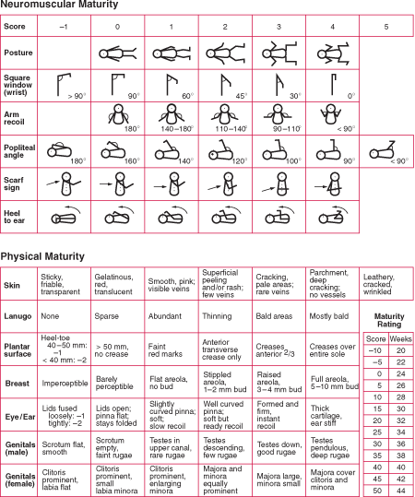

Slide 18
GROUPING BABIES INTO PRETERM AND TERM
PHYSICAL CHARACTER :
ANTHROPOMETRY- Preterm babies birth wt. <2500
SOLE CREASES- single deep crease over anterior one third of sole.
GENITALS-in male babies both the testes are at the external ring or above and scrotum is small with scanty rugosities, in girl labia majora are widely separated with labia minora.
BREAST NODULE- <5mm and nipple is small or absent.
EAR CARTILAGE- deficient and even absent.
HAIR-brownish black fuzzy or woolly in appearance.

Slide 19
NEUROLOGICAL CHARACTER
MUSCLE TONE- assessed by three parameters
Posture/attitude
Passive tone - popliteal angle and scarf sing
Active tone - asesed by traction response and recoil
JOINT MOBILITY-
the degree of flexion at ankle and wrist (square window) is initiated in preterm babies because relatively greater stiffness of joints in early gestation
CERTAIN AUTAMATIC REFLEXES-
moros reflex appears at early at 28-30 wks but lacks complete abduction phase till 38 wks of gestation .
pupillary response to light is present after 30 wks.
grasp response makes its appearance around 30 wks but strong grasp elicitable after 36 wks

Slide 20
THANK YOU

