Slide 1
Fever
DR. SANDESH .P. GOJE
ASSISTANT PROFESSOR
( KAYACHIKITSA)
SVAMCH, CHANDRAPUR

Slide 2
Introduction
The body temperature refers to the temperature of the viscera and tissues of the body.
Its maintaining a balance between the heat gain and heat loss, which is regulated by the hypothalamus.

Slide 3
The following terms the used when recording the body temperature.
 |  | Temp in C | Temp in F
1 | Hypothermia | 35º | 95º
2 | Subnormal | 35.0-36.7º | 95-97º
3 | Normal | 36.7-37.2º | 98-99º
4 | Mild fever | 37.2-37.8º | 99-100º
5 | Moderate fever | 37.8-39.4º | 100-103º
6 | High fever | 39.4-40.5º | 103-105º
7 | Hyperpyrexia | >40.5º | >105º

Slide 4
Types of Fever
Continuous Fever: The temperature does not fluctuate the more than 1ºC in 24 hours e.g.. pneumonia, typhoid , UTI, typhus etc.
Remittent fever: The temperature fluctuate the more than 1ºC in 24 hours. e.g. typhoid, infective endocarditis.
Intermittent fever: The temperature is present only for some hours in a day and remits to normal for the remaining hours.eg. malaria, kala-azar, pyemia.
Hectic or septic: the temperature variation aggressively is very large and exceeds 5ºC e.g. septicaemia.
Low grade fever: Temperature is present daily especially in the evening for several day but does not exceed 37.8^{oC} at any time.

Slide 5
Causes of Fever
Infections: Bacterial, viral, rickettsial, fungal parasitic, etc.
Neoplasms: Hypernephroma, lymphoproliferative, malignancies, carcinoma of pancreas, lung and bone and hepatoma.
Vascular: AWMI, pulmonary embolism, pontine haemorrhage, etc.
Traumatic: Crush injury.
Immunological:
Collagen disease, SLE, rheumatoid arthritis.
Drug fever
Serum sickness
Endocrine: Thyrotoxicosis, Addison’s disease.
Metabolic: Gout, porphyria, acidosis, dehydration.
Hematological: Acute haemolytic crisis
Physical agents: Heat stroke, radiation sickness.
Miscellaneous: Factitious fever, habitual hyperpyrexia

Slide 6
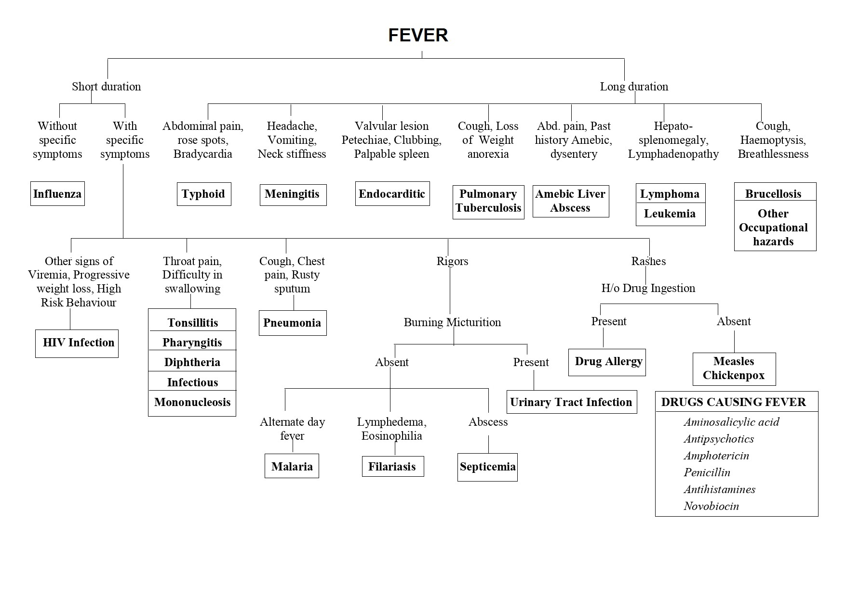

Slide 7
Thanks….

