Slide 1
PROTEIN ENERGY MALNUTRITION(PEM)
Dr. Kiran Nandeshwar
MD Kaumarbhritya

Slide 2
Defination
WHO defines PEM as a range of pathological conidition from the coincidental lack in varying proportions of proteins and calories occuring more frequently in infants and children and commonly associated with infections.

Slide 3
Etiology (causes)
Inadequate dietary intake
Increased nutritional requirement
● Child related factors-
LBW baby
Absence or early cessation of brestfeeding
Delayed weaning
Incorrect dietary habits
Recurrent/ persistent infections.

Slide 4
● Maternal factor –
lactation failure
Maternal malnutrition/ illness
ignorance about child feeding practices
sepaaration- dead, single or working mother
● Socioeconomic factors-
poverty and unemployment
large family size
unhygenic living conditions
Inequitable food distribution in family with mother and infants being last priority
Disadvantaged child

Slide 5
● Cultural factors-
wrong beliefs, superstition e.g colostrum harmful, milk aggravates diarrhea
wrong customs- delayed weaning
wrong cooking practices- peeling vegetables before cooking, polished rice, draining of water after cooking.
● Community factor-
natural/man made disasters, famines, civil wars
inappropriate agricultural practices
generalised economic depression
inadequate primary health care

Slide 6
Classifiction
Undernutrition
Kwashiorkor
Marasmus
Marasmic Kwashiorkor
Pathogenesis:-
▪Dietary theory
Caloric defi. – Marasmus
protein defi.- Kwashiorkor

Slide 7
▪ Duration theory-
gradually deprivition- Marasmus
sudden deficiency – Kwashiorkor
▪Role of infection- viscious cycle between infection and malnutrition
PEM
↓ Appetite ↓phagocytosis
↓ absorption ↓cell mediated immunity
↑requirement ↓local defence
↑ loss of nutrients ↓inflammatory response
Infections

Slide 8
IAP Classification-
Grade for Malnutrion | Wt for age of the standard
Normal | >80%
Grade 1 | 71-80% (mild)
Grade 2 | 61-70% ( moderate)
Grade 3 | 51-60% ( severe)
Grade 4 | <50 % ( very severe)

Slide 9
Undernutrition
Inadequate consumption
Poor absorption
Excessive loss of nutrients
Malnourished children susceptible to infection
sepsis
pneumonia
gastroenterities
● Indicators of undernutrition:
Stunting- low height for age (chronic malnutrition)
Wasting- low weight for height(acute malnutrition)
Underweight- loe weight for age( acute+ chronic malnutrition)

Slide 10
Anthropometric measurements
● Instrument to measure wt.
pan type weighing machine
bathroom scale
beam balance type
● Instruments to measure Ht.
stadiometer
infantometer
● skinfold thickness
Harpenderis callipers
●for CC, HC
measuring tape
Difference in Ht and length = <1cm
Due to lumber lordosis, vertebral compressions.

Slide 11
Mid arm cicumference-
increases rapidly in the first year(11-16cm)
1-5 yrs = 16-17cm replacement of water by fat
Shakir’s tape
13.5cm – abnormal- malnutrition
13.5 to 12.5cm – borderline- mod. Malnitrition
< 12.5cm – wasted- severe malnutrition
Bangle test -4cm diameter
Severe malnutrition- passed above elbow
Normal – can’t passed above elbow

Slide 12
Marasmus
Results from gradual deterioration in nutritional status ( carbohydrate deficiency)
Wasting of fats and muscles.
Child appears very thin (bone and skin) and has no fat
Severe wasting of shoulder, arms, Buttocks and thighs.
Monkey facies- loss of buccal pad of fats creates the aged or wrinkled appearance.
Baggy pants- Appearance due to loose skin of the buttocks hanging down.
Affected children may appear to be alert in spite of their condition
No edema, Anoxious look
Dull , lusterless sparse hair.

Slide 13
Grading for Marasmus- (ABCB)
Loose skin fold in Axilla and Groin
Loose skin fold in thigh and Buttocks
loose skin fold in Chest and Abdomen
Loss of Buccal pad of fat

Slide 14
Kshiorkor
After children aged 1-4 yrs
Triad- mental retardation
growth retardation
oedema
- Pitting edema = usually starting in the legs and feet and spreading in more advanced cases to hands and face
General appearance- fat sugar baby appearance
Oedema – mild to gross, 5-20% of the body wt.
Muscle wasting- always present weak, hypotonic and unable to stand or walk.

Slide 15
4) Skin changes- increased pigmentation, desquamation and dyspigmentation.
-flaky paint dermatities
Crazy pavement dermatities
Enamel spots ( on buttocks, perenium and upper thigh)
Mucous membrane lesion
smooth tongue/ bald tongue
cheilosis
angular stomatities
6) Hair
dyspigmentation
Loss of characteristics curls and sparseness
Loss of luster and are easily pluckable
Flag sign

Slide 16
7) Mental changes
Unhappiness, apathy or irritability
Sad & intermittant cry
No signs of hunger
Difficult to feed them
8) GIT
Anorexia with vomiting
Abdominal distention
Stools watery, emisolid, bulky, low ph, contains unabsorbed sugar
9) Anaemia- nutritional
CVS-
cold, pale,extrimities, prolonged CRT, Bradycardia, diminished cardiac output,hypotension

Slide 17
11) Renal fuction
Aminoaciduria
Inefficient excretion of acid load.
Grading of Kwshiorkor-
Peripheral oedema alone
Mooning of face
Presacral and abdominal will oedema
Ascites

Slide 18


Slide 19
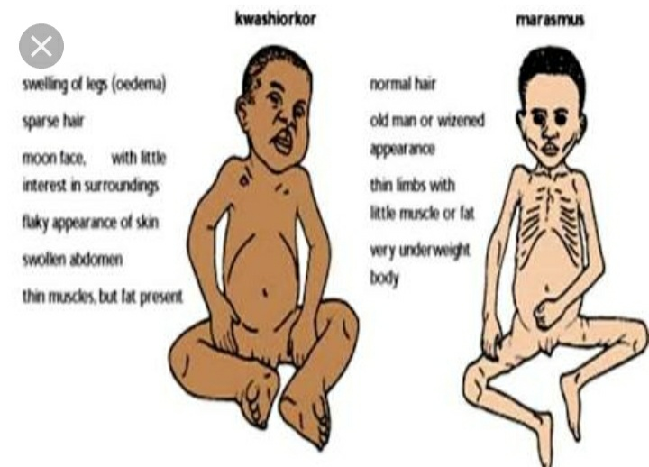

Slide 20
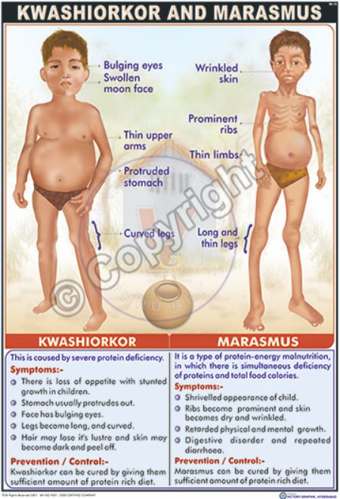

Slide 21
Severe acute Malnutrition (SAM)
Weight for height below-3SD of the median WHO growth reference
Visible severe wasting
Pressure of bipedal oedema
Mid upper arm circumference below 11.5cm

Slide 22
Pathological changes in malnutrition in various organ system
● Upper GIT
Mucosa shiny and atrophic papillae of tongue flattened
● Small and large intestine
Mucosa and villi atrophic, enzymes reduced, hypotonic rectal prolapse
●liver
Fatty liver
Deposition of trigycerides

Slide 23
● Pancreas
Exocrine secretion depressed but endocrine function less severely affected
Glucagon production reduced
Insulin level low
Atrophy and degranulation or hypertrophy of islet seen
●Endocrine system
Elevated thyroid hormone, thyroid involution and fibrosi , adrenal gland atrophic
●lymphoreticular system
Thymus involuted, loss of distinction between cortex and medulla
Depletion of lymphocytes

Slide 24
Management of Malnutrition
● Mild to moderate malnutrition-
80% of malnutrition associated death
150kcl/kg/day- calories
Frequent feeding upto 7 times / day
Oil is usually used to increase the energy
Protein- 3 gm/kg/day
● Attension should be paid about-
Usual diet/ including breast feeding
Presence of diarrhoea
Presence of vomiting , loss of appetite
Presence of tuerculosis
Malnutrition may be the presentation of HIV patients

Slide 25
Examinations-
Signs of dehydration
Shock/ cold hands, slow CRT, weak and rapid pulse
Severe palmar pallor
Eye signs of vitamin A deficiency
Localising signs of infections
Skin infections, pneumonia, signs of HIV infections, fever ( temp.> 37.5◦ C or 99.5 F)
Hypothermi ( rectal temp.<35.5◦C or 95.9 F)
Mouth ulcer, skin changes of kwashiorkor

Slide 26
Malnutrition treatment
10 steps and 2 phases
Stabilization phase
Rehabilitation phase
Hypoglycemia
Hypothermia 2-7 days
Infection stabilization
Dehydration due to diarrhoea
Electrolyte
Micronutrients
Feeding
Catch up growth several wks
Stimulation rehabilitation
Fallow up

Slide 27
Stabilization Phase
Step 1- Hypoglycemia
BSL < 54mg/dl or 3 mmol/l
Symptomatic Asymptomtic
Lethargic
Unconsciousness
Seizures
Periferal circulation fail
hypothermia

Slide 28
Rx – 5ml/kg of D10% IV Rx- 50 ml of D10%
Then or sucrose solution
50 ml D10% orally ( 1tsf sugar+ 31/2 tbf water)
or
( 1tsf sugar+ 31/2 tbf water)
Then
F-75

Slide 29
Step 2- Hypothermia
Axillary temp. <35◦C / 95F or
Rectal temp. < 35.5◦C /95.9F
Rx – child should be rewarmed providing heat using Radiation (overheated warmer)
Conduction( skin contact)
convection ( heat convector)
- Proper covering of the body including head caps and two 100W bulbs kept 45cm above the bed.
Kangaroo mother method
If severe hypothermia rectal temp< 32◦C
Warm humidified oxygen should be given followed immediately by 5ml/kg of D10%IV or 50 ml of D10% By NG route
Warm feeds.

Slide 30
Step 3 – Infections
Classical signs of infections- fever and tachycardia absent but hypothemia present
Common site- Investigation-
Skin CBC
Alimentary tract(diarrhea) urine analysis
Respiratory tract(pnemonia) blood culture
Urinary tract(UTI) PS for MP
Septicemia( gram –ve bacteria) CSF examination
TB, Malaria

Slide 31
Rx- Antibiotic treatment
Ampicillin 50mg/kg 6hr IV
Gentamicin 7.5 mg/kg OD IV
OPD- cotrimoazole
(if no improvement)
IV cefotaxime
IV ceftriaxone
-All SAM babies> 6 month must be offered measles immunisation also then at 9 month measle vaccine
- Metronidzole PO 30mg/kg/day 8 hrly 7 days
to treat anerobic infections.

Slide 32
Step 4- Dehydration due to diarrhoea
Loss of elasticity of skin due to loss of the subcutanious fats in marasmus, loss of extracellular fluid in dehydration.
Should be corrected slowly over12 hrs
Some dehydration- ORS(IAP)- Resomol(WHO)
IV for severe dehydration and shock
ORS – orally or by NGT 5ml/kg every 30 min for first 2 hr and then 5-10 ml /kg every 1 hr upto 4-10 hr
Refeeding must be initiated with started F-75
IV fluids RL +D5%
½ NS +D5%

Slide 33
Step 5- Electrolytes
In malnutrition - sodium↑↑
potassium and magnesium↓↓
↓potassium (hypokalemia)- weakness of abdomen, skeletal and respiratory muscles, hypotonia, flaccid paralysis
ECG changes- ST depression
T waves inversion
presence of U waves
If potassium < 2mEq/l
Rx – IV infusion 0.3-0.5mEq/kg/hr
Then maintain 3-4mEq/kg/day for 2wks(oral)
Can be given orally
syp. Potassium chloride20mEq/15ml

Slide 34
Magnesium deficiency- decrease muscle mass
On day 1 – inj. MgSO4 (50%)
0.1-0.2ml/kg IM
Then maintain orally 0.8-1.2mEq/kg
Hypocalcemia- present due to low albumin bound fractions but do not need treatment as ionic calcium is usually normal

Slide 35
Step 6- Micronutrients
anemic – Iron should be started after 1wk .
●vit A –
2lac IU>1yr
1lac IU = 6months to 1yr
50,000 IU = < 6 months on day 1, 2, 14/28
●vit K- single dose 2.5mg IM at admission
thiamine 0.5mg/1000kcal
riboflavin 0.6mg/1000kcal multivitamin
nicotinic acid 6.6mg/1000kcal syp
Multivitamin with A,C,D,E and B12

Slide 36
●folic acid
Day1 – 5mg then 1mg/day
●zinc for skin lesion 2mg/kg/day
●copper 0.2mg/kg/day
●iron (after 1 wk) 3mg/kg/day

Slide 37
Rehabilitation phase
Step 7- feeding
Started as soon as homeostasis is achieved
Recommended dietary intake
Energy- 100kcal/kg/day
Protein – 1-1.5gm /kg/day
Fluids- 130ml/kg/day
if edema 100ml/kg/day

Slide 38
F-75
-Starter feed
Milk based cereal based
Cow milk-30ml cow milk- 30ml
Sugar-10gm sugar-5gm
MCT oil-2gm MCToil- 2gm
Water 100ml cereal powder- 3.5gm
water100ml
Energy- 75kcal/100ml 75kcal/100ml
Proteins-0.9gm/100ml 1.1gm/100ml
Lactose- 1.2gm/100ml 1.2gm/100ml

Slide 39
Step 8 – catch up growth
Once appetite returns and child is stabilised, begin to rebuild wasted tissue and ensure weight gain.
F-100 (for catch up diet)
Milk based cereal based
Cow milk-90ml cow milk- 75ml
Sugar-5gm sugar-2.5gm
MCT oil- 2gm MCT oil – 2gm
Water100ml cereal-7gm
Water100ml
Energy-100kcal/100ml 100kcal/100ml
Proteins- 2.9gm/100ml 2.9gm/100ml
Lactose- 3.8gm/100ml 3gm/100ml
8 feeds/day
Continue breastfeeding
Expeted wt gain> 10gm/kg/day
F100 C/I in < 6 months baby

Slide 40
Step 9- Provide sensory stimulation and emotional support:
Tender and loving care
Cheerful and stimulating enviroment
Encourgement of physical activity
Maternal involvement in child care
Structural ply sessions including language nd motor activities with the help of toys

Slide 41
Step 10- follow up after recovery
Most cases needs 10-15 days of hospitalisation
Periodic follow up after 4-6 months to prevent recurrence.
On regular family meals
Correct feeding practices
Immunization
Deworming
Follow up plan discuss with mother

Slide 42
Criteria for discharge
WHO-
Wt for Ht> -2SD score
No edema foe at least 2 wks
Mid arm circumferance > 12.5cm
Govt. of India-
Wt gained > 15% of pre-admission wt
Accept nutritious food
All infections and complication treated
Provide micronutrients
Fully immunised
Mother trained with good feeding practices and sensory
Stimulation at home

Slide 43


