Slide 1
EXAMINATION OF RESPIRATORY SYSTEM IN CHILDREN

Slide 2
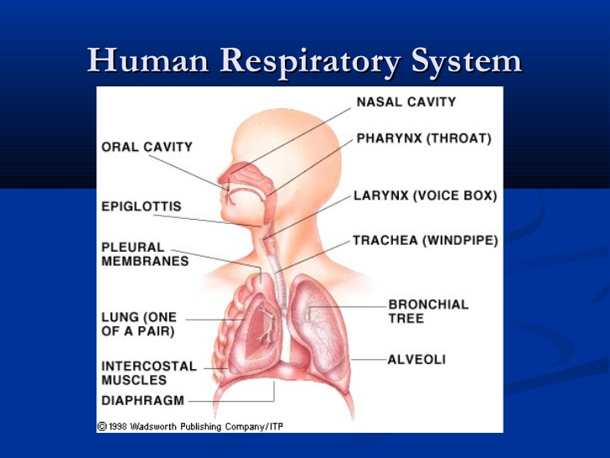

Slide 3
Ayurvedic Aspect of Pranavaha Strotasa
qÉÑsÉxjÉÉlÉ
iÉ§É mÉëÉhÉuÉWx§ÉÉåiÉxÉÉÇ WØSrÉÇ qÉÔsÉÇ qÉWÉx§ÉÉåiÉvcÉ | - cÉ.ÌuÉ. 5
SÑ·Ï WåiÉÔ
¤ÉrÉÉiÉ xÉÇkÉÉUhÉÉiÉè UÉæ¤rÉÉSç urÉÉrÉÉqÉÉiÉ ¤ÉÑÌkÉiÉxrÉ cÉ |
mÉëÉhÉuÉÉWÏÌlÉ SÑwrÉÎliÉ x§ÉÉåiÉÉÇÌxÉ AlrÉåvcÉ SÉÂhÉæ: || - cÉ.ÌuÉ. 5
SÑ·Ï sÉ¤ÉhÉå
AÌiÉxÉ×·ÇqÉÌiÉoÉ®Ç MÑüÌmÉiÉqÉsmÉÉsmÉqÉpÉÏ¤hÉÇ uÉÉ xÉvÉoSvÉÑsÉ-qÉÑcNçuÉxÉliÉÇ S×·uÉÉ mÉëÉhÉuÉWÉlrÉxrÉ x§ÉÉåiÉÉÇÌxÉ mÉëSÑ·ÉÌlÉiÉÏ ÌuÉ±ÉiÉè | - cÉ.ÌuÉ. 5

Slide 4
PARTS OF R.S.
1. UPPER R. S. –
1. Nose
2. Pharynx
3. Adenoids
4. Tonsils
5. Epiglottis
6. Larynx
7. Trachea
2. LOWER R.S.-
1. Bronchi
2. Bronchioles
3. Alveoli.

Slide 5
STEPS
Examination done in 4 steps –
1. Inspection
2. Palpation
3. Percussion
4. Auscultation

Slide 6
INSPECTION
FOLLOWING STEPS :
1.Face inspection
2. Nose
3. Neck
4. Throat
5.Chest

Slide 7
NOSE :
1. Nasal patency
2. Nasal flaring.
3. Nasal polyps
4. Sinus tenderness
5. Discharge
THROAT :
1. Breath odor
2 . Tongue, Teeth.
3. Tonsils – Sizes and sign of inflamation

Slide 8
THORAX
Observation of respiratory
movements :
1. Rate
2. Rhythm
3. Depth
4.Quality

Slide 9
NORMAL R. R. AS PER THE AGE
AGE | R.R.
0-6 Months | 30 - 60
6 Months - 1 yr | 30 - 50
1 -3 yrs | - 40
3 -5 yrs | 22 - 34
5 - 12 yrs | 14 - 25
> 12 yrs | 14 - 20

Slide 10
ABNORMAL BREATHING PATTERNS
A ) Disorders of R. R. :
1. Tachypnea
2. Bradypnea
3. Dyspnea
4. Apnea
B ) Disorders of Respiratory
Depth :
1.Hyperpnea
2. Hypoventilation
3. hyperventilation

Slide 11
PATHOLOGICAL RESPIRATION
1. Seesaw / Paradoxic respiration -
In Respiratory failure.
2. Kussmaul’s Breathing -
Hyperventilation, gasping and laboured
respiration.
Present in –
Severe dehydration
Respiratory acidosis.
Diabetic ketoacidosis.
Acute renal failure.

Slide 12
3. Chyne-stroke Breathing-
Alternating breathing in high freqeuncy and low frequency.
Present in –
Brain stem injury.
Encephelitis.
Hypoxia.
Meningitis.

Slide 13
INSPECTION OF ANTERIOR CHEST WALL
1. Shape of chest –
Circular or cylindrical in infants.
See the ratio of A.P. And transverse diameter.
Abnormalities of shape :
1. Pigeon chest.
2. Funnel shaped chest
3. Barrel shape chest.
4. Harrisons sulcus.
5. Ricketic rosary
2. Symmetry –
Note the chest is symmetrical or not.
3. Shoulder inspection :
Drooping of shoulders towards pathological side.
in Fibrosis.

Slide 14
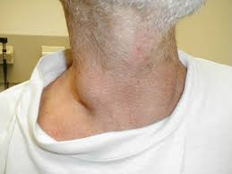
4. THE POSITION OF TRACHEA :
Inspection for the position of trachea-
“TRAILLES SIGN”.
A. Trachea may be pulled towards diseased
side in -
Collapse
Fibrosis
Thickened pleura.
B. Trachea may be pushed towards the normal
side in –
Pleural effusion
Pneumothorax.

Slide 15
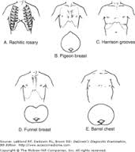
5.Harrison’s sulcus -
Sign of prolonged R.D. in children.
Also in Rickets.

Slide 16
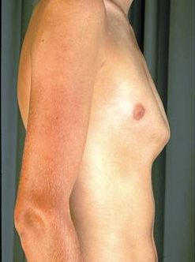
DEFORMITY OF SHAPE OF CHEST
1.Pectus carinatum –
Also called Pigeon chest.
Protrusion of sternum and ribs.
Common in male.
Less stamina.

Slide 17
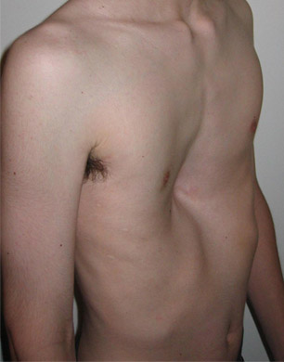
2. Pectus excavatum –
Produces caved –in or sunken
appearance of chest.
Also called “FUNNEL CHEST”
It can impair cardiac and
respiratory functions.

Slide 18
PALPATION
Palpation of ant. Chest wall :
1. Palpate upper lung zone
2. Palpate Middle lung zone
3. Palpate lower zone.
Others –
1. Vocal fremitus- conduction of voice sound
through respiratory tract.

Slide 19
2. Crepitations –
Cracking sensation when hand pressed over
the affected area.
3. Tactile fremitus –
The patient said 99 physician sense with ulnar
aspect of hand.

Slide 20
PERCUSSION
PERCUSSION TECHNIQUE –
1. Place the left hand on chest wall palm downwards with finger seperated.
2. 2nd phalanx over the area of intercostal
space.
3. Right middle finger strikes the 2nd phalanx
producing hammer effect.
4.Entiremovement comes from wrist.

Slide 22
EVALUATION OF PERCUSSION
1. Resonance –
Heard over the all lobes of lungs.
2. Liver dullness –
Heard over the 5th interspacein the
right midclavicular line.
3. Cardiac dullness –
Over the left sternal border from 2nd to 5th
intercostal space.

Slide 23
Pathological dullness heard in –
1. Pneumothorax
2.Hydrothorax
3. Haemothorax
4. Pulmonary oedema
5. Lungs or mediastinal tumer.

Slide 24
AUSCULTATION
“Auscultation involves using stethoscope to e
valuate breath and voice sound”
In lungs breath sound are classified as –
1. Vesicular breath sound
2. Bronchovesicular sound
3. Bronchial breath sound .

Slide 25
1.Vesicular breath sound –
Heard over the entire lung except –
upper interscapular area and area beneath
the manubrium.
2. Bronchovesicular breath sound –
Inspiration is higher and louder than vesicular
breathing .

Slide 26
3. Bronchial Breath sound-
Reverse of vesicular sound .
Heard over trachea near suprasternal notch.
“ Absent or diminished sounds” are always an abnormal finding warranting investigation.

Slide 27
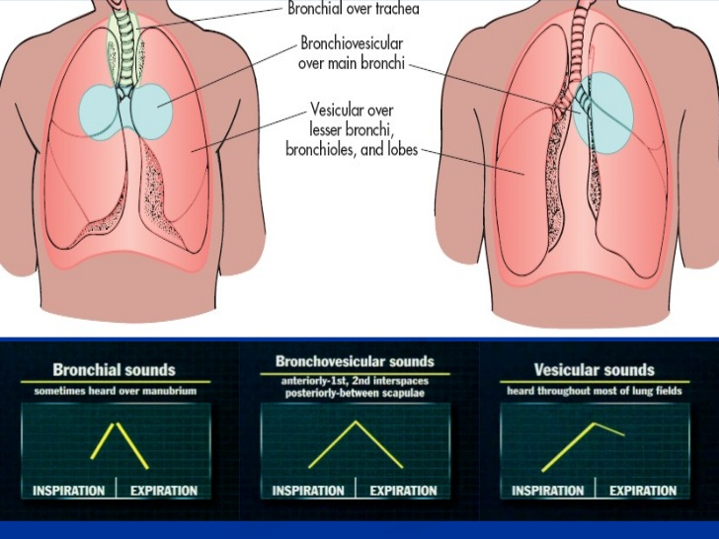

Slide 29
ABNORMAL FINDINGS
1.Reccession –
Any increased negative pressure generated in
thorax will result in reccessions .
This are of 3 types.
Greater the reccession ₌ greater the R.D.
2.Stridor –
Indicates upper airway obstruction.
More during inspiration.

Slide 30
5. Ronchi –
Result of viscous fluid in airways.
Bubbly sounds similar to blowing bubbles.
Heard on insprstion and expiration.
2 types -
1.Sibilant ronchi – High pitched., musical .
Produced in smaller bronchi and bronchioles.
2. Sonorus ronchi – low pitched and snoring.
Produced in trachea ands bronchi.

Slide 31
3. Wheeze –
Indicates lower airway narrowing.
More pronounced during expiration.
4. Grunting –
Sign of severe Respiratory distress.
Attempt to keep the distal airways open by
generating Grunted PEEP.

Slide 32
ASESSMENT OF TRANSMITTED VOICE SOUND
VOCAL RESONANCE –
Similar to TVF but evaluated by auscultation.
1. Egophony -
Nasal twang or bleating vocal
resonance.
2. Bronchophony –
V.R. is loud as that it appears that sound
being produced in ear piece of stethoscope.
3. Whispering pectoriloquy –
Heard in Broncho-pleural fistula.

Slide 33
SPECIAL TEST
1.COIN TEST –
For the Pneumonia
2. FRICTION TEST –
Conduction of sound is better when
chest scratched on side having
pnemothorax.

