Slide 1
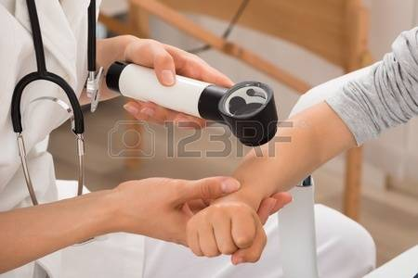
Skin diseases in pediatrics
Presented by
Dr.Kiran Nandeshwar

Slide 2
Why this topic?
Most children will have a skin infection at some.
Skin infections are a common reason for consultation in primary care and in dermatology practice.
Patients having skin problems regularly visit our opd,this presentation is an small effort to focus those conditions.

Slide 3
Contents
Introduction of skin organ.
Anatomy of skin
Functions of skin
Difference between child and adult skin.
Approach to patient with skin lesion
Terms used to describe skin lesions.
Skin conditons in newborn
Skin conditions in children.
Fungal nfections
Viral exanthemata

Slide 4
Ayurvedic view of skin diseases.
Ayurvedic drugs effective in skin diseases.

Slide 5
introduction
The skin is the external organ that protects against mechanical trauma,UV light and infection.
Skin is the largest organ in the body.
It is composed of 2 layers:
1.epidermis &
2.dermis.

Slide 6
Layers of skin

Slide 7
Epidermis : thickness of 0.1 to 0.6 mm.
90-95% of cells in the epidermis are keratinocytes.
Dermis : 0.3 to 0.4 mm.Blood vessels supplying nutrients to all skin layers are in dermis.

Slide 8
Functions of skin
Protection
Thermoregulation
Immunological response
Barrier to water loss
Secretion of waste products through sweat.
Sensation.

Slide 9
Neonatal & adult skin difference
Thinner,less hairy,weaker.
Fewer eccrine and sebaceous gland secretions.
Increased susceptibility to external irritants.
Increased susceptibility to micrococcal infection.

Slide 10
Approach to patient with skin lesion
Examine with area fully exposed.
Distribution pattern: Symmetrical or asymmetrical pattern?
Proper history: the time & evaluation of the spread.
Triggering factors in cases like urticaria or other allergic skin reactions.

Slide 11
Terms used to describe skin lesions
Macule
Papule
vesicle
bulla
Pustule
Comedon
Cyst
Abscess
Patachia

Slide 12
Purpura
Erythema
Fissure

Slide 13
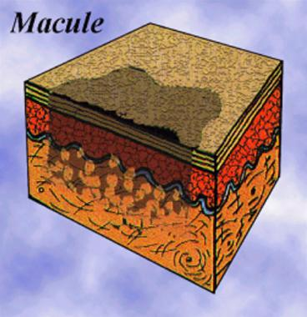
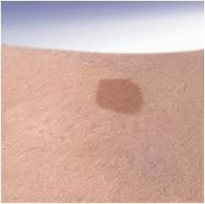
Macule
A localised area of colour change or textural change in the skin.

Slide 14
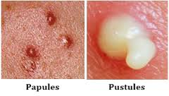
Papule
A solid elevation of skin less than 5 mm in diameter.

Slide 15
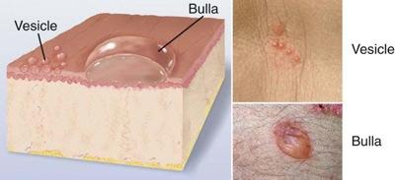
Vesicle
Clear,fluid filled blister less than 5 mm in diameter.

Slide 16
bulla
It is a cavity formed in layers of skin,containing blood ,plasma,epidermal or inflammatory cells.

Slide 17
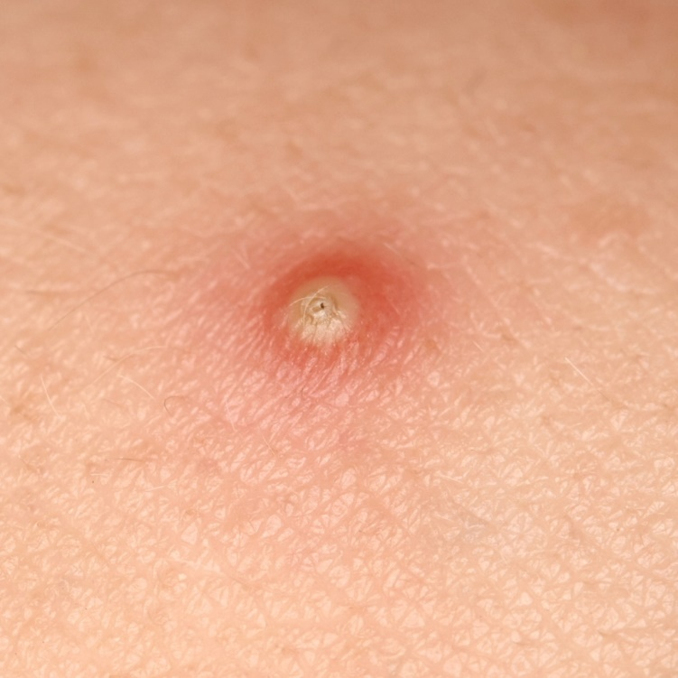
Pustule
A visible collection of pus in a blister.

Slide 18
Comedo
Conical raised lesion with a broad base & plug apex.
Types : 1.Black
2.white
Blackhead is an open comedons,black color is due to oxidised melanin,can be easily removed.

Slide 19
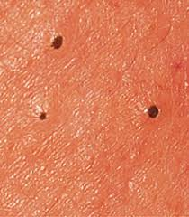
Whitehead is a closed comedon & plug cant be removed easily.

Slide 20
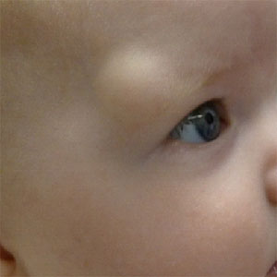
Cyst
A nodule consisting of a epithelial line cavity filled with fluid or semisolid material.

Slide 21
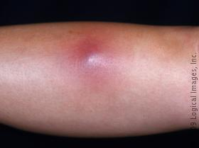
Abscess
A localised collection of pus.

Slide 22
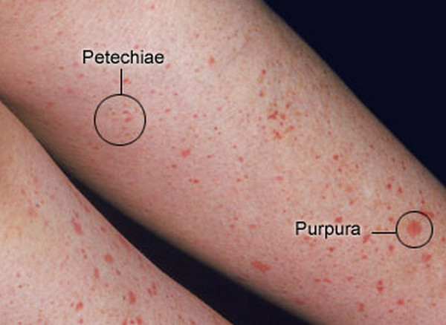
petechie
Haemorrhagic punctate spot 1- 2 mm in diameter.
Purpura –extravasation of blood resulting in redness of skin.

Slide 23
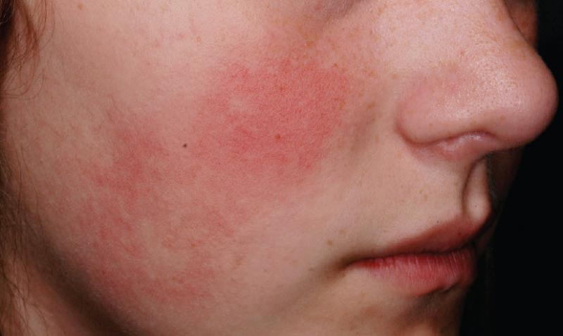
Erythema
Redness of the skin due to vascular dilatation.

Slide 24
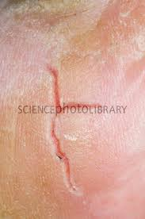
Fissure
A linear split in epidermis.

Slide 25
Skin conditions in Newborn
1.Erythema toxicum.
2.Milia
3.Mongolian Blue spots
4.Acne neonatorum
5.Napkin rash
6.Albinism

Slide 26
Erythema toxicum
Also called as Urticaria neonatorum.
Characterized by erythematous blotches with central pale papule.
affects about 40 -55% of term infants.
Appears on 2nd day of life,appears on face,neck & trunk
Resolves spontaneously within few days.
T/t –application of neosporin powder.
Use soft linen for baby.

Slide 28
Milia
Yellow white spots on the nose.
Due to retension of sebum.
Present in practically in all newborn babies & disappears spontaneously.
No specific t/t .

Slide 29
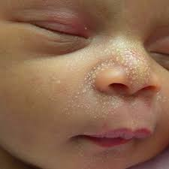

Slide 30
Acne Neonatorum
Typical acne like lesions with comedones.
May be seen over forehead,nose &chicks at birth in term babies.
Occur due to transplacental passage of maternal androgen to the foetus.
Diminish within next couple of days.

Slide 32
Mongolian spot
Irregular blue patches of skin pigmentation,
Often present over the sacral area and buttocks.
Extremities & rest of the trunk may also be affected.
t/t :
Self limiting.No specific treatment.

Slide 34
Napkin rash
Mainly due to use of nylon or water tight plastic napkins or soakable diaper.
Delay in changing the napkins causes redness,induration and excoriation dur ammonical dermatitis.
t/t –change diaper frequently.
Zinc oxide calamine combination for soothing effect.

Slide 36
Albinism
Autosomal recessive disorder due to deficiency of tyrosinase enzyme.
Hypopigementation involving skin,hair & eyes.
No specific t/t but skin should be protected from UV light .Use of dark glasses to protect aganist photophobia.

Slide 38
Skin conditions in paediatric age group
Phrenoderma
Furuncle
cellulitis
Urticaria
Vitiligo
Acne vulgaris

Slide 39
Xeroderma pigmentosa
Keloid
Fungal infections
Eczema
Dermatitis
Scabies
Impetigo contagiosa.

Slide 40
Phrenoderma
Horny follicular plugs with perifollicular plugs of 2 -3 mm on the elbow,knee,anterolateral thigh,postero lateral upper arm,posterior axillary folds,buttocks.
The cause is unknown ,but thought to be due to vit. A deficiency with or without deficiencies of essential fatty acid ,B complex ,E,D etc.
Treatment is by supplimentation of this nutrients.

Slide 41
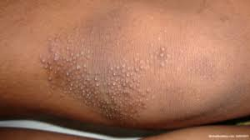
Local application of betamethasone plus salicylic acid brings quick symptomatic improvement.

Slide 42
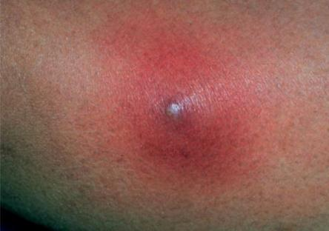
Furuncle
Infection originating from one hair follicle
Extending deep into dermis and subcutaneous tissue.

Slide 43
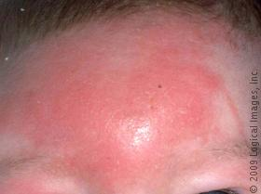
Cellulitis
Infection of subcutaneous tissue

Slide 44
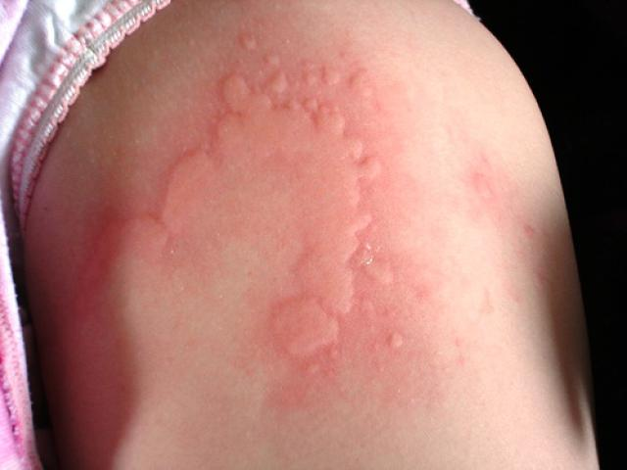
Urticaria
Acute pruritic elevated,flat – topped wheal.
It disappear & reappear many times during a single episode itself.
Triggering factor.

Slide 45
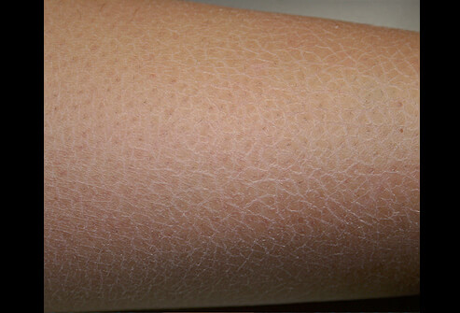
Xerosis
Dry skin.
t/t:Moisture retaining creams are applied.
Nutritional imbalances,if any,must be corrected.

Slide 46
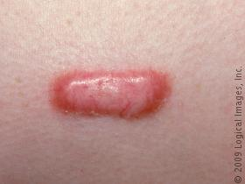
keloid
Excessive formation of collagen in healing process may result in keloid formation.

Slide 47
Vitiligo
Well defined white macules with sharply defined borders.
Normal cutaneous sensations.
No scaling.
Hair within the patch is also depigmented.
Main difference between leprosy & vitiligo is sensory impairment,present in leprosy.

Slide 49
Acne vulgaris
It is a disease of sebaceous glands.
Pathological process involved are:
Excessive sebum production
Ductal hypercornification,
colonization by proponibacterium acne.
Inflammation

Slide 50
Fungal infections
1.Tinea capitis
2.Tinea corporis
3.Tinea pedis

Slide 51
Tinea capitis
Fungal infection of scalp.
Low socio economic class & rural areas.
Transmission through shared combs,brushes &pillows.
Rare after puberty,because the sebum produced at this age contain fatty acid which inhibits the growth of this organism.

Slide 52
Continue…
Sign &symptoms :
Patches with minimal inflammation,mild swelling with patchy hair loss.
Hair are lusterless & break off easily.
t/t :
Griseofulvin 5-15 mg/kg/day. For 6 to 12 days.
Clotrimazole(candid) lotion for LA.

Slide 54
Tinea corporis
Fungal infection of smooth skin of body.
There is ring like lesion with an active red raised margin & tendancy towards central clering.
Common site :
Lower abd.wall.
Back & thighs
Occasionaly on neck & face.
t/t –same as tinea capitis.

Slide 56
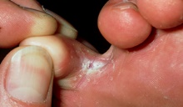
Tinea pedis
Erythema,maceration,fissuring & cellulitis of interdigital areas of foot.
Tinea manum –only one hand is affected ,cause is unknown.

Slide 57
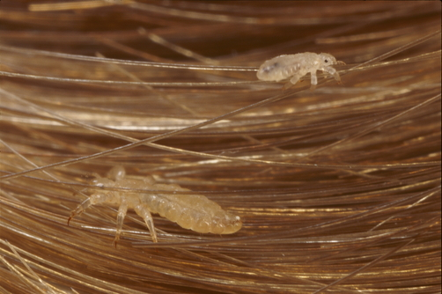
pediculosis
Ectoparasitic infestations caused by the lice pediculus capitis,pediculus corporis & phthirus pubis.

Slide 58
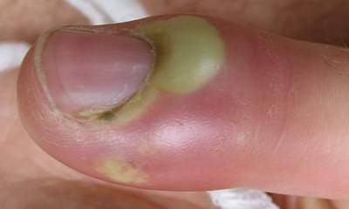
paronychia
Inflammaton of the nail fold.
Acute paronychia –staphylococci
Chronic paronychia –candida albicans.

Slide 59
impetigo
Superficial staphylo-coccal or streptococcal skin infection that presents in young children as erosions covered with thin honey colored crust on face.
Lesions begin as vesicle –pustules.
Treatment- oral Azithromycin(10mg/kg/day OD)or cefadroxyl(30mg/kg/day BD)is frequently necessary in addition to topical antibiotic.

Slide 61
scabies
Causative organism : sarcoptes scabiei
Erthematous excoriated papules
Intensely pruritic
Itch is worst at night.
Commonly involved areas – dorsal interdigital spaces of hands,flexor aspect of wrist,anterior axillary folds,inner thighs,periumbiical area,buttocks,penis & waist.

Slide 62
Continue…
Treatment - Lotions are best applied after a scrub bath.
Drug is applied all over the body below the neck.
1% undiluted gammabenzene hexachloride (Lindane)applied thoroughly,washed after 8 hour.
Repeat application considered only after 1 week.
Permethrin 5% cream single application.drug of choice,most eefective &safest.

Slide 63
Continue…
Ivermectin 200mcg/kg single oral dose.
Treat secondary infection with antibiotic.
Antihistamine for itching.
Calamine lotion for local application.

Slide 65
Xeroderma pigmentosum
It is an autosomal recessive disorder in which sun exposed skin is more prone to damage.
The condition results from decrease ability to repair the sunlight induced damage to DNA.
Patients of this are more prone to develop various skin cancers.

Slide 67
Viral exanthemata
Viral exanthemata are a group of contagious conditions in which the epidermal cells are detroyed by replication of viruses causing erruption or rash.
1.Measles
2.Herpes zoster
3.Chicken pox (varicella)

Slide 68
Measles
It’s a viral disease with febrile illness and rash over the body.
Discrete maculopapular rashes,first appear behind the ears.
Rash appears on 5th day of fever.

Slide 70
Herpes zoster
Unilateral dermatomal distribution that stops in the midline.
It is not much painful in children.
Herpes zoster is rare in children,may occur if the child has had varicella in early life or intrauterine exposure to varicella or immuno-compromised.
Rash appears in crops,progresses rapidly from red papules to vesicles,pustules and crust within 3 -4 days.

Slide 71
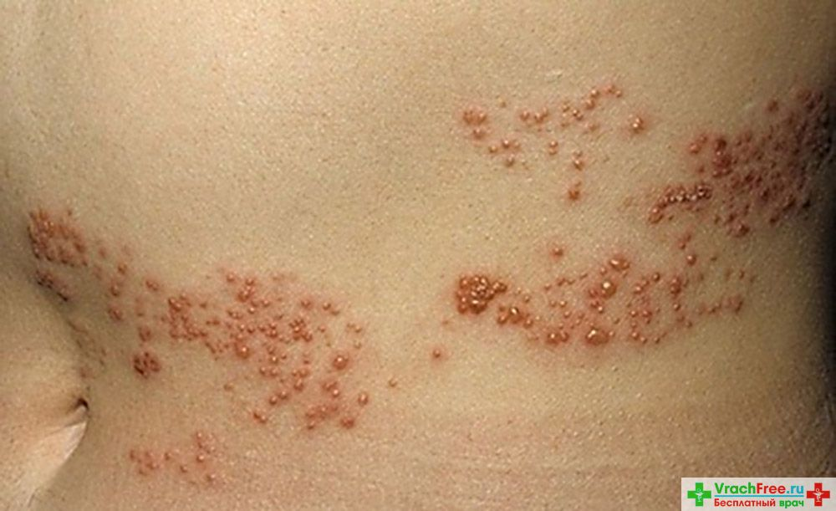
Rash having pruritic,centripital distribution on trunk,back & shoulders.

Slide 72
Chicken Pox(Varicella)
It is an acute vesicular exanthem occuring in non immune person specially in children.
Maculopapular rash.
Usualy on the upper trunk & face.
Followed by formation of vesicles which ruptures & heal with formation of scab.

Slide 74
rubella
Macules of few mm-day 1
Pin points papules – day 2
Subsides rash –day 3

Slide 76
Psoriasis
Chronic inflammatory dermatosis.
Affects 2% of population,usually appears between age 15 & 30 years.
Lesions are characterised by browish red papules & plaques which are sharply demarketed & are covered with fine silvery white scales.

Slide 78
आयुर्वेद विचार
त्वकगत् रोग

Slide 79
त्वचा निर्माण :
शुक्रशोणितस्य अभिपच्यमानस्य क्षीरस्येव संतानिका: सप्त त्वचो भवति ॥

Slide 80
त्वचा | प्रमाण (व्रीही) | व्याधी
अवभासिनी | १/१८ | सिध्म पद्म कंटक अधिष्ठान
लोहिता | १/१६ | तिलकालक,न्यछ,व्यंग
श्वेता | १/१२ | चर्मदल,अजगल्लिका,मषक
ताम्रा | १/८ | किलास,कुष्ठ
वेदिनी | १/५ | कुष्ठ
रोहिणी | १ | ग्रंथी,अपची,अर्बुद,गलगण्ड
मांसधरा | २ | भगंदर,विद्रधी,अर्श

Slide 81
अवभासिनी
लोहिता Epidermis
श्वेता
ताम्रा
वेदिनी Dermis
रोहिणी
मांसधरा - subcutaneous tissue

Slide 82
त्वकगत् रोग
कुष्ठ
श्वित्र- किलास
विसर्प
शीतपित्त -उदर्द -कोठ

Slide 83
व्याख्या :
त्वच: कुर्वन्ति वैवर्ण्यं दुष्टा: कुष्ठमुशन्ति तत्।
कालेनोपेक्षितं यस्मात् सर्वं कुष्णाति तद्वपु:॥
अ.सं.नि.१४
त्वचा आदि..धातूंचा नाश करत असल्यामुळे आणि
त्वचेवर वैवर्ण्य उत्पन्न करतो म्ह्णुन कुष्ठ हे नाव.

Slide 84
महाकुष्ठ
महाकुष्ठ | दोषाधिक्य | आधुनिक मत
कपाल | वात | Non lepromatous leprosy
औदुम्बर | पित्त | Lepromatous leprosy
मण्डल | कफ | Non lepromatous L-psoriasis
ऋष्यजिव्ह | वातपित्त | Non lepromatous l
पुण्डरीक | कफ पित्त | Lepromatous L.
सिध्म | वातकफ | Pityriasis leprosy
काकणक | त्रिदोषज | Lepromatous leprosy

Slide 85
क्षुद्रकुष्ठ-
क्षुद्रकुष्ठ | दोषाधिक्य | आधुनिक मत
एककुष्ठ | वातकफज | Psoriasis
चर्मकुष्ठ | वातकफज | Xeroderma
किटिभ | वातकफज | Lichen planus/psoriasis
विपादिका | वातकफज | phagades
अलसक | वातकफज | -
दद्रु | पित्तकफज | Ringworm
चर्मदल | पित्तकफज | Impetigo

Slide 86
पामा | पित्तकफज | Scabies
विस्फ़ोट | पित्तकफज | exenthymeta
शतारु | पित्तकफज | Erythema induratum
विचर्चिका | कफज | Eczema

Slide 87
औपसर्गिक रोग
प्रसंगात् गात्रसंस्पर्शात् नि:श्वासात् सहभोजनात्।
सहशय्यासनाच्चापि वस्त्रमाल्यानुलेपनात्॥
कुष्ठं ज्वरश्च शोषश्च नेत्राभिष्यन्द एव च।
औपसर्गिकरोगाश्च सन्क्रामन्ति नरान्नरम्॥
सु.नि.५/३३

Slide 88
संप्राप्ति घटक
दोष : त्रिदोष प्रधान
दुष्य : त्वक् ,रक्त, मांस,लसिका
स्रोतस : रक्तवह
अधिष्ठान : बाह्य रोग मार्ग
स्वभाव : चिरकारी.

Slide 89
भेद
महाकुष्ठ – ७ .
क्षुद्रकुष्ठ -११.

Slide 90
chikitsa
निदानपरिवर्जन:
संशोधन :
पक्षात् पक्षात् छर्दनानि
मासान्मासात् स्रंसनं
स्राव्यं रक्तं वत्सरे
द्विरल्पं नस्यं दद्याच्च त्रिरात्रान्
सु.चि.९

Slide 91
चिकित्सा
संशमन :
आरोग्यवर्धिनी वटी
कैशोर गुग्गुलु
मंजिष्ठादि क्वाथ
खदिरारिष्ट
सारिवाद्यासव

Slide 92
महातिक्तक घृत
पंचतिक्तक घृत
त्रिफला घृत
बाकुची तैल
मरिचादि तैल
करंज तैल
निम्ब तैल.

Slide 93
एकल द्रव्य
Mango –used in dryness after exposure to sun.restores elasticity of skin.
Aloe vera – accelerates the process of wound healing & helps in skin burns.effective against UV radiations.
Onion – renews & softens the skin.helps in formation of scar tissue on wounds.
Garlic – has shown antifungal activity.
Honey – used topically for wound healing.antifungal & antibacterial activity.

Slide 94
Nimba : antifungal,anti inflammatory.
Haridra : anti inflammatory,helps in healing.
Masoor : used in dark patches.
Madhuka : healing property,complexion.

Slide 95
Wood’s light
Blood tests including haematology
Serology
Microscopy &fungal culture
Surgical biopsy
Doppler studies
Prick test
Vitiligo,fungal infection
Systemic disease
Autoimmune disease &eczema.SLE
Rashes
Rashes or nodules
Leg ulcers
Immediate allergy
Investigation
Indications

Slide 96
Bibliography
1.Essential pediatrics : Dr.O.P.Ghai
2.Care of newborn : Dr.Meharban Singh
3.Paediatric clinical Examination :Santoshkumar
4.Manual of Paediatric Practice :Santosh Kumar
5.Charak Samhita ;Hindi commentory by Ravidatta Tripathi
6.Sushruta samhita: hindi commentory by Ambikadatta Shastri.
7.Kayachikisa :Dr.Ajay Sharma,Chaukhmba prakashan.
8.Macleodes clinical examination.

