Slide 1
Acute Appendicitis
DR. SANDESH .P. GOJE
ASSISTANT PROFESSOR
( KAYACHIKITSA)
SVAMCH, CHANDRAPUR

Slide 2
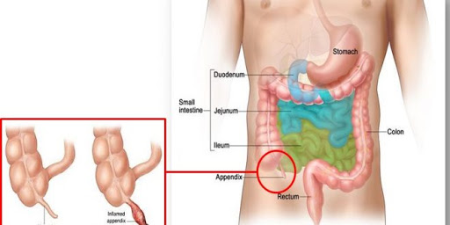
Inflamed Appendix

Slide 3
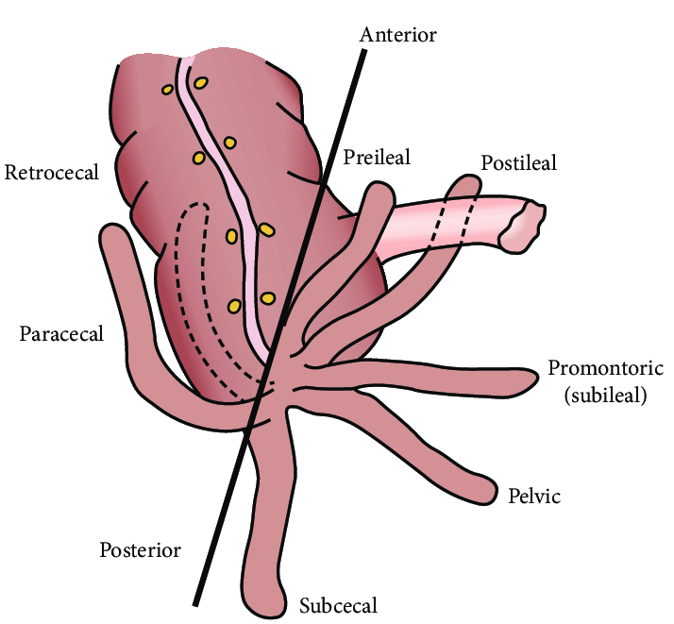
Different positions Acute appendicitis

Slide 4
Introduction and definition
Appendicitis is term to be the end result of infectious and pathological condition inside the lumen of appendix.
This condition gives rise to severe abd. Pain, nausea, vomiting and fever.
Being a medical emergency, it is acute and mild cases are usually successfully treated with conservative measures in intensive care unit to monitor and manage complications of the disease. While in most emergency as well as in chronic stages surgical intervention is needed.

Slide 5
Causes
Bezoars, foreign bodies
Infection
Trauma
Obstruction by calcified fecal deposits (appendixcoliths), intestinal worms and gallstone.

Slide 6
Pathogenesis of appendicitis
As the obstruction occurs at the opening of the lumen of appendix, filled with various mucus and exudates.
Leads to increased pressures in the appendix, decreased blood flow to the tissues of the appendix, and bacterial growth inside the appendix causing inflammation.
Inflammation, reduced blood flow to the appendix and distention of the appendix causes tissue injury and tissue death, If untreated, the appendix may burst, releasing bacteria into the abdominal cavity, leading to increased complications.

Slide 7
Clinical features of Acute appendicitis
Severe bad. Pain at right iliac region and epigastria.
Acute onset.
Nausea, vomiting, loss of appetite
Fever with chills.
Signs of dehydration.
Guarding and rigidity.
Hemodynamic instability
Tachycardia, respiratory distress, peritonitis, hiccup
Hypotension, hypoglycemia, shock.

Slide 8
Signs:-
Fever,Tachycardia, Tachypnoea
Abd. Rebound Tenderness @ Mcburnys region.
Psoas sign.
Rovsing’s sign .
Obturator sign.
Kocher’s sign.
Hamburger’s sign.
Dunphy’s sign.
Bartomier – Mechelson’s sign.
Aure – Rozanova sign.
All signs may positive in case of Ac. appendicitis .

Slide 9
Investigations:-
CBC (leucocytosis)
LFT, KFT, ESR, RBS, urine routine
Blood gases (PaO2, PaCO2, pH, HCO3‾,O2CT)
Plain x-ray abd.
CXR-PA view
USG Abd., CT Abd., MRI Abd.

Slide 10
Differential diagnosis
Gastritis, APD, gastroenteritis.
Intestinal perforation, peptic ulcer
Mackle's diverticulitis.
Bowel ischemia, intussusceptions, intestinal obstructions.
Amoebic liver abscess, crohn’s disease
Acute cholecystitis
Pneumonia
Acute or chronic Rt. Renal colic
Oophritis, salphingitis, endometritis, PID
Torsion of Rt. Ovaries, testicular torsion
Ectopic pregnancy

Slide 11
Complications:-
Appendicular perforation.
Empyema.
Perforation peritonitis.
Severe Septicemia.
Fecoperitonium .
Haemodynamic instability.
Acute renal failure

Slide 12
Treatment
Pts. Should be Admitted in ICU.
Watch for TPR-BP, SPO2, RBS
O2 Inhalation if required.
NBM
Starts IV fluids
Insert Ryle's tube with continuous Nasogastric aspiration
Connect monitor (NIBP)
Watch for Abd. Girth, urine output, Blood gases.
Send Blood sample for investigation.
Assess Foley’s catheterization for UOP.

Slide 13
Treatment cont….
A. Fluid replacement therapy:-
DNS,Normal saline, RL (Isotonic, Hypertonic, colloidal)
20ml/kg per hour for 1 hour followed by 3 ml/kg per hour
B. Pain control:- (Opoids\NSAIDs)
ing. Pethidin 100 mg IM tds. OR
Ing. Morphine 1 ml SOS OR
Ing. Pentazocine 30 mg IM/IV/SC may repeat dose every 3 to 4 hours
Ing. Fentanyl 50 to 100 microgram daily OR
Ing. Hyoscine butylbromide 20mg SOS OR
Ing. Drotaverine HCL 40mg to 100 mg SOS OR
Ing. Diclofenac Sodium 75mg IM SOS
C. Broad spectrum Antibiotics:-
Ing. Meropenen 1 gm IV TDS OR
Ing. Imipenem 1 gm IV TDS OR
Ing. Pipracilline tazobactum 4.5 gm IV TDS OR
Ing. Ceftriaxone HCL 1 gm IV TDS
D. Surgical intervention:- Open Appendectomy, Laparoscopic Appendectomy.

Slide 14
Treatment cont….
F. Anti Protozoals:-
- IV Metronidazole 400mg IV TDS OR
IV Tinidazole 500 mg IV OD
G. Anti emetics:-
- Ing. Ondensetrone 4 mg – 8 mg IV TDS OR
Ing. Granisetrone 1 mg – 3 mg IV BD OR
Ing. Metoclopramide 10mg TDS
H. H2 Antagonist/ PPI’s :-
Ing. Ranitidine 15 mg IV BD OR
Ing. Omeprazole 20 – 40 mg IV BD OR
Ing. Pantaprazole 40 mg IV BD OR
Ing. Rabeprazole 20 – 40 mg IV BD

Slide 15
Thanks

