Slide 1
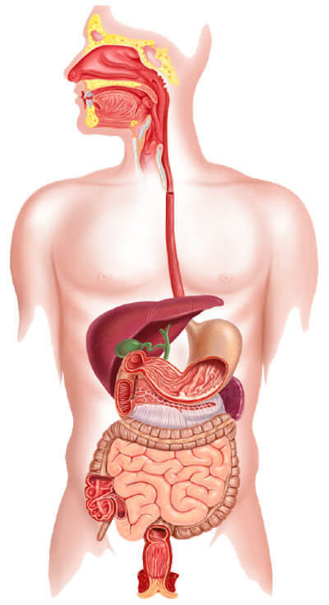

Slide 2
DIGESTIVE SYSTEM
what is digestion?
Organs in digestive system

Slide 3
Digestion
Digestion is the process in which complex food material is converted into simple absorbable constituents. OR
Chemical breakdown of food into small organic pieces so that can be absorbed is called as digestion of food.

Slide 4
Functional anatomy of G.I tract
Digestive system made up of
GI tract + accessory organ
GI tract is the continuous tube that extend from mouth to anus length about 30 feet.
it is formed by 2 type of organs
Primary digestive organs
Accessory digestive organs

Slide 5
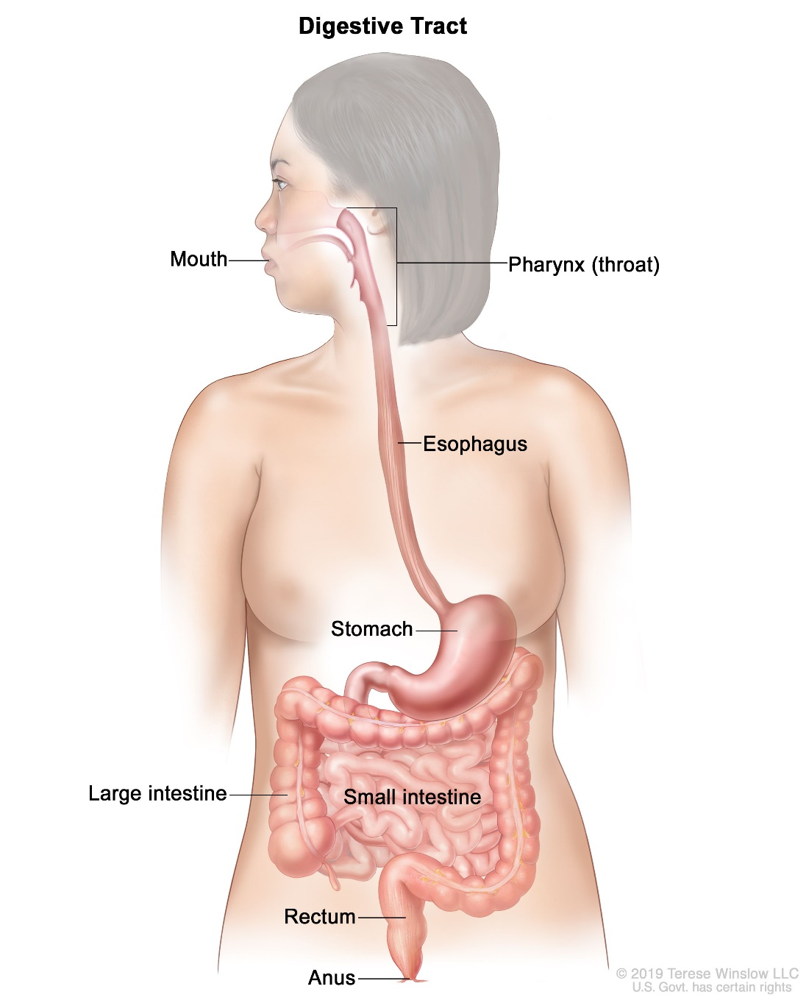
Primary digestive organs
Mouth
Pharynx
Esophagus
Stomach
Small intestine
Large intestine

Slide 6
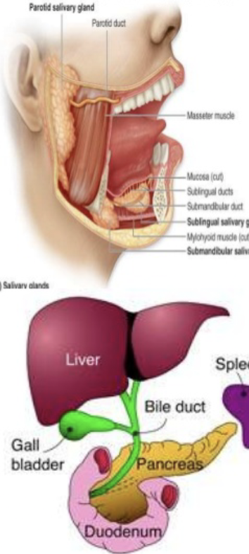
Accessory Digestive Organs
Teeth
Tounge
Salivary glands
Liver
Gall bladder
pancreas

Slide 7
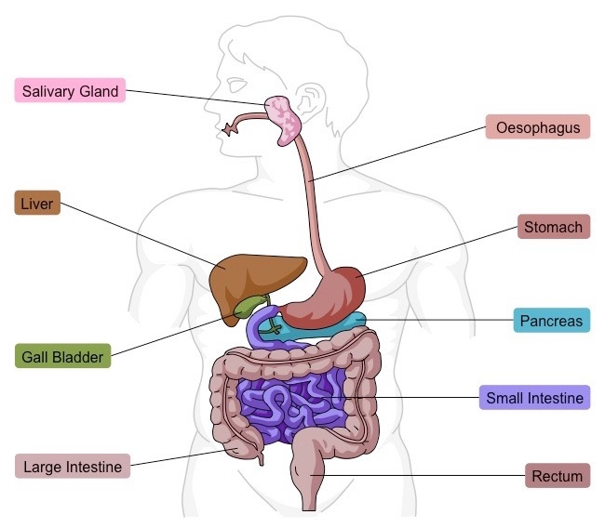
CONTENTS
MOUTH
TONGUE
SALIVARY GLAND
PHARYNX
OESOPHAGUS
STOMACH
SMALL INTESTINE
LARGE INTESTINE
LIVER
GALL BLADDER
PANCREAS.
DIGESTIVE JUICES

Slide 8
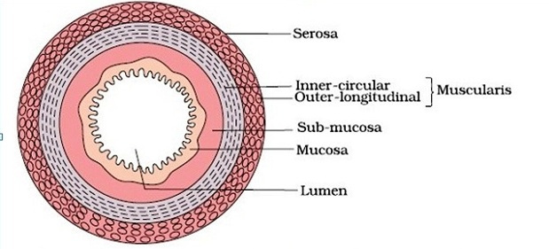
Layers of GI tract
wall of GI tract has 4 layers….inside to outside
Mucus layer
Submucus layer
Mascular layer
Serous layer

Slide 9
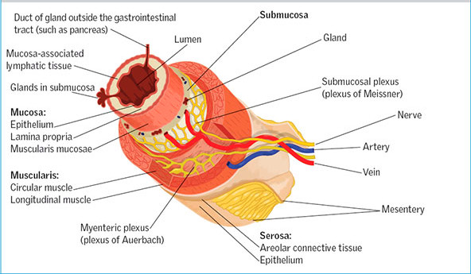

Slide 10
MOUTH
Mouth is also known as oral or buccal cavity
Its is formed by :- 1. CHEEKS
2. LIPS
3. PALATE
It encloses the teeth, tongue, and salivary glands.
Digestive juice present in the mouth is saliva which secreted by salivary gland

Slide 11
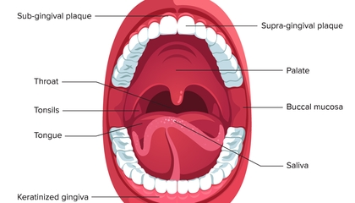

Slide 12
Function of Mouth
Primary function eating
Ingestion of food material
Chewing and mixing the food with saliva
Appreciation of taste
Transfer of the food(bolus) to the esophagus by swallowing
Role in speech
Social function such as smiling and other expression

Slide 13
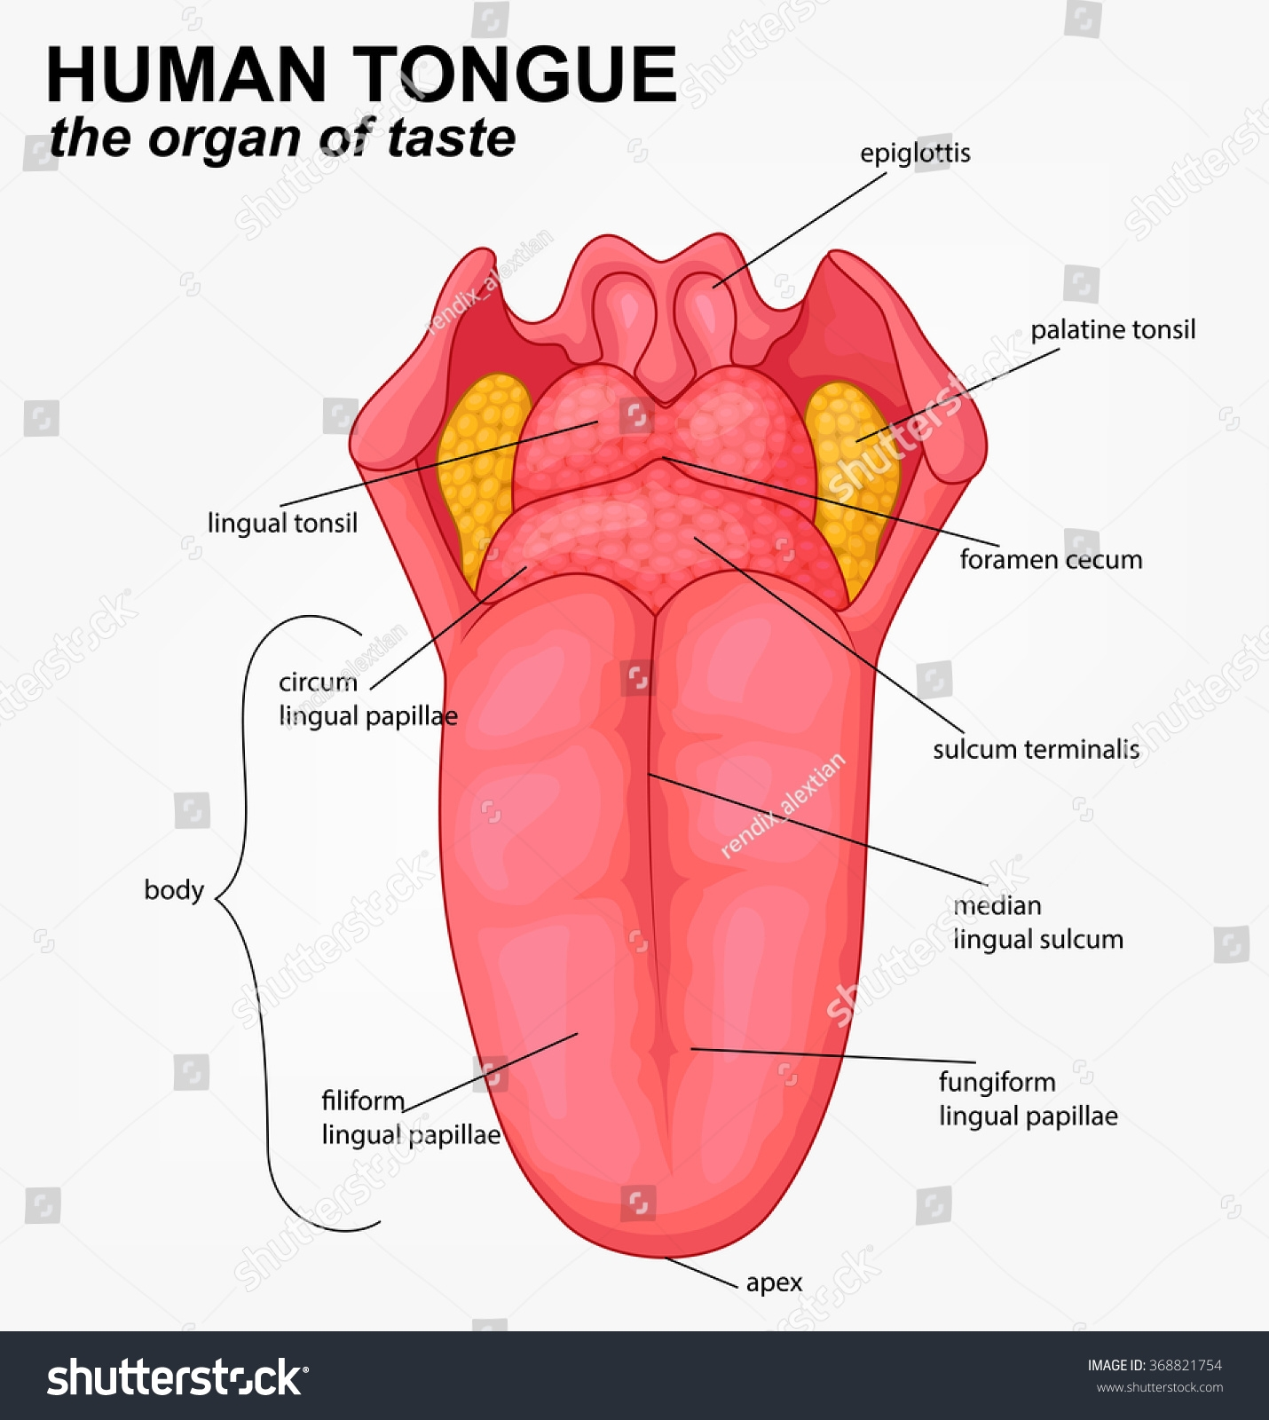

Slide 14
TONGUE
Tongue is used to mix food with saliva
Its made up of 3 elements . Epithelium, Muscles, Glands.
2 special structures, taste buds and papillae are present on tongue
Taste buds – sense organ of taste, made up of 4 t0 20 taste cell, responsible for detection of taste
Papillae- a small elevation or projection on tongue where tastebuds are present.

Slide 15
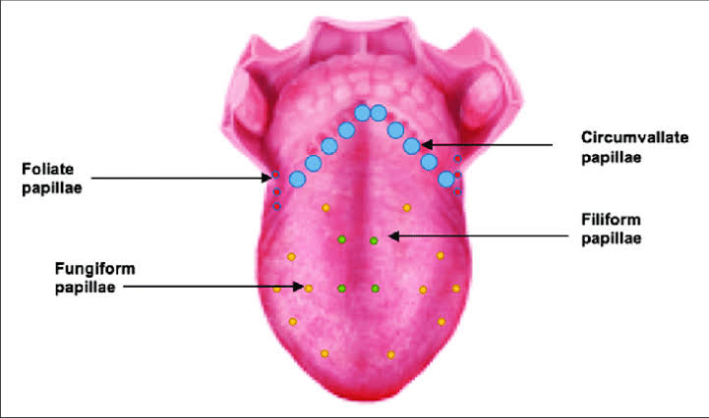

Slide 16
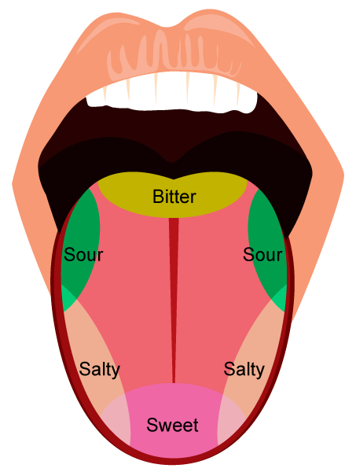

Slide 17
SALIVARY GLAND
Salivary glands secret saliva into the oral cavity
Saliva – Digestive juice present in mouth c/a saliva which secreted by salivary gland.
There are 3 pair of major salivary glands and some minor salivary gland.
The major glands are
1. Parotid glands
2. Submandibular glands
3. Sublingual glands

Slide 18
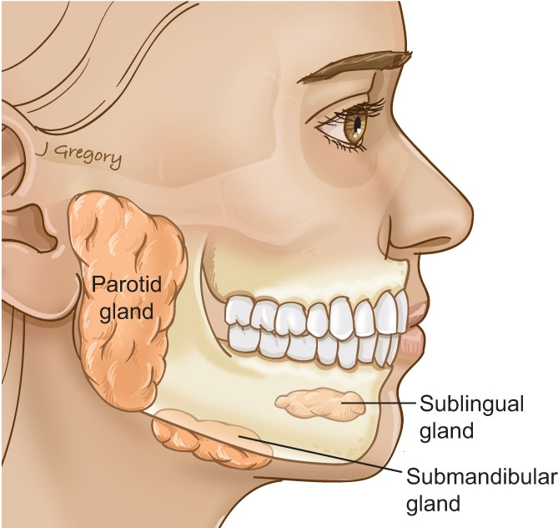

Slide 19
Minor salivary gland
Lingual mucus gland
Lingual serous gland
Buccal gland
Labial gland
Palatal gland
They make small contribution in saliva

Slide 20
Properties and composition of saliva
volume – 1000 to 1500 ml
reaction – slightly acidic ph 6.35- 6.85
Specific gravity – 1.002 to 1.012

Slide 21
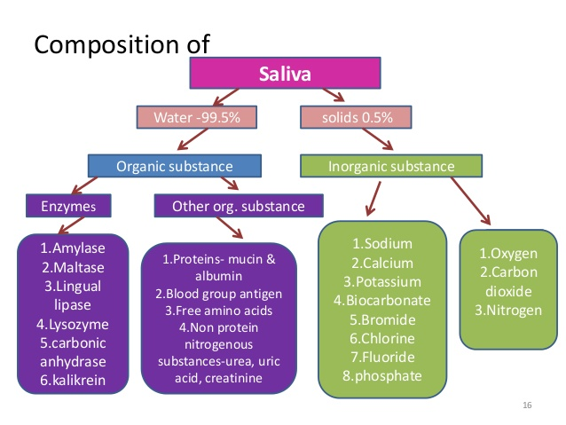

Slide 22
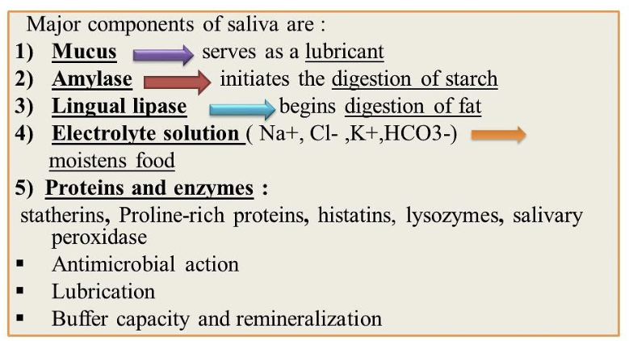

Slide 24
PHARYNX
When food is first swallowed, it passes from mouth into the pharynx
Pharynx is funnel shaped tube that extends from internal nares to the oesophagus
It consist of 3 parts
1. Nasopharynx
2. Oropharynx
3. Laryngopharynx.

Slide 25
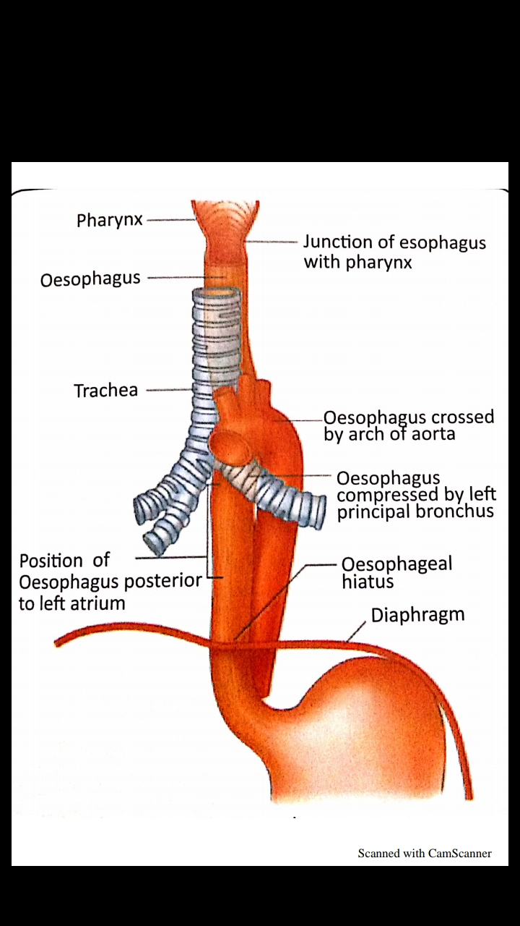

Slide 26
OESOPHAGUS
Oesophagus is a collapsible muscular tube.
It is about 25 cm long
Oesophagus has 2 sphincters
1. Upper oesophageal sphincter
2. Lower oesophageal sprinter

Slide 27
STOMACH
Stomach is a J shaped hollow organ in the abdominal cavity
PARTS OF STOMACH:-
1. Cardiac region
2. Fundus
3. Body
4. Pyloric region

Slide 28
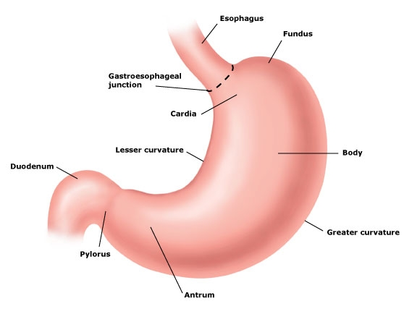

Slide 29
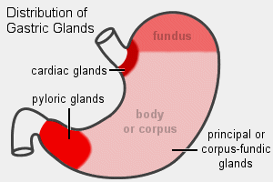
Structure and glands of stomach
Structure of stomach wall consists of 4 layers
1. Serous
2. Submuscularis
3. Sub mucosa
4. Mucosa
Glands of stomach
1. Fundic gland
2. pyloric gland
3. Cardiac gland.

Slide 30
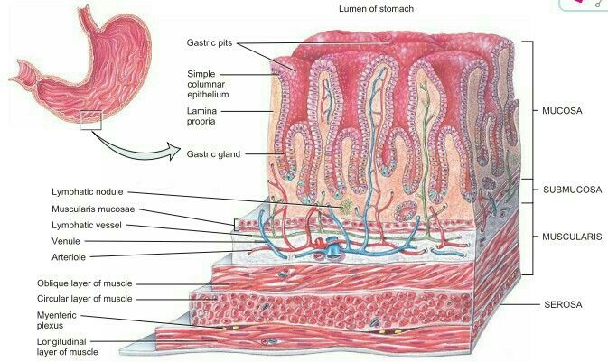

Slide 31
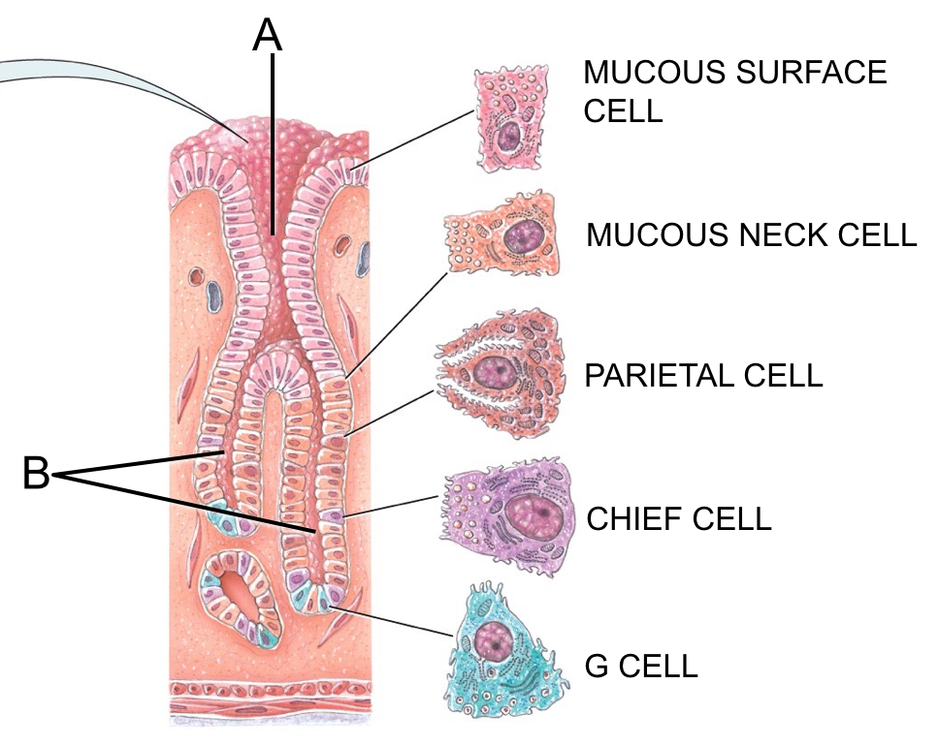
Types of Cells and function of stomach
Types of cells
1. Chief cells
2. Parietal cells
3. Mucous cells
4. G cells
EC cell
ECL cell

Slide 32
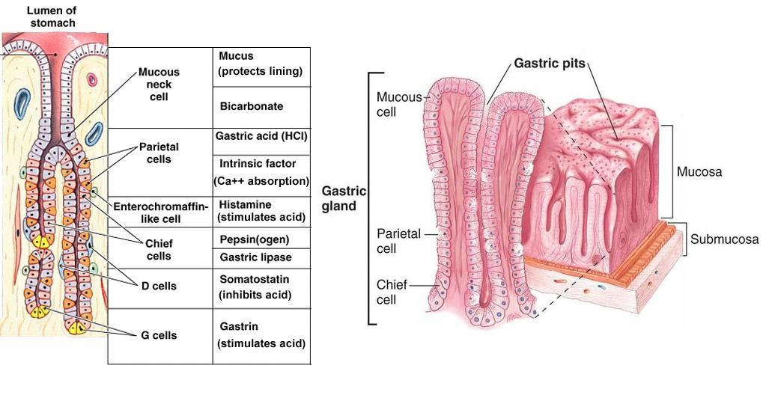

Slide 34
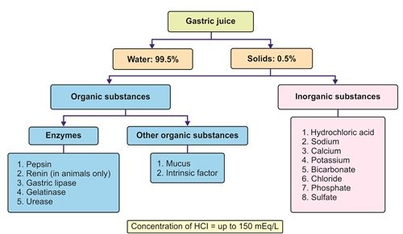

Slide 35
FUNCTION OF STOMACH
1.MECHANICAL FUNCTION
2.SECRETION
3.DIGESTION
4.ABSORPTION
5.EXCRETION
6.STIMULATORY FUNCTION
7.REFLEX FUNCTION

Slide 36
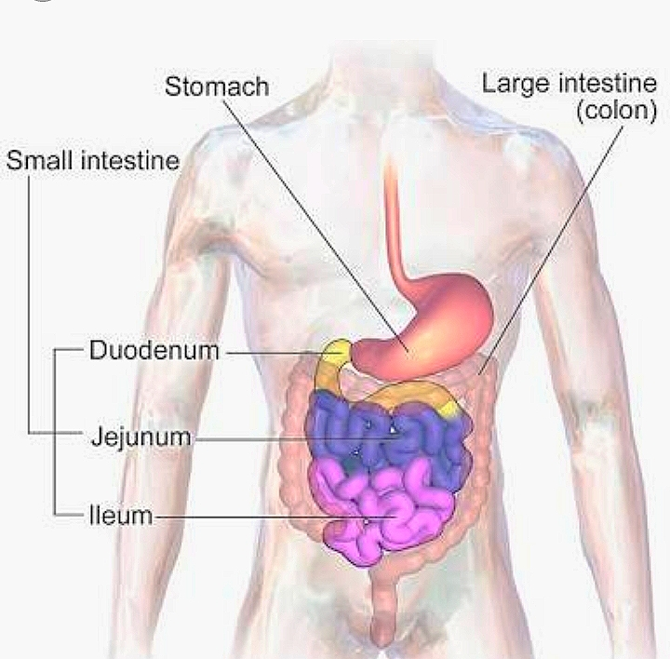

Slide 37
Small Intestine
Extend from gastric pyloric orifice onwards up to ileo colic junction which is guarded with ileocolic sphincter.
Proximal part – Duodenum
Middle part – jejunum
Distal part – ileum
Small intestines are about 6. 5 meters in length, first 20 - 25 cm portion is formed by the duodenum, about 2/5 th by jejunum & 3/5th by ileum.

Slide 38
Small Intestine
The duodenum & jejunum are mainly concerned with digestive processes,--
While the main function of ileum is absorption (Hence it is richly supplied with villi)
The wall of small intestine has all the four layers as in stomach

Slide 39
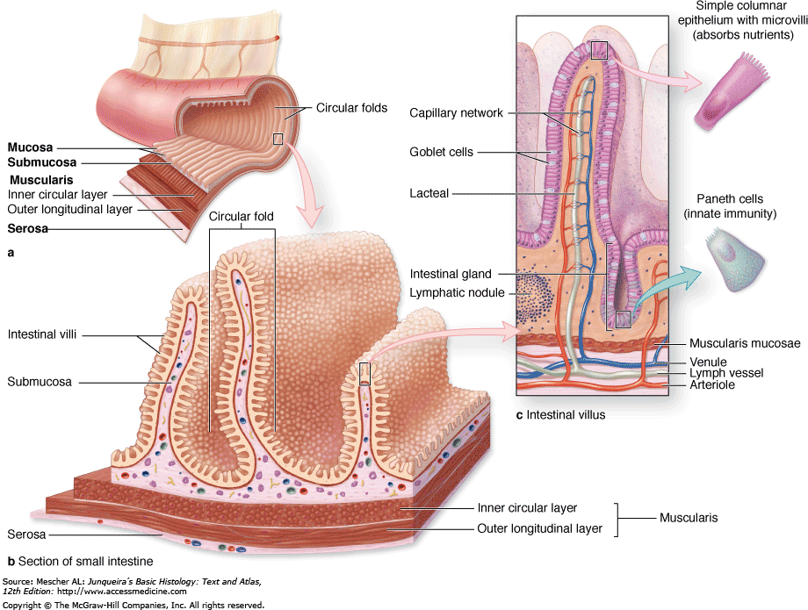

Slide 40
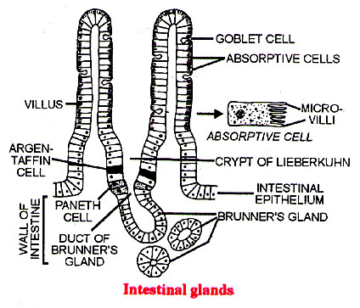
Important feature of small intestine
1) intestinal villi
2) Simple tubular Gland
3) Brunners Glands

Slide 41
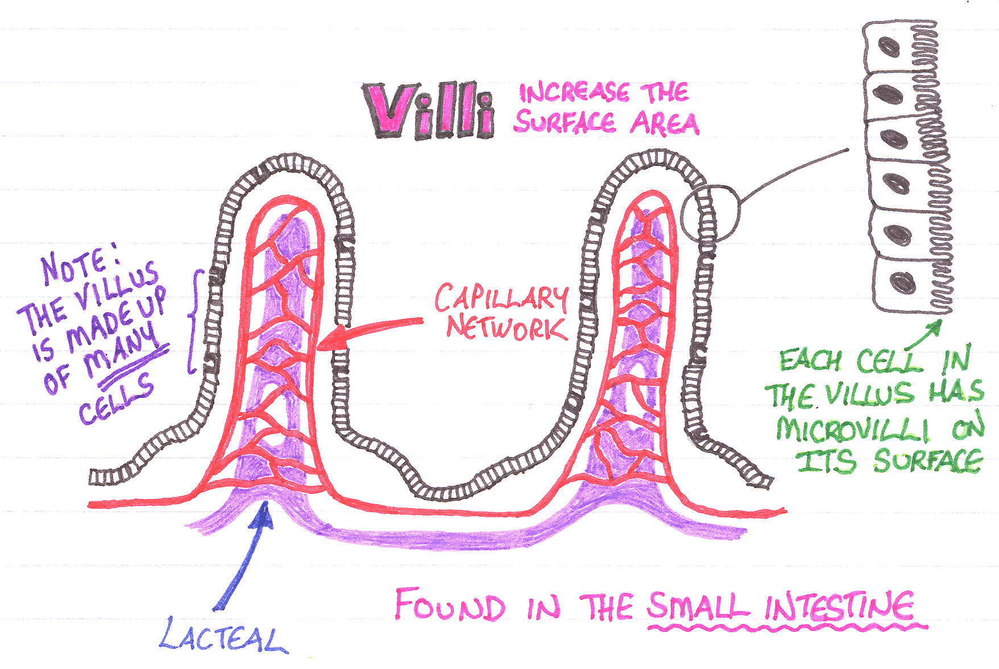
Small Intestine
1.the mucus membrane of small intestine is covered by minute projection called as villi.
2.the height of villi is about 1mm and diameter is less than 1mm.
The villi are lined by columnar cell which are c/a Interocyte has hair like projection called as microvilli.
Villi and microvilli increase the surface area of mucus membrane by many fold.

Slide 42
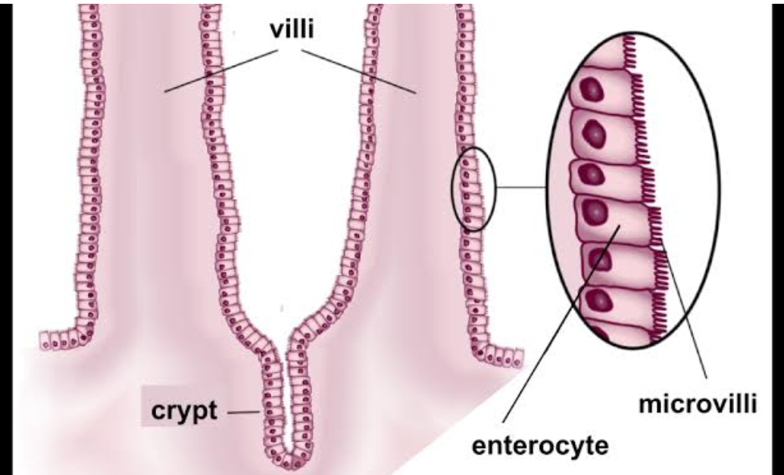
Simple tubular gland
Also c/as crypts of lieberkuhn or simle tubular gland. These intestinal glands open into the lumen of intestine between the villi. The lining of each gland is continuous with epithelial lining of villi and villi are lined by columnar cells

Slide 43
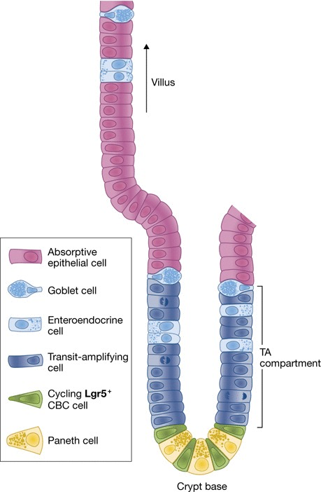
three type of the cell interposed between the columnar cell
Argentaffin cells- secrete intrinsic factor
Goblet cells – secrete mucus
Paneth cells – secrete cytokines (defensin

Slide 44
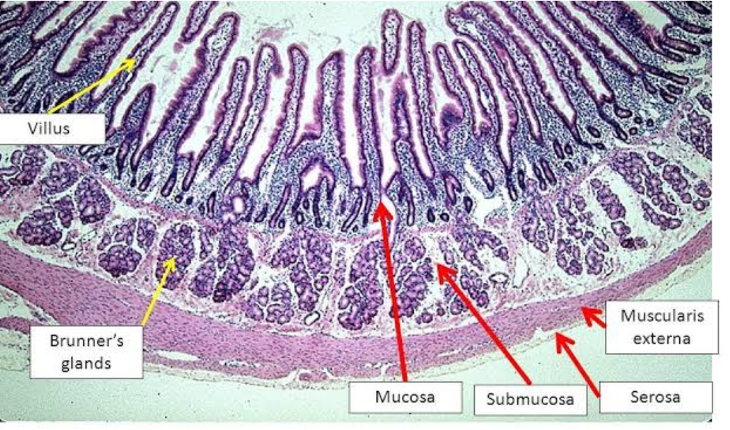
Brunner's Gland
The first part of the duodenum contain some mucus glands which are called Brunner's glands. The Brunner's gland open into lumen of intestine directly.
Bruner's gland secrete
mucus and traces
of enzymes.

Slide 45
Properties and composition of succus entericus
Secretion of small intestine c/a succus entericus.
volume – 1800 ml/day
Reaction – alkaline
Ph- 8.3

Slide 46
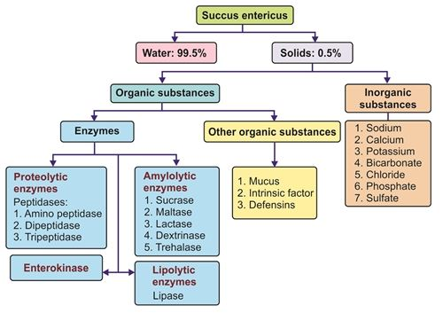

Slide 47
FUNCTION OF SMALL INTESTINE
Nutrients from the food pass into the blood stream through the small intestine walls
Absorbs:- 80% ingested water.
Vitamins
Minerals
Carbohydrates
Protein
Lipids

Slide 48
Function of small intestine
Mechanical function
Secretory function
Hormonal function
Digestive function
Activator function
Haemopoetic function

Slide 49
Large intestine

Slide 50
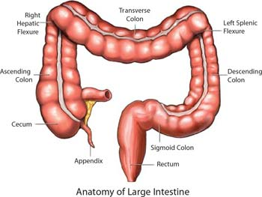
Large Intestine
large intestine also c/as colon
it extend from ileocecal valve up to anus
About 1.5 meters long
Large intestine divided up to 7 region
1) cecum with appendix
2) Ascending colon
3)transverse colon
4) Descending colon
5) Sigmoid colon or
6) Rectum
7) Anal canal

Slide 51
Layers of large intestine
Serous layers – formed by peritoneum
Muscular layers – outer longitudinal layer and inner circular layer
Longitudinal layer have 3 long band called as tinea coli.
sabmucas layer – not well developed
mucus layer- the crypts of Lieberkuhm & mucus secreting glands are present in mucosa but villi are absent.

Slide 53
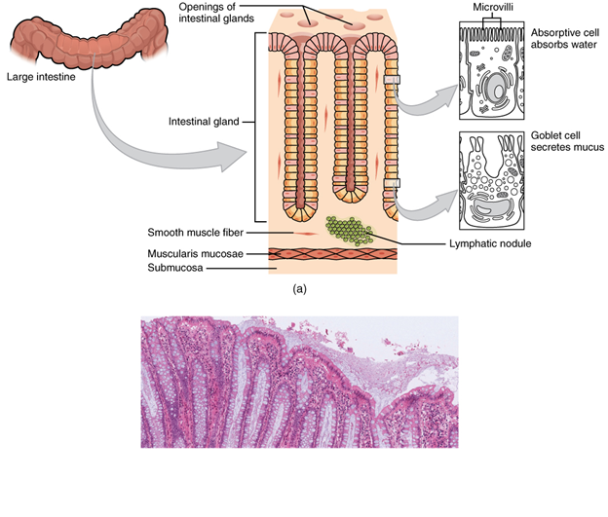
Histology of Large Intestine
Slide - Serous, muscularis, submucosa, mucosa (villi- absent)
Mucosa - Few Intestinal glands,enterocyte but goblet cells and lymphatic nodules - numerous.

Slide 54
Properties and composition of large intestinal juice
Large intestinal juice is watery fluid with
Ph- 8.0
Digestive enzyme is absent but concentration of bicarbonate is high in large intestinal juice.

Slide 55
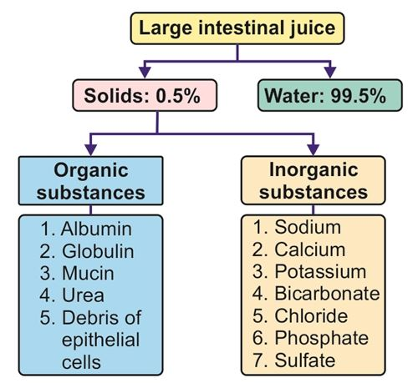

Slide 56
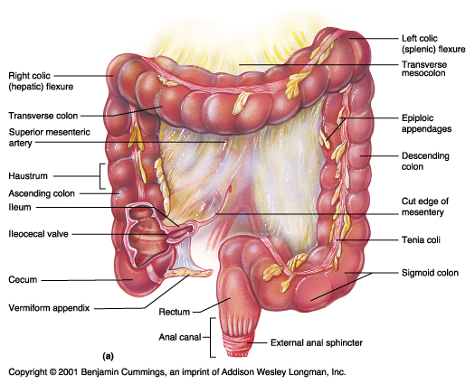
Function ofLarge Intestine
1.Absorptive 1function
2. Formation of feces
3. Excretory function
4.Secretory function
5.Synthesis function

Slide 57
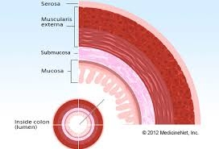
Layers of Large Intestine
Serous Layer
Muscular Layer
Submucus Layer
Mucus Layer

Slide 58
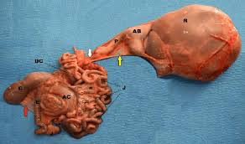

Slide 59
Gall Bladder
Stores bile from the liver, needed for the digestion of fat, releases it into the small intestine.
Pear shaped gall bladder lies beneath the liver.
Fatty diets can cause gallstones.

Slide 60
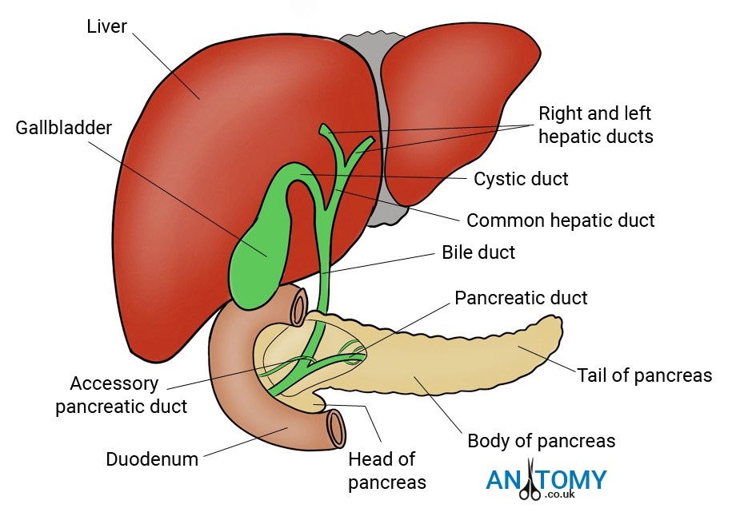
LIVER

Slide 61
Liver is a dual organ and largest gland in the body
Location- right hypochondric, epigastric and left hypocondric region
Colour-reddish brown in colour
Weight-1600 in males and 1300 in female s
Shape-wedge shaped

Slide 62
Hepatic lobules-liver consists of many lobules called as hepatic lobules.they are the structural and functional units of liver. It consists of 50000-100000.
Hepatocytes-It is honey comb like structure made up of liver cells called hepatocytes.some macrophages present in liver cells called kuffer's cells which are phagocytic in function.

Slide 63
FUNCTIONS OF LIVER
HEAT PRODUCTION
HEMOPOIETIC
HEMOLYTIC
INACTIVATION OF HORMONES AND DRUGS
DEFENSIVE AND DETOXIFICATION
METABOLIC
STORAGE
SYNTHETIC
SECRETION OF BILE
EXCRETORY

Slide 64
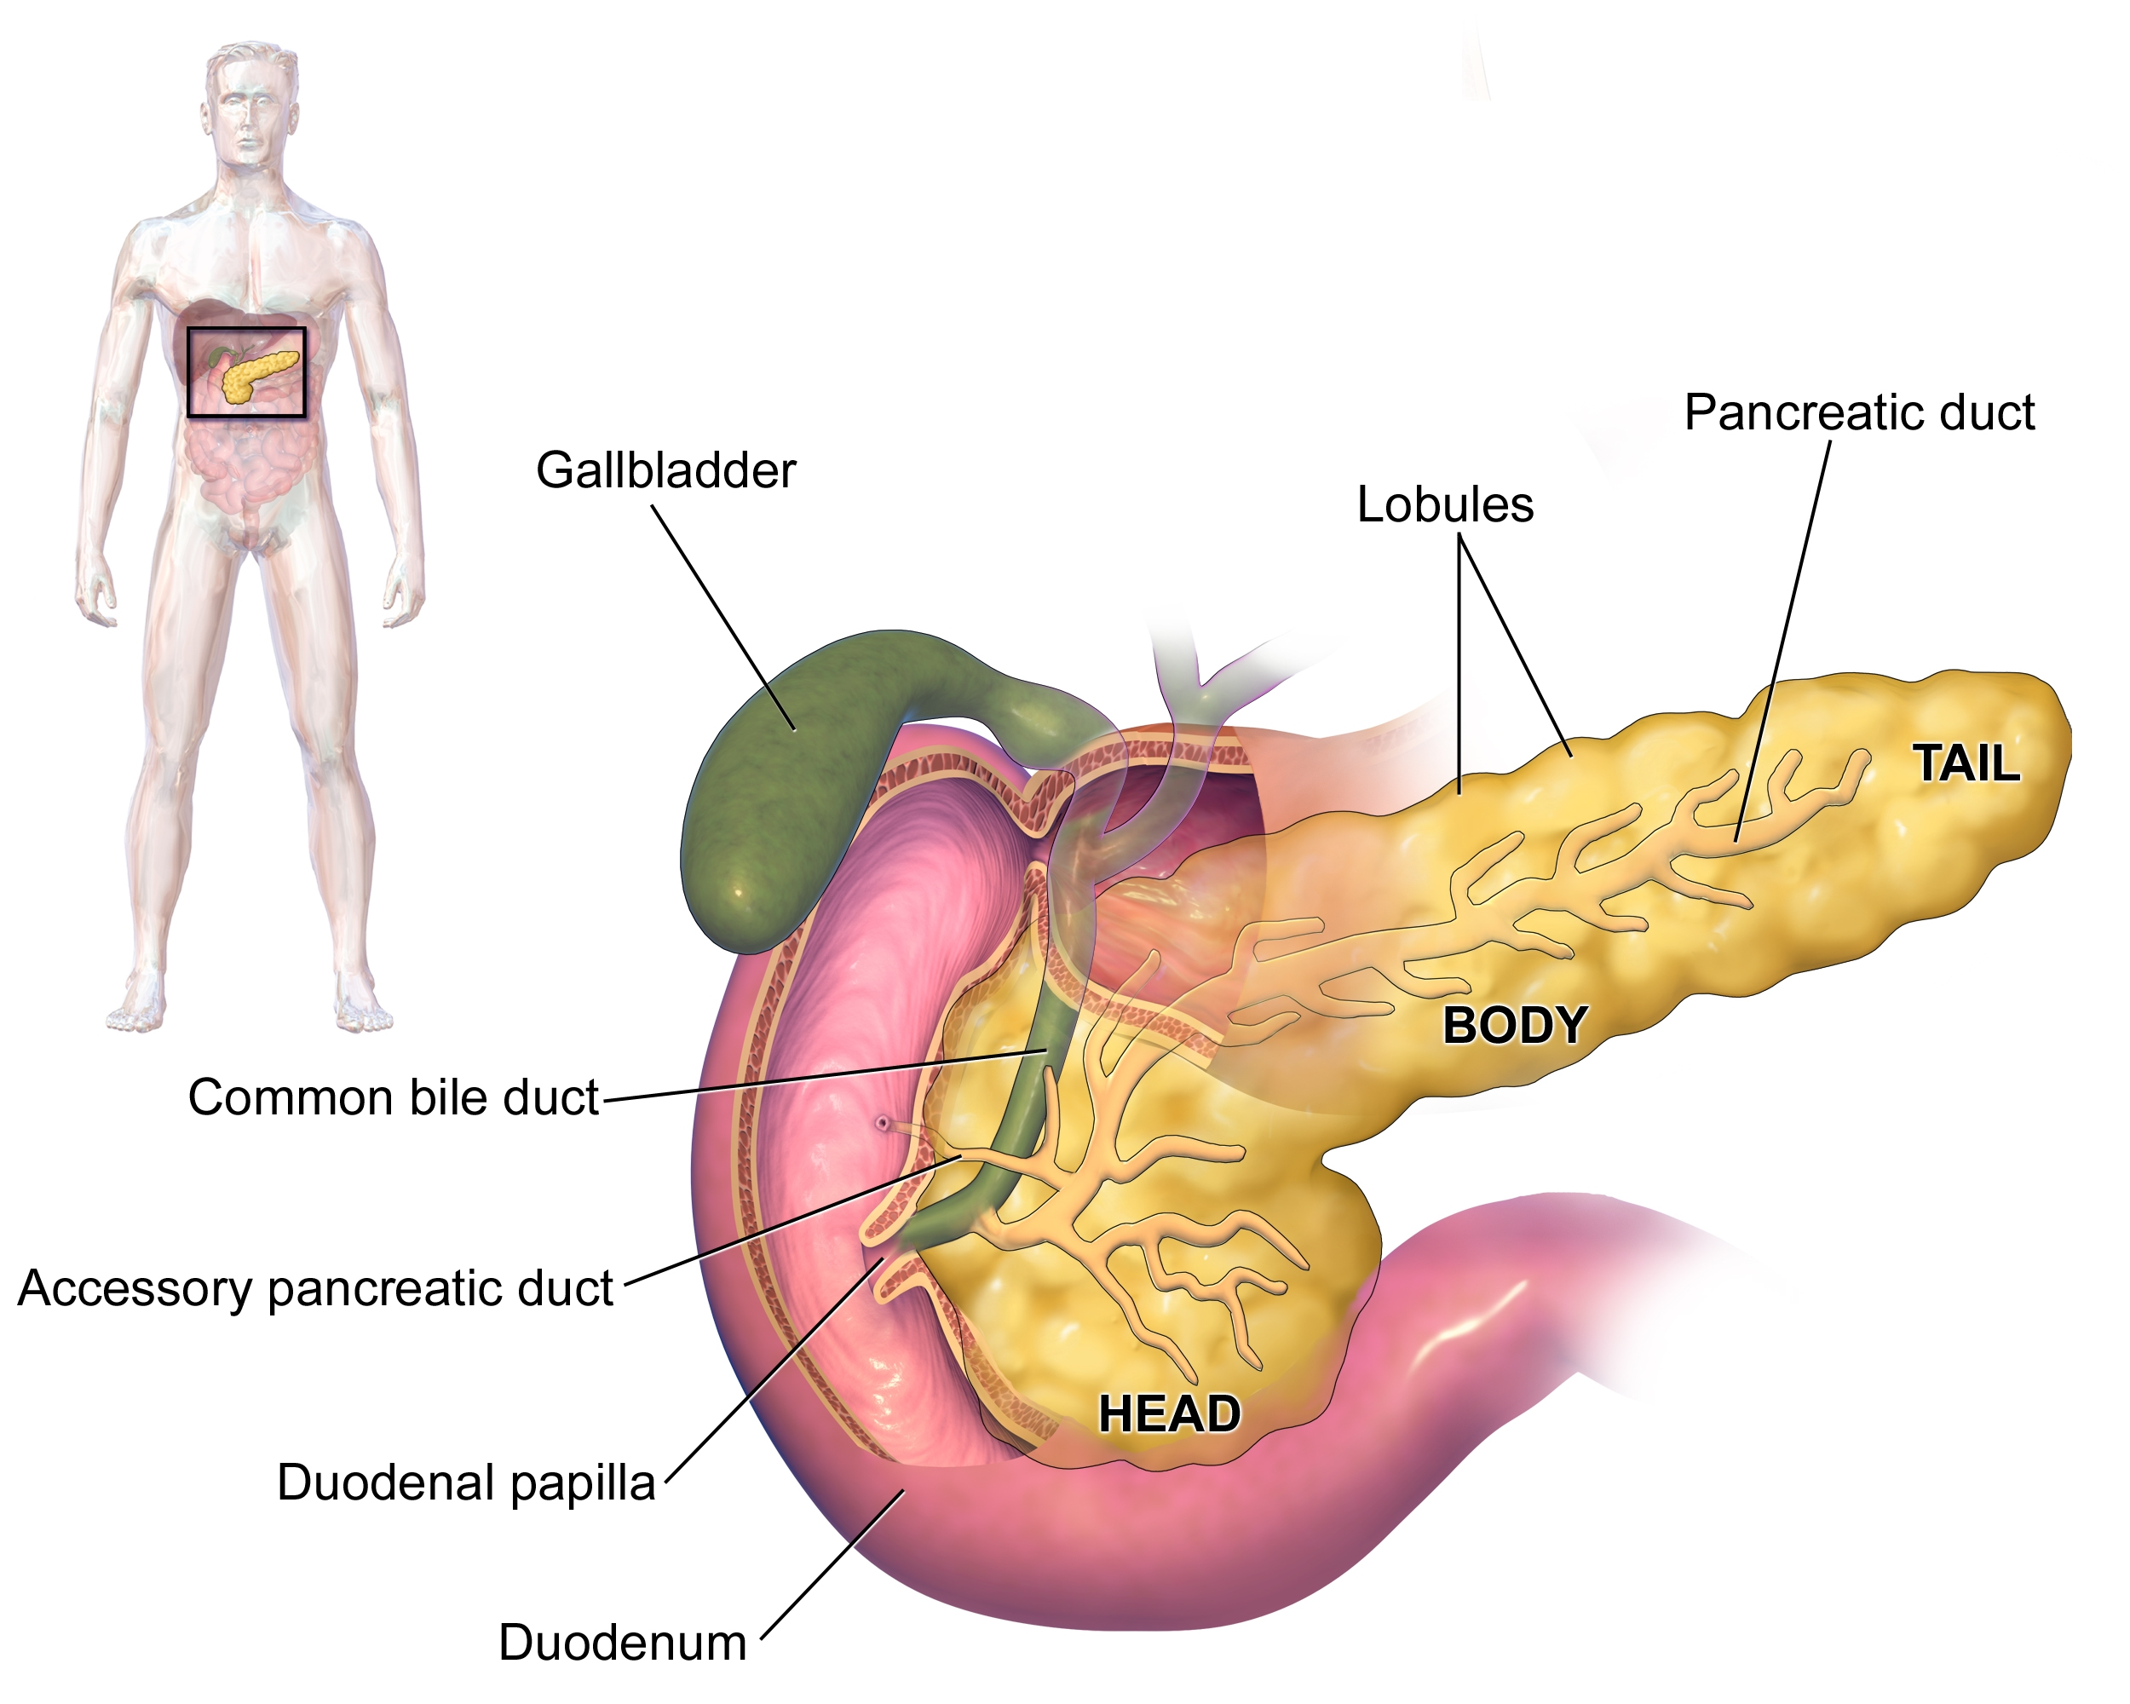
PANCREAS

Slide 65
Pancreas is a both an endocrine as well as exocrine gland.
It consist of :- 1. Head.
2. Body
3. Tail
It is made up of small cluster of glandular epithelial cells
Pancreatic juice are secreted by exocrine cells of pancreas.

Slide 66
DIGESTIVE JUICES
1. Saliva
2. Gastric juice
3. Pancreatic juice
4. Succus entericus
5. Bile

Slide 67
PRESENTED BY:-
GAURAV RAUT
NAMITA RAUT
PRATIK RAUT
AYAN SAHA
RAJSHRI SAMRIT
SARVESH SAWARKAR
AVANTI SELOKAR
IZAN MALIK
VAISHNAVI SHRIRAME
ASHWAGOSH SONKAMLE
PRAVIN VISHWAKARMA
VAISHU THEMBARE
AAYUSHI THAKRE
MAHIMA WANJARI
MRUNAL ZODE

