Slide 2
WORM INFESTATION
Dr. Kiran Nandeshwar
MD Kaumarbhritya

Slide 3
INDEX
Helmenthiasis and krimivichar
Helmenthiasis :
Prevalence study
Classification of worms
Subclassification…..
Single topic each by each….like nematodal… ascariasis etc .cestodal….like intestinal and tissue infestation …hydatid cyst and neurocysticercosis
Schistosomiasis
Filariasis

Slide 4
Preventive measures…..
Krimi vichar:
Krimi vichar
Nirukti and prakaar
Aahar sambandhi hetus
Vihaar sambandhi hetus
Krimi lakshanas
Krimi chikitsa in deep

Slide 5
Research articles published
in various journals
Some ayurvedic preparations

Slide 6
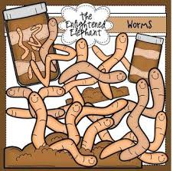
PREVALENCE STUDY

Slide 7
CLASSIFICATION OF WORMS
NEMATODES
TREMATODES
CESTODES
(Round worm , Pin worm ,Whip worm , Hookworm)
(Flukes)
(Tapeworm)

Slide 8
NEMATODES
INTESTINAL : Ascaris Lumbricoides
Strogyloides Stercoralis
Ancylostoma Deodenale
Necator Americans
Tricuris Trichuria
Enterobius Vermicularis
NON INTESTINAL : Brugia Malayi
Brugia Tomari or
Wucheria Bancrofti

Slide 9
CESTODES
TAENIA SOLIUM
TAENIA SAGINATA
DIPHYLLOBOTHRIUM LATUM
HYMENOLEPIS NANA

Slide 10
TREMATODES
Liver flukes
Lung flukes
Blood flukes

Slide 11
ASCARIASIS

Slide 12
ASCARIASIS
C .ORG: Ascaris lumbricoides
: Heterosexual
:Female(20-30 cm) more longer than male(12-20cm)
:female lays eggs upto 2lacs per day
: Eggs are excreted in the faeces

Slide 13
LIFE CYCLE OF ASCARIS

Slide 14
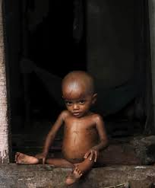
CLINICAL FEATURES
May be asymptomatic
Loffler’s syndrome
Vague abdominal pain
Malabsorption
Undernutrition
Airway obstruction
Intestinal obstruction
Biliary obstruction
Worms in stools

Slide 15
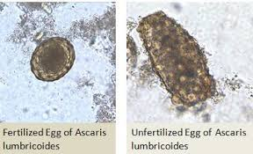
DIAGNOSIS
History of passing worms in stools or vomitus
Stool microscopy : kato’s thick smear

Slide 16
Kato’s thick smear

Slide 17
TREATMENT
Uncomplicated cases:
single dose albendazole
Intestinal or Biiary obstruction:
Piperazine citrate (paralytic action on worms) which facilitates it’s expulsion.

Slide 18
Loffler’s Syndrome
Characterized by
Fever
Cough
Dyspnea
Wheeze
Urticaria
Eosinophillia
Lung infiltrates

Slide 19
TOXOCARIASIS

Slide 20
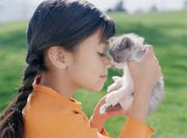
TOXOCARIASIS
(Visceral Or ocular larva migrans)
Accidental human infestation by primary zoonotic ascarids..i.e …1.T.Canis(Dogs) 2.T. Catis(Cats)
Excretion of eggs in human excreta accidental feco oral ingestion by children via contaminated fingers or food

Slide 21
Iife cycle continues
Hatching and larva release
Gut penetration
Migration to different tissues eg .lungs ,liver ,eyes ,brain etc
Taxacara larva do not develop beyond this stage in human host(no adult worms)

Slide 22
Clinical features of Toxocariasis
Immunological reactions….
a. fever
b. hepatomegaly
c. urticaria
d. Loffler’s syndrome
Mechanical damage due to migrating larvae…..e.g..sudden decrease in visual acuity or blindness(ocular larva migran)

Slide 23
Diagnosis
Visualization of larvae in tissues or an antibody ELISA test
History supportive of frequent dog or cat exposure

Slide 24
TREATMENT
Non specific
Use of steroids in allergic manifastations
Longer therapy for 3-4 weeks is needed in ocular or neurological manifastations

Slide 25
ENTEROBIASIS

Slide 26
ENTEROBIASIS
Thread worm or pin worm
Essentially harmless except inconvenient perianal itching
Causitive organism: enterobius vermicularis
Size:.0.5 to 1 cm
Lives in caecal region of infested human host

Slide 27
LIFE CYCE Of ENTEROBIUS
MATURE IN 6 HRS, VIABLE FOR NEXT 20 HRS

Slide 28
CLINICAL FEATURES OF ENTEROBIASIS
Clinically….commonest and perhaps only manifastation ……..nocturnal perianal pruritus
Leading to disturbed sleep
Rarely….perianal granuloma containing live or dead worms or eggs

Slide 29
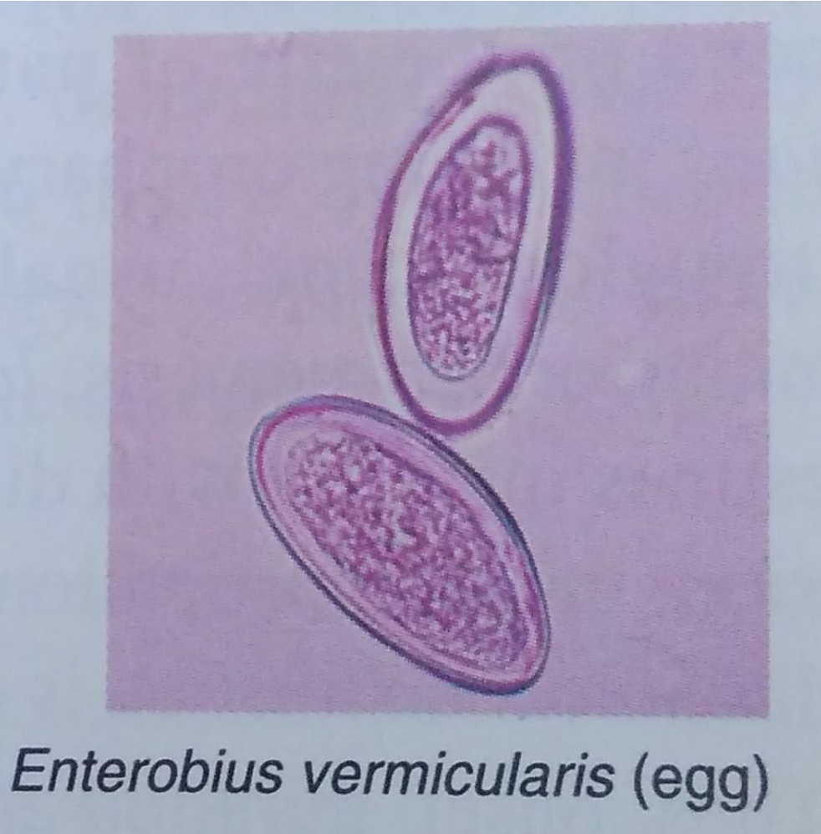
Diagnosis of Enterobiasis
Eggs are not passed in stool generally.
Definative and best method:
Press adhesive cellphane tape against perianal region in early morning and examine under microscope

Slide 30
Treatment
Albendazole 400 mg single dose
Or other wormicidal agents
* Treatment should be repeated after 2 weeks in all cases to reduce residual infestation
*all family members should be treated simultaneously to prevent cross infection
Soothing creams to relieve perianal itching and prevent autoinocuation

Slide 31
TRIACHURIASIS

Slide 32
Triachuriasis
Whip worm
Causitive organism : T.trichuria
Length : 3 to 4 cm
Lives in caecum and ascending colon firmly anchored to the mucosa to suck nearly 0.005 ml blood l day

Slide 33
Infection is transmitted feco orally , on ingestion of embryonated eggs in contaminated hands, food, water

Slide 34
Clinical features
Rare
Vague abdominal pain e.g. colic or distension
Mild anemia
Bloody diarrheoa
Rarely rectal prolapse in heavily parasitized host

Slide 35
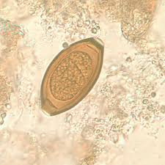
Diagnosis
Stool examination for typical eggs

Slide 36
Treatment
Single dose albendazole 400 mg
Longer therapy for 3 days is recommended in heavy infestation

Slide 37
HOOKWORM INFESTATION

Slide 38
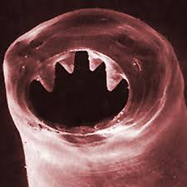
Hookworm infestation
Ancylostoma duodenale
Necator americans
Most important cause of iron deficiency anemia and occasionally hypoproteinimia
Ancylostoma duodenale:
Heterosexual adult worm(5-13mm) lives in small intestine
Female worms produce upto 30000eggs per day

Slide 40
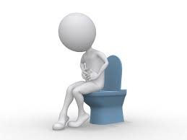
Clinical features
Anemia due to intestinal blood loss by hooked attachment of worms
Each woorm is responsible for 0.2 -0.3 ml of bood loss each day
Other manifastation include …..
1) Non specific GIT problems
abdominal pain,
anorexia ,
diarrheoa,
malena

Slide 41
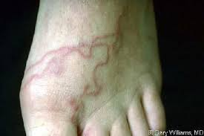
2).Localised itching …
ground itch at the site of
skin entry (rarely)
3). Transient stridor or pharyngitis during airway migration of larvae

Slide 42
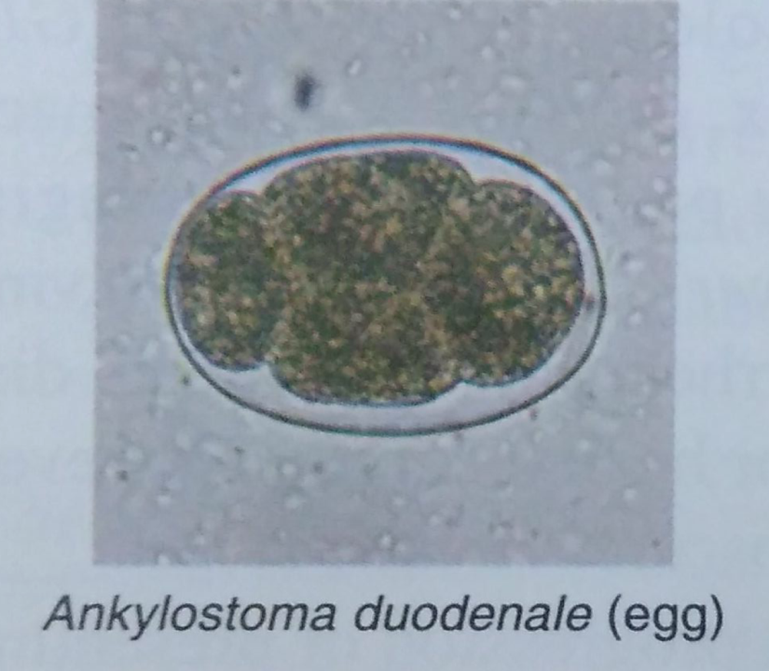
Diagnosis
Diagnosis should be suspected with unexpained anemia and occult blood in stools
Confirmed on stool examination for egg

Slide 43
Treatment of hookworm infestation
1) Antihelmenthics….preferably single dose albendazole 400 mg
2) Correction of anemia by oral iron therapy. rare cases needs transfusion

Slide 44
STRONGYLOIDOSIS

Slide 45
STRONGYLOIDOSIS
Causitive organism: Strongyloides stercolaris
Uncommon
Life cycle is similar to hook worms… except that eggs often hatch in vivo during intestinal passage and infective larvae reenter the circulation by penetrating intestinal walls or perianal skin

Slide 46
Clinical features of strogyloidosis
Clinically asymptomatic or present with….
1)Perianal itching
2)Loffler’s like syndrome with eosinophilia
3)Malaabsorption syndrome in heavy infestation
4)Rarely disseminated strongyloidosis, a septicemia like illness in severely nourished and immunocompromized children

Slide 47
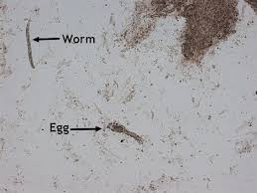
Diagnosis
Examination of stools or duodenal aspirate for characteristic larvae

Slide 48
Treatment of strongyloidosis
Drug of choice : PO Ivermectin 200 mcg per kg per day for 1-2 day
PO Thiabendazole 50 mg per kg per day q 12 hrly….specially in disseminated disease

Slide 49
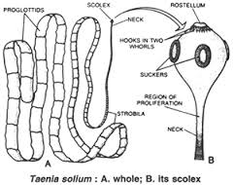
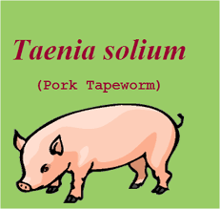
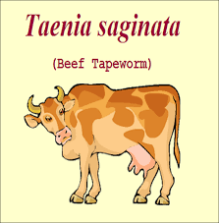
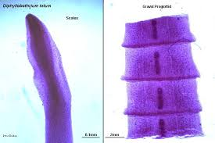
Cestodal infestation

Slide 50
Tapeworm infestation
Intestinal infestation
T.Solium (Pork)
T.Saginata(Beef)
D. Latum(Fish)
H. Nana(Dwarf)
Tissue
infestation
Hydatid cyst
Neurocysticercosis

Slide 51
Life cycle of tapeworm
A) Ingestion of parasitic eggs present in contaminated soil or water or over body of intermediate hosts
B)undercooked beef , pork ,fish containing invasive stages of parasite

Slide 52
Adult tapeworms are present in human intestines and have long ,segmented proglattids bodies with variable length

Slide 53
On maturation caudal gravid segments detach intermittently to pass in stools and release eggs in soil
Although entire life cycle may be completed in human hosts only( except D . Latum ),animal like dogs, pigs ,cattle etc are frequently by ingestion of eggs contaminated in soil or invasive stage contaminated flesh of infected animals, to contribute propagation of disease (co hosts)

Slide 54
Clinical features
Asymptomatic
Vague abdominal pain
Except D. Latum infestation ,which may cause megaloblastic anemia by inhibiting vitamin B12 absorption and utilising it for own metabolism

Slide 55
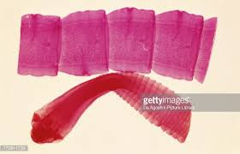
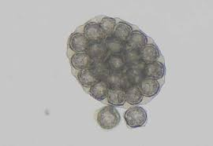
Diagnosis
Presence of proglattids on naked eye or eggs on microscopy

Slide 56
Treatment
Drug of choice :
PO single dose praziquntel 5-10 mg l kg
PO Niclosamide:
<15 kg -1 gm
>15 kg-1.5 gm
PO Nitazoxinade:
1-3 yr:100 mg BD
3-12 yr:200 mg BD
>12 yr:500 mg BD

Slide 57
HYDATID CYST

Slide 58
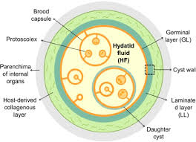
Hydatid cyst
Is caused by intermediate (invasive) form of Echinococcus granulosus - a zoonotic tapeworm in dogs or other canines

Slide 59
Structurally
These cysts are surrounded by tough fibrous capsule of host tissue ,lined by inner layers of parasitic origin and contain thousands of parasites ( protoscolices ) along with cystic fluid

Slide 60
Pathogenesis
Humans are accidentally infected by ingestion of intermediate forms of parasite, present in contaminated water l food or over fecal contaminated body of infected dogs
Ingested intermediate forms penetrate the gut wall carried via lymphatics l blood to liver , lungs ,bones .etc and develop into gradually enlarging cyst

Slide 61
Clinical features
Liver cysts: hepatomegaly with palpable mass and pain
Lung cysts: cough , hemoptysis, chest pain
Bone cyst: pathological fractures
Lung cysts: common in children
Liver cysts: common in adults
may be asymptomatic or mass effect

Slide 62
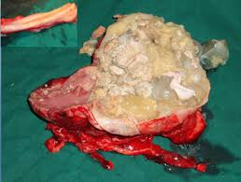
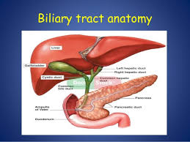
Complications of hydatid cyst
Cyst rupture ( spontaneous or during surgery) which may lead to sudden anaphylaxis and l or formation of secondary cysts
Pressure on other structures e.g. biliary tree with obstructive jaundice

Slide 63
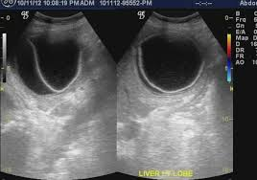
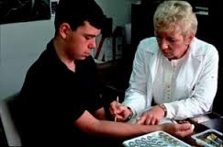
Diagnosis of hydatid cyst
USG
Casoni’s skin test
i. e. cystic lesion with internal membranes and floating echogenic cyst material (hydatid sand)
To detect hypersensitivity against crude or partially purified antigen

Slide 64
Treatment of hydatid cyst
Depends on size and site of cyst
Conventional surgical removal
PAIR technique
Medical therapy for multiple ,small, deep seated cysts with albendazole ( PO 7.5 mglkg BD ) for 28 days

Slide 65
PAIR TECHNIQUE
PAIR Technique:
Percutaneous Aspiration
Instilation of hypertonic saline or other scolicidal agents
Re –aspiration after 15 minutes

Slide 66
Neurocysticercosis
Commonest parasitic infection of CNS
Caused by invasive intermediate stage of T . Solium (pork tapeworm)
With formation of asymptomatic or symptomatic cysts in the brain

Slide 67
TREMATODAL INFESTATIONS
Liver flukes
Lung flukes
Blood flukes

Slide 68
Liver flukes : Fasciola hepatica , Clonorchis sinensis
Lung flukes : Paragonimus westermani
Blood flukes : Schistosoma hematobium

Slide 69
Schistosomiasis
life cycle is similar to hook worm except for important exception that the ova mature into larvae within the host’s intestine itself so that auto infection can occur

Slide 70
Cutaneous penetration by infective larvae. i. e. cercarie, present in contaminated water bodies and on aquatic plants.
Post entry,cercariae migrates via subcutaneous tissue, lung and liver; and develops as adult worm (sexual stage) that reside in venous plexus surrounding ureters and urinary bladder.

Slide 71
Oviposition occurs intravascularly and eggs are intermittently excreted in urine , after rupture of invaded capillories
Further development from egg to infective larvae (asexual stage) occurs only in fresh water snails (intermediate host) to continue cycle.

Slide 72
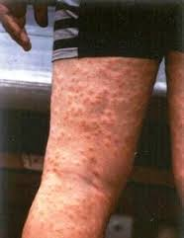
Clinical features
Local pruritic rash at the portal of entry
Swimmer’s itch
Katayama fever: acute febrile
Illness with eosinophilia
after 4-6 weeks of infection
Chronic granulomatous injury at site of parasitic deposition e.g .periureteric or perivesicular venous plexus ,leading to hematuria

Slide 73
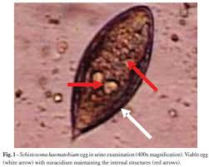
Diagnosis
Urine examination of schisostome eggs

Slide 74
Treatment
PO praziquntel 20 mg l kg total two doses at 12 hr interval

Slide 75
Filariasis

Slide 76
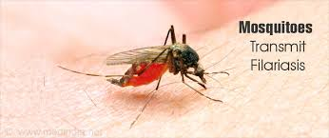
Lymphatic filariasis
Causitive organism:
Wucheria bancrofti
Brugia malayi
Brugia timori
Transmitted by mosquitoes
*Culex quinquefasciatus
*Mansonia annulifera
*Mansonia uniformis

Slide 77
Life cycle of filariasis

Slide 78
Clinical features
Recurrent attacks of fever
Lymphangitis and lymphadenitis
Episodes can recur as frequently as 10 times l yr
Usually subside spontaneously over 7-10 days
Both upper and lower limbs involved in Bancroftian and Brugian
Genital lymphatic involvement

Slide 79
Chronic stage
Lymphadenitis lymphatic obstruction elephantiasis
Chronic signs usually do not develop before the age of 25 yr
In Bancroftian …...Hydrocele ,chyluria, lymphedema and elephantiasis
In Brugian…leg below knee ,arm below elbow are involved

Slide 80
Diagnosis
Microfilarie can be detected in blood ,urine (chyluria),hydrocele fluid,or tissues
Thick blood film – best diagnostic tool
Biopsy
Lymphoscintigraphy

Slide 81
Management
Drug of choice : diethylcarbamazine
Act both against adult worm and microfilarie
Ivermectin 400 mcglkg single dose
Combination of ivermectin and albendazole

Slide 82
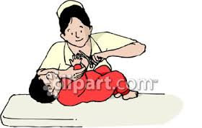
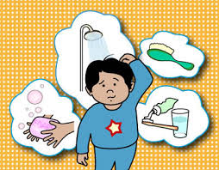
Preventive measures
MASS DEWORMING IN PRESCHOOL AGES
Hygienic sanitary & excreta disposal practices
Reduced use of human faces as manure
Regular trimming of nails
Avoidance of bare foot walking
Personal cleanliness

Slide 83
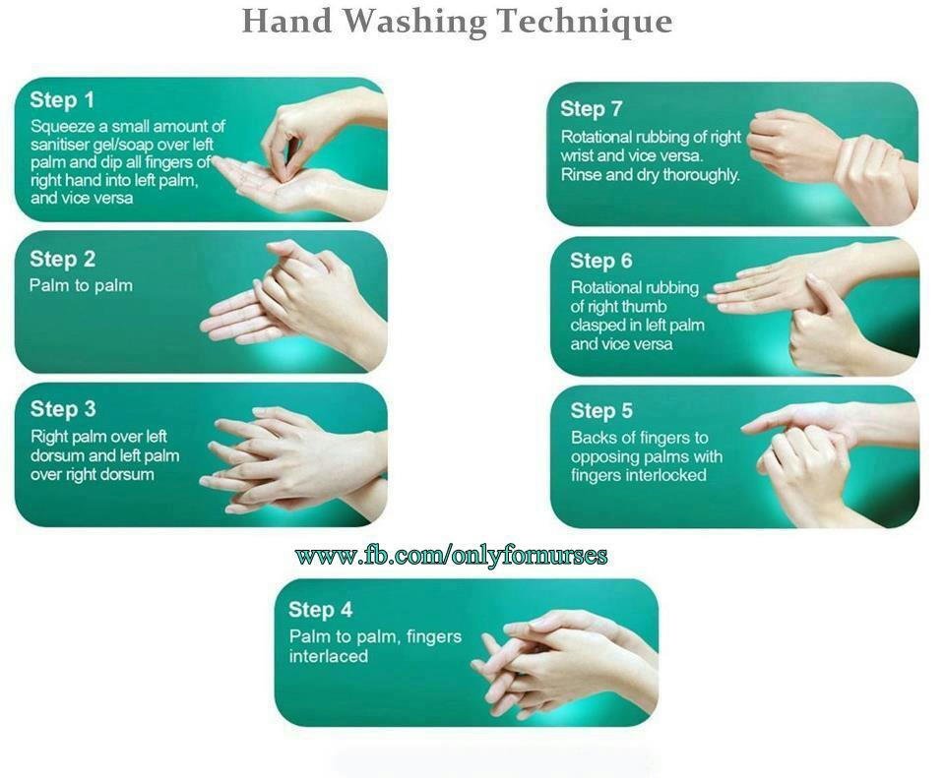

Slide 84
क×मि विचार
सÇदर्भ :
च.वि.७
च.सु.४
च.सु.२०
प्रकार:
बाह्यज:२
पुरिwÉज:६
रक्तज:५
कफज:२

Slide 85
निरुक्ति :
क्रिमति हिनस्ति इति क्रिमि |

Slide 86
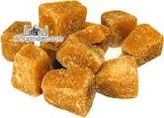
आहार सÇबÇधी हेतू
Milk
Jaggery
Sesamum
Fish
Meat
Sweets
Heavy .i.e. guru aahar
Cold .i.e sheet aahar

Slide 87
विहारसÇबÇधी हेतू
दिवास्वाप
आसन
अव्यायाम

Slide 88
क×मि ल¤ÉhÉ
सामान्य
ज्वर (fever)
विवhÉïता(discolouration)
शूल(pain)
¾द्रोग
भ्रम
भक्तद्वेwÉ
अतिसार
सदन
Nदिï
µÉÉस
विशेwÉ
पुरिwÉभेद
काश्यï
लोमहwÉï

Slide 89
क×मि चिकित्सा
अपकwÉïhÉ Elimination therapy
प्र क×ति विघात To create an unfavourable environment
निदान परिवजïन Avoiding the etiology

Slide 90
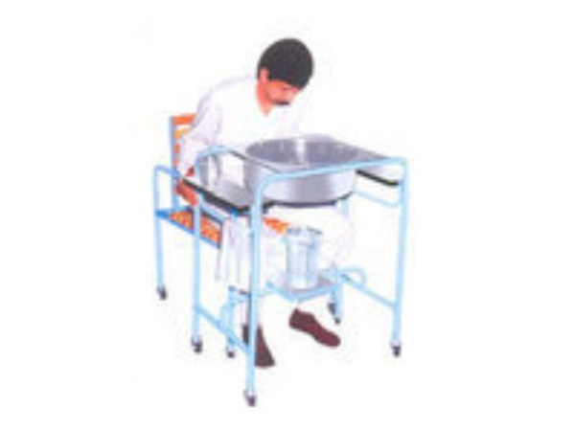
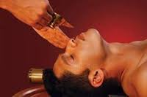
अपकwÉïhÉ
१.हस्त यन्त्र
२. भेwÉज:
वमन
विरेचन
आस्थापन
शिरोविरेचन

Slide 91
प्र क×ति विघात
कOÔ तिक्त कwÉÉय ¤ÉÉर उwhÉ
क×मिघ्न द्रव्ये : अ¤ÉÏव मरिच गÇhQÏर केबुक विQÇग निगुïhQÏ किhÉÏहि गो¤ÔÉर व्रुशपर्निका आखुपर्निका

Slide 100
ARTICLES PUBLISHED

Slide 108
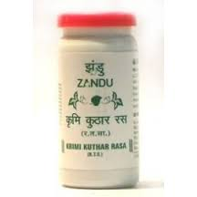
Some ayurvedic preparations

Slide 110
IN conclusion…
Helmenthiasis and krimivichar
Helmenthiasis :
Prevalence study
Classification of worms
Subclassification…..
Single topic each by each….like nematodal… ascariasis etc .cestodal….like intestinal and tissue infestation …hydatid cyst and neurocysticercosis
Schistosomiasis
Filariasis

Slide 111
Preventive measures…..
Krimi vichar:
Krimi vichar
Nirukti and prakaar
Aahar sambandhi hetus
Vihaar sambandhi hetus
Krimi lakshanas
Krimi chikitsa in deep

Slide 112
Research articles published in various journals
Some ayurvedic preparations

