Slide 1
Acute pancreatitis
Acute pancreatitis
DR. SANDESH .P. GOJE
ASSISTANT PROFESSOR
( KAYACHIKITSA)
SVAMCH, CHANDRAPUR

Slide 2
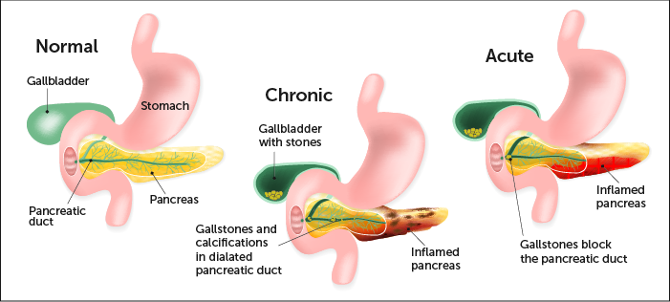
Inflamed pancreas

Slide 3
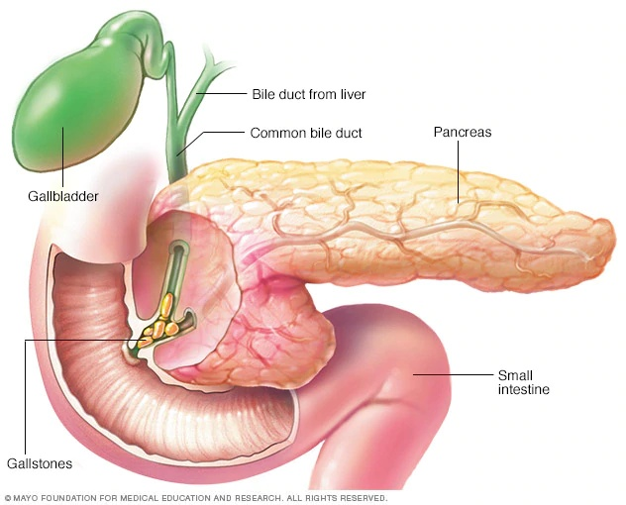
Acute pancreatitis

Slide 4
Introduction and definition
Acute pancreatitis is a sudden inflammation of the pancreas caused due to a gallstone, heavy alcohol use, systemic disease, trauma. and in minors, of mumps which gives rise to severe epigastria pain, nausea and vomiting.
Acute pancreatitis may be a single event it may be recurrent or it may progress to chronic pancreatitis.
Being a medical emergency, it in acute and mild cases are usually successfully treated with conservative measures in ICU to monitor and manage complications of the disease.

Slide 5
Causes
Biliary calculus
Alcohol
Post operative (abdominal, non abdominal)
Trauma to abdomen
Metabolic conditions
Drugs (Sulphonamides, thiazides, Oestrogens, Azathioprine, corticosteroids)
OP Poisoning
Hereditary causes
Infections (Virus, bacterial, roundworm, mycoplasma)
Post mumps
Post ERCP, MRCP
Carcinoma of the head of pancreas
Radiations By Radioisotopes.
Autoimmune pancreatitis(SLE, Thrombotic thrombocytopenic purpura, polyateritis nodosa)

Slide 6
Pathogenesis
There is abnormal activation of digestive enzymes within the pancreas called zymogenes mostly trypsinogen.
Trypsinogen is converted to its active form in duodenum, assists the digestion of proteins. During an episode of acute pancreatitis, trypsinogen comes into contact with lysosomal enzymes specifically cathepsin, which activate trypsinogen to trypsin which leads to further activation of other molecules of trypsinogen and results inflammation, oedema, vascular injury, and even cellular death and necrosis.
The initial injury there is an extensive inflammatory response due to pancreatic cells synthesizing and secreting inflammatory mediators: primarily TNF-alpha and IL-1.
The inflammatory response leads to the secondary manifestations of pancreatitis:
Results :-hypovolemia from capillary permeability, acute respiratory distress syndrome, disseminated intravascular coagulations DIC, renal failure, cardiovascular failure, and gastrointestinal haemorrhage.

Slide 7
Types of pancreatitis
Acute pancreatitis
Chronic pancreatitis
Tropical pancreatitis

Slide 8
Clinical features of acute pancreatitis
Severe epigastria pain mild to severe.
Dull boring steady pain, sudden and acute onset.
Pain radiates from abdomen to back.
Partial relief if pts. sits up and leans forwards.
Intensity of pain lasts for more than one day
Nausea, vomiting, loss of appetite
Fever with chills.
Severe toxicity and septic condition.
Hemodynamic instability.
Tachycardia, respiratory distress, peritonitis, hiccup.
Hypotension, hypoglycemia, shock.

Slide 9
Signs:-
Fever
Tachycardia
Tachypnoea (sec. to inflammation of lungs and pleural effusion)
Hypotension (due to plasma leakage into peritoneal cavity, kinine-induced vasodilatation and proteolytic, lipolytic enzmes released in circulation)
Jaundice
Abd. Tenderness, guarding, distension.
In lungs- cyanosis, basal crepitation, pl. effusion.
Cullen’s sign positive (bluish discoloration around the umbilicus )
Turner’s sign positive (bluish or green discoloration in the flanks)
Haematemesis or malena.

Slide 10
Signs continue…..
Grunwald Sign
(presence of bruise, ecchymosis around the umbilical region due to local toxic lesion of the vessels.)
Korte sign
(severe pains or resistance at umbilical region where head of pancreas is located)
Kamenchik sign
(pain with pressure under xiphoid process)

Slide 11
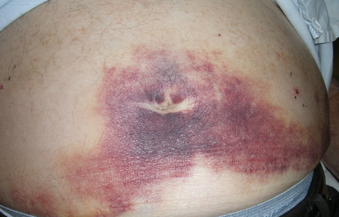
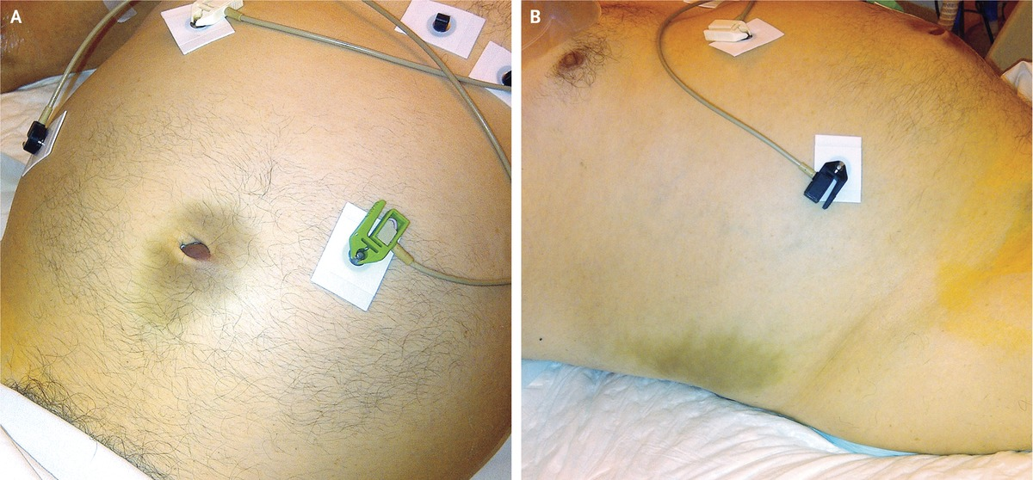
Cullen’s sign & Turner’s sign

Slide 12
Chronic pancreatitis
Chronic information of pancreas presenting as recurrent pain, endocrine deficiency (diabetes mellitus), exocrine deficiency (malabsorption) or a combination of two or all three features.

Slide 13
Chronic pancreatitis …Causes
Cholelithiasis
Chronic alcoholism
Autoimmune causes
Sjogren’s syndrome
Cystic fibrosis
Idiopathic

Slide 14
Clinical features of Chronic pancreatitis
Epigastria pain continuous are intermittent type.
Radiating from front to back side.
Pain aggravates ever while consuming alcohol or irritant food.
Vitamin deficiency, weight loss
Diarrhoea, steatorrhoea, malabsorption.
Diabetes mellitus.

Slide 15
Tropical pancreatitis
Not related to alcohol intake
Juvenile form of chronic pancreatitis
Exclusively seen in tropical countries Asia, Northern Africa etc.
In India @ Kerala and Tamilnadu

Slide 16
Tropical pancreatitis …Causes
Infection (viral, bacterial, tubercular, coxsachie)
Stress
Malnutrition
Idiopathic

Slide 17
Clinical features of Tropical pancreatitis
Generally males affected.
Recurrent abd. Pain @ epigastria area radiating towards back.
Pain aggravated by heavy irritant meals.
Malabsorbtion.
Abd. Distention
Enlarged parotid glands.
Diabetes mellitus.
Ketosis rarely.

Slide 18
Investigations:-
CBC (leucocytosis)
LFT, KFT, ESR, RBS, urine routine mic.
Serum amylase (elevated)
Serum lipase (elevated)+++
Trypsin selective test.
Sr. Calcium.(decreases)
Lipid profile
Blood gases (PaO2, PaCO2, pH, HCO3‾,O2CT)
Plain x-ray abd.
CXR-PA view
USG Abd., CT Abd., MRI Abd.
ERCP(Endoscopic retrograde cholangiopancreatography)
MRCP (Magnetic resonance cholangiopancreatography)

Slide 19
Differential diagnosis
Intestinal perforation.
Bowel ischemia.
Acute myocardial infraction.
Amoebic liver abscess.
Acute appendicitis
Pneumonia
Acute cholecystitis
Acute or chronic Renal colic
Oophritis, salphingitis, endometritis
Torsion of ovaries.

Slide 20
Complications:-
ARDS
Multiple organ failure, Pleural effusion.
Hypovolaemic shock. Cardio vascular failure.
DIC, anemia, jaundice, Arthalgia.
G I Haemorrhage,Renal Failure.
Hypocalcaemia, Hyperglycemia, Hypertriglyceridemia
Thrombosis of Splenic vein
Obstruction of portal veins
Pancreatic Ascites, pancreatic abscess, necrosis
Pancreatic pseudo cyst, Pancreatic cancer. etc.

Slide 21
Treatment
Pts. Should be Admitted in ICU.
Watch for TPR-BP, SPO2, RBS.
O2 Inhalation SOS.
NBM
Starts IV fluids
Insert Ryle's tube with continuous nasogastric aspiration
Connect monitor (NIBP)
Watch for abd. Girth, urine output, Blood gases.
Send Blood sample for Investigation.
Assess Foley’s catheterization for UOP.

Slide 22
Treatment cont….
Fluid replacement therapy:-
NS, RL, DNS, Isolyte -M
20ml/kg per hour for 1 hour followed by 3 ml/kg per hour
B. Pain control:- (Opoids\NSAIDS)
ing. Pethidin 100 mg IM tds.
Ing. Morphine
Ing. fentanyl
Ing. Hyoscine butylbromide 20mg SOS
Ing. Drotaverine HCL 40mg to 100 mg SOS
Ing. Diclofenac sodium 75 mg im SOS
C. Broad spectrum Antibiotics:-
Ing. Meropenen 1 gm IV TDS OR
Ing. Imipenem 1 gm IV TDS OR
Ing. Pipracilline tazobactum 4.5 gm IV TDS OR
Ing. Ceftriaxone HCL 1-2 gm IV TDS
ERCP or MRCP may perform within 24 to 72 hours
Surgical intervention:- (if pancreatic necrosis, complications )
- Pancreatectomy , Pancreato-jejunostomy, necrosectomy.

Slide 23
Treatment cont….
F. Anti Protozoals:-
- IV Metronidazole 400mg IV TDS OR
IV Tinidazole 500 mg IV OD
G. Anti emetics:-
- Ing. Ondensetrone 4 mg – 8 mg IV TDS OR
Ing. Granisetrone 1 mg – 3 mg IV BD OR
Ing. Metoclopramide 10mg TDS
H. H2 Antagonist/ PPI’s :-
Ing. Ranitidine 15 mg IV BD OR
Ing. Omeprazole 20 – 40 mg IV BD OR
Ing. Pantaprazole 40 mg IV BD OR
Ing. Rabeprazole 20 – 40 mg IV BD

Slide 24
….Thanks

