Slide 1
Dr. jyoti k. varthi
M.D. (Swasthavritta)

Slide 2
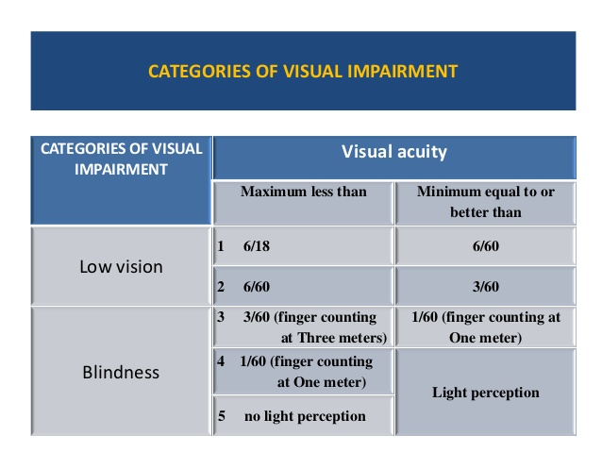
What is the definition of blindness under NPCB

Slide 3
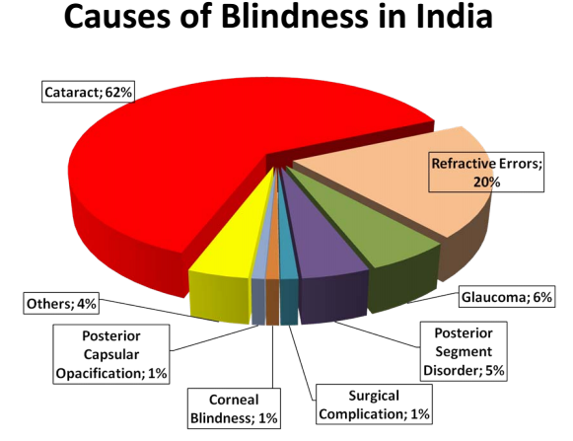

Slide 4
National Programme for Control of Blindness
National Trachoma control program 1968
NPCB was launched in the year 1976 with the goal
To Reduce the prevalence of blindness from 1.4% to 0.3%.
2001-02, prevalence of blindness was to be 1.1%.
2006-07 the prevalence of blindness reduced to 1%
Various activities under NPCB are targeted achieving the goal of reducing the prevalence of blindness to 0.3% by the year 2020.
Major focus on Cataract and refractive errors

Slide 5
financial Assistance National Programme for Control of Blindness
World Bank 1994-2002 3% to75 % cataract IOL Implemented in 8 states. 15.35 million operations done against 11 million target.
G O I 1976
Danish assistance 1998 - 2003 for training and supply of equipments
WHO
Intra country fellowships in transplantations, surgery, and paediatric ophthalmology for vision 2020

Slide 6
Guidelines for specific Diseases under 11th Five Year Plan.
Diabetic Retinopathy Rs. 1,000 will be paid for the complete treatment /case. XII
Glaucoma
Payment Rs. 1000, per case, one time as reimbursement towards cost of laser and/or surgery XIII
Keratoplasty
Rs. 1,000 to be paid per case after surgery & follow up. XV
Childhood blindness:
(age 0-16 years)=All children to be included for the purpose of the scheme26
Congenital & Dev
Cataract & Glaucoma,
will be covered under new component of childhood blindness will be reimbursed Rs. 1,000 per eye.
Squint& Congenital Ptosis
Surgical Treatment will be eligible Pre-Op & Post-Op photograph as evidence along with Medical record Payment after surgery & follow up

Slide 7
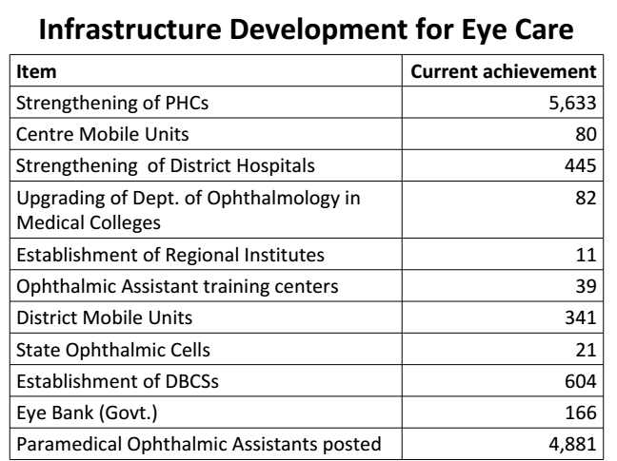

Slide 8
Goals & Objectives of NPCB in the XII Plan
To reduce the backlog of blindness through identification and treatment of blind at primary, secondary and tertiary levels in the country.
Develop and strengthen the strategy of NPCB for “Eye Health” and prevention of visual impairment.
Strengthening and upgradation of RIOs to become centre of excellence in various sub-specialities of ophthalmology
Strengthening the existing and developing additional human resources and infrastructure facilities for high quality comprehensive Eye Care in all Districts
To enhance community awareness on preventive measures;
Increase and expand research for prevention of blindness and visual impairment
To secure participation of Voluntary Organizations/Private Practitioners in eye Care

Slide 9
SCHOOL EYE SCREENING PROGRAMME
6-7% children of age gr 10to 14 yrs have eye problems
Screening by trained teacher
Suspected for Refractive error by ophthalmic assistant
Corrective spectacles free for BPL

Slide 10
COLLECTION & UTILISATION OF DONATED EYES
During 2008-2009 41,780 donated eyes were collected for corneal transplantation

Slide 11
25th August To 8th September Eye Donation Fortnight

Slide 12
Eyebanks

Slide 13
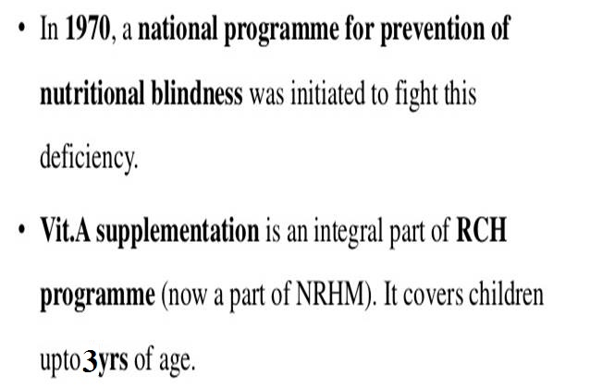
Preventive Measures:
MMR vaccination
Vitamin A Prophylaxis

Slide 15
Global Action Plan 2014 - 2019 Universal Eye Health
Refractive services
Cataract surgery

Slide 16
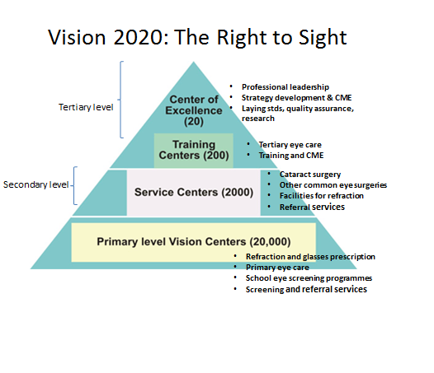
Retinal, corneal transplantation
Gluaucoma surgery

Slide 17
INFORMATION | EDUCATION | COMMUNICATION

Slide 18
Refractive Errors

Slide 19
Cataract

Slide 20
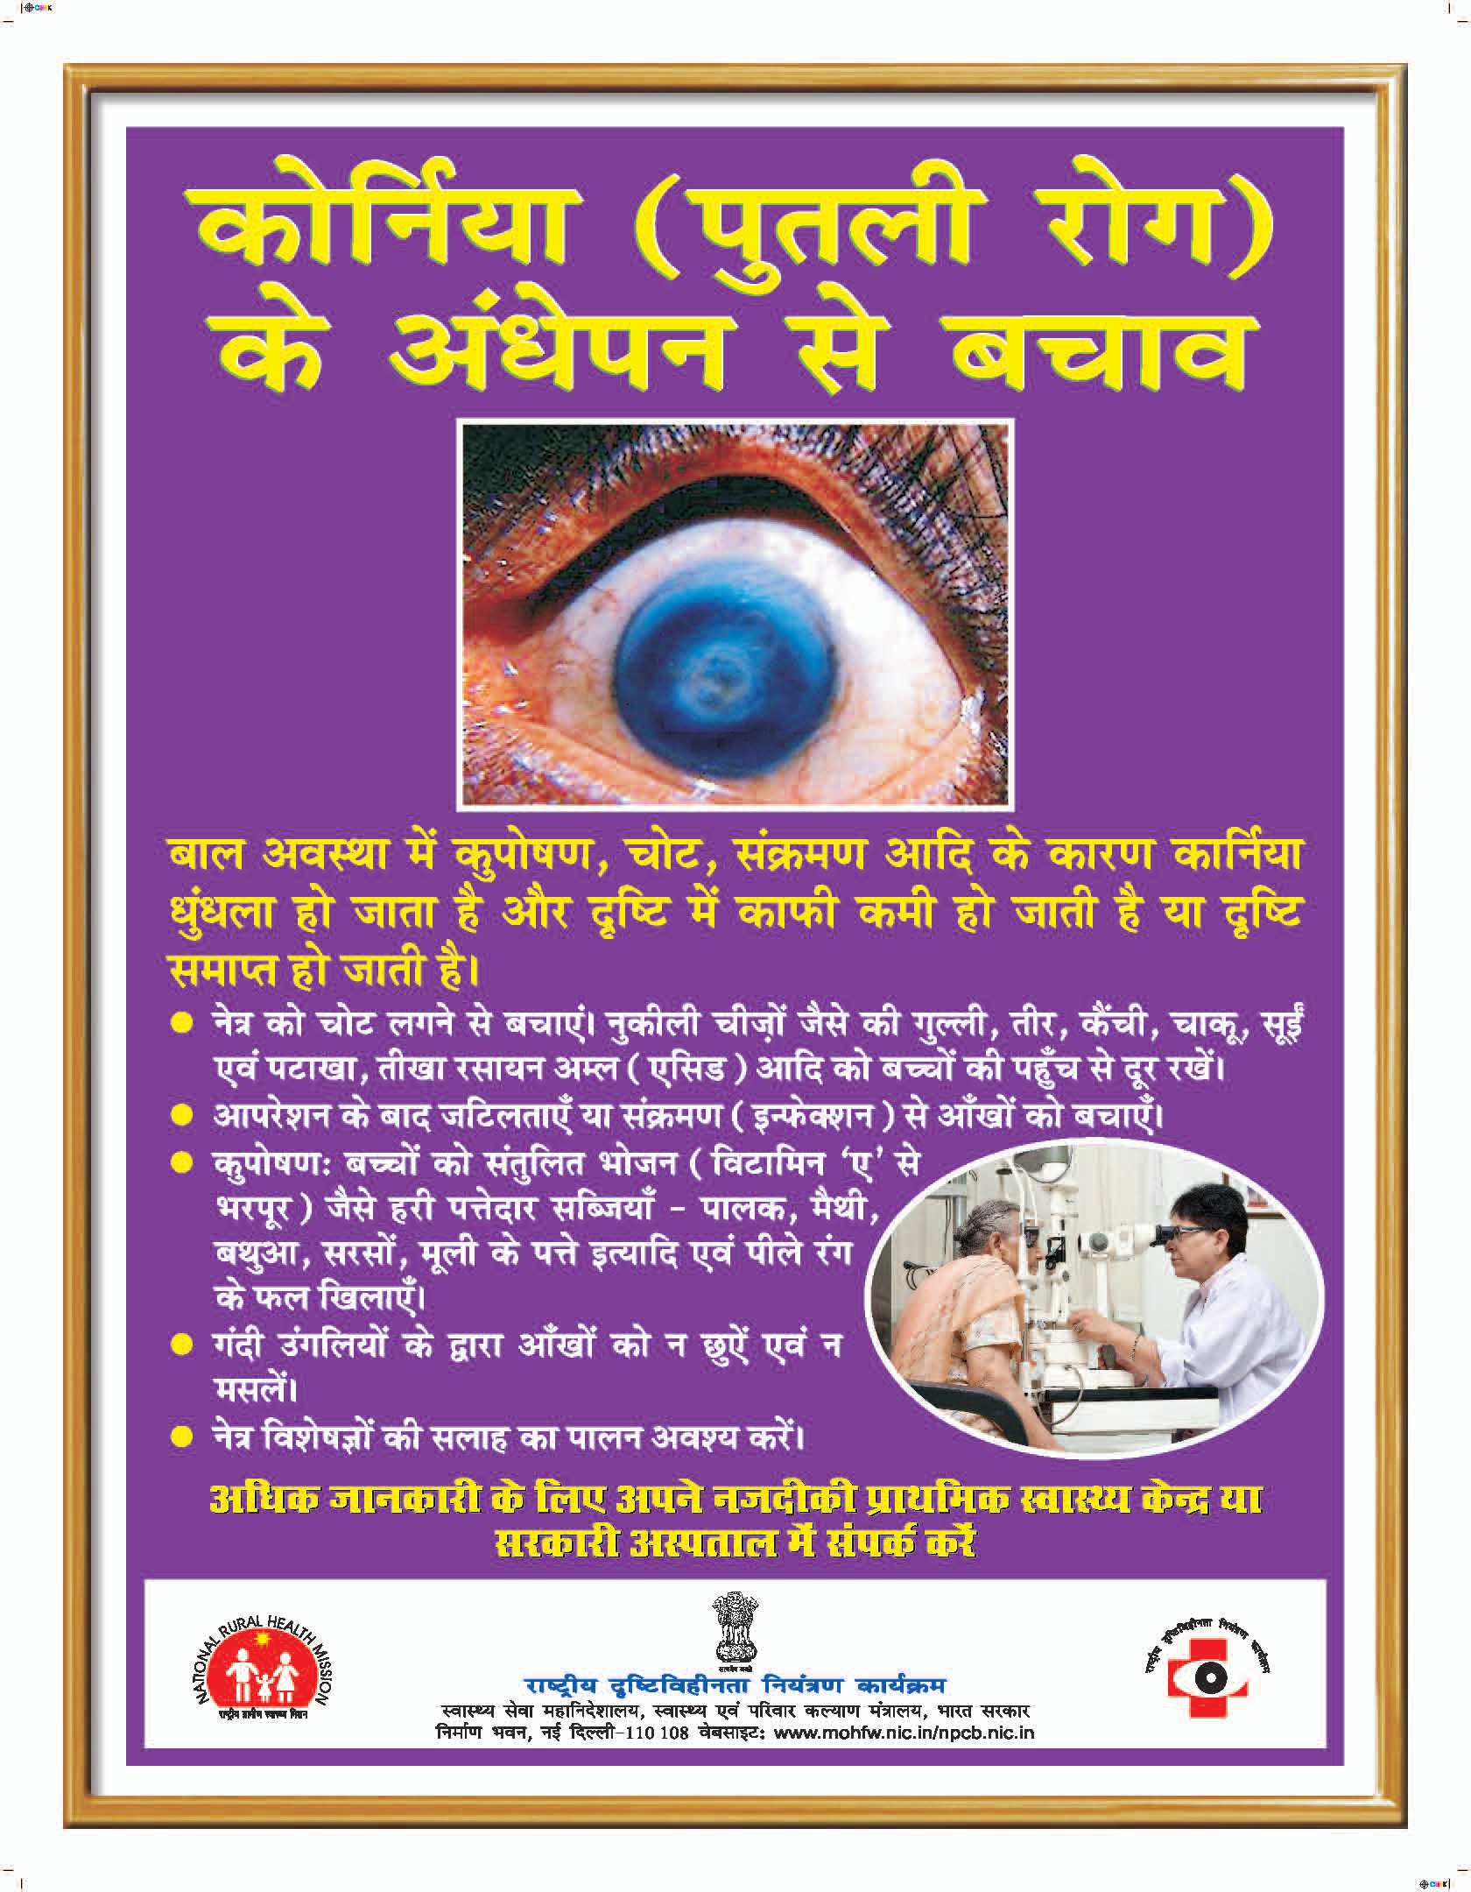
Corneal opacity

Slide 21
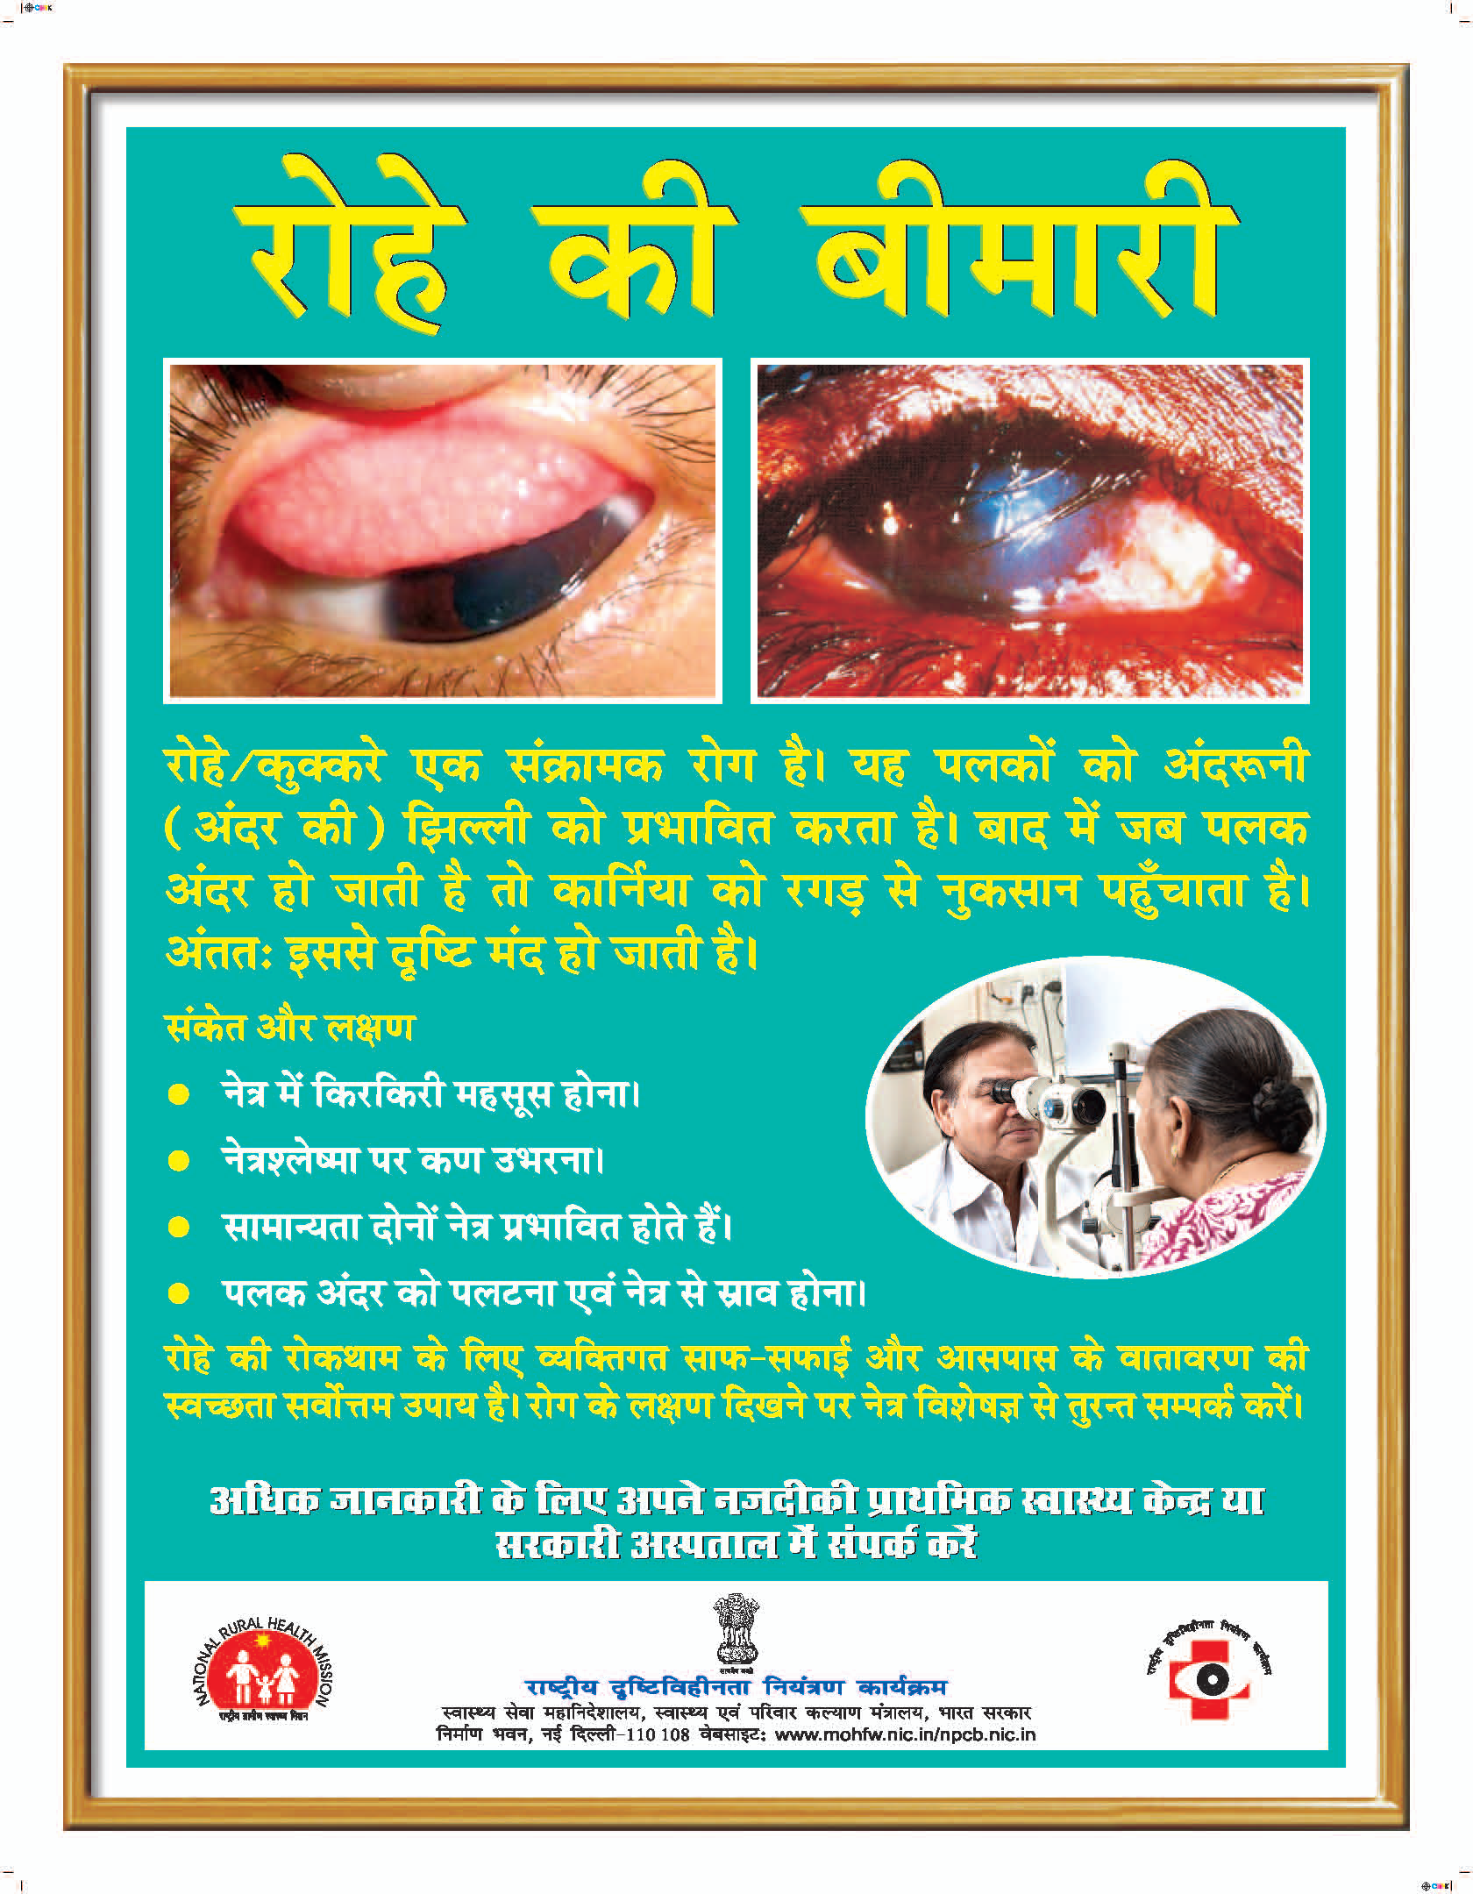
Trachoma

Slide 22
Glaucoma

Slide 23
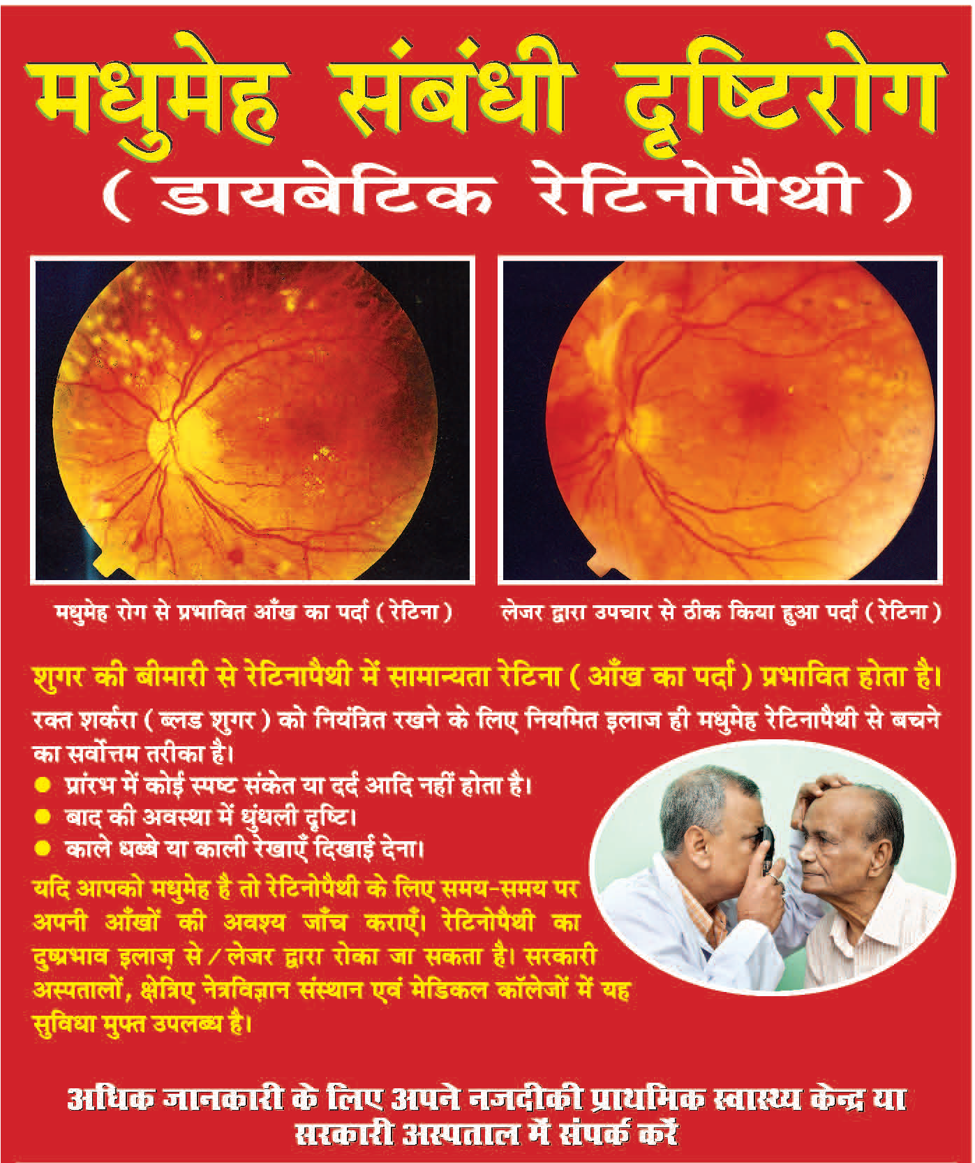
Diabetic retinopathy

Slide 24
vk;qosZnh; fopkj
vkgkj o iks"k.k
vkeydh jlk;u
lIrke`r ykSg
f«kQyk ?k`r
vatu
usfr
«kkVd

Slide 25
Thank You

