Slide 1
!!जयतु संस्कृतम्!!
प्रा.सौ.प्रणीता प्रशांत भाकरे
श्रीमती विमलादेवी आयुर्वेदिक मेडीकल कॉलेज
वांढरी चंद्रपूर.

Slide 2
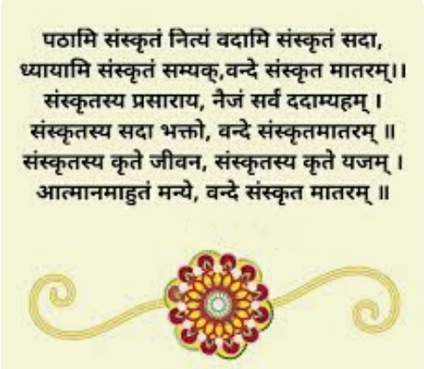
संस्कृत प्रार्थना

Slide 3
KNOW YOUR SYLLABUS
Smt.Vimladevi Ayurvedic medical College and hospital chandrapur
. Course code
AYUG SN & AI
Name Of course
Sanskrit and Ayurved Itihaas

Slide 4
List of Topics paper 1
1 संस्कृत वर्णानां परिचय:! 7. समास
2. संज्ञा प्रकरणम्. 8. शब्दरुपाणि
3. उपसर्गा:. 9. धातुरुपाणि
4 अव्ययानि. 10. सर्वनामपदानि
5. कारकप्रकरणम्. 11. प्रत्यया:
6. सन्धि 12. विशेषण विशेष्य

Slide 5
List of Topics paper 2
Part A
निरुक्ति तथा पर्यायपदानि
परिभाषापदानि
अन्वयलेखन
वैद्यकीय सुभाषित साहित्यम्

Slide 6
Paper 2 Part B Ayurved Itihaas
1. Derivation (Vyutpatti and Niruktti) and definition of Itihaas.
Necessity, significance and Utility of knowledge of Ayurveda Itihaas,Means and method of study of Ayurveda Itihaas,
Different Time periods relevant for the study of Ayurveda Itihaas (viz,prevedic,Vedic, Samhita kala,Sangraha kala etc.)

Slide 7
Ayurveda Itihaas topic 2
O
2 Origin and lineage of Ayurveda (Ayurvedavataran)
And Introduction of references of Ayurveda in Veda,Upanishad
And Purana

Slide 8
Ayurveda Itihaas topic 3
Structure, Specialities,Time period of Ayurveda Samhitas and their
Commentaries (including special contributions of authors and commentators)
Charaka samhita, Sushruta samhita,Ashtanga Sangraha,Bhelsamhita,Hareeta samhita,Kashyap samhita.

Slide 9
Ayurveda Itihaas topic 4
Structure, contributions and importance of laghutrayee and commentaries
Madhava nidana
Sharangadhara samhita
Bhavprakasha

Slide 10
Ayurveda Itihaas topic 5,6,7
5 Origin and period of different systems of medicine in the world.
6 Introduction to Vrukshayurveda,Hastyaurveda and Ashwayurveda.
(Included in Transitional carriculam)
7 Status of Ayurveda during the period of Ashoka,Mughal and British rule

Slide 11
Ayurveda Itihaas topic 8 ,9
8 Contributions of Scholars of modern era
Acharya Gana nath sen,Vaidya Yaminibhushan rai,Vaidya Shankar Dajishastri Pade,Acharya Swami Lakshmiram,Acharya Yadavji Trikamji,Dr.PM.Mehata ,Vaidya B G Ghanekar,Vaidya Damodar Sharma Gaur,Acharya Priyawrat sharma,Vaidya C Dwarkanath,Vaidya K R Shrikantamurthy,Vaidya VJ Thakkar,Vaidyaratanam PS Varior,Vaidya B V Ghokhale
9 Globalization of Ayurveda.

Slide 12
Ayurveda Itihaas topic 10
1 Developmental activities in Ayurveda in the post –independence
. * Introduction to various committees and their recommendations
. * Introduction of activities of the following Organisations
. Department of AYUSH,CCIM/NCISM, CCRAS,
National institutions Viz-AIIA –All India Institute of Ayurveda
. National institute of Ayurveda,Jaipur,ITRA,Jamnagar, Faculty of Ayurveda in,BHU, Varanasi.Rashtriya Auurvea Vidyapeeth,New Delhi

Slide 13
Paper pattern
Paper 1 and paper 2 both are in same pattern
Que.1 MCQs 1×20=20a(20questions)
Que 2. Short answer questions 5×8=40(8que.)
Que 3. Long answer questions 10×4=40(4 que.)
Paper 1_____100 marks paper 2 ___100 marks
Viva and practical......100 marks total marks 300

Slide 14
Exam shedule
Nine periodical test 20 Marks each
Two term tests
First term paper- 100 marks and viva 100marks
Second term paper -100marks and viva 100 marks
UNIVERSITY EXAM
Paper 1-100marks
Paper 2-100marks
Viva 100 marks
Most important thing. PRACTICAL 50
Lecture shedule.....250+50

Slide 15
इति शम्
।। धन्यवादा:।।
🙏

