Slide 1
Water and electrolyte balance
DR. PRASHANT D. CHANDEKAR
ASSO. PROFESSOR SMT. VIMLADEVI AYURVED COLLEGE CHANDRAPUR

Slide 2
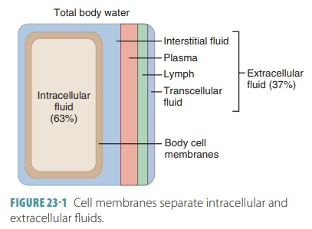
Distribution of body fluid
body fluids are not uniformly distributed they are coupe compartments of different volumes that contain wearing composition
. Water and electrolyte movements between these compartments is regulated to stabilize their distribution and the composition of body fluids.

Slide 3
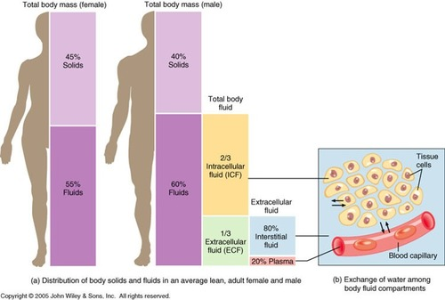
Flute compartment
In adult 40 litres
About two third is intracellular fluid
About one-third is extracellular fluid
In adult female about 52% of body weight
In adult male about 63% of body weight

Slide 4
Body fluid composition
extracellular fruits are generally similar in composition including high concentration of sodium calcium chloride and bicarbonate ion
intracellular fluids have high concentration of potassium magnesium phosphate and sulphate ion.

Slide 5
Movements of loot between compartment
hydrostatic pressure and osmotic pressure are two major factors that regulate the movements of water and electrolyte from one fluid compartment to another.
flute leaves plasma at arteriolar ine of capillaries because how to work force of hydrostatic pressure predominates.
flute returns to plasma at vennila end of capillaries because in workforce up ko light osmotic pressure predominates.
Hydrostatic pressure within interstitial space forces fluid into lymph capillaries.
Interstitial fluid is in equilibrium with extracellular and intracellular fluid.

Slide 7
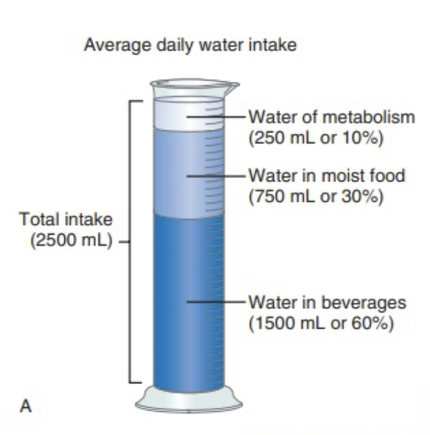
Water balance
Watermelon suggestive in water intake equal water or photo messages require controller but water intake converter output.
water intake
the volume of water gained is day where is among individual.
. 60% from drinking.
30% from my food.
10% as a byproduct of oxidative
metabolism of nutrient
called water of metabolism.

Slide 8
Regulation of water intake
If the body loses as little as 1% of its water
An increase in the cosmetic pressure of extracellular flude due to water loss stimulated asthma receptor in the third centre.
Activity in hypothalamus causes person to feel thirsty and drink water.
Drinking and the resulting distension of the stomach by water stimulate now impulse says that inhibit the third centre.
Water is absorbed through the wall of the stomach and small intestine.
The osmotic pressure of extracellular fluid returns to normal.

Slide 9
Water output
Water normally enter the body only through the mouth but it can be lost by a variety of fruits including.
Urine 60% loss
Fishes 6% loss
Sweat 6% loss
Evaporation from skin and lungs 28% loss

Slide 10
Regulation of water output India hydration condition
Extracellular fluid becomes as matakali more concentrate.
asthma receptor in the hydra thalamus are stimulated by the increase in the asthmatic pressure of body fluid.
due to the hypothalamus signals the posterior pituitary gland to release head ears into the blood.
Blood carries a DH to the kidney.
AIDS causes the distal convoluted tubules and collecting ducts to increase water reabsorption.
Urine output decreases and for the water loss in minimised.

Slide 11
In excess water intake
She play extra cellular applaud become has medically place concentrate.
this this change stimulated osmoreceptors in hypothalamus.
The posterior pituitary gland decreases ADH release.
Renal tubules decreases water reabsorption.
Urine output increases and excess water x-rated.

Slide 14
Electrolyte intake
The electrolytes are greatest importance to the cellular functions and these are sodium, potassium, calcium, magnesium, chloride, sulphate, phosphate, bicarbonate and hydrogen ions.
These electrolytes are primarily obtained from foods but some are from water.

Slide 15
Regulation of electrolyte intake.
Ordinarily a person obtain sufficient electro light by responding to hunger and thirst .severe electrolyte deficiency may cause salt craving.

Slide 16
Electrolyte output
The body loses some electrolyte by pursuing typically on warmer days and during strenuous exercise.
Some are lost in the feces.
The greatest output is as a result of kidney function and urine output.

Slide 17
Regulation of electrolyte output
the concentration of positively charged ions such as sodium,(Na+) potassium (K) and calcium (Ca) are of particular importance these ions are vital for nerve impulse conduction muscle fiber contraction and maintenance of cell membrane permeability

Slide 18
