Slide 1
Reproductive and child health programme
By
Dr. jyoti k. varthi
Dept. of Swasthavritta & Yoga

Slide 2
Definition -
People have the ability to reproduce and regulate their fertility, women are able to go through pregnancy and child birth safely, the outcome of pregnancies is successful in terms of maternal and infant survival and well being and couples are able to have sexual relations free of fear of pregnancy and of contacting diseases.

Slide 3
Why there is a need ?
Mother and children comprise
71.14 % of the population of developing countries.
57.5 % of the population in India.
Globally MMR ( Maternal mortality Ratio) averages
16/lac.live births in developed countries
IMR and MMR are high in developing countries.

Slide 5
.
RCH Phase 1 launched on 15th October, 1997.
2001-2002 –A scheme for training of dais was initiated and implemented in 156 districts in 18 states/Uts.
RCH Phase 2 launched on 1st April 2005.
JANANI SURAKSHA YOJANA (JSY) launched on 12th April 2005.
1st June 2011 – govt. of India launched Janani shishu suraksha karyakram.( JSSK).

Slide 6
INTEGRATED APPROACH TO THE PROGRAMME
Improving the health status of young women and children
Namely-
Family welfare programme.
Universal immunization programme.
Oral rehydration therapy.
Child survival and safe motherhood.
Acute respiratory infection control.

Slide 7
rch phase-1
The program was formally launched on 15 October 1997.
The RCH program
National Family Welfare Program and
Child Survival and & Safe Motherhood Program ( CSSM)
Sexually transmitted disease and
Reproductive tract infections.
7

Slide 8
Components of RCH Phase- 1
FAMILY PLANNING
PREVENTION/
MANAGEMENTOF
RTI/STD/AIDS
CHILD SURVIVAL
AND SAFE
MOTHERHOOD
CLIENT
APPROACH
TO HEALTH
CARE

Slide 9
Main highlights of rch program
Family Planning
MTP & IUD Insertion
Private sector inclusion
Collaborate with NACO in condom distribution
Safe Motherhood
Quality ANC
Institutional Deliveries
Skilled Birth Attendance
Emergency Obstetric care
Home based post-partum & NBC
Quality safe abortion services
Child Survival
Intensify existing services. Immunization,
NBC
Micronutrient Supply
Chronic dirrohoel diseases
ARI
RTI/STD
Specialist facilities for STD & RTI.
CLIENT ORIENTED
Address quality
Based on needs of community

Slide 10
Major intervention under RCH phase 1
Essential obstetric care
Emergency obstetric care
24 hour delivery service at PHCs / CHCs
Medical termination of pregnancy
Control of RTI & STD
Immunization
IEC Activities
Essential new born care
Diarrhoeal disease control
Acute respiratory disease control
Prevention & control of Vit A deficiency in children.
Prevention & control of anemia in children.
Introduction of Hepatitis B vaccination.
Training of Dais.

Slide 11
Intervention in selected states & district
Screening & treatment of RTI / STD
Emergency obstetric care
Essential obstetric care
Additional ANM at sub centers.
Improved delivery service & emergency care.
Facility of referral transport of pregnant women

Slide 14
RCH Program: Phase II
RCH Phase II began from 1 April 2005.
The components being:
Essential obstetric care
Emergency obstetric care
Strengthening referral system

Slide 15
New initiatives
Training Of PHC Doctors In Life Saving Anesthetic Skills For Emergency Obstetric Care At FRUS
Setting Up Of Blood Storage Centers At FRUS
Janani Suraksha Yojana
Vandemataram Scheme
Safe Abortion Services
Village Health And Nutrition Day
Maternal Death Review.
Pregnancy Tracking
Janani Shishu Suraksha Karyakram (JSSK)

Slide 16
A. Essential obstetric care
Promotion of institutional deliveries
50% of the PHCs and CHCs made operational as
24 hours delivery centers.
Skilled attendance at birth.
Policy decisions to permit Health workers
to use drugs in emergency situations to reduce
maternal mortality.

Slide 17
B. Emergency Obstetric Care :-
Minimum services provided by FRU are
24 hour delivery services including normal and assisted deliveries.
Emergency obstetric care including surgical interventions.
New born care.
Emergency care of sick children.
Full range of family planning services including laproscopic services.
Safe abortion services.
Treatment of STD/RTI.
Blood storage facility.
Essential laboratory services.
Referral services.

Slide 18
3 Critical determinants of a facility declared as a FRU
Availability of surgical interventions
New born care
Blood storage facility
C. Strengthening Referral system
Indicates to involve local self help groups, NGOs
and women groups.

Slide 19
24 hrs. Functioning of PHCs
• It is planned to establish 2000 FRUs in phases in
RCH-II 50% PHCs and all CHCs to be
operationalised in phases
• Availability of Services such as
- 24 Hrs. Delivery services
- New Born care
- Family Planning, Counselling and services
- Availability of RTI, STI services
- Safe abortion services (MVA etc.)

Slide 20
Training in Anaesthesia
• Training of MBBS Doctors in Life Saving
Anaesthetic Skills for Emergency Obstetric
Care.
• 16 weeks training course
• The First Training Programme
Conducted at AIIMS for Chhattisgarh
Notes:
• Training guidelines giving criteria for certification,
selection of trainees & training instt./medical
college, minimum procedures etc. finalized
20

Slide 21
Training in Obstetric Management
Training of MBBS doctors in obstetric
Management and skills including C.S. in RCH-II
Training to be conducted in collaboration with FOGSI
Duration of training to be 16 weeks.
Expert Group is considering other details.

Slide 22
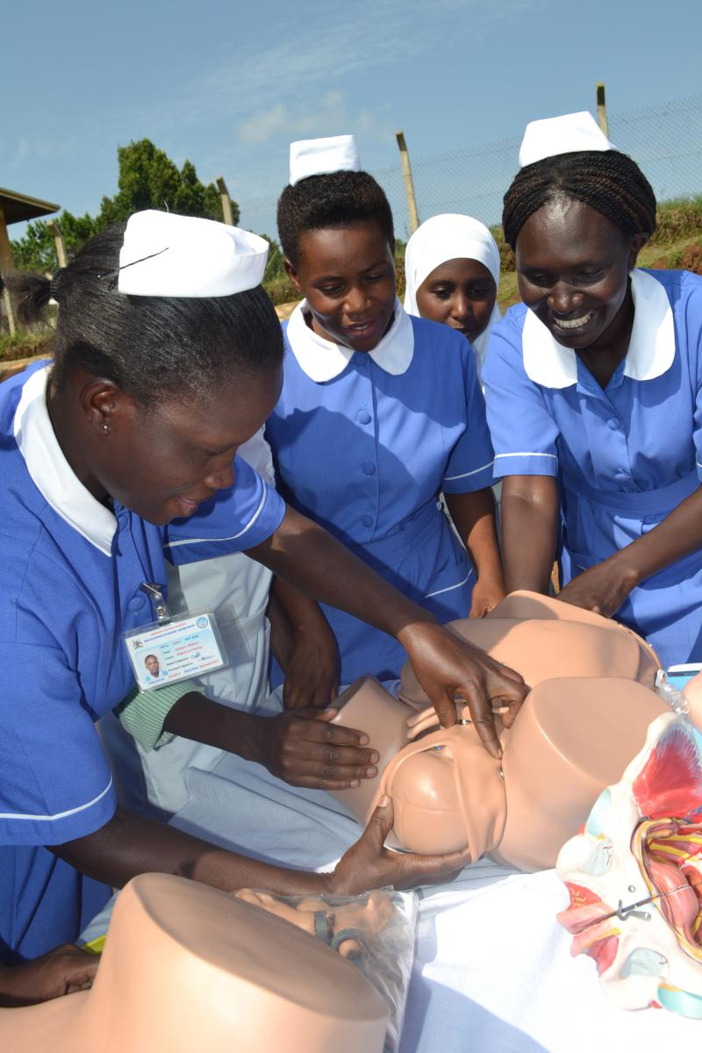
Training of midwives

Slide 23
Drug and equipment kits: Mid-wifery kit & drug kit
Kit-E – Laparotomy set
Kit-F - Mini– Laparotomy set
Kit-G – IUD insertion set
Kit-H – Vasectomy set
Kit- I – Normal delivery set
Kit- J – Vacuum extraction set
Kit- k – Embryotomy set
Kit- L – Uterine evacuation set
Kit-M – Equipment for anesthesia
Kit-N- Neonatal resuscitation set
Kit-O- Equipment and reagent for blood test
Kit-P – Donor blood transfusion set

Slide 24
Blood Storage Facility
Management of obstetric emergencies is sometimes not possible due to non-availability of blood.
The Drugs and Cosmetics Act was therefore
modified to facilitate establishment of blood
storage centers at FRU’s.

Slide 25
Janani Surkasha Yojna
Launched on 12th April 2005
To promote Institutional Deliveries
To reduce
Maternal Mortality Ratio
Infant Mortality Rate
A safe motherhood intervention, replacing the
“National Maternity Benefit Scheme”, under NRHM
100 % centrally sponsored
Integrates cash assistance with delivery
& post-delivery care.

Slide 26
Vandematram Scheme
It is a voluntary scheme wherein any obstetric and gynaec specialist, maternity home can volunteer
Enrolled doctors will display ‘Vandemataram logo’ at their clinics.
Iron and folic acid tablets, oral pills, TT injections, etc will be provided for free distribution.

Slide 27
Safe Abortion Practices
MEDICAL METHOD
Termination of early pregnancy (49days) using 2 drugs
- mifeprestone followed by mesoprostol
MANUAL VACCUM ASPIRATION
Safe and simple technique for termination of pregnancy.
Can be used at PHC or comparable facility

Slide 28
Village health & nutrition day-
Once in a month at Anganwadi centres.
Maternal death review –
Maternal death audit both
facility and community based.
Pregnancy tracking.

Slide 29
Janani shishu suraksha karyakram
Launched on 1st June 2011.
Provide the new facilities to the pregnant women-
Absolutely free and no expense delivery including caesarean section.
Free medicine, diets, blood and transport.
Similar entitlements for all sick new-borns till 30 days after birth.
The scheme now extended to cover the complications during ANC, PNC and also sick infants.

Slide 30
Child health component
Nutritional Rehabilitation Centers (NRCs)
Integrated Management of Neonatal and Childhood Illnesses (IMNCI).
Newborn care corner (NBCC)
Newborn stabilization Unit (NBSU)
Special newborn care unit (SNCU)
Triage of sick newborns
Navjat Shishu Suraksha Karyakram (NSSK)
Rashtriya Bal Swasthya Karyakram(RBSK)

Slide 31
Classify condition & identify treatment action according to colour coded t/t
YELLOW
GREEN
PINK
t/t at out patient health facility
Urgent referral
Home management

Slide 32
Navjat shishu suraksha karyakram (NSSK)
Aim – to train health personnel in basic newborn care & resuscitation.
It has been launched to address care at birth issue
prevention of hypothermia
Prevention of infection
Early initiation of breast feeding
Basic newborn resuscitation.

Slide 33
Rashtriya bal swasthya karyakram
Launched on Feb 2013
Child health screening & early intervention services
through early detection & management of 4Ds prevalent in
Children. (Defects at birth, Diseases in children, Deficiency
conditions and Development delays).
Age group 0-18 yrs.

Slide 34
Programme implementation
1) For Newborn 0 To 6wks –
a)Facility based newborn screening at public health
facilities by existing health manpower.
b) Community based newborn screening at home
through ASHA
2) For children 6wks to 6 years - At Anganwadi
center by dedicated mobile health service.
3) For children 6yrs to 18yrs –Govt. & Govt. aided
school based screening
- Twice a year in Anganwadi
- Once a year in school children

Slide 35
Referral Transport
Easy access to ambulance & assistance from AWW
Key issues: Roads, transportation, RCH I funds poorly Utilized, Community participation lacking
Under Consideration
– Place funds with AWW /ANM; [ JSY]
– Develop community mechanisms
– Provide out source ambulances at PHCs
CHCs, and FRUs
Notes:
35

Slide 36
Role of ASHA
A village level link worker attached to
AWW/ANM
Motivator for ANC, PNC, Institutional Delivery.
Immunization and Family Planning Services.
Provide Escort to beneficiary for above services.
Adolescents Health Counsellor.
Notes:
• Link between beneficiaries and ANMs.
36

Slide 37
Goals and targets
The 12th five year plan
the three goals
Reduction of infant mortality rate (IMR)
Reduction of maternal mortality ratio (MMR)
Reduction in total fertility rate (TFR)

Slide 38
Highlights of the program
Integration of all programs related fertility regulation, maternal and child health and reproductive health.
Services are client oriented, demand driven through decentralized participatory process and target free approach
Up-gradation of facilities : Creation of First referral units
Provision of specialist services for STD and RTI

Slide 39
Infection Management and Environment Plan
Treatment and disposal of biomedical wastes
Disposal of syringe waste
Provision of water sanitation and good hygiene conditions.

Slide 40
Ayurvedic Approach
ekrk
ckyd
Pre-conception care
Liquid and sweet diet in 1st trimister jljDr/kkrqo/kZd
Sweet, liquid and heavy diet in 2nd trimister ekalesnks/kkrqo/kZd
Liquid and solid diet rich in fats and proteins in last trimister vfLFkeTtk’kqØo/kZd
Prasav Paricharya
Concept of Daee
Exclusive breast feeding for 6 months
Continue Breast feeding till 2 years
Weaning diet: 6 supplementary feeds/ day (Yush, Cereals, Rice, Legumes)
Suvarnaprashan till 16 years

Slide 41
THANK YOU

