Slide 1
DACRYOCYSTITIS
Inflammation of the lacrimal sac

Slide 2
Type of DACRYOCYSTITIS
Congenital Dacryocystitis
Adult Dacryocystitis

Slide 3
CONGENITAL DACRYOCYSTITIS
inflammation of the lacrimal sac occurring in newborn infants so called it as a Dacryocystitis neonatorum

Slide 4
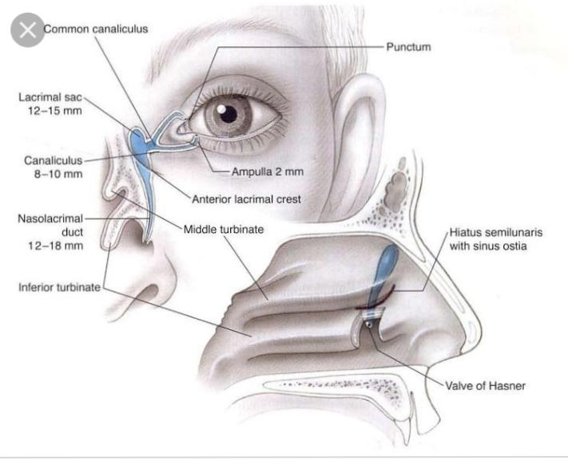

Slide 5
Etiology
‘membranous occlusion’ at its lower end, near the valve of Hasner
causes of congenital NLD block are: presence
of epithelial debris, membranous occlusion at its
upper end near lacrimal sac, complete non-
canalisation and rarely bony occlusion. Common
bacteria associated with congenital dacryocystitis
are staphylococci, pneumococci and streptococci.

Slide 6
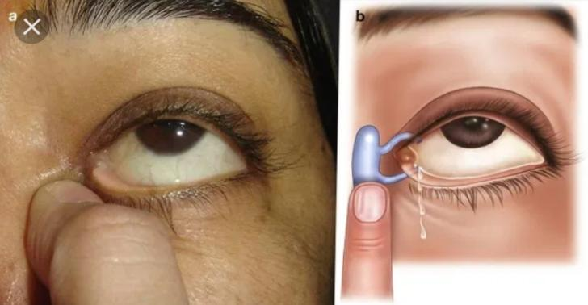
Clinical picture
Epiphora,
Regurgitation
Swelling

Slide 7
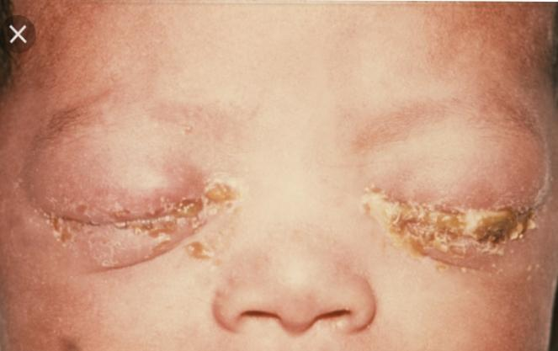
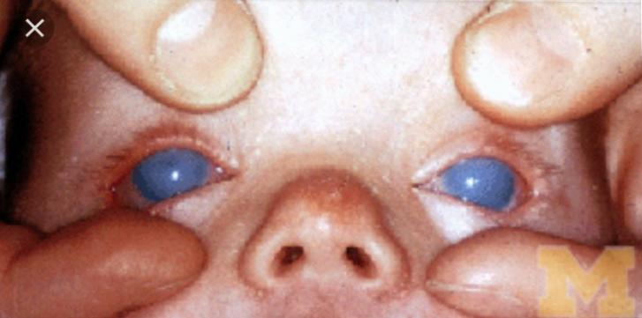
Differential diagnosis
ophthalmia neonatorum
Congenital glaucoma.

Slide 8
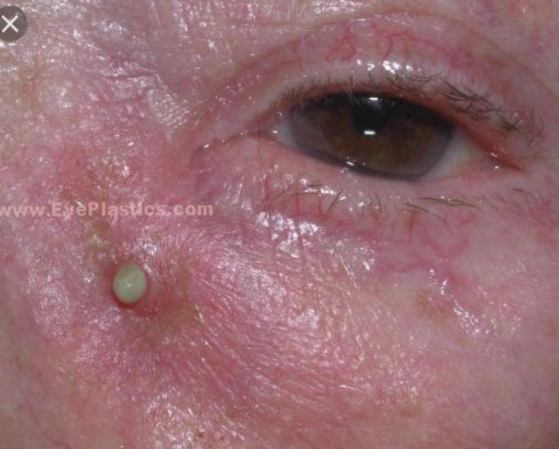
Complications
recurrent conjunctivitis, acute on chronic dacryocystitis, lacrimal abscess and fistulae formation.

Slide 9
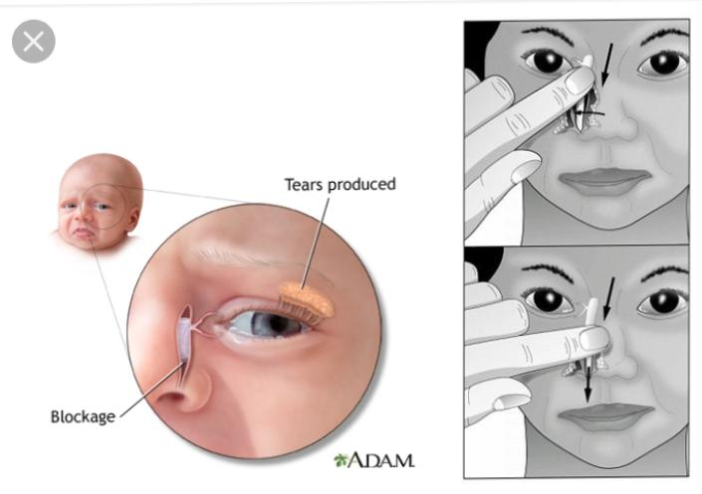
Treatment
Massage over the lacrimal sac area and topical
antibiotics constitute the treatment of congenital
NLD block, up to 6-8 weeks of age.

Slide 10
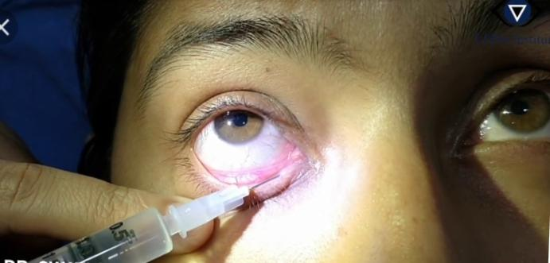
Lacrimal syringing (irrigation) with normal
saline and antibiotic solution. More than 2 months

Slide 11
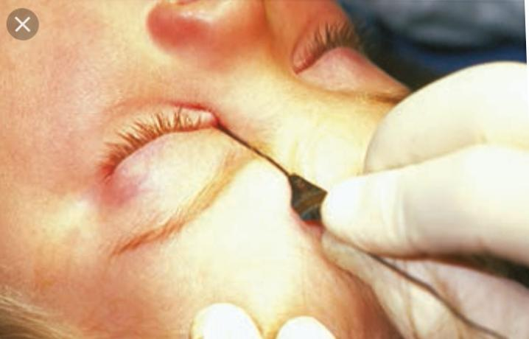
Probing of NLD with Bowman’s probe. More than 3-4 months.

Slide 12
Intubations with silicone tube

Slide 13
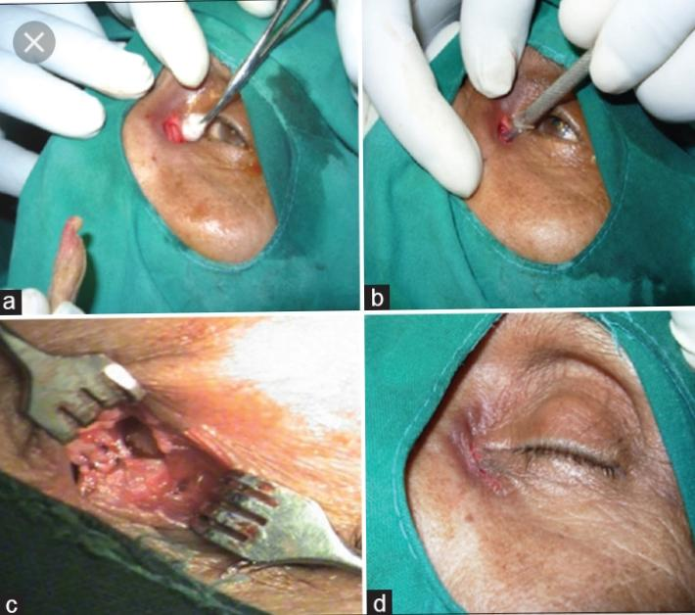
Dacryocystorhinostomy (DCR) operations: at the age of 4 years

