Slide 1
LEAD POISONING
AGADTANTRA VYAVAHAR AYURVED EVUM VIDHIVAIDYAK
Name :- Vivek Deshmukh
Batch :- 3rd BAMS (2017)
Roll no :- 17

Slide 2
INTRODUCTION
Lead is an irritant inorganic metal poison.
Lead poisoning may occur by:- 1)Ingestion
2)Inhalation
3)Absorption through skin.
Lead is 10 times more poisonous when inhaled.

Slide 4
The common poisonous preparations of Lead are:- Lead tetroxide Vermillion or Sindoor)
Lead acetate (salt of satum)
Lead sub-acetate
Lead carbonate (safeda)
Lead nitrate
Lead sulphate
Lead chromate (chrome yellow)
Lead chloride
Lead bromide
Lead iodide
Lead sulphide (white surma)
Tetra-ethyl lead (was earlier added to petrol as anti-knocking agent)
Lead monoxide-mudrasang.

Slide 5
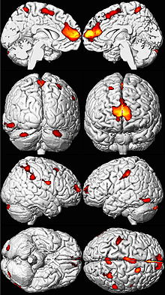
MECHANISM OF ACTION
It inhibits enzymes- sulphydryl group
ATPases
aminolaevulinic acid dehydrase
ferrochelatase.
The chronic manifestations are mainly due to fixation of lead in brain and peripheral nervous system.
Spasm of capillaries.

Slide 6
ACUTE LEAD POISONING
Acute poisoning is very rare. The manifestations resemble other metallic poisons except that diarrhoea is replaced by constipation and stools are black and foul smelling.Blood lead levels: increased and lead lines are seen on bones on X-ray.
GIT Manifestations:-
A sweet, metallic, astringent taste.
Burning of the throat
Vomiting white or bloody
Colicky pain relieved by pressure
Abdomen tender and contracted
Constipation.

Slide 7
Urinary Manifestations:-
Oliguria.
Albuminuria
presence of lead in urine
presence of copro-porphyrin 3 in urine. (red coloured urine).
CNS Manifestations:-
Drowsiness
Insomnia
Headache
muscular cramps
Convulsions and rarely paralysis.

Slide 8
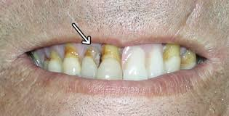
SUB ACUTE POISONING
It results from consumption of repeated doses of soluble salts of lead.
Blue-line on the gums.
Face is pale and looks are anxious.
Decreased secretions.
GIT and Urinary manifestations (as in acute).
CNS manifestations (as in acute) are more pronounced.
At times, after recovery from acute poisoning, there may be return of manifestations (due to release of deposited lead)

Slide 9
FATAL DOSE AND PERIOD
Fatal Dose :-
Uncertain, 0.5-20 gms.
Fatal Period :-
Uncertain (2-3 days to few months)

Slide 10
TREATMENT
1) Use of emetics
2) Stomach wash
3) For pain in abdomen - Morphine and Atropine
4) Calcium gluconate or Cacl2, i.v.
5) Vit D.,Vit C.

Slide 11
ANTIDOTE
(A) Physical:- Demulscents.
(B) Chemical:- Sodium sulphate and Magnesium sulphate.
(C) Pharmacological:- Calcium edetate CaNa2EDTA (Calcium disodium ethylene- diamine tetra acetic acid), 1 gm per day as slow IV drip as 3% solution in saline or 5 ml of 50% solution BD given as 3% solution in saline.

Slide 12
POST MORTEM APPEARENCE
Gastric mucosa is congested, sometimes eroded.
Stools are black.
Features of gastroenteritis.

Slide 13
CHRONIC LEAD POISONING
(Plumbism, also known as saturnism)
1) It occurs in people working in factories and industries using lead due to inhalation of dust (in paint industry, plumbing, glass blowers, electric wire industries, batteries, toys, hair-dye and gasolene industries)
2) Food contaminated with lead (Stored or cooked in tins)
3) Water stored in lead vessels.
4) Vermillion (Sindur) used by ladies, oil helps lead absorption.
5) Lead- tetraoxide (Sindur)used on Hanuman idol

Slide 14
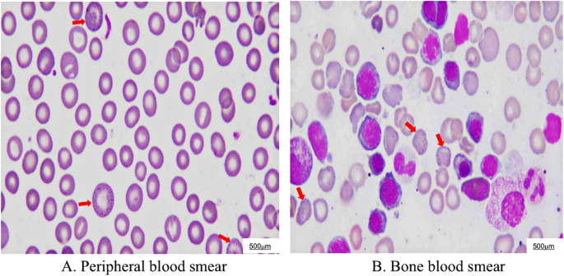
Manifestations :-
1) Hypochromic Anaemia with punctate Basophilia, i.e. red cells show dark blue spots are due to metabolic products of porphyrin (anaemia is due to impairment in the synthesis of heme from protopophyrin and of porphobilinogen from aminolaevulinic acid. Basophilic stippling is due to condensation of iron containing ribonucleic acid near the mitochondria).
Other effects on RBC: a) Defective haemoglobin formation
b) Increased fragility of RBC.
c) Reduced life span of RBC
Other features seen on peripheral smear examination
a) Reticulocytosis
b) Decreased platelets.
c) Increased monocytes.
d) Anisocytosis
e) Poikilocytosis
Lead value in blood is more than 0.8 mg% (Normal is 0.03 mg %)

Slide 15
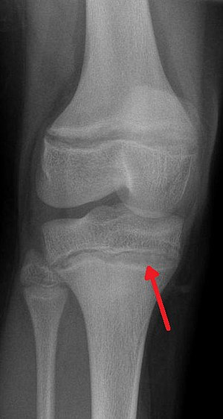
2) Arthralga is involving large joints eg.shoulder, elbow and knee.
3) Bones :- X-ray of long bones shows lead lines, which are bands of increased density
4) Colic and Constipation. (also known as dry-belly ache) it affects intestines,uterus, ureters, and blood vessels.
The colic is intermittent, spasmodic and relieved by pressure and is associated with constipation.
5) Candiorenal manifestations:-
A) Cardiac: Increased B. P.,arterio sclerotic changes.
B) Renal: Presence of albumin, lead and coproporphyrin -3 in urine,Nephritis.
An X-ray demonstrating the characteristic finding of lead poisoning in humans—dense metaphyseal lines.

Slide 16
6) Delirium
7) Paralysis (lead palsy), It affects the extensors of fingers, wrist and foot leading to:a)Wrist Drop and claw shaped fingers.b) Foot Drop
8) Encephalopathy :- Usually seen in children. Headache, loss of concentration and memory, insomnia, optic neuritis, peripheral neuritis, convulsions, hallucinations, insanity and coma.
9) Eye changes :- Retinal stippling and optic atrophy.
10) Facial pallor :- due to vasospasm, specially around the mouth.
11) Lead :- line on Gums- a blue line (Burtonian line) is seen at the junction of gums and teeth-especially on upper jaw, is more prominent, when teeth are dirty (because H2S liberated from food particles combines with lead to form Lead sulphide - producing blue line). It disappears if teeth are kept clean. (Sometimes lines are black or grey).
(Blue line is also seen in Mercury, Copper, Silver, Iron, Bismuth and Thallium poisoning)

Slide 18
12) Reproductive System (Genital) Manifestations :-
a) May produce sterility.
b) Degenerate offsprings.
c) May cause abortion.
d) May cause death of foetus.
e) Menstrual disturbances - amenorrhoea, dysmenorrhoea, menorrhagia.
13) General Manifestations:-
Weakness, anorexia, foul breath, dyspepsia, irritability and pain in joints.
14) Hair - may be alopecia.

Slide 20
MEDICOLEGAL ASPECTS
1) Use of lead for suicide and homicide is very rare.
2) Sometimes used as cattle poison and to procure abortion.
3) Poisoning is mainly accidental and is usually chronic.

