Slide 1
ADULT DACRYOCYSTITIS
Adult dacryocystitis may occur in an acute or a
chronic form.

Slide 2
CHRONIC DACRYOCYSTITIS
more common

Slide 3
Etiology
Age 40 to 60
Sex more in female (comparatively narrow lumen of the bony canal.)
Race rarer among Negroes than in Whites
Hereditary due to facial configuration
Socioeconomic common in low socioeconomic
Poor personal hygiene

Slide 4
Anatomical factors,
Foreign bodies
Excessive lacrimation,
Mild grade inflammation of lacrimal sac due to associated recurrent conjunctivitis
Obstruction of lower end of the NLD
Source of infection.
Causative organisms. These include: staphylococci, pneumococci, streptococci and Pseudomonas pyocyanea. Rarely chronic granulomatous infections like tuberculosis, syphilis, leprosy and occasionally rhinosporiodosis may also cause dacryocystitis.

Slide 5
Clinical picture (4 stages )
Stage of chronic catarrhal dacryocystitis
Stage of lacrimal mucocoele
Stage of chronic suppurative dacryocystitis.
Stage of chronic fibrotic sac.

Slide 6
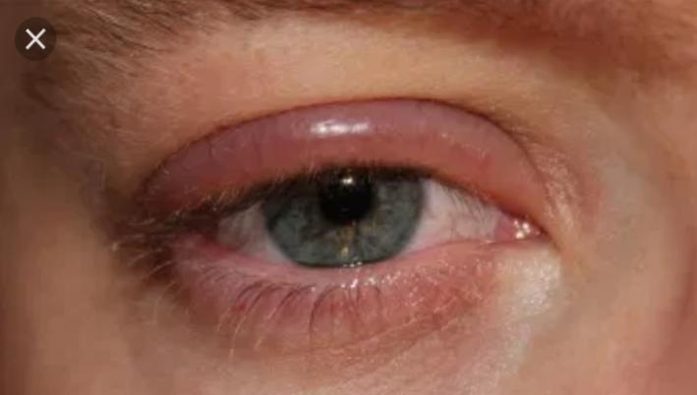
Stage of Chronic catarrahal dacryocystitis
mild inflammation of the lacrimal sac associated with blockage of NLD
Only watering and some time redness at inner canthus area
On syringing clear saline water or some flakes stain discharge come from punctum
Choice of investigations Dacryocystography

Slide 7
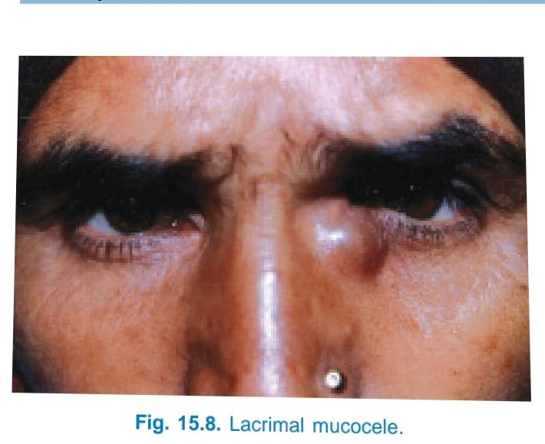
Stage of lacrimal mucocoele
distension of lacrimal sac.
constant epiphora associated with a swelling just below the inner canthus

Slide 8
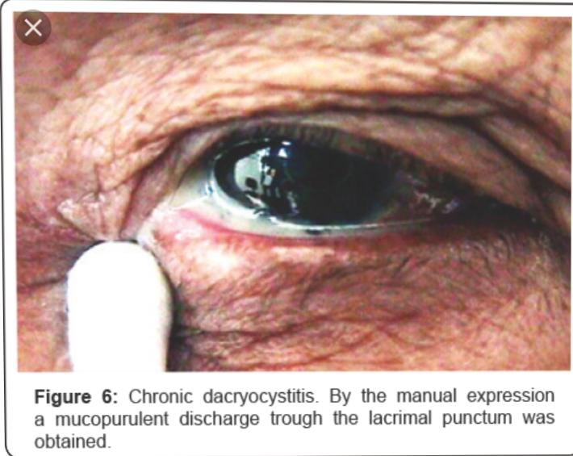
Stage of chronic suppurative Dacryocystitis
mucoid discharge becomes purulent, converting the mucocele into
pyocoele

Slide 9
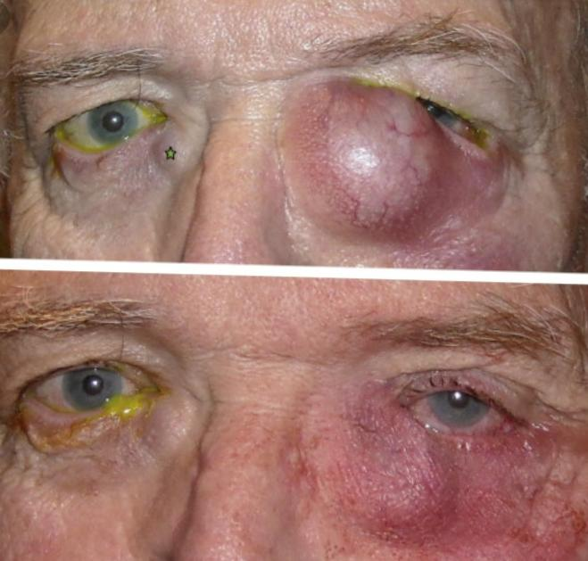
Stage of chronic fibrotic sac
a small fibrotic sac due to thickening of mucosa, which is often associated with persistent epiphora and discharge

Slide 10
Complications
Chronic intractable conjunctivitis, acute on chronic dacryocystitis.
Ectropion of lower lid, maceration and eczema of lower lid skin due to prolonged watering.
Simple corneal abrasions may become infected leading to hypopyon ulcer.
If an intraocular surgery is performed in the presence of dacryocystitis, there is high risk of developing endophthalmitis. Because of this,syringing of lacrimal sac is always done before attempting any intraocular surgery.

Slide 11
Treatment
1. Conservative treatment sac syringing for only recent cases only
Dacryocystorhinostomy (DCR) with pre antibiotics coverage
(CDCR)

Slide 12
Dacryocystectomy (DCT) contraindicated. Indications of
DCT include: (i) Too young (less than 4 years) or too
old (more than 60 years) patient. (ii) Markedly
shrunken and fibrosed sac. (iii) Tuberculosis, syphilis,
leprosy or mycotic infections of sac. (iv) Tumours of
sac. (v) Gross nasal diseases like atrophic rhinitis (vi)
An unskilled surgeon, because it is said that, a good
‘DCT’ is always better than a badly done ‘DCR’

Slide 13
Conjunctivodacryocystorhinostomy(CDCR)

Slide 14
Acute Dacryocystitis
Acute dacryocystitis is an acute suppurative
inflammation of the lacrimal sac, characterised by
presence of a painful swelling in the region of sac

Slide 15
Etiology
As an acute exacerbation of chronic dacryo-
cystitits.
As an acute peridacryocystitis due to direct
involvement from the neighbouring infected
structures such as: paranasal sinuses, surrounding
bones and dental abscess or caries teeth in the
upper jaw.
Causative organisms. Commonly involved are
Streptococcus haemolyticus, Pneumococcus and
Staphylococcus.

Slide 16
Clinical picture 3 stages
Stage of cellulitis. Painful swelling on sac area with fever and Malaise

Slide 17
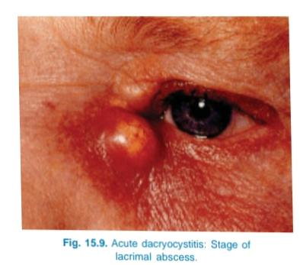
Stage of lacrimal abscess

Slide 18
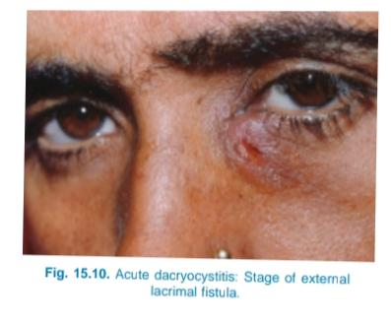
Stage of fistula formation

Slide 19
Complications
These include:
Acute conjunctivitis,
Corneal abraision which may be converted to
corneal ulceration,
Lid abscess,
Osteomyelitis of lacrimal bone,
Orbital cellulitis,
Facial cellulitis and acute ethmoiditis.
Rarely cavernous sinus thrombosis and very
rarely generalized septicaemia may also develop

Slide 20
SURGICAL TECHNIQUE OF
DACRYOCYSTORHINOSTOMY
Dacryocystorhinostomy (DCR) operation can be
performed by two techniques:
Conventional external approach DCR, and
Endonasal DCR

Slide 21
Conventional external DCR
Anaesthesia.
Skin incision.
Exposure of medial palpebral ligament (MPL) and Anterior lacrimal crest.
Dissection of lacrimal sac.
Exposure of nasal mucosa.
Preparation of flaps of sac.
Fashioning of nasal mucosal flaps.
Suturing of flaps
Closure.

Slide 22
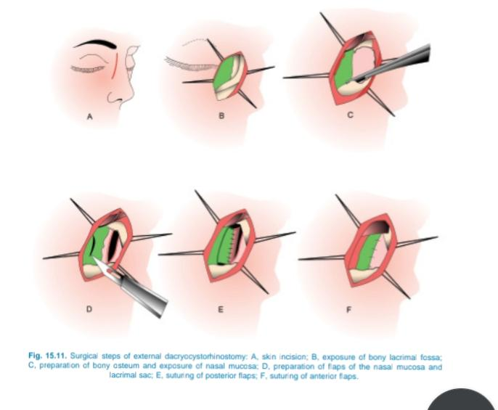

Slide 23
Endonasal DCR
Preparation and anaesthesia.
Identification of sac area.
Creation of opening in the nasal mucosa, bones forming the lacrimal fossa and posteromedial wall of sac
Stenting of rhinostomy opening
Postoperative care and removal of sialistic lacrimal stents.

Slide 24
