Slide 1
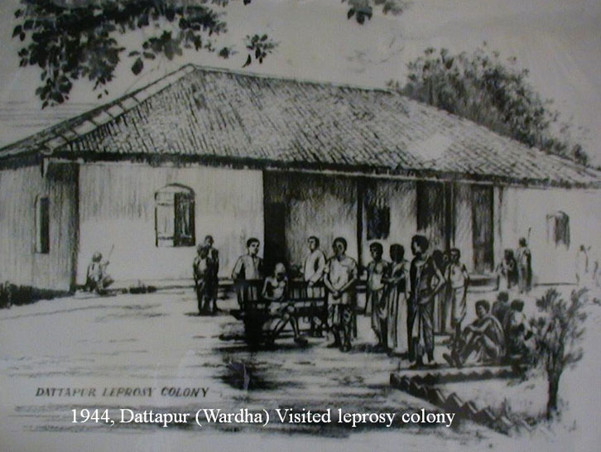
NATIONAL LEPROSY ERADICATION PROGRAMME(NLEP)
By
Drjyoti k. varthi
Dept. of Swasthavritta

Slide 2
Leprosy (Hansen's Disease)
It is a chronic infectious disease caused by M. leprae.
It affects mainly the peripheral nerves and skin, muscles, eyes, bones, testes and internal organs.
Cardinal features :-
Hypo pigmented patches
Partial or total loss of cutaneous sensation in the affected area.
Presence of thickened nerves.
Presence of Acid fast bacilli in the skin or nasal smear.

Slide 4
Component of Programme-
Decentralized integrated leprosy service through general heath care system.
Capacity building of all general health services functionaries.
Intensified information, education and communication.
Prevention of disability and medical rehabilitation
Intensified monitoring and supervision.

Slide 5
Major Initiative
More focus has now been given to new case detection than prevalence .
Treatment completion rate has been taken as important Indicator.
More emphasis is being given on providing prevention and medical rehabilitation (DPMR) services to leprosy affected person.

Slide 6
Cont.
Aid provided as follows-
Dressing material, supportive medicines and ulcer kits.
Micro-cellular rubber footwear
41 NGO and 42 govt. medical college have been strengthened for providing reconstructive surgery services.
An incentive of 5,000/- is provided to leprosy affected person from BPL family undergoing reconstructive surgery.

Slide 7
Cont.
It includes
Early reporting of cases and their treatment completion.
Reduction of stigma and discrimination against leprosy affected person.
Awareness generation activities.
Provision of quality leprosy service.

Slide 8
Urban Leprosy Control Programme
Initiated in 2005.
Assistance is provided to urban areas having population size >1 lakh.
For graded assistance, urban area are grouped into 4 categories
Township 1
Medium cities-1
Medium cities-2
Mega cities

Slide 9
Disability Prevention and Medical Rehabilitation(DPMR)
Main activity-
Implementation of DPMR activities as per guidelines and reporting its outcome.
e.g. Treatment of Leprosy reaction, Ulcer, Physiotherapy,
Reconstructive surgery and providing MCR footwear.
Integrating DPMR services –Convergence of NLEP services into NRHM facilitates this integration.
To develop a referral system to provide prevention of disability services to all leprosy affected person in an integrated set up.

Slide 10
This service are planned to carried out in three tier system-
Primary Level Care (First level )-PHC, CHC, Sub-divisional hospital, Urban Leprosy Center.
Secondary Level Care (Second level)- District Head Quarter, hospital and District Nucleus Unit.
Tertiary Level Care (Third level) - Institutes are-
Agra, Chennai, Aska, Raipur, Gouripur

Slide 11
Programme Implementation Plan for 12th Plan Period (2012-13 to 2016-17)
Objectives-
Elimination of leprosy i.e. Prevalence of
<1 case/10,000 population in all district of the
country.
Strengthen disability prevention and medical rehabilitation of persons affected by leprosy.
Reduction in the level of stigma associated with leprosy.

Slide 12
Programme strategy
Integrated leprosy services through general health care system.
Early detection and complete treatment of new leprosy cases.
Carrying out house-hold contact survey for early detection of cases.
Involvement of ASHA worker in detection and completion of treatment of leprosy cases on time.

Slide 13
Cont.
5. Strengthening of disability prevention and
medical rehabilitation(DPMR) services.
6. Information, Education and Communication(IEC)
activities in the community to improve self
reporting to PHC and reduction of stigma.
7. Intensive monitoring and suppression at block
primary health care center/community health
center.

Slide 14
Multi bacillary Leprosy

Slide 15
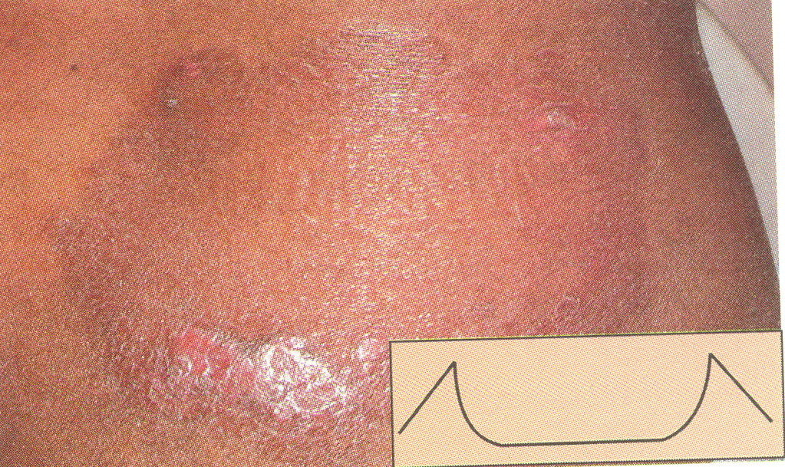
Pauci bacillary Leprosy

Slide 16
CONTROL OF LEPROSY
The Minimum requirement for all leprosy control programme are
Medical Measures
Estimation of the problem
Early case detection
Multidrug therapy
Surveillance
Immunoprophylaxis
Chemoprophylaxis
Deformities rehabilitation
Health education

Slide 17
CONTROL OF LEPROSY
Social Support
Programme Management
Evaluation

Slide 18
Medical Measures
Estimation of the problem
The first step in leprosy control is to find out the size of the problem or disease load in the community by means of epidemiological surveys.
e.g. Random survey like examination of all school age children etc.

Slide 19
Early case detection
Case finding by
Contact survey-
In areas where prevalence rate is less than 1 case/1000 population
e.g. Household contacts, especially children & person reported to be suspected cases

Slide 20
Group Survey:-
Where prevalence rate is 1/1000 population e.g. Screening of preschool & school children, people living in slums, military recruits, industrial labour & other selected group for all types of skin diseases.
Mass Survey:- Prevalence rate is about 10 or more than 10/1000 population e.g. total population survey

Slide 21
MULTIDRUG THEROPY
In MDT only bactericidal drug are used e.g.
Rifampicin single dose of 150 mg or 600 mg TDS
Dapsone (DDS) 1-2 mg/kg body wt. or 50mg daily
Clofazimine (CLF)
Ethionamide } kills 98% bacilli in 4-5 days
Protionamide }

Slide 23
FOR MULTIBACILLARY CASES
Rifampicin :- 600 mg once monthly given under supervision
Dapsone :- 100 mg daily self administered
Clofazimine :- 300 mg once monthly supervised or 50 mg daily self administered.

Slide 24
FOR PAUCIBACILLARY CASES
Rifampicin :- 600 mg once a month for 6 months supervised.
Dapsone :- 100 mg daily for 6 months, self administered.

Slide 25
SURVEILLANCE
Paucibacillary leprosy :- Cases should be examined at least once a yr for minimum 2 yrs after completion of treatment.
Multibacillary leprosy :- Cases should be examined at least once a yr for minimum period of 5 yrs after completion of treatment.

Slide 26
IMMUNOPROPHYLAXIS
It is considered that BCG provide some protection against clinical leprosy

Slide 27
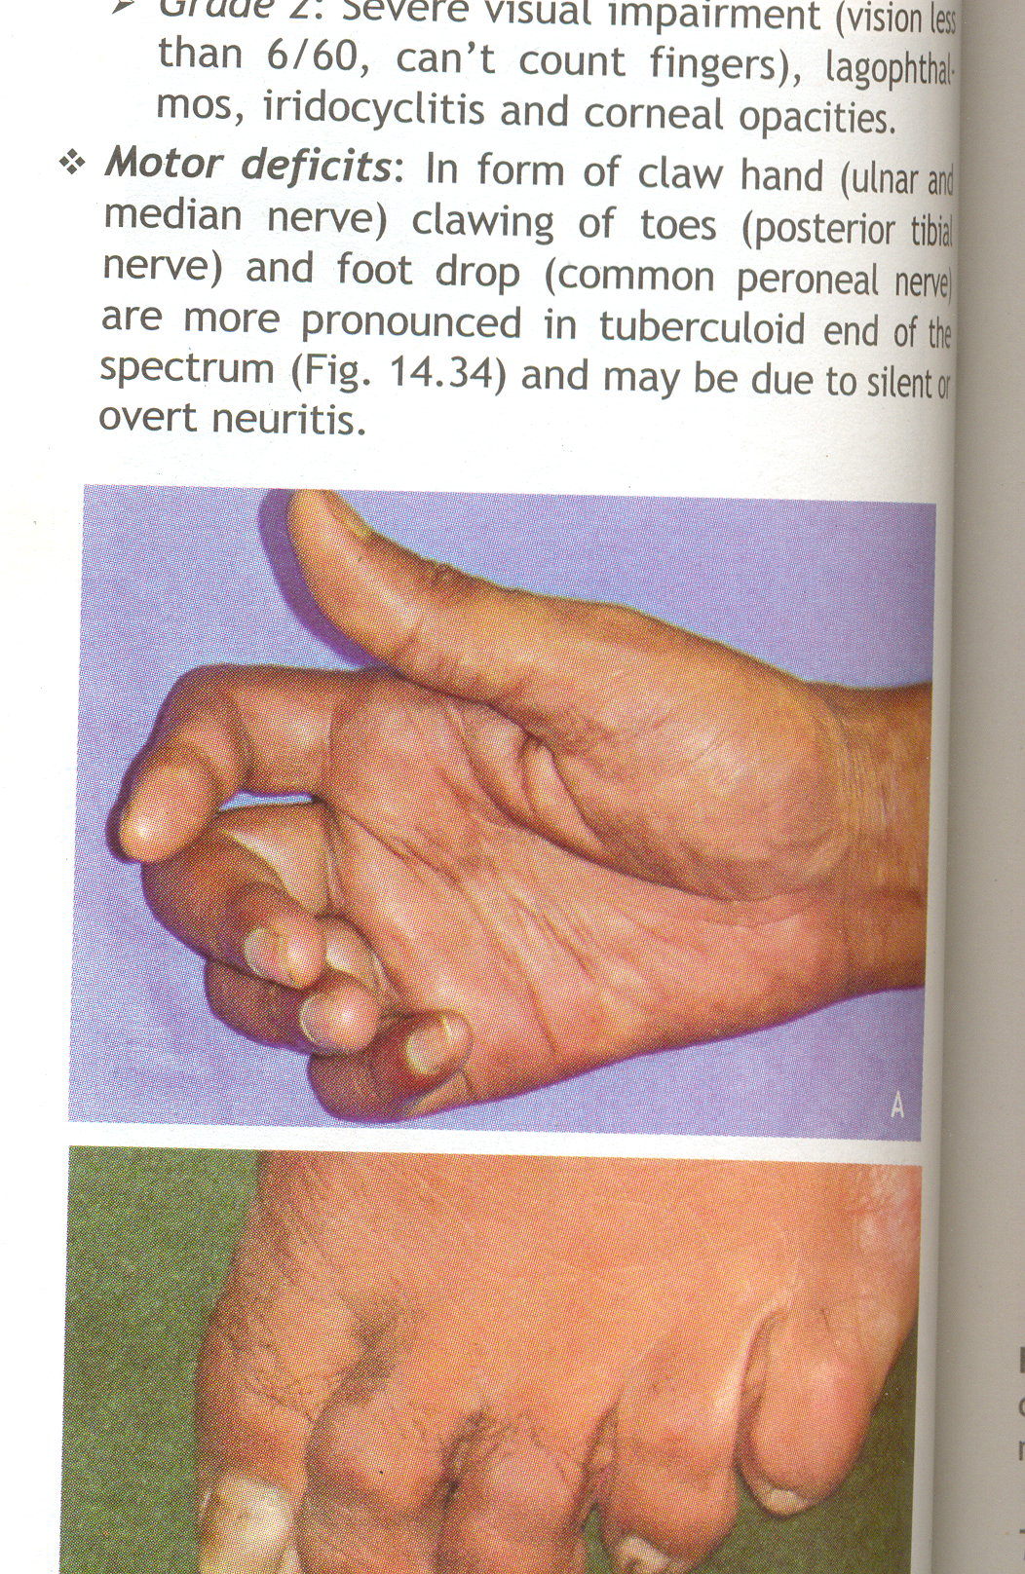
Deformities and Rehabilitation

Slide 28
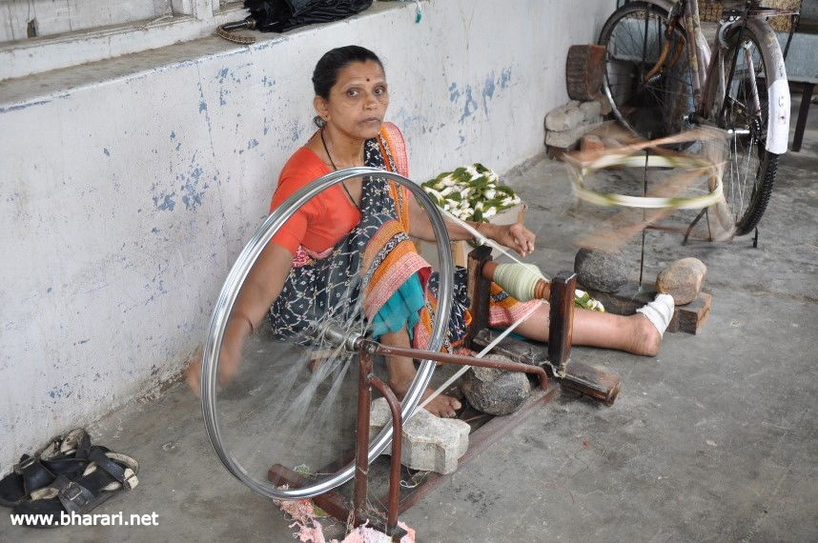
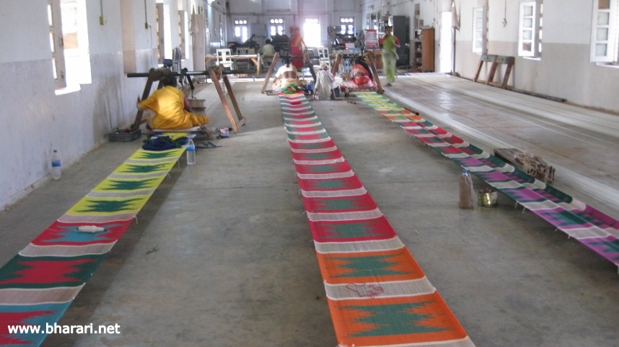
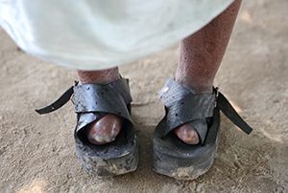
Rehabilitation

Slide 29
vk;qosZnh; fopkj
’kks/ku %
i{kkr~ oeu
eklkr~~ fojspu
6 eklkr~~ jDreks{k.k
jksi.k
jksi.k rSy %
pkyeksxjk rSy
egkejhP;kfn rSy
777 oil
’keu
egkeaft"Bkfn dk<k
xa/kd jlk;u
vkjksX;of/kZuh oVh
[kfnjkfj"V

