Slide 1
The Oesophagus and Diseases

Slide 2
Surgical anatomy
The oesophagus is a muscular tube, approximately 25 cm long, mainly occupying the posterior mediastinum and extending from the upper oesophageal sphincter (the cricopharyngeus muscle) in the neck to the junction with the cardia of the stomach.
Cricooesophageal Junction lies at the C6/T1 vertibra level & Cardio-oesophageal junction lies to the left of T11 vertebra. It is identified at endoscopy by a Z-line (A jagged line where the oesophageal mucosa changes to gastric mucosa). It is lined throughout with squamous epithelium, lower end (last 3 cm) with coloumnar epithelium. Mucosa is the toughest coat of oesophagus.
The musculature of the upper oesophagus, including the upper sphincter, is striated. This is followed by a transitional zone of both striated and smooth muscle with the proportion of the latter progressively increasing so that, in the lower half of the oesophagus, there is only smooth muscle.
Collar of Helvitius: It is the site at which the circular muscles of oesophagus turns to oblique muscles of the stomach at the incisura.

Slide 3
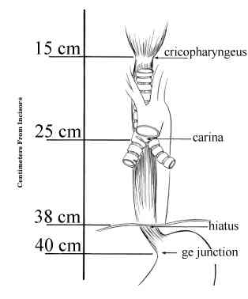
The parasympathetic nerve supply is mediated by branches of the vagus nerve that has synaptic connections to the myenteric (Auerbach’s) plexus. Meissner’s submucosal plexus is sparse in the oesophagus.
The upper sphincter consists of powerful striated muscle. The lower sphincter is more subtle and created by the asymmetrical arrangement of muscle fibres in the distal oesophageal wall just above the oesophagogastric junction.
It is helpful to remember the distances 15, 25 and 40 cm for anatomical location during endoscopy
Physiological constrictions
Constrictions Distance from incisor teeth Diameter of oesophagus Problems
I. Cricopharyngeal 15 cm 14mm Foreign body lodgement
2. Aortic and bronchial 25 cm 15-17 mm Perforations during endoscopy
3. Diaphragmatic sphincter 40cm 16--19 mm Malignancy

Slide 4
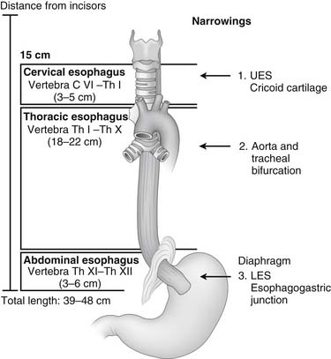
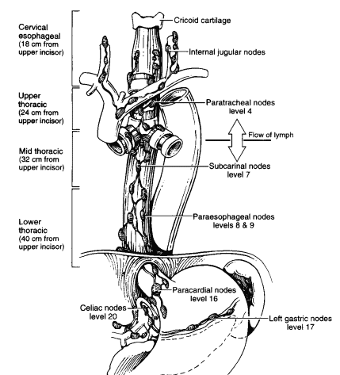
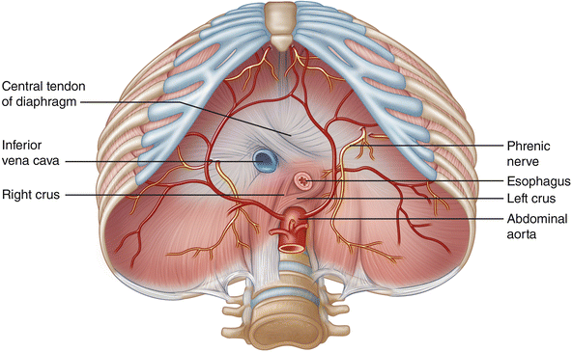
Muscle layers
Oesophagus has four coats from outside in wards—
fibrous coat,
(ii) muscular coat,
(iii) areolar or submucous coat and
(iv) mucous coat. Oesophagus does not possess a serous coat like other abdominal viscera.
• Inner circular layer and an outer longitudinal layer.
• Upper 1/3rd has striated muscle fibres.
• Lower 2/3rd has smooth muscle fibres.

Slide 5
Lymphatic drainage
• Upper oesophagus drains into the left and right supraclavicular nodes. • Middle oesophagus drains into the tracheobronchial nodes and paraoesophageal nodes. • Lower oesophagus drains into lymph nodes along the lesser curvature of stomach and then into coeliac nodes. Involvement of coeliac nodes indicate inoperability.
Nerve supply
The parasympathetic nerve supply is by vagus nerve through extrinsic and intrinsic plexuses. The intrinsic plexus has no Meissner's network and Auerbach's plexus is present only in the lower two-thirds.
Blood Supply
Arterial • Cervical oesophagus: Mainly from branches of the inferior thyroid artery. • Upper thoracic oesophagus: Mainly from branches of the inferior thyroid artery and less consistently from anterior oesophagoh·acheal branch from aorta. • Mid and lower thoracic oesophagus: Supplied by bronchial arteries.

Slide 6
• Lower oesophagus: Small branches of the left gastric artery. Rich internal arterial anastomosis is present in the oesophagus and in the stomach. Hence, extensive mobilisation of oesophagus can be done without compromising viability.
Venous drainage : Veins accompany corresponding arteries. Importantly, thoracic oesophagus drains into azygos and hemiazygos veins.
PHYSIOLOGY
The main function of the oesophagus is to propel ingested material from the pharynx to the stomach.
The two physiological sphincters — one at the upper end (upper oesophageal sphincter) and one at the lower end (lower oesophageal sphincter) contract and relax in such a harmony that the ingested material without any obstruction moves towards the stomach. The upper oesophageal sphincter (UES) is normally closed with its excessive tone and thus does not allow entry of air into the oesophagus during each inspiration. But as soon as the swallowed material reaches the pharynx the upper oesophageal sphincter opens up temporarily to allow the swallowed bolus of food to pass into the oesophagus. This is followed by a postdeglutitive contraction. The upper oesophageal sphincter is about 3 cm in length and the mean resting pressure within it is about 40 mmHg.

Slide 7
During swallowing it relaxes only for a second and then is closed down for postdeglutitive constriction which lasts for 4 seconds and the pressure within it increases to 80 to 100 mmHg. Thus the bolus of food enters the oesophagus and a primary peristaltic wave is thus initiated.
As the oesophagus is within the thorax, due to the negative intrathoracic pressure its intraluminal pressure ranges from -5 mmHg (during inspiration) to +5 mmHg (during expiration). But when the peristaltic wave reaches a particular part of oesophagus the intraluminal pressure in that area increases to about 25 mmHg. The lower oesophageal sphincter (LES or LOS) also remains closed during rest to prevent reflux of gastric contents into the oesophagus. The normal resting pressure within LOS is about 20 mmHg. This pressure is abnormally low in patient who is suffering from reflux oesophagitis.
The LOS only relaxes during swallowing and when the peristaltic wave reaches it. It must be confessed that LOS is not the only thing which prevents gastro-oesophageal reflux. The other factors which importantly contribute in preventing gastro- oesophageal reflux are—(a) oblique angle of entry of oesophagus (Angle of HIS) (b) mucosal folds at the lower end of the oesophagus, (c) the diaphragm and (d) the valve-flat mechanism

Slide 8
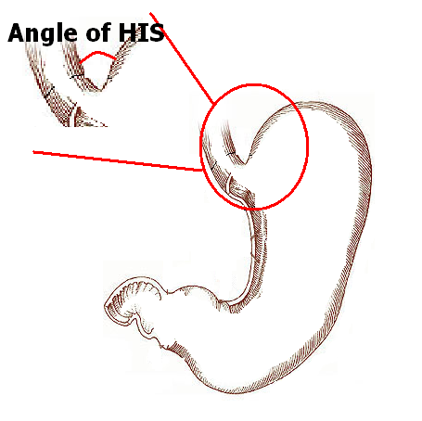
The basal sphincter pressure of LOS is due to tonic myogenic activity and not due to autonomic neural activity. LOS is also controlled by neural and hormonal influences. The sphincter relaxation is chiefly due to vagal activity. A few factors influence in lowering LOS basal tone. These are excessive ingestion of alcohol, smoking, atropine, beta-adrenergic agents, pregnancy (effect of excessive progesterone) etc. The LOS basal tone can be enhanced by drugs such as metoclopramide, bethanecol (Cholinergic), glucagon, gastrin and gastric neutralisation. When the intragastric pressure increases the normal resting tone of LOS is also increased. This response is due to vagal activity and can be abolished by vagotomy. This is the most essential feature of a component LOS to prevent gastro- oesophageal reflux.

Slide 9
GERD/GORD
Loss of competence of LOS leads to gastro-oesophageal reflux disease (GORD). The competence of LOS can be affected by obesity, smoking, excessive eating, etc. Sliding hernia is associated with GORD.
As a result of reflux of gastric acid, extensive inflammation of the lower oesophagus occurs which results in various forms of oesophagitis.
Types:
1. Acute: Following alcohol, bums, stress.
2. Chronic: It is associated with hiatus hernia or following oesophagojejunostomy.

Slide 10
It is mainly precipitated by:
1. Structurally defective LOS secondary to inflammatory injury.
2. Inadequate abdominal length (short length) of oesophagus precipitates a reflux when gastric distension occurs.
3. Ineffective oesophageal pump affecting clearance of food into stomach. This is influenced by following factors: • Gravity • Oesophageal motility •
4. Increased gastric pressure: Can occur due to pyloric stenosis and diabetic gastroparesis. Following vagotomy, loss of receptive relaxation occurs resulting in increased intragastric pressure.

Slide 11
Aetiopathogenesis:
Acid refluxes into the lower oesophagus and produces diffuse inflammation with multiple ulcers. The symptoms are worse when the patient lies down.
Due to vagal hyperactivity, inflammation and ulcers develop which produce severe longitudinal muscle spasm. Consequently, the cardia is drawn up into the thorax, leading to an increase in the oesophago-cardiac angle. This increases the reflux. Later, fibrosis causes shortening of the oesophagus.
Thus, it becomes a vicious circle of oesophagitis-longitudinal muscle spasm-displacement of oesophagusincreased regurgitation.

Slide 12
Clinical features:
Most common presentation of GORD is history of dysphagia, heart bum and regurgitation. Heartburn is confined to epigastrium and retrosternal areas, does not radiate to the back.
Retrosternal pain: It is burning in nature and becomes worse on lying down. The pain reduces in the sitting position. The pain is described as heart burn and can be confused for angina pectoris. It is relieved on taking antacids.
Heart burn is otherwise called pyrosis. Occult blood in stools and streaks of blood in the vomitus are common.
Anaemia and weakness are uncommon features.
Dysphagia: Transient difficulty in swallowing results from spasm due to inflammation of the lower end of oesophagus. Late dysphagia is due to stenosis or stricture of the oesophagus. Belching is not uncommon.

Slide 13
Modified Savary Millier classification of reflux oesophagitis
Grade I: Single or isolated erosion at or above GE junction
Grade II: Multiple non-circumferential erosions above GE junction
Grade III: Circumferential erosions above GE junction
Grade IV: Chronic lesion-stricture, ulceration/short oesophagus
Grade V: Columnar epithelium in continuity with Z line (Barrett's oesophagus)
Investigations:
Barium swallow' in the Trendelenburg's position (head down position) can demonstrate the reverse flow of barium into the lower end of the oesophagus (from the stomach).
Oesophagoscopy may reveal red, angry looking mucosa in the lower end of the oesophagus.
Oesophageal manometry to detect motility disorders.
24-hour pH monitoring is the gold standard.

Slide 14
Medical management:
Lifestyle modification • Stop smoking • Stop alcohol • Control obesity • Avoid coffee, chocolate and coke • Head up-propped-up position • Avoid stooping • Avoid tight garments .
Drugs • Antacids • Proton pump inhibitors: Pantoprazole 40 mg, esomeprazole till 20 mg may have to be given for one or two months or full symptoms are controlled. These are antisecretory drugs. • Prokinetics: ltopride 50 mg can be given 2-3 times a day for 8 weeks on empty stomach. Prokinetics enhance motility. Cisapride and mosapride are not favoured because they can cause cardiac arrhythmias.
Mucosa protective agents • Sucralfate colloidal bismuth---cytoprotective agent. • It is a sucrose sulfate-aluminium complex which binds to the mucosa. Thus it protects mucosa of GI tract against hydrochloric acid. • Colloidal bismuth compounds.
Endotherapy • Endoscopic plication/suturing • Enteryx injection • Plexiglass microspheres (PMMA): Through an endoscopic needle, microspheres suspended in gelatin are injected. Gelatin is absorbed and spheres cause tissue bulking.

Slide 15
Surgery:
Indication 1. Intractable pain 2. Complications such as haemorrhage or stricture
Types of surgery:
Three types of anti-reflux operation are commonly practiced. These are — (1) Nissen fundoplication, (2) Belsey Mark IV operation and (3) Hill posterior gastropexy and calibration of the cardia.
Nissen's total fundoplication : The aim is to restore 2-4 cm of intra-abdominal oesophagus by reducing the hernia, followed by repair of the hiatus.
A vertical midline incision is made to enter the abdomen.
The oesophageal hiatus is now explored and the size of the hernia, if at all present, is assessed.
The triangular ligament of the left lobe of the liver is divided and it is retracted to the right.
Traction on the stomach is made to reduce the hernia and to facilitate division of phreno-oesophageal ligaments which constitute the sac of the hernia.
A rubber sling is used to pull down the mobilised oesophagus. If there is a good gap in the oesophageal hiatus, this should be repaired anterior or posteriorly with non-absorbable material.

Slide 16
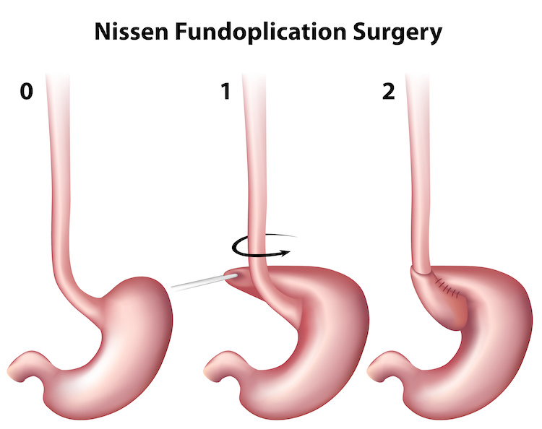
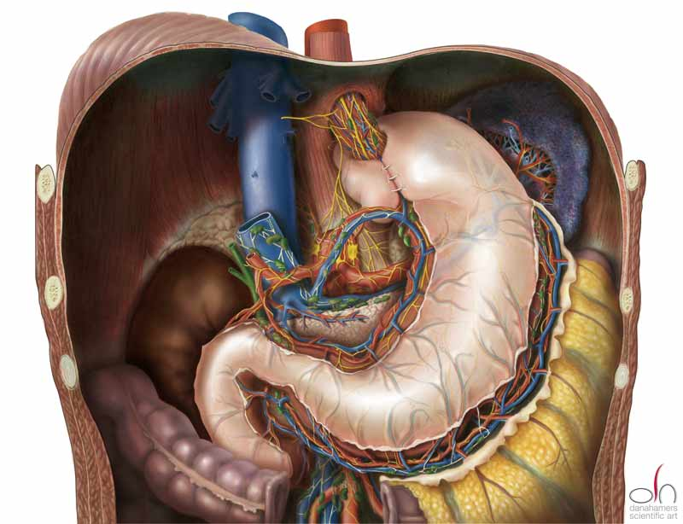
Both the vagi nerves are preserved.
Fundus of the stomach is mobilised by dividing short gastric arteries. Fundus is brought behind the oesophagus and wrapped in front of oesophagus and sutured. Sutures are placed through the anterior fundus, the wall of the oesophagus. It is a loose wrap (Floppy Nissen's).
This technique involves full 360° plication of stomach around the oesophagus and causes a higher intraluminal pressure in the abdominal oesophagus which is the sole objective of anti-reflux operation.
Mortality and morbidity should be minimised.

Slide 17
Laparoscopic fundoplication:
• Most popular today • Minimal morbidity and mortality • Early discharge, within 1-2 days • Early recovery All operative steps that are performed in open surgery are carried out here with a 'better vision' in laparoscopic method. 360° gastric fundoplication should be no longer than 2 cm. • It should be constructed over a 60 F bougie. Principles of fundoplication are same as in Nissens Total fundoplication.
• Complications: • Too tight a plication may result in dysphagia or gas bloat syndrome wherein belching is prevented.
Partial fundoplication - Toupet solves the above problem wherein fundus is sutured around the back of oesophagus (2-3cm , 270° posterior fundoplication) or Dorr's/Watson , where fundus is sutured anterior to the oesophagus (180°).
2. Belsey Mark IV operation • There are 3 layers of sutures to be placed in this operation via a thoracotomy through the 6th intercostal space. The oesophagus is mobilised above upto the aortic arch to allow a sufficient long intraabdominal oesophagus. The cardia is freed from attachments to the diaphragm.

Slide 18
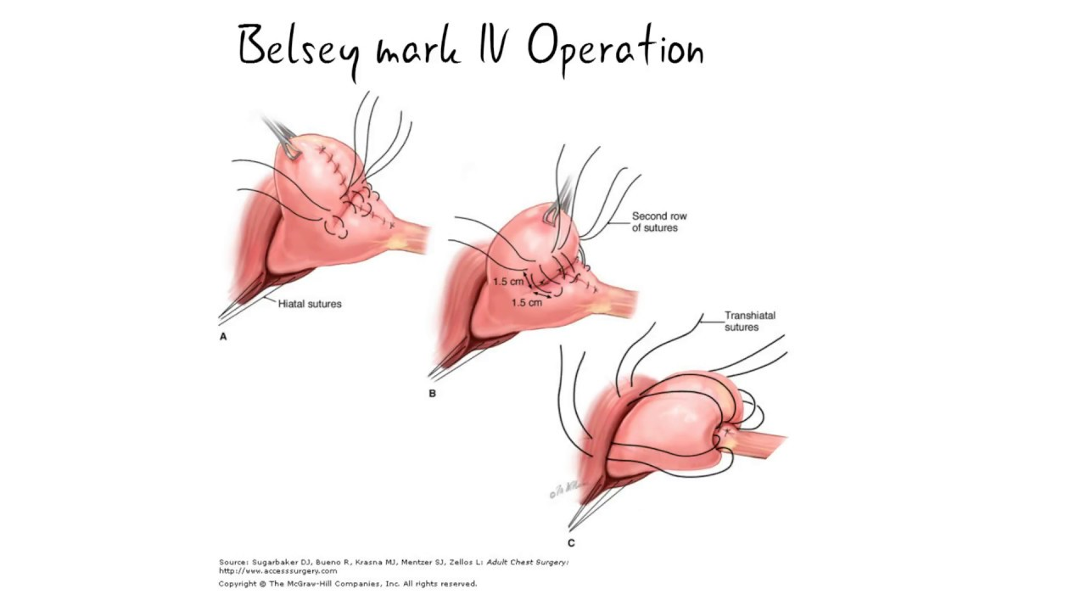
• First row: Four interrupted silk mattress sutures are placed between the anterior surface of the oesophagus and adjacent fundus of the stomach so as to wrap the stomach around the anterior two-thirds of the oesophagus along its lower 3 to 5 cm. The posterior segment of the oesophagus is not included in the wrap.
• Second row: Sutures are placed between oesophago-gastric junction and under surface of the diaphragm to maintain the junction below the diaphragm.
• Third row: Posterior crural sutures are placed to tighten the opening.

Slide 19
4. Hill's repair:
The main intention of this procedure is to narrow the abdominal oesophagus and thus increasing the intraluminal pressure of the distal oesophagus. The operation is done through an abdominal approach.
The oesophagus is mobilised extensively through the hiatus, a rubber sling is used to pull the abdominal part of the oesophagus down. The opening of the hiatus is narrowed by inserting sutures anterior to the oesophagus, so that only one finger can be passed between the oesophagus and the hiatal margin.
The gastro-oesophageal junction is anchored to the arcuate ligament.
Now the stomach is wrapped around the entrance of the oesophagus into stomach by placing sutures on both anterior and posterior aspects of the gastro-oesophageal junction. These sutures are also passed through the median arcuate ligament for posterior gastropexy.

Slide 20
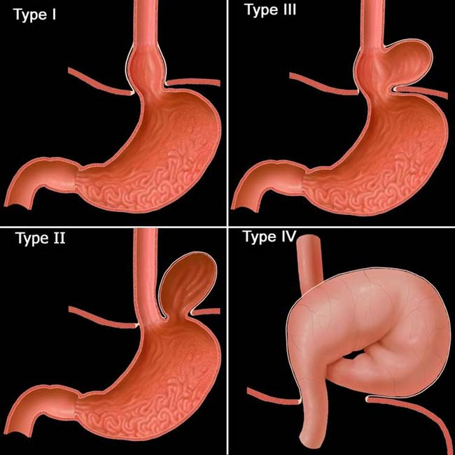
HIATUS HERNIA
Definition: Abnormal protrusion of abdominal viscus through the oesophageal hiatus into the chest.
Sliding hernia or Oesophagogastric hernia: It is the commonest type of hiatus hernia, about 80% of cases. It may be associated with GORD.
Rolling or para-oesophageal hernia
Mixed hernia
Massive herniation
Common symptoms
Symptoms due to reflux: Regurgitation and heart burn
are the two most common symptoms.
Symptoms due to complications: They are dysphagia, odynophagia, haematemesis and melaena.
Nonoesophageal symptoms: They are asthma and chest pam.

Slide 21
SLIDING HERNIA:
Anatomical factors which prevent sliding hernia
1. Presence of 2 cm of intra-abdominal oesophagus.
2. The angle of His: The oesophago-cardiac angle of about 45° has valvular effect.
3. Mucosal folds at the oesophago-cardiac junction.
4. Positive intra-abdominal pressure which closes the abdominal oesophagus.
5. Lower oesophageal sphincter (LOS): It is a functional sphincter which increases the pressure during coughing, straining, etc.
Causes of sliding hernia:
1. Deposition of fatty tissue in the hiatus leads to weakening of the hiatus in obese individuals.
2. Advancing age resulting in muscular degeneration can predispose to hernia.
3. Raised intra-abdominal pressure due to lower abdominal tumours, pregnancy, etc.
4. Saint's triad: Gall stones, diverticulosis and hiatus hernia can occur together in a patient.

Slide 22
Clinical features:
Sliding hernia produces symptoms like reflux oesophagitis. • More common in women, especially if obese.
Investigations:
• Oesophagoscopy reveals varying degree of inflammation. During oesophagoscopy, when the patient is asked to strain (Valsalva's manoeuvre), the sphincter is seen to be more patulous and herniation of gastric mucosal folds can be seen. Reflux of the gastric acid is the most valuable sign.
• Barium meal demonstrates gastro-oesophageal reflux in the Trendelenburg position.
Treatment:
1. Conservative treatment: Lifestyle changes, Decrease in weight, Diet control with increased intake of proteins anc decreased consumption of fat and sugar. • Decreased alcohol and tobacco consumption.

Slide 23
2. Oesophageal mucosa protection • Antacids: Preparations containing alginates, cytopro· tective agents. • H2 blockers: Ranitidine. • Proton pump inhibitors: Omeprazole or esomeprazole.
3. Reflux prevention • Oesophageal reflux: Cisapride, metoclopramide • Gastric reflux: Domperidone, metoclopramide, cisapride.
4. Surgery: Same as for GERD.
ROLLING HERNIA: In this condition, cardio-oesophageal junction is normal. Greater curvature of the stomach ascends into a preformed sac in the mediastinum. Thus, there are no features of reflux oesophagitis but the sac containing stomach in the thorax causes compression of the heart and lung.
Clinical features: No retrosternal burning pain because no reflux • Discomfort after a small meal • Feeling of fullness after a meal or dysphagia due to large sac • Palpitations due to compression on the heart • Respiratory tract infection and hiccough due to irritation of phrenic nerve.
Investigation: Barium meal shows the sac in the thorax containing stomach. Sometimes, it can be upside down.

Slide 24
Treatment:
Reduction of the sac and repair of the hiatus by using nonabsorbable suture material to approximate the right crus of the diaphragm.
MIXED HERNIA: In this, both sliding and rolling hernia are present • Symptoms are mixed. Treatment is also mixed and is done for both sliding and rolling hernia.
Complications of GORD:
Stricture oesophagus: It is seen in middle-aged and elderly patients. Due to repeated reflux, ulcers, fibrosis and stricture develop in the lower end of the oesophagus. Early diagnosis by endoscopy followed by frequent dilatation and proton pump inhibitors will help the situation.
• Peptic strictures are difficult to manage surgically.
• Surgery is indicated in refracto1y cases of dilatation, in the form of gastroplasty.
2. Oesophageal Shortening is also treated by Collis gastroplasty by using stomach (short oesophagus).
3. Barrett's oesophagus: Also known as columnar-lined oesophagus (CLO)

