Slide 1
Smt.Vimladevi Ayurvedic Medical College and Hospital,Wandhari, Chandrapur
Subject:Kriya Sharir
Topic:Vata Dosha

Slide 5
Vata Dosha

Slide 6
Introduction of Vata Dosha

Slide 7
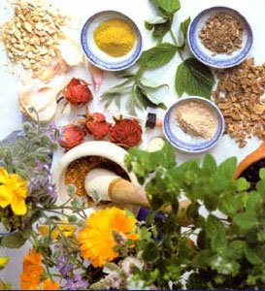

Slide 9
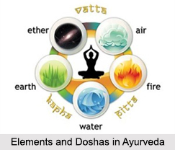

Slide 12
PranaVayu

Slide 13
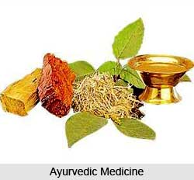

Slide 15
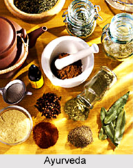

Slide 17
Site of Prana Vayu
Site of Udaan Vayu

Slide 18
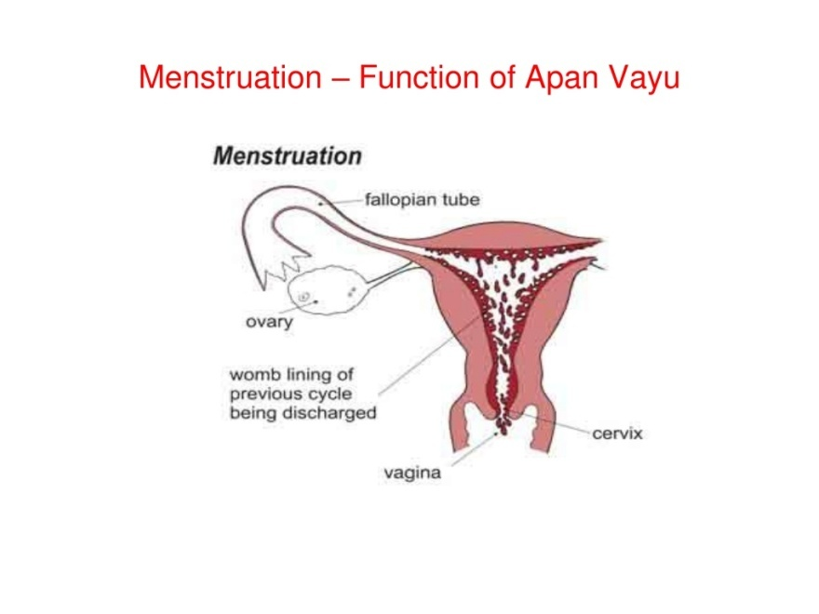
Site of Apan Vayu
Site of Vyan Vayu
Site of saman vayu

Slide 21
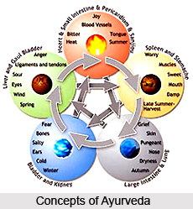

Slide 23
Symptoms of Vata kshaya and Vruddhi

Slide 26
Protection for Vata Prakop

Slide 27
Thank you for listening and watching the slides!!
Presented to: Dr.Prashant Chandekar Sir
Presentation by:Anushri Akare
Shaminaz Ali
Nandini Ambatkar
Rupali Angalwar
Sneha Bakshi
Parisameer Barsagde
Nandkishor Bhagile
Rajshree Bhojane
Sakshi Burghate
Narayani Chandewar
Vinay Chaudhari
Vishnu Chauhan
Neha Chauhan
Swati Dangare
Shraddha Dehankar

