Slide 1
National Malaria Eradication Programme
By
dR. JYOTI K. VARTHI
Dept. of Swasthavritta

Slide 2
INTRODUCTION
Malaria is a vector borne disease caused by a parasite called as
plasmodium which is transmitted via bites of infected mosquitoes.
In human body, the parasites multiply in the liver and then infect the blood
cells.
Malaria derived from the Italian word,
MAL’ ARIA i. e Bad Air.
Malaria is the fifth cause of death from infectious diseases worldwide (after
respiratory infections ,HIV/AIDS, Diarrheal diseases & Tuberculosis).
And the second in Africa after HIV/AIDS.

Slide 3
Life Cycle Of Malaria

Slide 4
Why there is a Need of this programme?
Malaria is one of the serious public health problems in India. At the time of independence malaria was contributing 75 million cases with 0.8 million deaths every year prior to the establishment of National Malaria control Programme in 1953.
The result of the programme were highly successful which decline the cases from 75 million to 2 million cases in 1958.
Govt. of India then launch National Malaria Eradication Programme in 1958.

Slide 5
Cont.

Slide 6
Milestones of malaria control activities in India
Prior to - Estimated malaria cases in India- 75 million,
1953 death due to malaria- 0.8 million.
1953- Launching of National malaria control programme(NMCP).
1958 – NMCP was changed to National malaria Eradication
Programme(NMEP).
1965 – Cases reduce to 0.1 million.
Early 1970 – Resurgence of malaria.
1976 – Malaria cases – 6.46 million.
1977 – Modified plan of operations implemented.
1997 – World Bank Assisted Enhanced Malaria Control Project
(EMCP) launched.
1999 – Renaming of programme to National Anti Malaria Programme.
2002 – Renaming of NAMP to National Vector borne Disease Control
Programme.

Slide 7
CONT.
2005 – Global Fund assisted Intensified Malaria Control Project
(IMCP) launched.
2005 – Introduction of RDT in the programme.
2006 – ACT introduced in areas showing Chloroquine resistance
in falciparum malaria.
2008 – ACT extended to high Pf predominant districts covering
about 95 % Pf cases.
2008 – World Bank supported National malaria control project
launched.
2009 – Introduction of LLINs.
2010 – New drug policy 2010.
2012 – introduction of bivalent RDT.
2013 – New Drug policy 2013.

Slide 8
Objectives
Goals –
1. Screening all fever cases suspected for Malaria.
2. Treating all P. Falciparum cases with full course of effective Artemisinin based Combination Therapy (ACT) and Primaquine, and all P. Vivax cases with 3 days Chloroquine and 14 days Primaquine.

Slide 9
Cont.
3. Equipping all health institutions, especially in
high risk areas, with microscopy facility and
Rapid Diagnostic Test (RDT) for emergency use
and injectable Artemisinin derivatives.
4. Strengthening all district and sub-district
hospitals in Malaria endemic areas as per Indian
Public Health Standards (IPHS) with facilities for
management of severe Malaria cases.

Slide 10
Treatment
Malaria
P. Vivax
P. Falciparum
Negative
CQ- 3 Days, PQ-14 Days
ACT-3 Days+ PQ single dose,
For NES- CQ- 3 Days+ PQ single dose
Needs further Evaluation
ACT- Artemisinin Combination Therapy (Artesunate+ Sulphadoxin+ Pyrimethanin)

Slide 12
Malaria Control Strategies
1. Surveillance and case management
Active and passive case detection.
Early diagnosis and complete treatment.
Sentinel surveillance
2. Integrated vector management (IVM)
Indoor residual spray (IRS)
Insecticide treated bed nets (ITNs) / long lasting
insecticidal nets (LLINs).
Antilarval measures including source reduction.

Slide 13
CONT.
3. Epidemic preparedness and early response
4. Supportive interventions
Capacity building
Behavior change communication (BCC)
Intersectoral collaboration.
Monitoring and Evaluation.
Operational research and applied field research.

Slide 14
Integrated Vector Control Measures

Slide 16
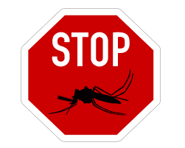
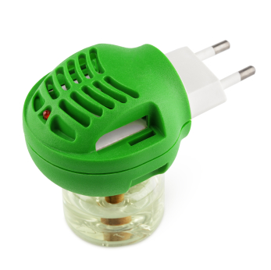
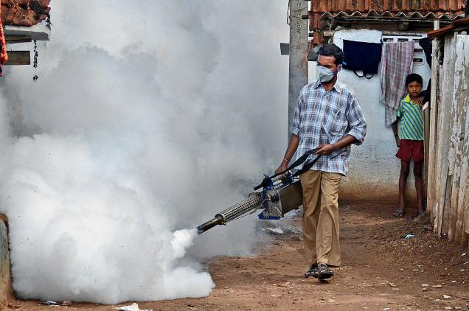
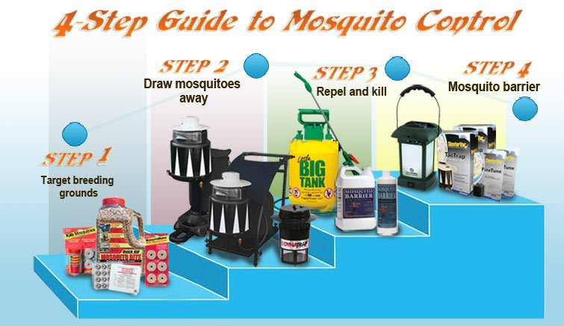
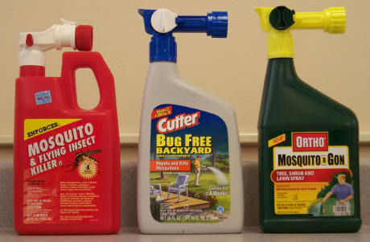
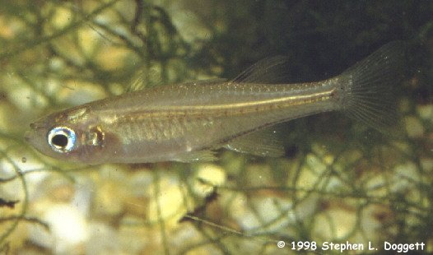
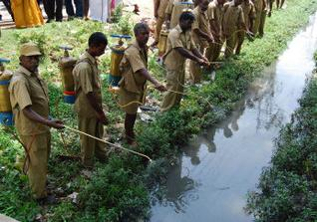
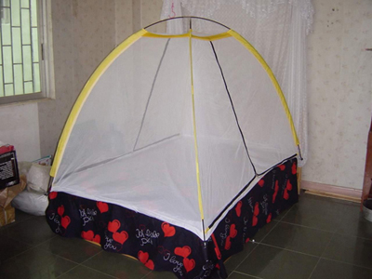
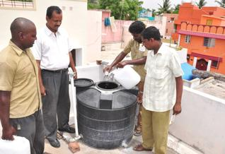

Slide 17
Anti Malaria Month Campaign
Anti malaria month is observed every year in the Month of June throughout the country, prior to the onset of monsoon and transmission season, to enhance the level of awareness and encourage community participation through mass media campaign and interpersonal communication and inter-sectoral collaborative efforts with other govt. departments.

Slide 18
THANK YOU

