Slide 1
PHIMOSIS
Presented by:
Dr Pranali Manthanwar

Slide 2
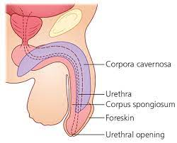

Slide 3
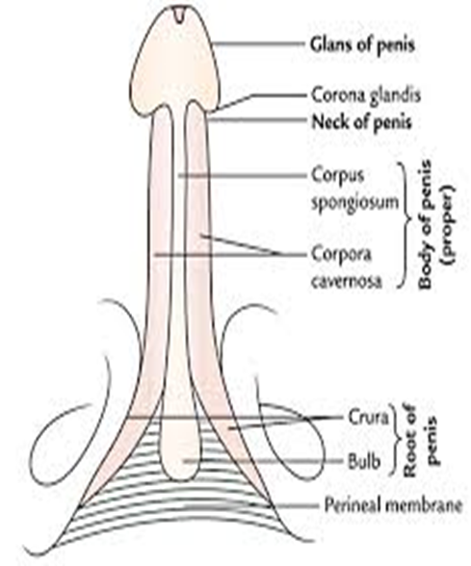

Slide 4
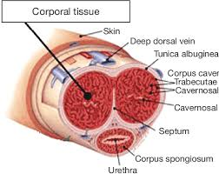

Slide 5
PHIMOSIS
At birth the foreskin is adherent to the glans penis. These adhesions separate spontaneously with time.allowing the foreskin to became retractile.
At 1yr of age about 50% of boys have a non retractile foreskin.
By 4yrs of age this declined to 10% and by 16 yrs of age to just 1%.
Balloning of the normal non retractile foreskin may occur with micturition.
Gentle retraction of the foreskin at bath time helps to maintain hygiene but forceful retraction should never be attempted.
The presence of preputial adhesions when the foreskin remains partially adherent to the glans is normal and resolves spontaneously
Physiological adhesions between the foreskin and the glans penis may persist until 6 yrs or more giving impression that the prepuce will not retract.
This condition should not be confused with the true phimosis in boys with scarring of the prepuce ,which will not retract without fissuring.
In this case the aperture in the prepuce may be so tight as to cause urinary obstruction.

Slide 6
AETIOLOGY:
CONGENITAL:
In this case prepuceal orifice is narrow since birth. In extreme case sac balloons out when patient micturate and weak thin stream of urine flows.
ACQUIRED:
1)Inflammatory: Long standing inflammation of the glans (balanitis) or of the prepuce (posthitis) or a combination of both (balanoposthitis).
2)Traumatic: Trauma to the prepuce may cause prepuceal fibrosis resulting in narrowing of the openingof the prepuce.
3)Neoplastic: underlying carcinoma may lead to narrowing of prepuceal orifice.
Clinical features
Symptoms
Difficulty in micturition
Balloning of prepuce
Thin stream of urine

Slide 7
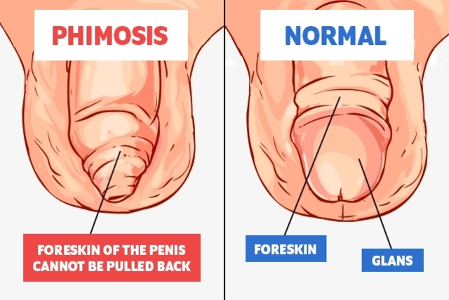
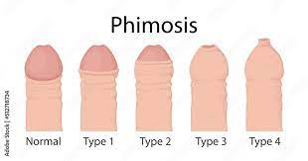

Slide 8
In old age recurrent balanitis causes purulent discharge through orifice.
Occasionally paraphimosis
Local Examinations: When opening of peni sis to small cannot retracted to backover gans penis its phimosis.
In case of adult one should carefully examine for infection of glance, prepuce ,carcinoma.
Complication:
Balanoposthitis
Prepuceal stone or calculus- when smegma retained for years to cause calculus
Paraphimosis
Obustruction to flow of urine, hydroureter, hydronephrosis. In this case one must exclude pin hole meatus or atresia.

Slide 9
TREATMENT:
Circumcision
Under GA (child), Local anesthesia (adult)
All sub prepuceal adhesion are severd by blunt dissection with probe (circumference)
2 pairs of artery forcep are applied to prepuce and dorsal slit is made with scissor upto 1cm of corona
Prepuce with mucus membrane layer is divided ll to corona glandis upto frenulum is reached.
Artery forcep is applied to secure artery of frenum and then devision of foreskin is completed (catgut )
Now, skin of prepuce is sutured with mucus membrane with interrupted fine catgut suture.

