Slide 1
Netra sandhi
Pakshmavartma
Vartma shuklagata sandhi
Shuklakrushna gata sandhi
Krushna drushti gata sandhi
Kananika sandhi
Apanga sandhi

Slide 2
Sandhigat roga
Sankhya samprapti 9 (sushrut)
Puyalas; upanaha, parvani,alaji, krimighanthi ; strav( 4 sub type) puyastrav,shleshmastrav, raktastrav, pitastrav (vagbhat pitastrav/jalstrav)

Slide 3
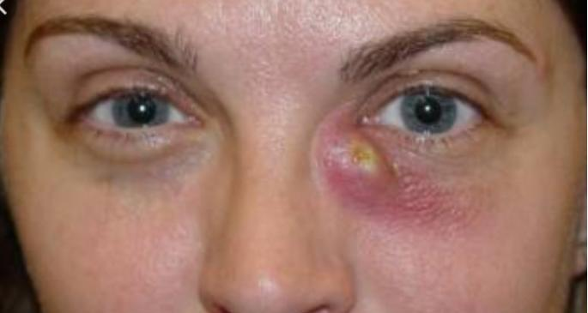
Poyalas
Kananika sandhi pradesh
Shotha
Lalima
Netra strav
Pak
Vrana
Durgandhiyukta sandhra puyastrav

Slide 4
Apakva avastha
Todvat vedna
Bhedvat vedna
Pakkavaavashta
Vrna
Kananikka sandhi pradeshi utsedha
Sthanik pidan– strav
Tridoshaj vyadhi

Slide 5
Upanaha
Vayu prakop – kapha netra pradesh sancharan -vyadhi utpatti
Guru . Snighdha. Mrudu. Pichila. Savrana granthi
Vedna rahit , pak rahit
Snaghraha mata (chala )
Videha ( arun varna )
Sthana –drushti sandhi
Madhukosha ---krushna drushti mandal pradesh

Slide 6
Strav
Dosh prakop - ashru marg dushti --doshancha—kananika sandhi pradeshi sancharan– strav nirmiti

Slide 7
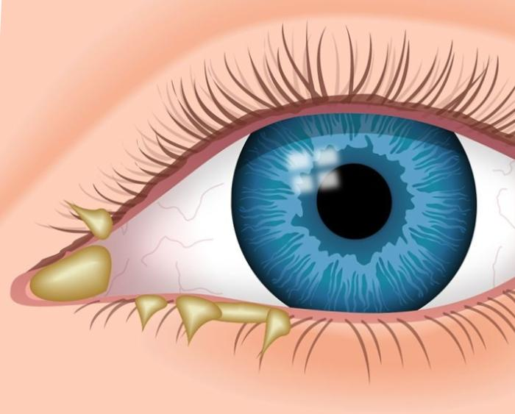
Puyastrav
Kannanika sandhi /Appang sandhi pradeshi Strav yeto ---poya strav
Tridoshaj lakshan
Vagbhat ( stan kananika sandhi only)
Shotha –pak –puyastrav
kahi anshi puyasobat rakt strav
Tvachya mansa pak utpana hoto
Puyalasa nanatar rog utpana
Yogratnakara (sanipatik strav)

Slide 8
Shleshma strav
Shleshma strav shwet ,ghan,pichil strav
Vedana rahit

Slide 9
Rakta strav
Rakta dushti-netra tun sarakta strav.,ushana ,sandra guna

Slide 10
Pittastrav
Jala sadrush strav ., varn – pita / Nil varan
Vyau vrudhi –jal strav

Slide 11
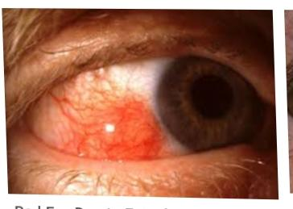
Parvani
Shuklakrushna sandhi pradeshi – vayu.,kapha,rakta pradeshi pitika utpatii
Varna tamra varni
Muga mudropama
lakshana - Daha chosha shula
Ushna strav Pitika bhedan paschyat raktastrav
Vartma shukla sandhi padesh(vagbhat)

Slide 12
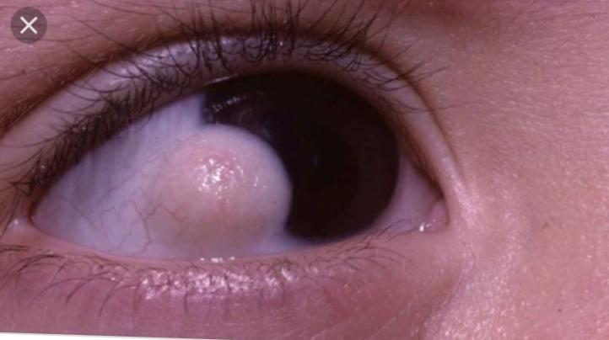
Alaji
Tri dosh dushti
Shukla krushana praseshi Gostana akar pidika
Lakshan paravani sadrusha
Tod Ashru strav adhikya lakshan

Slide 13
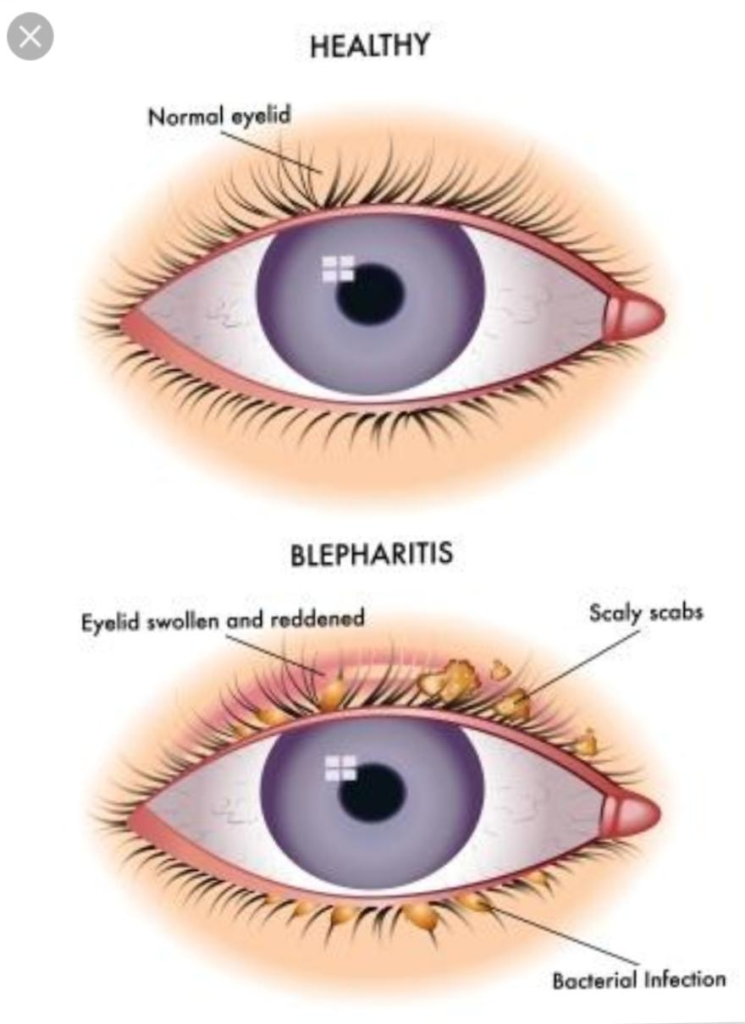
Krimigranthi
Vartma shukla sandhi pradeshi tridoshaj granthi utpana
Kapha pradhanya
Pita prakop granthi pak krimi utpana
Krimi antarbahya sancharan
netra pardeshi kandu utpana
Vagbhat sthan kananika / apang

Slide 14
Sadhya sadhyatva
Kruchasadhya (shastrakarma ) Upanaha krimigranthi pooyalas
Asadhya ---4 types of strav and alaji

Slide 15
Chikitsa
Pooyalas
Shiravedh—Raktamokshan
Upanah Sweda
Churnanjan
Shalaka Dahan karma
Shashtra karma

Slide 16
Upanah
Swedan - Bhedan ,lekhan,prachan karma

Slide 17
Parvani
Sthanik Sewadan parvani chye nirharan

Slide 18
Krimigranthi
Swedan ---Bhedan ---- pratisaran

Slide 19
Pillasadhyanyak vyadhi

Slide 20
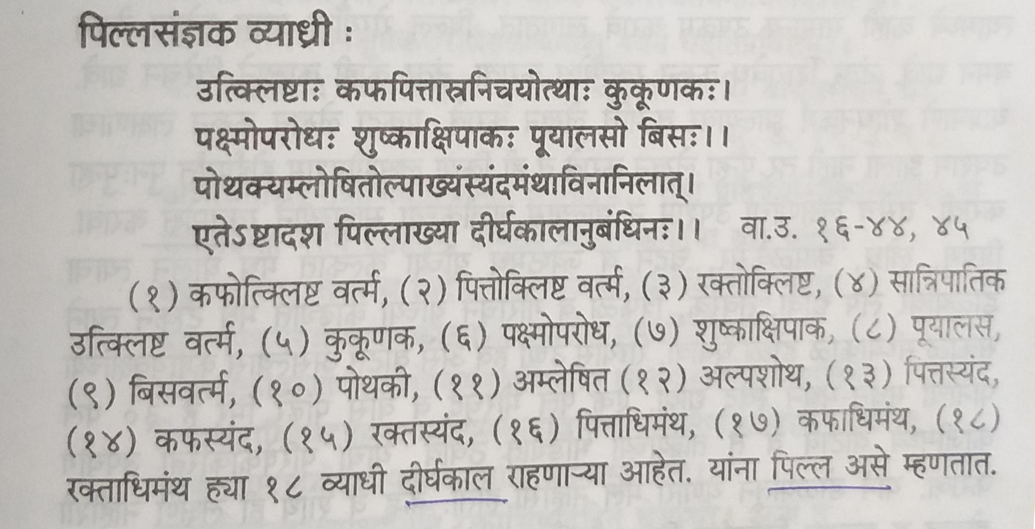

Slide 21
Chikitsa sutra Pilla
Snehan –vaman
Shiravedh –raktamokshan
Virechan
Vartma lekhan (lakshan upasham hot paryant)
Jalauka Avacheran
Bidalak (priyangu,lodhara,kamalkesar,chandan,jeshtamadha+madh)
Netra dhavan
Swdan

Slide 22
Parishek
Anjan
Netradhavan
Dhupan

